Slide 1
Consultation on the disclosure of carbon storage information and samples
Public engagement session
Ian Hill
Eva Zimmer
David Lecore
Phil Harrison
20/03/2024

Slide 2
NSTA Speakers
Presenters
Ian Hill
Head of Strategy Projects
Eva Zimmer
Energy Transition Technical Data Manager
Providing comment
David Lecore
Head of Data Services and Compliance
Phil Harrison
Head of Technical Data

Slide 3
Housekeeping
The chat function is enabled
For spoken questions: please use the “raise hand” function, we will then enable your microphone
Any questions or points raised by attendees in this meeting will not be seen as a formal response to the consultation Please send your formal response to the consultation to informationandsamples.consultation@nstauthority.co.uk by 12th April 2024

Slide 4
Meeting purpose
Outline proposals for the disclosure of carbon storage information and samples
Provide general clarifications and/or additional commentary on the proposals, as may be requested
Please note that the NSTA will not provide any formal response to the consultation during the meeting

Slide 5
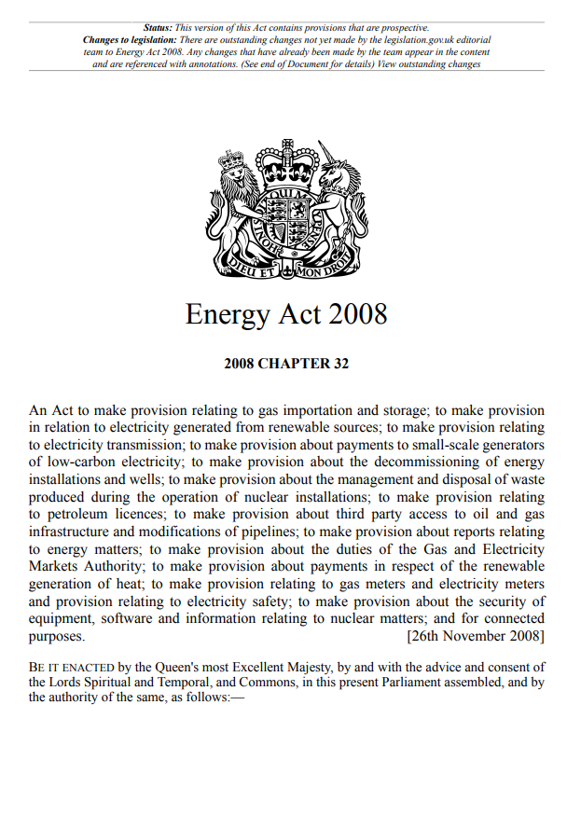
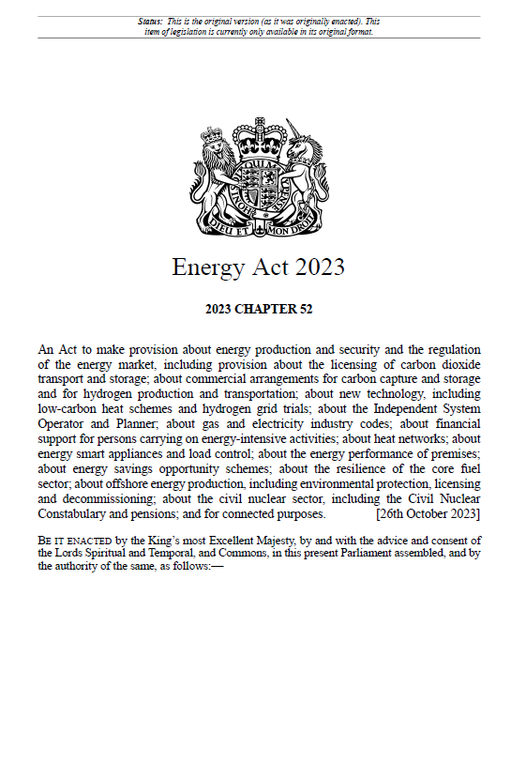
Background
OGA/NSTA becomes licensing authority for offshore carbon storage
Consultation on the principle of CS data powers for NSTA
Relevant powers in the Energy Act 2023 come into force
Nov ‘12
Nov ‘16
Jan ‘18
Jan ‘23
May ‘23
Dec ‘23
Jul ‘13
First two CS licences awarded by Secretary of State
First CS licence awarded by the OGA/NSTA
Information and samples powers included in the Energy Bill
New powers in the Energy Act 2023
Retention (section 108)
Information and samples need to be retained by licensees/expl. operators
No obligation to create information and samples
Disclosure (section 113, schedule 7)
What information and samples may be disclosed; when they may be disclosed
Regulations are made by the Secretary of State for Energy Security and Net Zero (DESNZ)
The NSTA’s role, following consultation, is to make recommendations to DESNZ on the content of those regulations
Information and Samples Plans (ISPs, sections 109-110)
Required at certain licence events
Ensuring information and samples are transferred or reported
AWAITING REGULATIONS
IN FORCE
Reporting (section 112)
Reporting of information to the NSTA
Requested through a routine or ad-hoc reporting notice
Guidance: form and manner
Information and Samples Coordinators (ISCs, section 111)
Designated point of contact for information and samples in a company
Monitors the company’s compliance
IN FORCE
AWAITING REGULATIONS
IN FORCE

Slide 6
Well information and samples & geophysical survey information

Slide 7
Well information and samples & geophysical survey information - Summary of proposals
 | Trigger date for commencement of time period | Time period after which information may be disclosed
Well information | Date on which information was due to be reported. Planned reporting: 6 months after the regulatory completion date for information created before that date 6 months after the information was created for information created after the regulatory completion date | 2 years
Summary well information | When information is obtained by NSTA | Immediately
Well samples | As “well information” | 2 years
Geophysical survey information acquired under a CS licence | Date on which the acquisition was complete as stated in the summary information submission process | Raw and processed survey information: 5 years
Geophysical survey information acquired under an Exploration licence | Date on which processing was complete | Processed survey information: 10 years Raw or intermediate processed survey information: 15 years
Summary geophysical survey information | When information is obtained by NSTA | Immediately

Slide 8
Well information and samples & geophysical survey information
Notable differences concern the trigger date; the period before disclosure has not been proposed to be different
 | Energy Act 2023 Proposals for disclosure regulations | The Oil and Gas Authority (Offshore Petroleum) (Disclosure of Protected Material after Specified Period) Regulations 2018
Well information Well samples | Date on which information was due to be reported. Planned reporting: 6 months after the regulatory completion date for information created before that date 6 months after the information was created for information created after the regulatory completion date | Date on which information was reported. Reporting: 6 months after the regulatory completion date for information created before that date 6 months after the information was created for information created after the regulatory completion date
Geophysical survey information acquired under a CS licence | Date on which the acquisition was complete as stated in the summary information submission process | Date on which the processing was complete

Slide 9
Injection, resource and site information

Slide 10
Injection, resource and site information - Summary of proposals
 | Trigger date for commencement of time period | Time period after which information may be disclosed
Injection information (per well/per day) | End of the month to which the injection information relates | 2 months
Injection information (any other granularity) | End of Operational Term | Immediately
Summary storage site information | When information is obtained by NSTA | Immediately
Total storage resources information | n/a – disclosure defined by licence lifecycle | Disclosure upon granting of a Storage Permit, at the end of the Operational Term, at the end of the Post-Closure Period
Geotechnical storage site development information | First injection | 5 years
Storage formation information | n/a – disclosure defined by licence lifecycle | After determination of the subject licence
Computerised model inputs | n/a – disclosure defined by licence lifecycle | Upon entry into Operational Term

Slide 11
Injection, resource and site information
Notable differences concern the type of information that may be disclosed and the introduction of disclosure before licence determination
 | Energy Act 2023 Proposals for disclosure regulations | The Oil and Gas Authority (Offshore Petroleum) (Disclosure of Protected Material after Specified Period) Regulations 2018
Injection information During injection/production | Disclosure on a “per well/per day” basis | Disclosure of production data on a “per month/per field” basis
Total storage resources | Proposed to be disclosed at certain points within the licence lifecycle | No disclosure before licence determines
Computerised model inputs | Proposed to be disclosed at a certain point within the licence lifecycle (start of operational term) | No disclosure before licence determines

Slide 12
Monitoring information and samples & installation information

Slide 13
Summary of proposals – Monitoring information and samples & installation information
 | Trigger date for commencement of time period | Time period after which information may be disclosed
Monitoring report | When information is obtained by NSTA | Immediately
Monitoring information and samples | When monitoring report that discusses these information and samples is disclosed | Immediately
Summary carbon storage installation information | When information is obtained by NSTA | Immediately
Other carbon storage installation information | n/a – disclosure defined by installation lifecycle | After decommissioning of the installation
Installation information disclosure proposed for these regulations does not differ from the disclosure arranged under the 2018 petroleum-related regulations
Monitoring information is a new type of information

Slide 14
Proposed monitoring information disclosure timeline examples
First example: Period before disclosure of baseline survey is shorter than period until 1st repeat survey
Assumes acquisition under CS licence
Disclosure of raw/ processed baseline survey
Disclosure of reprocessed baseline survey
Disclosure of reprocessed baseline survey
Monitoring:
Baseline survey information
End of acquisition
5 years
Disclosure of reprocessed 1st repeat survey
Monitoring:
1st repeat survey information
Until relevant monitoring report is reported+disclosed
End of acquisition
4D survey included in monitoring report
Disclosure of
raw + processed information
Monitoring:
further repeat survey information
Until relevant monitoring report is reported+ disclosed
Trigger date
End of acquisition
4D survey included in monitoring report
Disclosure of
raw + processed information
Time period before disclosure
Disclosure date

Slide 15
Proposed monitoring information disclosure timeline examples
Second example: Period before disclosure of baseline survey is longer than period until 1st repeat survey
Assumes acquisition under CS licence
Disclosure of raw/processed/reprocessed baseline survey
Initially planned disclosure of raw/processed baseline survey
Disclosure of reprocessed baseline survey
Monitoring:
Baseline survey information
End of acquisition
5 years
Disclosure of reprocessed 1st repeat survey
Monitoring:
1st repeat survey information
Until relevant monitoring report is reported+disclosed
End of acquisition
4D survey included in monitoring report
Disclosure of
raw + processed information
Monitoring:
further repeat survey information
Until relevant monitoring report is reported+ disclosed
Trigger date
End of acquisition
4D survey included in monitoring report
Disclosure of
raw + processed information
Disclosure date not in effect
Time period before disclosure
Disclosure date

Slide 16
General disclosure proposals

Slide 17
Summary of proposals – General
 | Trigger date for commencement of time period | Time period after which information may be disclosed
Any licence information and samples | Upon CS licence surrender, expiry, termination, or revocation | Immediately

Slide 18
Next steps

Slide 19
Next steps
The NSTA will consider the responses and propose a final policy to DESNZ
The proposals will be subject to government and parliamentary approval
Consultation closes 12th April
NSTA to issue consultation response before regulations are laid in parliament
Any questions or points raised by attendees in this meeting will not be seen as a formal response to the consultation.
Please send your formal response to the consultation to informationandsamples.consultation@nstauthority.co.uk by 12th April 2024

