Slide 1








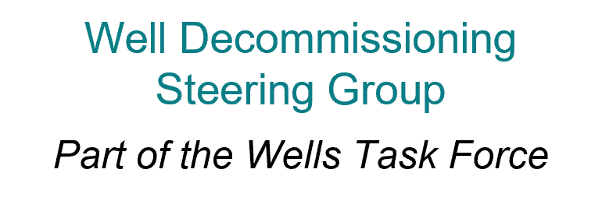






View the potential options for subsea P&A to be conducted riserless from light well intervention vessels (LWIVs). The webpages contain information on capabilities, potential advantages and disadvantages and generic example procedures.
Decom Data Tools
View well data apps, maps and spatial tools, including downloadable datasets for UKCS development, exploration and appraisal well stock.
The North Sea Transition Forum (NSTF) is hosted and chaired by the NSTA and is the tripartite body which provides senior government and industry leadership for the offshore oil and gas industry.
It is made up of seven
task forces, including
two with a focus on
subject matter including
well decommissioning.
Wells spatial maps and dashboards
Riserless LWIV P&A Capabilities
Using data from the annual UK Stewardship Survey, the dashboard shows quantities and weights of topsides and subsea infrastructure, and the wells, that companies plan to decommission over the next five years.
The Tree and Wellhead Information for Subsea Tooling dashboard shares accessible information on subsea trees and wellheads, collating industry knowledge for the benefit of upcoming well decommissioning scopes.
Data Visibility Dashboard
TWIST
The NDR – a key component of our wider Digital Energy Platform – is a treasure
trove of offshore petroleum-
related licence information which, in time, will also host carbon dioxide appraisal
and storage licence records.
Energy Pathfinder provides visibility of upcoming tendering opportunities for major UKCS energy production, emissions reduction and decom projects for a range of systems, including oil and gas, offshore wind, CCS and hydrogen.
Use this tool to find information about registered wellbores and their mechanical status.
National Data Repository (NDR)
Public Wellbore Search
Energy Pathfinder
This report aims to facilitate cost-effective drilling activity, improve the management of existing well stock and reduce well abandonment costs to maximise reserves, sustain production and optimise basin activity.
This report reveals the cost estimate for the decommissioning of redundant wells and infrastructure on the UK Continental Shelf.
This report provides insights into UKCS decommissioning performance and underpins the drive to continuously improve planning, execution readiness, delivery and performance.
Wells Insights Report
UKCS Decom Cost
and Performance
Update
UKCS Decom
Benchmarking
Report

