Slide 1
Seismic Imaging within the UKCS Energy Transition Environment.
Overview & Summary
TECHNICAL REPORT
Seismic technology considering co-location and co-surveying in Southern North Sea Carbon Stores
10 October 2023

Slide 2
1.1 Report Aims
This report is targeted at two quite different potential audiences:
Firstly, to provide those without geological knowledge some background into the role of seismic acquisition to aid understanding of offshore carbon stores and how it can impact other co-located marine users.
Secondly, this report provides an extensive review of the rapidly developing role of geophysical technology to help describe the rock layers below the UK’s seabed.
This research is principally aimed at underpinning the role of seismic data and its ability to identify, define and in the future, monitor, Carbon Storage (CS) sites and complexes. This work now has particular significance following the announcement of the UK governments support to progress four existing licence areas to development and the recent award of an additional 21 carbon storage licences with associated licence work programmes.
For CS to help the UK reach climate change net zero targets and associated carbon budgets, it is estimated that it will be necessary to progress up to 100 projects around the UKCS. This involves completely redeveloping large areas of some of the UK’s subsea “geological basins”. Given this very large area and the necessary rapid pace, we have only a short time to build upon our existing knowledge, to comprehensively describe both the underground CO₂ storage reservoir and ensure the competency of its surrounding trapping complex. Whilst there are a large suite of geophysical tools available, this report focuses on impulsive, active sourced seismic, generated and reflected back to receivers recorded in the water column. Resulting guidance is focused on the high concentration of CS activity in the SNS issues surrounding future seismic acquisition. Many aspects are also relevant to the other main CS areas (East Irish Sea, Central and Northern North Sea).
The aims are therefore to help inform
Wider marine users of the geophysical role & footprint and help ensure co-located CS developments are carefully planned with consideration to other marine sectors.
The development of the appropriate geophysical techniques.
It should be noted many of the seismic imaging techniques covered within this report are also relevant to other parts of the ongoing energy transition. Whilst seismic technology is already deeply embedded in established oil and gas (O&G) reservoir evaluation and asset stewardship. This report attempts to start to cross the divide and considers the relationship of geophysical surveying for the siting of windfarms.
(Refs. 1a , 1b, 1c & 1d)
Two very different potential audiences: Covering fundamentals and deep geophysical dive.
Notes:
.

Slide 3
1.2 Report Structure
This represents a compilation of NSTA enabled projects, undertaken in collaboration with The Crown Estate-led Co-Location Forum. It builds upon a previously published NSTA report “Measurement, Monitoring and Verification of CCS projects, with co-location considerations” (August 2022), and henceforth referred to as MMV Phase 1.
This Report
This report is complementary to the MMV Phase 1 report issued by the NSTA in 2022.
In this report, after an overall report summary (section 1), the report is split into two overlapping documents:
Part A is aimed at providing foundations for a non-geophysical audience.
Part B is created for Geophysicists and Seismic-Technologists.
For Geophysicists &
Seismic
Technologists
Part B:
MMV Phase 1 Report (2022)
Overview
and Summary
Part A:
Subsurface Foundations
for non-Geophysicists
Part B additionally incorporates technical detail which has been used to support the current assessment of seismic technology in the energy transition environment. Specifically, Part B includes
The current state of streamer and ocean bottom seismic acquisition and processing (sections 5, 7 & 10),
Principally for reservoir imaging in the SNS (section 4) but
Also overviewing site surveys for windfarms (sections 6 & 8).
Part B further includes synopsis of standalone studies into:
CO₂ detectability using 4D (sections 11 &12) and
The level of windfarm related disturbance (section 13).
The report concludes a perspective on the direction current technology could develop (Section 14).
CS geophysical report structure: Summary for all. Part A for non-subsurface, Part B- for interested geophysicists
Notes:
.

Slide 4
Contents and Mapping to study reporting
This document represents a consolidation of a series of internal NSTA technical projects. This page maps the parts for general interest (A) with those with specialist geophysical understanding (B). This report covers further analysis conducted from 2021 to mid 2023, some of which has been previously presented to co-location forum.
 | Report Part | Co-Location Project
1. Overall Summary |  | New
2. MMV Phase 1 report reminder | A & B | Phase 1/ Aug 2022/Updated
3. Subsurface & seismic imaging :Foundations | A & B | Phase 3/ New
4. Southern North Sea Seismic Imaging and new acquisition considerations | A & B | Phase 3/ June 2023 summary/ Full reporting
5. Streamer seismic technology | B | Phase 3/ New
6. Ultra & High resolution (UHR & HR) for site and geotechnical surveys | B | Phase 3/ Jun 2023
7. Ocean Bottom Seismic technology | B | Phase 2/ Jun 2022
8. Operational issues around windfarms (updated from Phase 1) | B | Phase 1 & 2/ Jun 2022
9. Comparative cost model of streamer vs OBN | B | Phase 2/ Jun 2022
10. Processing/Imaging Improvements | B | Phase 3/ New
11. 4D seismic signal and noise | B | Phase 2/ Jun 2022 Updated
12. Seismic detectability of CO₂ | A & B | Phase 2/ Jun 2022
13. Windfarm noise literature review & Intra windfarm Streamer data analysis | B | Phase 3/ Oct 2022 summary/ Full reporting
14. Geophysical Technology direction | B | New
15. References (Note separate Acronyms & Glossary document) | A & B | New
Contents & relationship to parts of report & previous co-location forum projects

Slide 5
1.3 Seismic Technology Executive Summary
The description of the rock storage (subsurface) for carbon stores, like oil and gas reservoirs, will continue to be heavily influenced by the quality of the initial pre-development seismic reflection image. Both modern data acquisition and extensive processing remain an excellent investment for the entire life of the project, especially as access is becoming an increasing consideration with time. We have one marine area and its underlying geology, imaged by an array of different geophysical “remote sensing” techniques for a range of users and projects.
CS Site characterisation: The majority of the current potential UKCS CS areas are covered with legacy O&G 3D seismic. Once reprocessed to modern minimum standards (broadband & FWI velocity modelling) these data are considered suitable for pre-development CS site characterisation during the licence project “appraise” and “assess” phases.
Pre-development CS Baseline seismic: During CS store development the NSTA expects a pre-injection baseline survey will be acquired involving modern long offset (3- 6km), broadband acquisition and enhanced modern processing afforded by the highly efficient streamer seismic acquisition will continue to be the expected mainstay. Seabed (ocean bottom (OB)) seismic is geophysically superior technology but will continue to be burdened by significant cost multipliers compared to streamer. OB seismic is the recommended approach in shallow water (<20m) areas with complex overburden/ reservoir imaging issues and areas increasingly congested with surface obstructions. The strong recommendation is for modern seismic operations to be conducted before windfarm development is undertaken as future intra-windfarm seismic operations will be complex, difficult, costly or even operationally impossible.
Injection phase Monitoring seismic: During the active injection phase, 4D (time lapse) seismic is anticipated across certain types of CS complexes. This involves periodically acquiring a new, high repeatability “deep” 3D seismic survey where it is believed CO₂ is injected directly into or has displaced the in-situ brine filled reservoir. Such monitoring will be particularly useful for providing dynamic reservoir data and assurance for those CS stores in early-stage development.
Long term monitoring: It is expected that occasional, as-required, shallow “site survey” seismic acquisition will be required throughout the life and abandonment of projects, particularly for critical risk areas such as around current and legacy wells and geological faults to seabed. Looking even further ahead – full complex “deep” 4D seismic is not only expensive but has an environmental impact. There is a both a need and technology trend to eventually undertake lower impact & cost, highly targeted reservoir monitoring, built upon very accurate model predictions and comprehensive baseline surveys.
Post Closure monitoring: Further consideration is also needed for the appropriate level of post closure/abandonment phase monitoring.
Enabling the energy transition: Sharing marine space is becoming ever more important. Whilst we may strive to expedite by technology solutions (e.g., greater seabed or hybrid seismic), early and open discussion concerning the extent and timing of marine activity will always be the best way to manage the potential of our offshore areas and everybody's expectations. Traditionally long-term planning has been poor, exacerbated by limited awareness of other user's needs and limited data sharing across disparate databases.
Full co-location of CS or O&G closures with windfarms is impossible as some seismic monitoring access can be expected throughout CS site life. Whilst seabed seismic can help to acquire images closer to the edge of a windfarm, it is unlikely any form of seismic equipment will be able to access within the tight confines of current turbine layouts. Partial overlap is only possible with more detailed risk assessment, coupled with careful design of future CS monitoring area and windfarm design.
Reprocessed legacy seismic suitable for appraisal. Good pre-development baseline expected.
Notes:
.

Slide 6
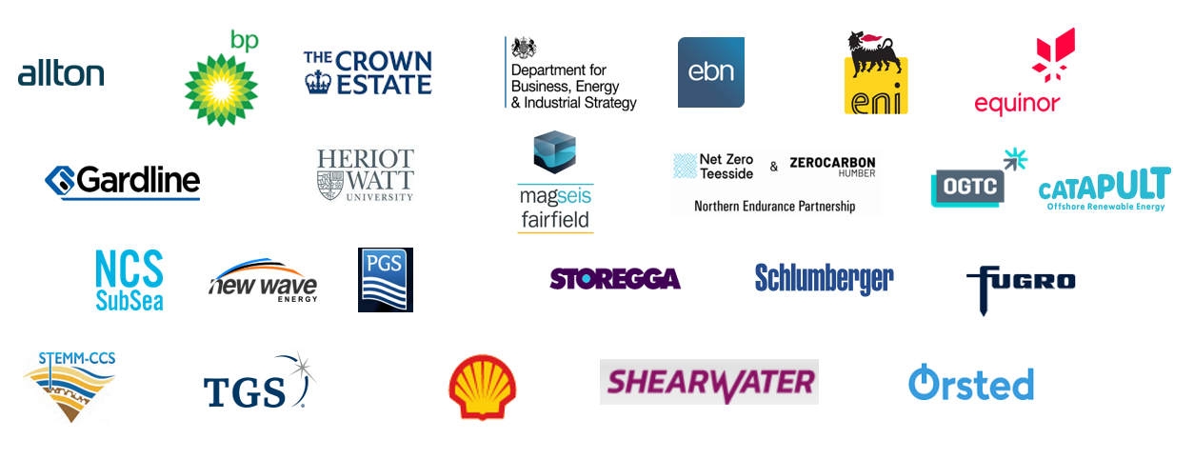



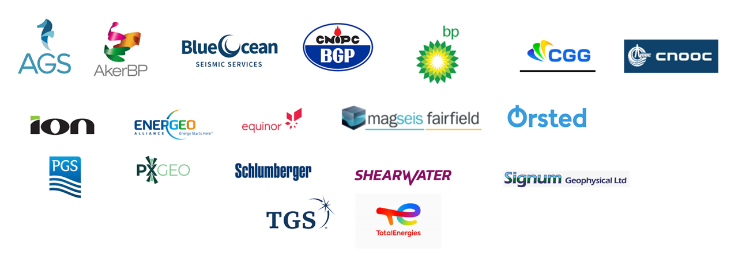
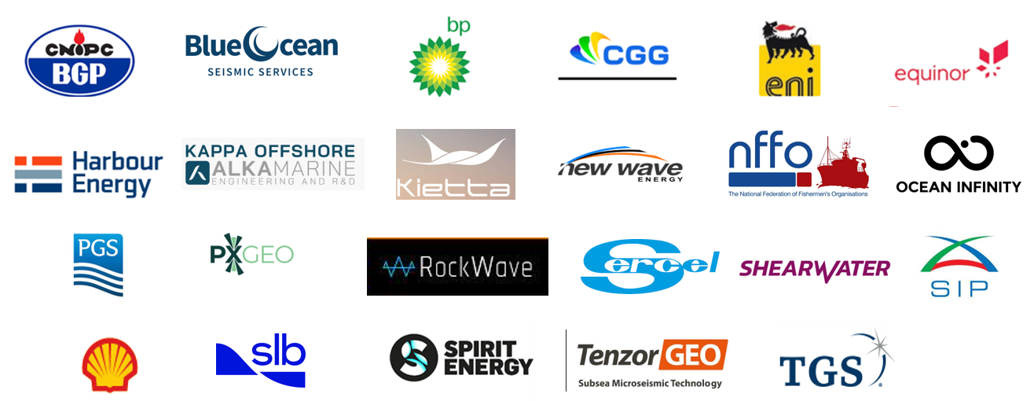





Acknowledgements
Phase 1 2021 MMV Study
The NSTA is very grateful to the many individuals & organisations for their willingness to freely provide time, knowledge and data.
2022 Seismic Detection
2022 OBN Study
2023 SNS Seismic Field Trial
2022 Windfarm Noise
2023 Consultations & Reporting
Particular thanks to Graham Lilley (CCS Geops Ltd) and Hemang Shah (Simply Geo) for coordinating the consultation process stages and fielding the authors innumerable clarifications. Special appreciation to those individuals subsequently willing give up their time to help check some of the key details: Colin MacBeth, Maria-Daphne Mangriotis & Phung Nguyen (Heriot Watt Uni/NOC), Dan Davies (TGS), Andrew Wilson (CNOOC), Alex Cooke, Ahmed Sameh, Mike Branston & Krishna Raman (SLB), John Underhill (Aberdeen University), Andrew Long (PGS), Dan Morgan (Scottish Power), Adrian Topham (Crown Estates) and of course, our very patient colleagues in the NSTA.
Very many contributors from Industry & Academia

Slide 7
1.4 Predominant Geophysical technology
Deep Imaging Geophysics
The O&G industry has helped support and drive the development of an array of highly sophisticated seismic acquisition and processing technologies. These are overwhelmingly seismic reflection based.
Carbon Stores
There are many similarities between traditional O&G deep seismic imaging and that being re-employed for CS sites, with greater focus on the overburden rock structure above the injection reservoirs.
Hydrocarbon
Fields
Carbon
Stores
Towed
streamer
2D seismic
“Ocean bottom”
Cables (OBC) and
Nodes (OBN) surveys
Production & injection
well
monitoring
3D
In reservoir 4D
Well access and
Injection Monitoring
Overburden
4D
One subsurface
Separate organisations (energy company, geophysical acquisition and research institutes) are beginning to utilise new full wave algorithms to understand the overlap.
Carbon Stores
In the long term, carbon stores are expected to move towards targeted monitoring around specific risk areas (e.g. legacy wells & critical faults). This could include minimal 2D, HR only, in well active seismic, in well or seabed passive reservoir monitoring.
Passive Seismic
Hybrid
Reprocessing
Existing Data
OBN
localised nodes
HR site surveys
Reprocessing
Existing Data
Shallow Imaging Geophysics
Siting offshore wind turbines, like installing O&G and CS facilities, relies upon very much shallower and higher resolutions, typically undertaken by a separate geophysical acquisition industry.
Windfarms
Windfarms are expected to increase in size and number with the evolving energy transition. One of the key challenges will be in maintaining surveillance of the subsurface and CO₂ injection in areas of colocation.
HD/UHD Geotechnical Surveys (Sparker, boomer, pinger)
Traditionally wide & separate range of geophysical technologies, beginning to see convergence of technologies

Slide 8
1.5 Seismic Technology Development
Seismic technology advancements: Acquisition and processing technologies continue to make rapid advances from the advent of small patch-work 3D surveys 40 years ago. Whilst many of these may appear to be incremental advancements, the complex interplay between acquisition design parameters and highly sophisticated processing algorithms have evolved an industry which is vastly different from its humble 2D origins:
A dramatic increase in acquisition accuracy, capacity and a large array of different options for in water (i.e. towed streamer) or on seabed (ocean bottom) recording.
Implementation of GPS navigation from initially vessel based to hydrophones and individual nodes.
An exponential increase in data storage and computer processing power which enables the implementation of ever more sophisticated processing/imaging algorithms that enhance the strength and reliability of the genuine geological seismic signature from the raw data and supress the various sources of noise.
These have greatly enhanced the resolution and reliability of a pre-development (static) subsurface image as well as being able to detect time lapse (4D) imaging fluid (oil, gas, water, CO₂) movement within the rock pore space.
Deep vs site survey (shallow) seismic: Traditionally, there have been 2 distinctly different geophysical businesses:
“Deep reservoir” seismic primarily for O&G but now being re-deployed to image proposed carbon storage sites. A) This is usually acquired by large, dedicated marine seismic vessels towing both wide and very long recording streamers (cables) a few metres below the sea surface covering very large, 3D areas. By necessity, this requires plenty of space, clear of surface obstructions. B) In some situations, ocean bottom recording allows acquisition closer to infrastructure or in shallow water and is also preferential for complex geological targets.
“Site survey” seismic either for safely locating wells, infrastructure (pipelines, cables, rigs) or increasingly locating wind turbines. This too has a role for CS monitoring. In contrast, it deploys very much reduced equipment, over highly focussed small areas.
This report starts to bridge the knowledge gaps of these traditionally very separate subsurface imaging techniques to help to better inform co-location considerations.
Looking even further ahead – time lapse seismic is an expensive undertaking for simply monitoring and has an environmental impact. There is a strong desire to ultimately move to more passive monitoring. Early research into this topic is included in this report.
Seismic tools and techniques have a track record of rapid development. Increasing overlap between traditionally separate “deep” and “shallow”

Slide 9
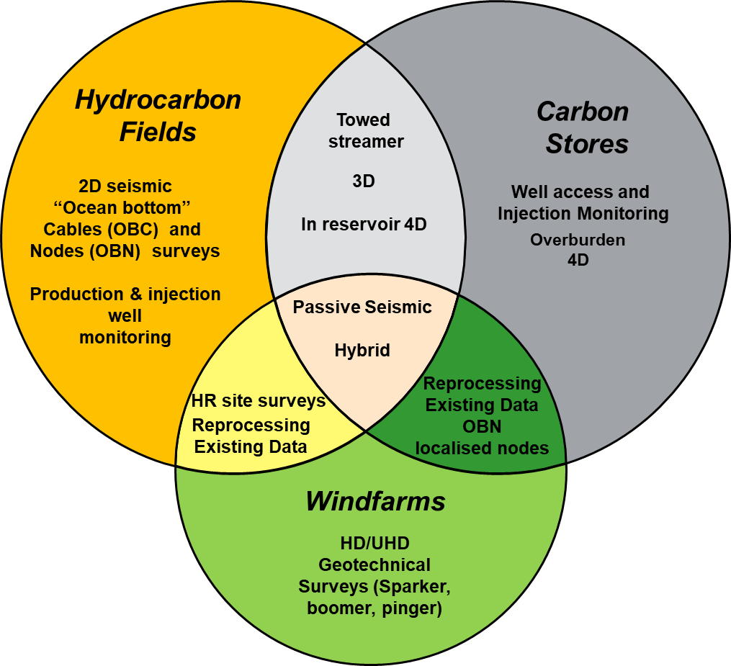
1.6 Seismic Technology Toolkit
1980s
1990s
2000s
2010s
2020s
Beyond
3DUHR
O&G, Wind
& CCS
2D/3D UHR
Geology &
Infrastructure
Limited Geophysical
(decarbonisation & AI focus)
Wind
CCS “Deep”
Reservoir
seismic
Reprocessed 3D
for site
characterisation
Co-location
OBN Or Hybrid
Regional Site
screening
Development
targeted 3D
Broadband
CCS Baseline
& Monitoring
Pipeline & cables routes, facilities surveying, bathymetry, Sub bottom profiling, UXO
Ambient signal: nodes & turbine
accelerometer
Crossover Technologies
2DUHR
O&G well
site surveys
Gas seep
monitoring
(Environmental)
Unified subsurface
model?
O& G “Deep” Reservoir streamer seismic
Broadband
Sparse 2D:
Low accuracy
Local 3D
patchwork
Regional 3Ds
Increasing offset
& number of streamers
Multi, Wide &
Rich azimuth
Dense streamer
Autonomous
USV
Hybrid Streamer/OBN
Dense Infrastructure
Sparse FWI
O&G Reservoir Monitoring Seismic
Steerable streamers & sources
Reduced
source size
Trials
Targeted 4D
PRM:
Permanent OBC
O&G “Deep” Reservoir seabed seismic
Sparse
4C OBN
Autonomous
node
OBS research
2C OBC
4C OBC
HD OBN
UHD OBN
Regional HDOBN
Seismic Processing
O&G
Limited Pre-stack processing
& Post-stack migration
Pre-stack
Time migration
Pre-stack
Depth migration
Very high
Trace density
Wavefield
separation
FWI Level 1:
“Refractions”
FWI L2:
“Reflections”
FWI L3:
“High frequencies”
FWI L4:
“Full wavefield &
Earth model”
Increasing 4D survey matching
Evolution of seismic technologies: Increasing cross-over and integration

Slide 10
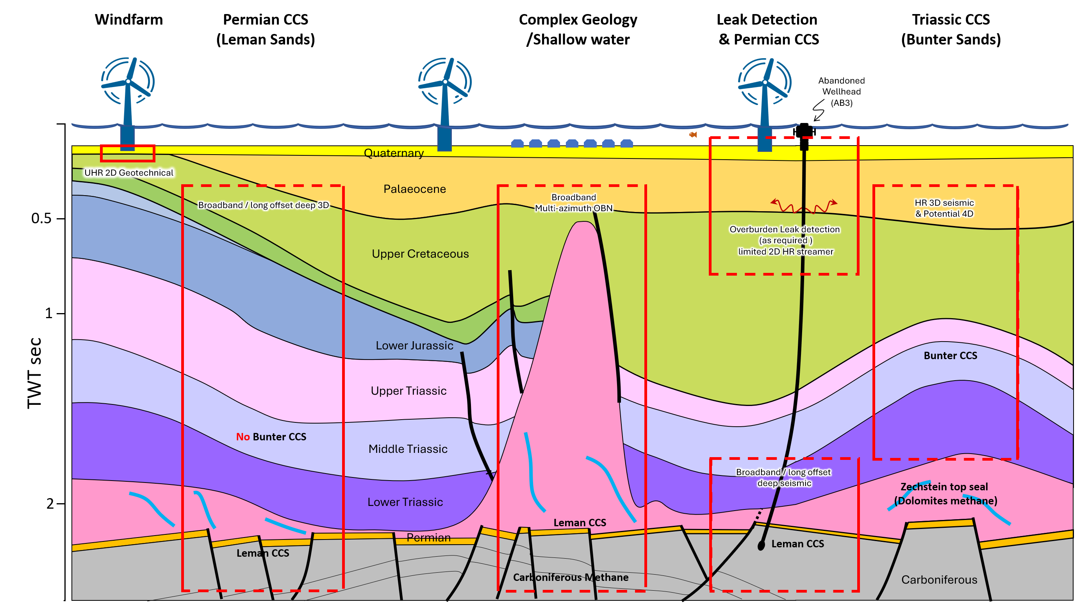
1.7 SNS developments & co-location
Permian CCS
(Leman sands)
Complex geology or shallow water
Leak detection
above Leman CCS
Triassic CCS (Bunter sands)
Windfarm
Proximity to windfarms needs OBN or highly restricted 2.5D streamer monitor swathes.
Top 100m geotechnical
Survey. UHR
Resolution ~0.5m
Optimise Leman/ Deep Bunter broadband/ long offset imaging. Probably no deep 4D, so carefully planned co-location may be considered
Complex geology needs high specification OBN to provide good pre-development image
No 4D access required,
so carefully planned co-location may be considered
Good temporal and lateral resolution 3D baseline seismic & anticipated clear water for repeatable 4D
Long offsets may be required for high velocity chalk
Good long offset pre-development baseline. Probably no deep 4D survey, but access to shallow section HR/ surveys and well heads required for long term
SNS CS targets & seismic type and co-location access considerations

Slide 11
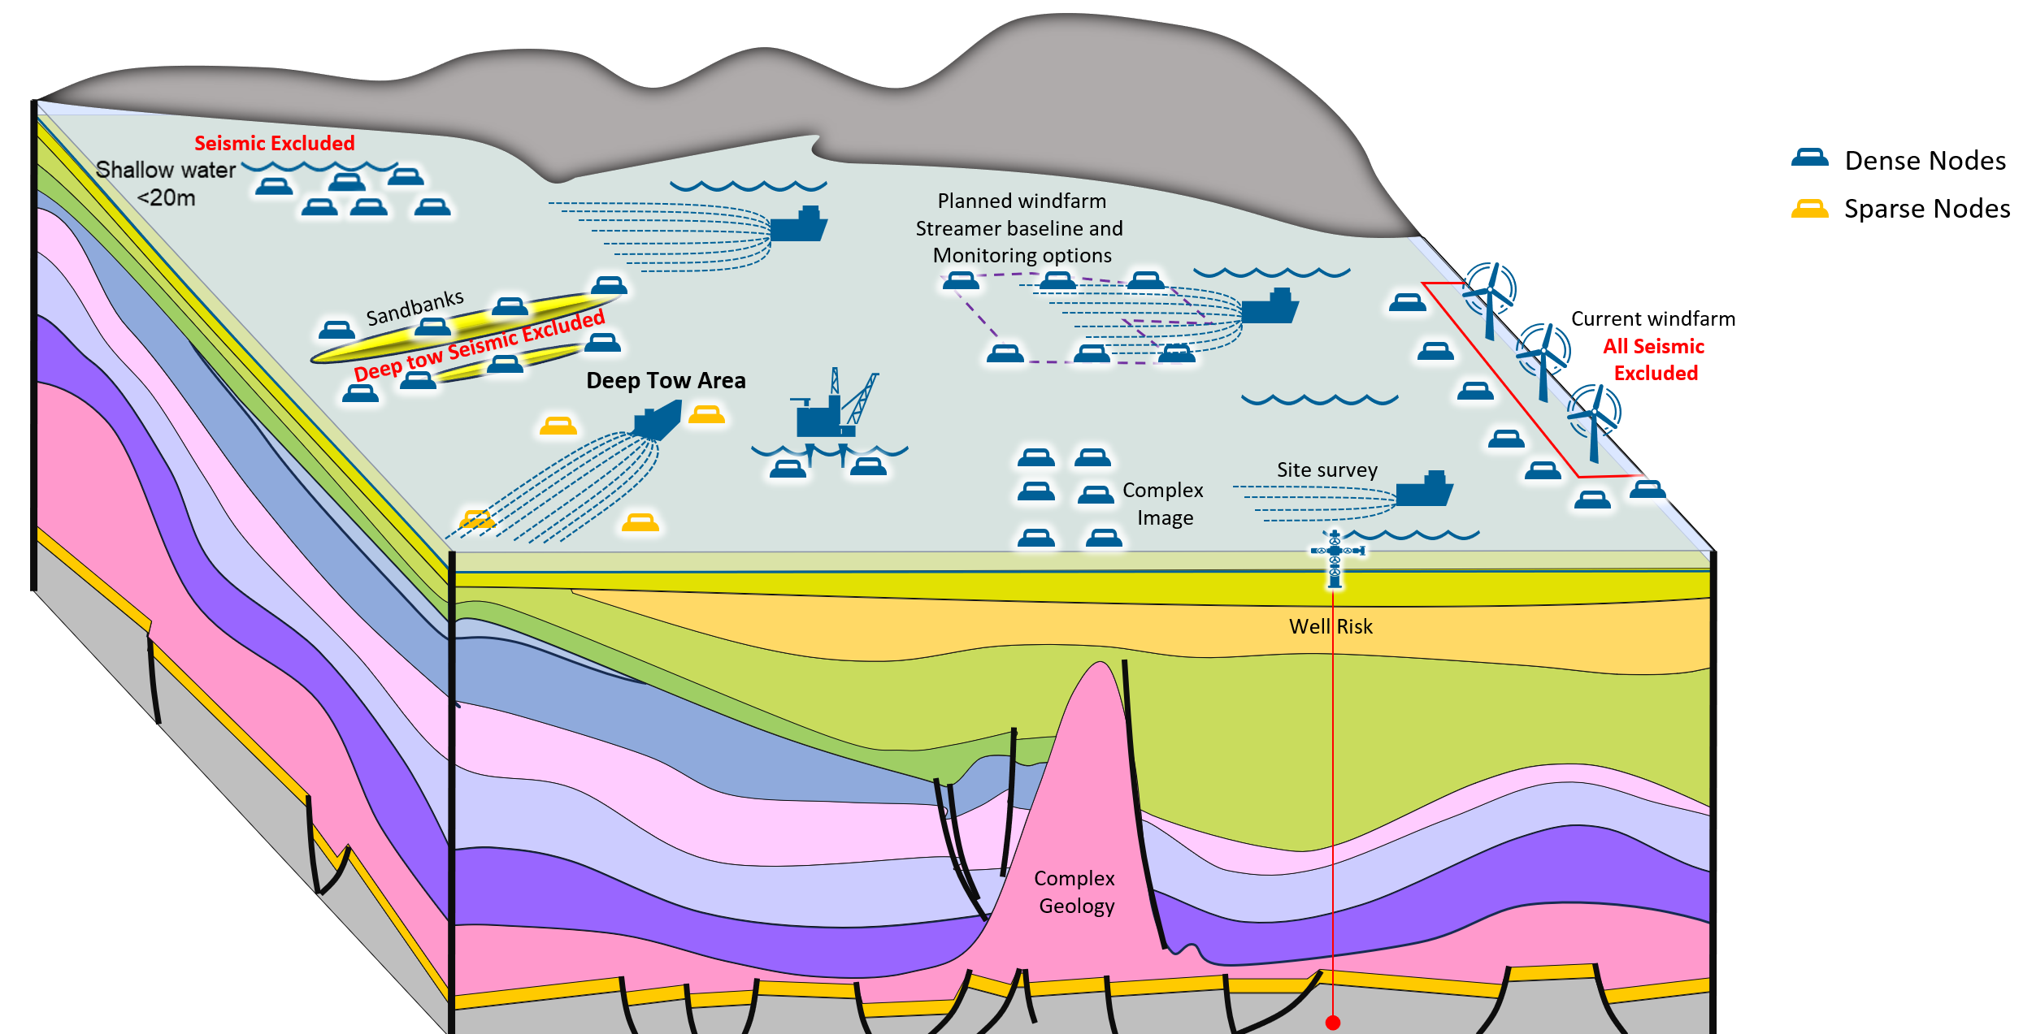
1.8 SNS nodes and site survey target
Deep tow seismic is the expected default: Focus on specific node & shallow seismic applications.
Current Risks
Preclude Windfarms
Seismic Acquisition Access
Tertiary
Upper Cretaceous
Lower Jurassic
Lower Cretaceous
Upper Triassic
Middle Triassic
Lower Triassic
Zechstein
Carboniferous
Deep tow streamer seismic expected default: Focus here is on OBN/site survey seismic

Slide 12
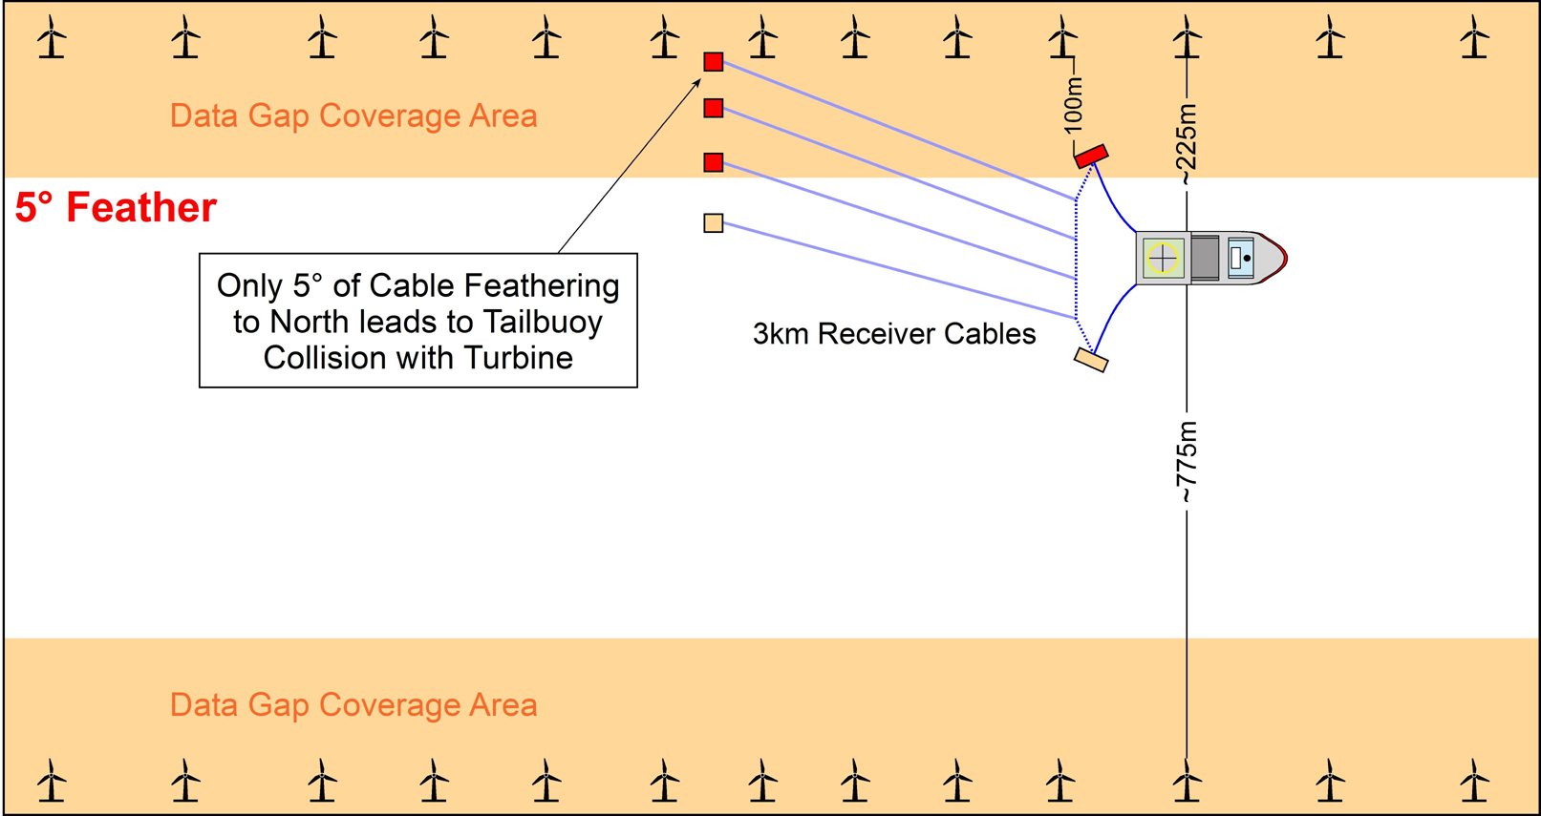
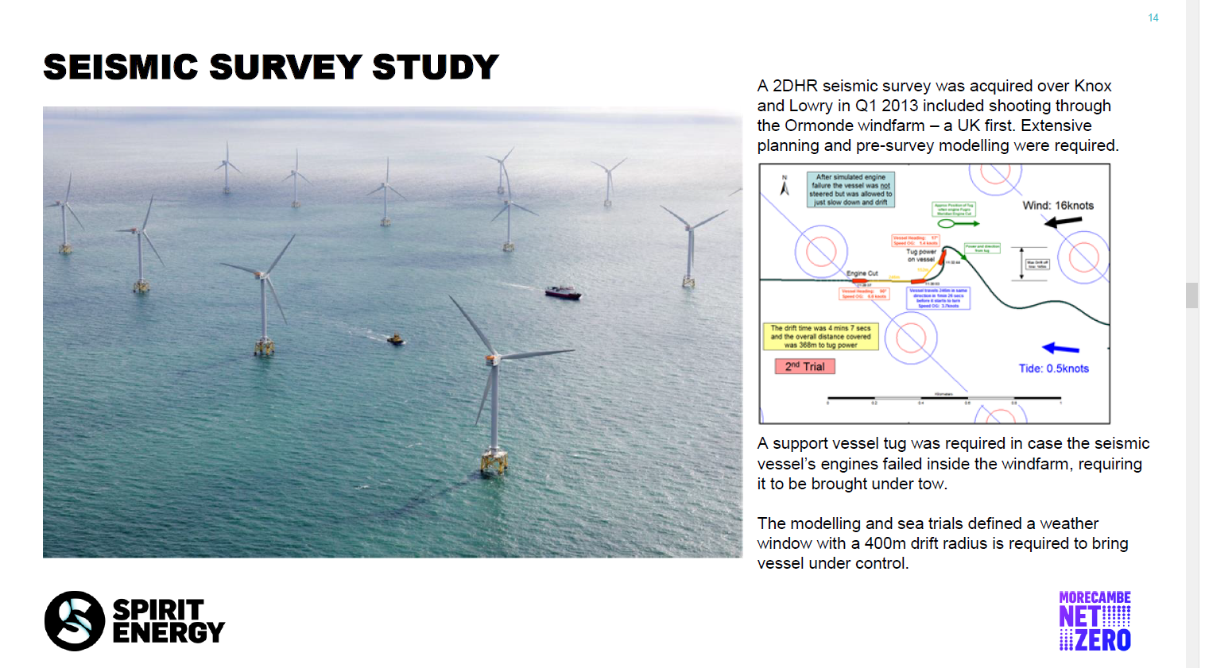
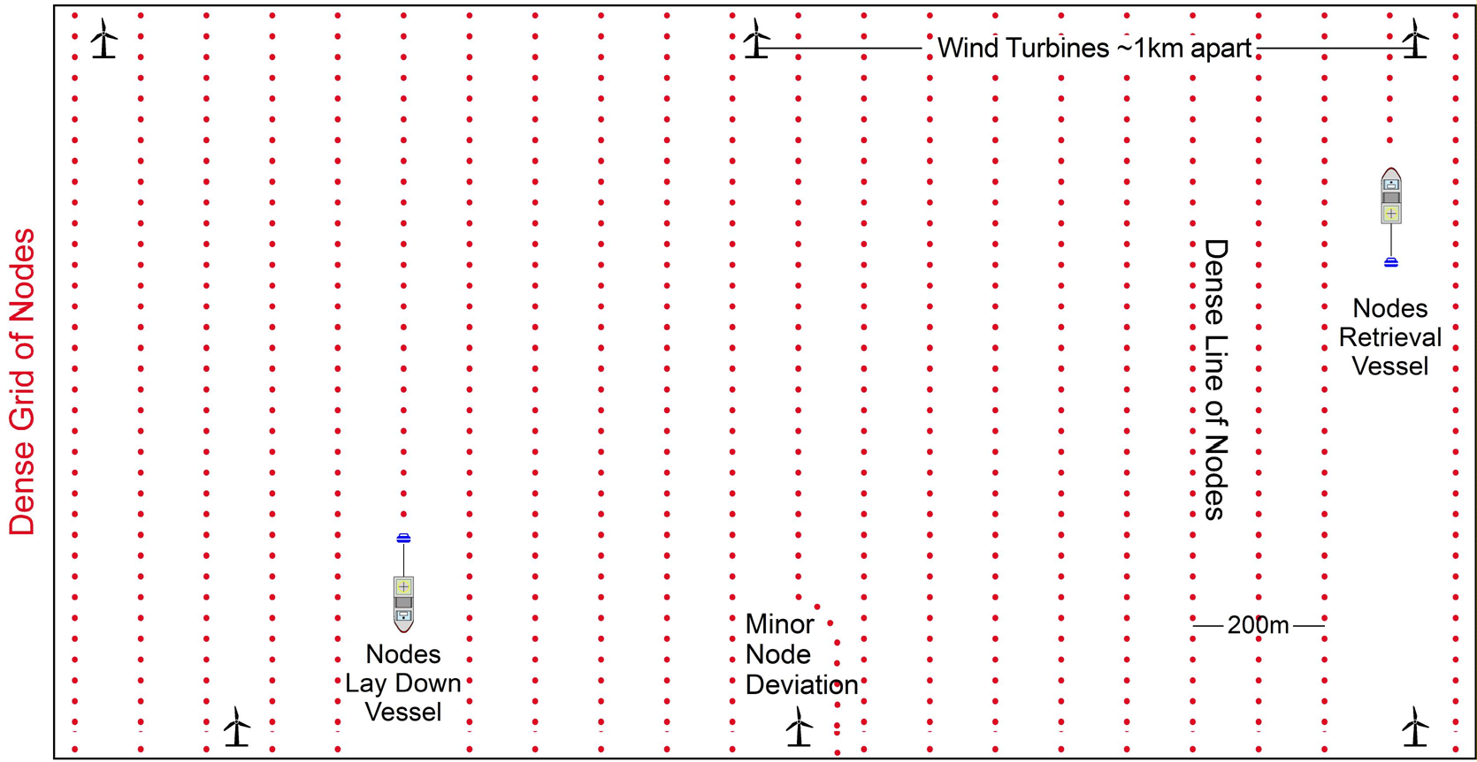
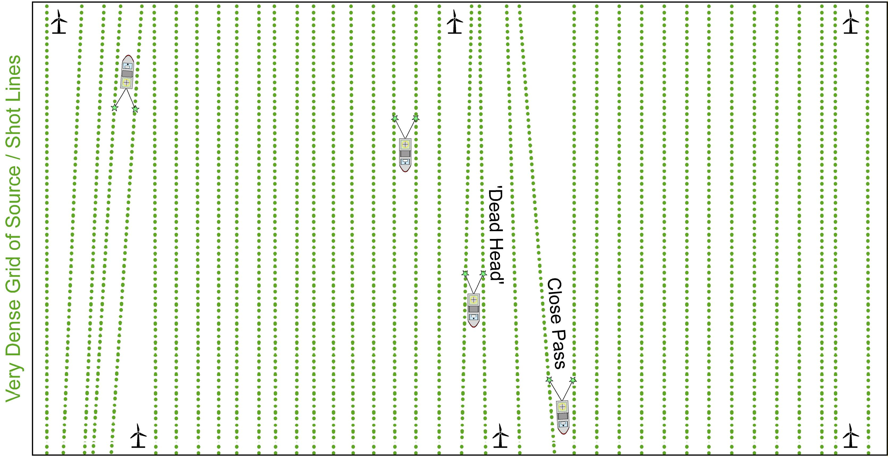
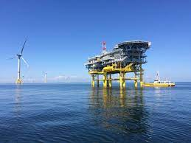
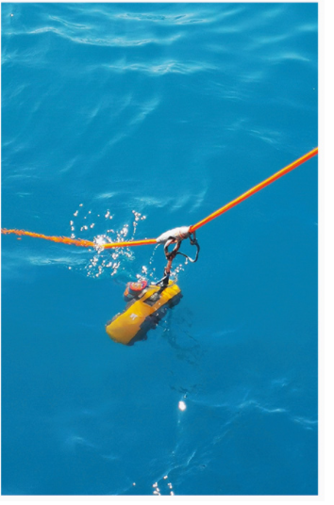

1.9 Intra-windfarm Seismic cannot currently co-exist
Streamer Seismic
HR (short streamer) seismic vessel
within windfarm
Careful pre-planning & operational drills
Risk Loss of propulsion?
No space to drift off
No space to manoeuvre
Standby tug
The NSTA is grateful to Chris Ward and
Spirit Energy providing the details of this survey
Collision!
Additional turbines end of corridors?
Unpredictable currents/
Cable feathering
Collision risk
(even for short streamers)
Dense grid of surface obstructions
Seabed (node) Seismic
In Theory:
Source vessel
Shoots over the top
Seabed (node) Seismic
Practicality:
Nodes laydown
Collaboration between multiple disparate parties
Turbines shut in during operation?
Loss of revenue
Liability
NOAR:
Node on a rope
Seismic crew
unfamiliarity
Tall seismic
vessels under turbines
Radar impact
Captain/Party chief & windfarm operator access agreement
Electronics on nodes near high voltage cables
Fibre based nodes?
Proximity/ exclusion
distances
Or very slow ROV deployment & retrieval
Dropped or unrecovered objects need surveying & removing (Jackup access?)
High risk of power
Cable entanglement?
Fragile nodes
See also section 8.6
A lot of effort and significant risk (needs to be fully assessed) for a very sparse dataset
Nodes can be deployed towards edge of a windfarm, but intra windfarm deployment untenable without full (HAZID) risk assessment

Slide 13
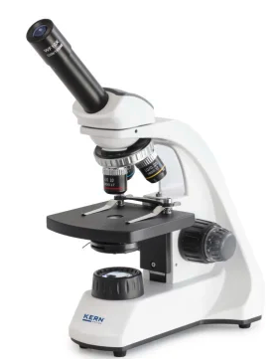
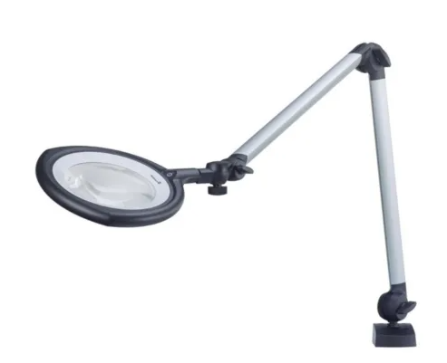
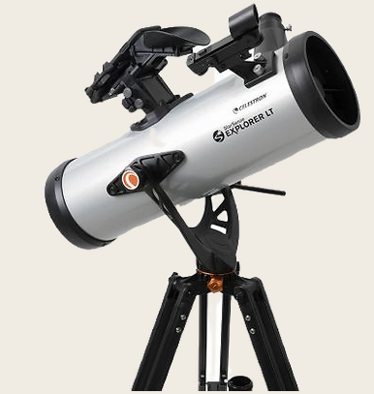
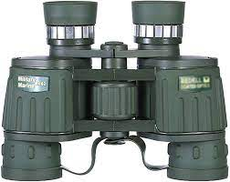
1.10 Is Seismic co-surveying possible?
Comparative summary of different seismic technologies and potential for co-surveying
Activity | Target | Current | Trend | Future | Cosurveying?
Windfarm geotechnical Foundations & Route | Seabed-> 100m Resolution: 0.5m Glacial fill, boulders. Scours, Buried objects: Wrecks, mines | Seafloor bathymetry, SSS, SBP, UXO - magnetometer Usually 2D UHR, Increasing interest in micro 3D Cone Penetration test P&S logs | Uncrewed surface vessels (USV) | Larger turbines with longer & wider piles: Geotechnical foundation focus rather than seismic 3D UHR (short cable P-cable) (section 5.12) Greater borehole seismic integration | Limited overlap.. Regularly combine equipment - Possible periodic co-inspection?
O&G/ CS: geotechnical pipe/ cable route/ Jackup |  |  | CS Seabed monitoring, Plume identification & sampling
O&G/ CS site surveys | Shallow methane pockets 0-1000m, Resolution ~5m | Mostly 2D HR Basic well log Lithology, Gamma, Sonic, Resistivity, ROP | Reservoir seismic configured for better resolution | Some P-Cable UHR Uncrewed surface vessels? | Possible overlap
O&G reservoir targeting | 1000-4000m Resolution 10-30m | Broadband. Reservoir focussed. Some 4D and/or multi-azimuth (e.g. OBN) Close integration with full well suite inc. density, core, pressures. | Routinely: Broadband & Reprocessing using latest algorithms, Main point of encouragement | Higher proportion of OBN. Lower cost autonomous nodes | No – limited legacy repurposing
CS complex (reservoir + overburden targeting) | 300-3000m streamer Resolution 5-30m | Broadband Reservoir targeting with greater emphasis on overburden. Expecting specific 4D | Increasing emphasis on overburden imaging or specific target illumination | Streamer/ OBN hybrid Very low-cost long-term monitoring e.g., passive Integration across range of MMV technologies | Limited overlap
 | 600-3000m OBN
Obstacles: Different industries & clients, very little skills-crossover. No common and open data management.

Slide 14
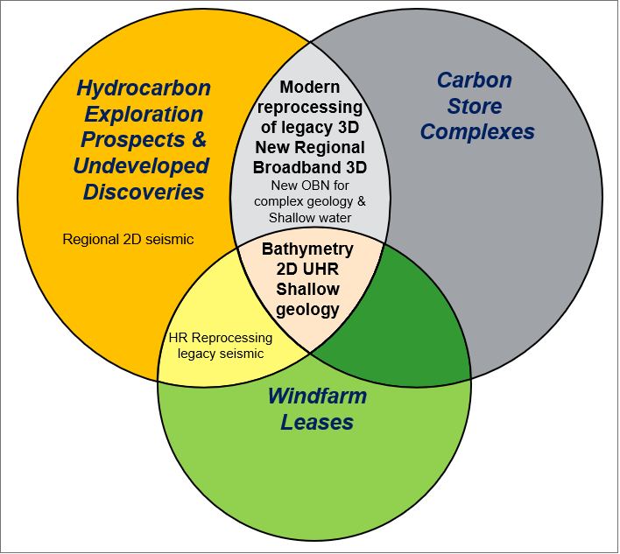
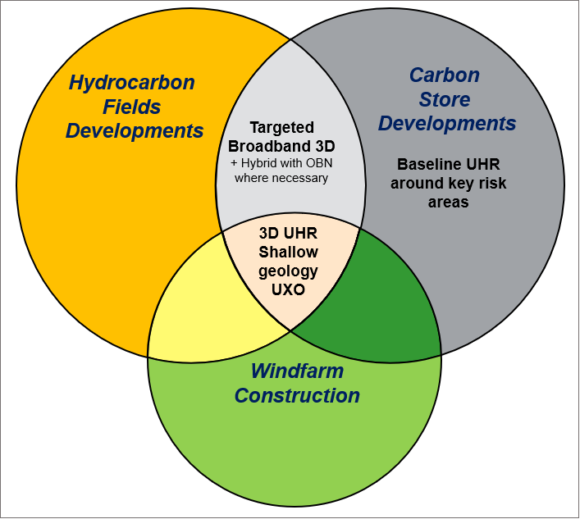
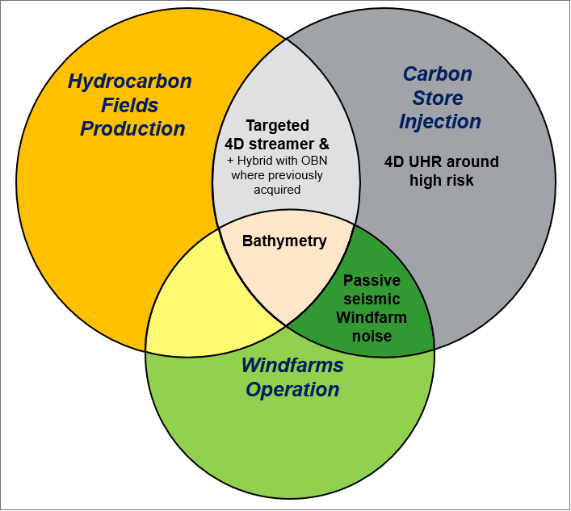
1.11 Geophysical Co-surveying (O&G, CS & Wind)
Geophysical techniques originally widely deployed in the O&G industry are being further developed for CS applications, albeit with greater emphasis describing the shallow section (reservoir overburden) and monitoring of near surface changes at higher risk locations. Superficially, there appears to be little co-surveying overlap in terms of scale & resolution with the windfarm geophysical activity, although common issues of permitting, access and noise budgets need further consideration.
Appraise
Develop
Monitor
Main geophysical tool
By project phase
There are signs of some technological convergence, for example:
Windfarm operators' willingness to screen areas using repurposed legacy seismic, increasingly followed up with limited UHR 3D acquisition, multi-channel processing and the potential to undertake more quantitative assessment of glacial channels & soil strength, particularly increasing turbine size and foundation depth.
Future potential. Can turbine accelerometers be used to provide subsurface imaging? Is there any benefit for long term node deployment to monitor turbine stability?
“Deep” seismic for O&G/ CS industry is paying greater attention to imaging effects of the shallow section and operationally now have the capability to provide extensive high resolution shallow 3D. For shallow water 3D acquisitions, a bathymetry survey is increasingly collected.
Future potential: There are signs of an emergent, revolutionary “single geophysical model” approach (section 14.3) which may provide the capability to incorporate a broad range of geophysical data. Future monitoring co-survey updates which could share more similar parameters to windfarm surveying. For example, we have considered the potential to use windfarms as an ambient seismic signal (section 13). Re-charge autonomous sources and data-drop from nodes at a local substation would make continuous monitoring attractive.
Synergies and differences between offshore businesses

Slide 15


1.12 Geophysical technology direction?
There is a range of seismic acquisition and processing options available, with all options having an associated cost (both financial and effort required for completion).
Much of the current UKCS CS & O&G areas are already covered with legacy 3D and there are many excellent examples of very good and cost effective modern FWI reprocessing of the raw data. Whilst this provides assurance up to CS site characterisation (appraisal) stage, often the restricted acquisition parameters and effects of subsequent O&G production/injection mean that it could not be considered as a baseline for monitoring of new field/complex development, let alone 50+ year store management.
The NSTA recommends:
- Good quality pre-development 3D survey with broadband frequencies and long offsets parameters appropriate structural imaging of the CS complex (overburden and down to target depth); this also serves as the seismic baseline for future 4D monitoring.
High resolution seismic for high-risk features (wells, shallow faults) in the overburden.
Streamer seismic remains the most cost-effective mainstay, but a targeted hybrid with OBN will be necessary for either a comprehensive velocity field by deploying sparse nodes or localised dense node patches around critical infrastructure.
The NSTA has no technical preference for proprietary vs multi-company acquisition.
Future Implications
The increasing difficulty of access, operational cost & environmental impact of large-scale geophysical data acquisition implies:
If not already available, early acquisition of a modern 3D image. A basin scale re-development strongly suggests that opportunities to work together should be used whenever possible.
Greater emphasis on the definition & sophistication of the pre-development geophysical description of the CS complex.
Support the development of smaller footprint active or passive technologies within the context of updating the geophysical model.
Long term spatial and temporal planning; marine infrastructure designed alongside appropriately scoped geophysical surveys which are phased within co-development timetables.
Countries bordering the UKCS are facing the same co-location issues (legacy O&G, offshore wind and early CS activities), so improve cross border planning would enable efficiencies and reduced overall environmental impact of MMV activities.
NSTA seismic guidance & Potential geophysical technology direction

