Slide 1
Greater Buchan Area Plan
Industry Engagement Session
15th November, 2018

Slide 2
Agenda
  Housekeeping and HSSE
  OGA Chief Exec introduction
  OGA Area Plan context
  Greater Buchan Area opportunity
  Outline of licensing round process
  Indicative timeline
  Area plan focus
  Scoring and guidelines
  Information and data access
  Participant questions received to date
  Questions?
  We will capture these questions for those not present and if we cannot answer a question today we will post answer as soon as possible
Notes:
Toilet facilities outside room, opposite lift door
Fire drill will take place at 11.30am, exit points are …..
Questions at end of presentation please
After presentation and questions there will be tea, coffee and the opportunity to network

Slide 3
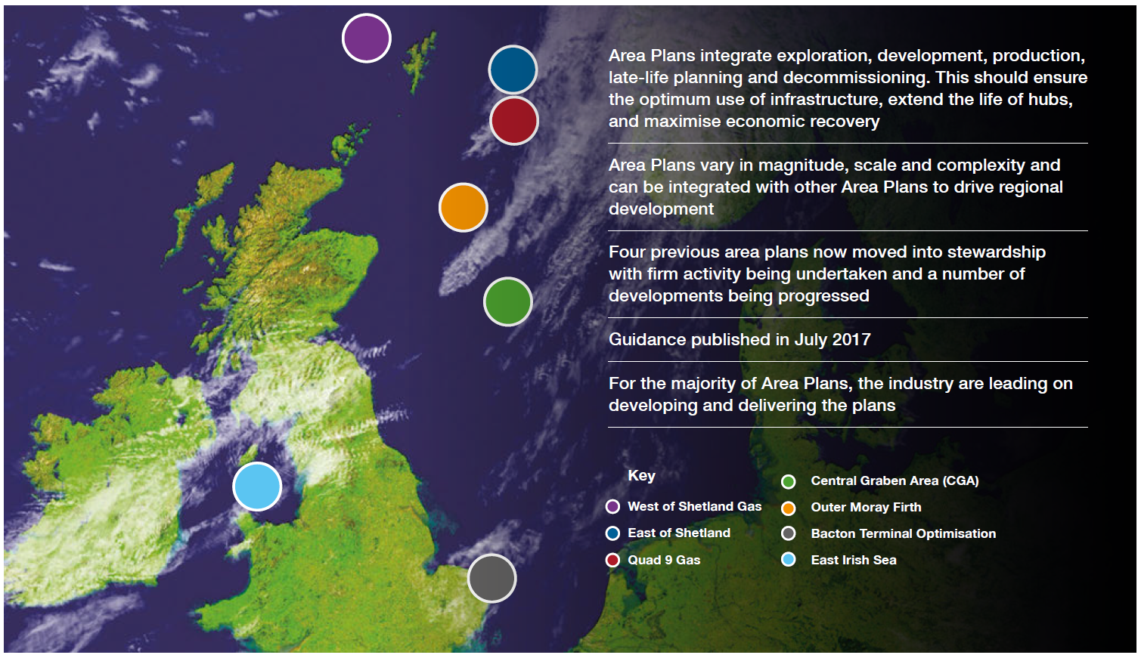
Area Plan context
Penguins
Fram
Arran
Columbus
Vorlich
Gannet (Fulmar Bypass)
CMS Redevelopment
Complete (Transitioned to Execute)

Slide 4
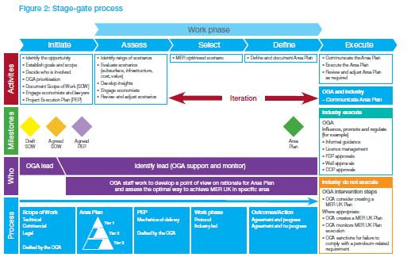
Greater Buchan Area Plan
“Area Plan – a proposal for action developed in partnership between the OGA and industry as to how economic recovery should be maximised in a particular geographical area of the UKCS based on analysis of evidence.”
OGA Guidance on the Development and use of Area Plans ( July 2017)
Greater Buchan Area Plan is in ‘initiate’ phase
31st supplementary licence will facilitate the development of the area plan through collaboration with industry to get the right assets in the right hands to deliver MER.

Slide 5
Area Plan Goals
Facilitate the progression to production of +300mm boe, through:
  Identification of MER UK approaches to development of discoveries and prospects and redevelopment opportunities in Greater Buchan area
  Through 31st supplementary licence round ensure unlicensed acreage is awarded to licensees seeking the MER optimal development scenarios
  Ensure that existing infrastructure is utilised in the most MER effective manner

Slide 6
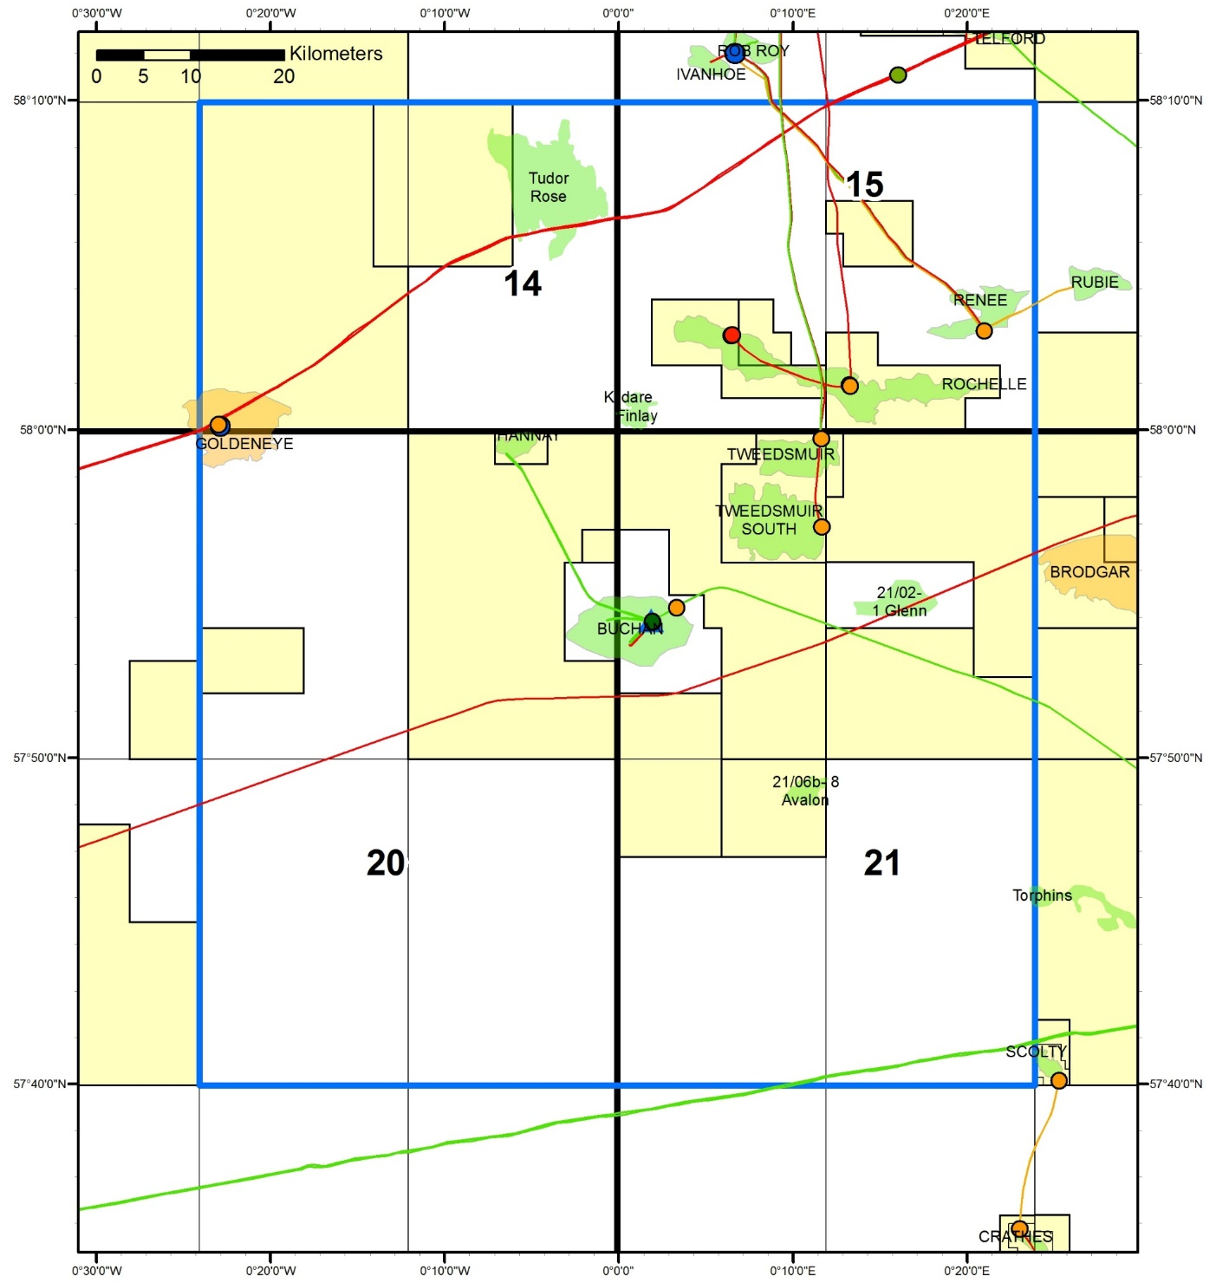
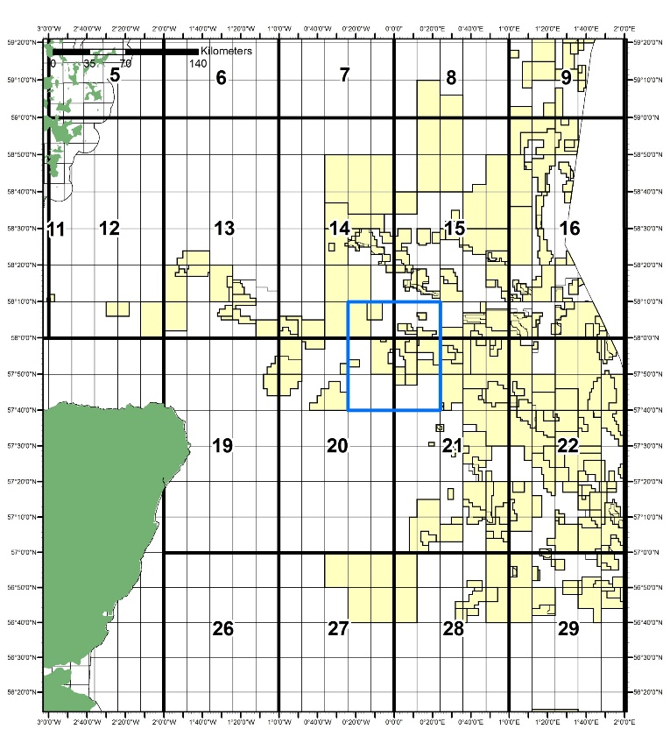
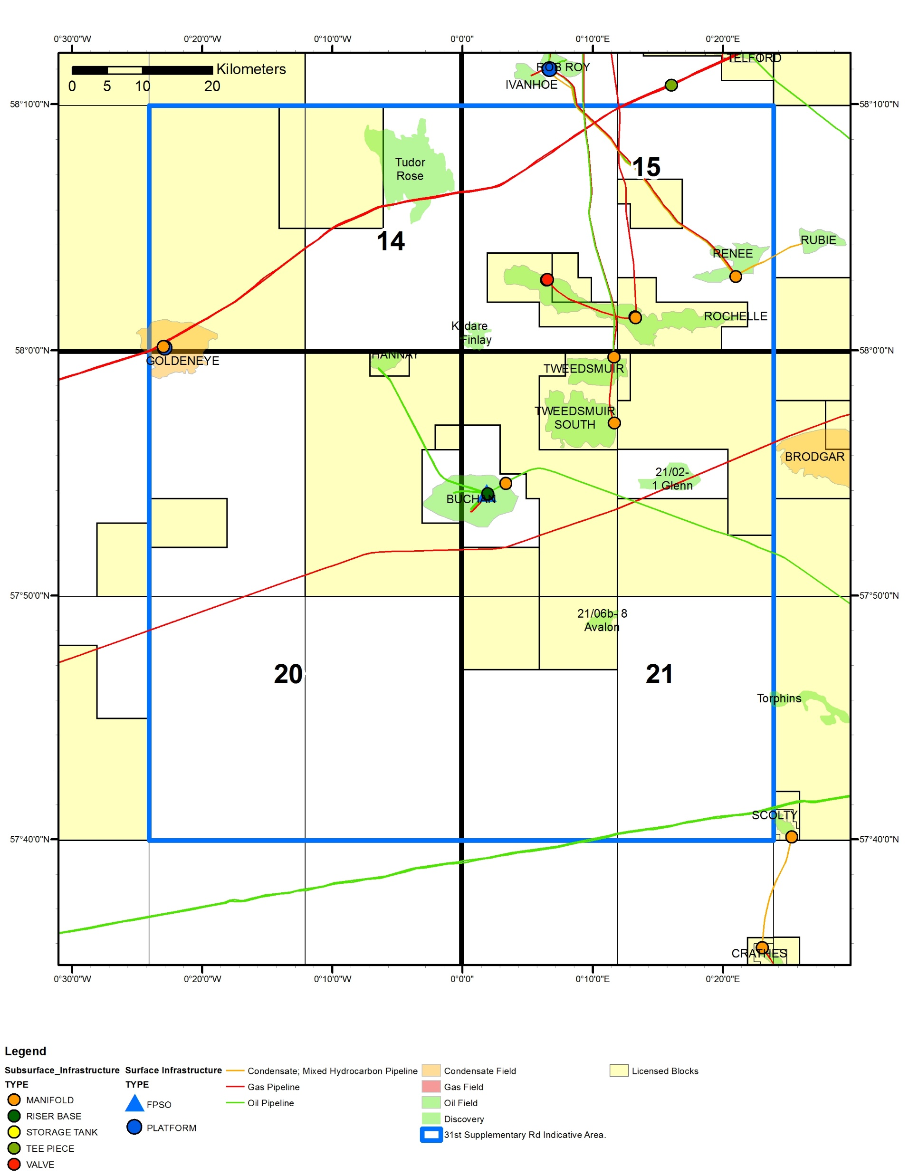
Greater Buchan Area
Notes:
Area Plan covers >9,000 sq km
Approx. 5,800 sq km is unlicensed
Hence why OGA is using for first time a supplementary licence round as a key component of developing an Area Plan

Slide 7
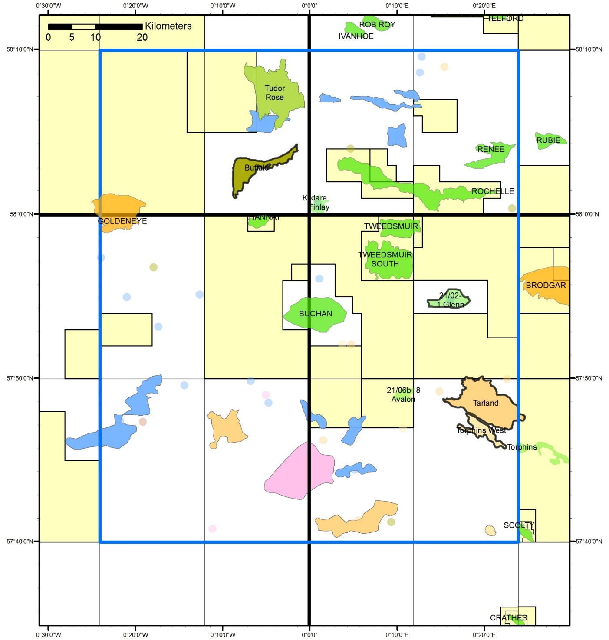

Opportunity
A diverse portfolio of undeveloped discoveries, prospects and leads, many of which are defined in relinquishment reports
The OGA will promote selected unlicensed Prospect & Lead montages
Notes:
This map shows some of the prospects and leads
Where OGA does not have releasable data we have used a dot to identify unlicensed prospectivity
OGA believes there could be up to:
160 mmboe P50 discovered contingent recoverable resources
100 mmboe of unrisked recoverable in mature prospects
Many other immature prospects and leads
in the unlicensed acreage
Significant potential in the license round
Boldly outlined prospects will have OGA promote material
Montages have been made available previously in the 30th Round

Slide 8
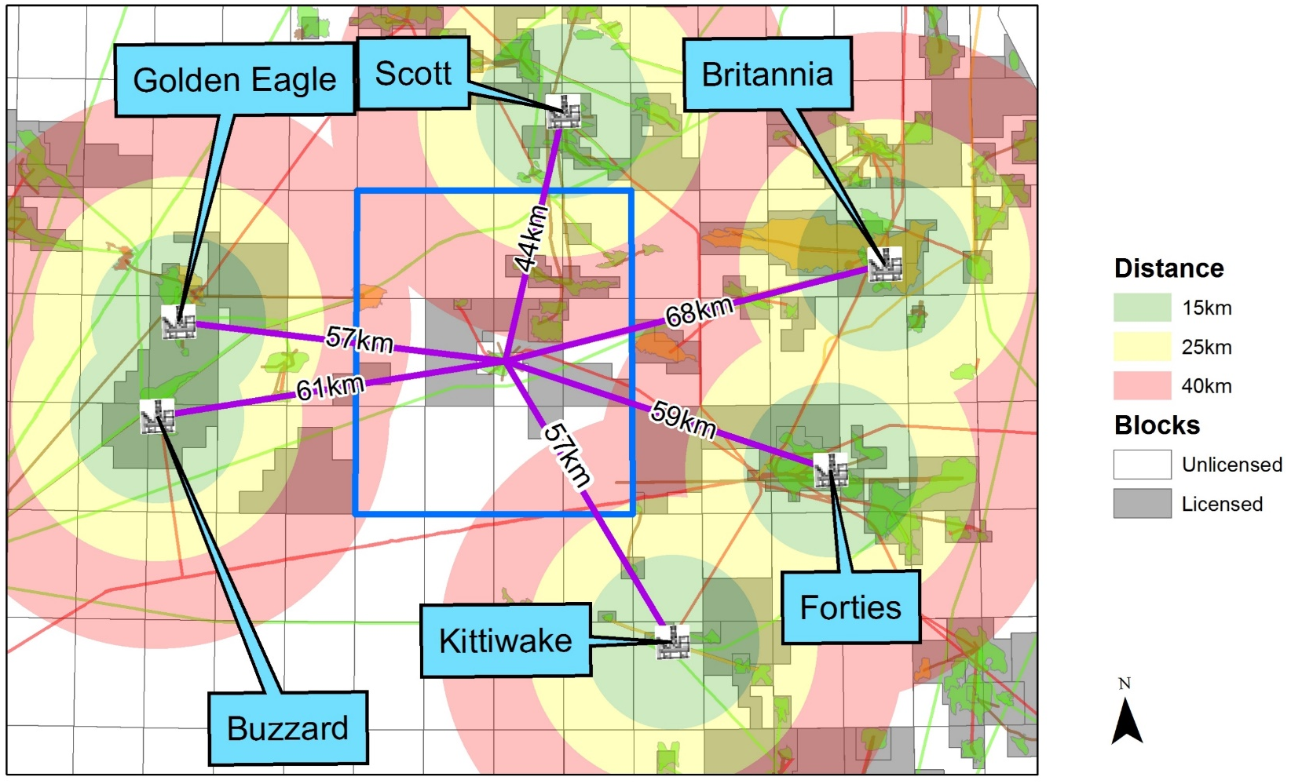
Infrastructure Challenge
ED50 UTM Zone 31N
Notes:
Significant gap in available infrastructure to tie into
Unusually for CNS this provides a relatively blank canvas for identifying optimal development concepts
OGA is commencing it’s own analysis of potential development concepts
These will be used by OGA as decision context when considering applications
They will not be made available to industry

Slide 9
31st Supplementary Licensing Round – Area Plan Focus
Licence round applications will be by block as normal
Scoring of applications however is intended to have an additional mark category to previous licence rounds
A new category for ‘ Area Plan’ with 100 max points is currently proposed.
It is expected that to attract a score for this category, an application would either have to be for more than one opportunity or have clear linkage to other block applications.
It is intended that the following will be considered in scoring the Area Plan category:
  Strategic vision for the area to achieve MER
  Incorporation of nearby prospectivity and discoveries and how these could be enabled
  Collaboration with area licensees
    Joint applications
    Willingness to be ‘partnered’ with other applicants by OGA
  Clear demonstration of understanding of risks and opportunities
  Realistic time bound and funded activity plans
We would welcome your thoughts on the above proposal, please provide any input by 30th of November 2018 to the Licence Round inbox.
Notes:
Of the five sub-categories, OGA’s current thinking is that the strategic vision and incorporation of nearby prospectivity & discoveries categories would hold more weight than the others but again would appreciate your thoughts on this.

Slide 10
31st Supplementary Licensing Round – Partnering
OGA considers given the mix of opportunities available in the licensing round partnering of applicants may be a key MER UK enabler
It is intended that the OGA will therefore actively consider if ‘partnering’ applicants will enable a better outcome for Maximising Economic Recovery (MER)
  Blending innovation and technical capability from different organisations
  Providing more robust financial capability
  Applicants have different, complimentary applications
To be ‘partnered’ by OGA you need to have applied for the block
Licence round guidelines will be updated to reflect final changes and provide more detail on scoring breakdown.
Notes:
Previous licence rounds have ‘married’ applicants to a limited extent

Slide 11







Licence Round 5 Yr Plan
Supplementary Licensing Round for the Greater Buchan area will take place between closure of the 31st and start of the 32nd rounds.
2016
2017
2018
2019
2020
2021
‘Frontier’
90-day Application Period
29th
New Innovate Model Licence Clauses
Awards
‘Mature’ Areas
120-day Application Period Introduced
30th
Launch
Applications
Awards
‘Frontier’ Areas
31st
Seismic Data Release
Launch
Applications
Awards
‘Mature’ Areas
Supplementary Licensing Round
Gr Buchan
Data Release
Launch
Applications
Awards
‘Mature’ Areas
32nd
Prospect Data Release
Launch
Applications
Awards
‘Frontier’ Areas
33rd
Launch
Applications
Awards
Notes:
The Supplementary Licensing Round for the Greater Buchan area will take place between closure of the 31st and start of the 32nd rounds.

Slide 12
Indicative Timeline
Data release end 2018; Licensing Round to commence Jan-Feb 2019; Award in Q3 2019.
Q3 2018
Q4 2018
Q1 2019
Q2 2019
Q3 2019
Q4 2019
OGA Evaluation
Frontier 31st
Awards
Operator Evaluation
Applications
OGA Evaluation
Launch
Awards
Mature Supplementary
Operator Evaluation
Supplementary Licensing Round
Data Release
Applications
OGA Evaluation
Mature 32nd
Launch
Operator Evaluation
Prospect Data Release
Applications
Notes:
Indicative as we’re still gathering data, awaiting EU translation, etc.
Data release, Operator assessments and OGA evaluations are scheduled for completion ahead of the 32nd Round in 2019.

Slide 13
APPLICATION ASSESSMENT - CRITERIA
As provided for under the Hydrocarbons Licensing Directive (1995), Applicants will be assessed on the basis of:
Technical Capability (Subsurface and Surface)
Financial Capacity (including viability)
Nature of the Work Programme (the way the activity is to be carried out)
Track Record under existing or expired licences
Other relevant criteria (may be applied under certain circumstances)
Applications should ensure that these criteria are fully addressed
Typically the assessment process will involve invitation to a clarification interview
Interviews will be held in Q2 2019
Applications should be made through the online ‘LARRY’ System (Guidance Available).
Applications will be assessed in accordance with the published Marks Scheme.
Notes:
As with previous recent Licensing Rounds, Applications will be assessed on:
technical content,
financial capacity
work programme
Track record and other criteria may be taken into account.
Interviews will be held in Q2 2019.
Assessments will be made in accordance with the published Marks Scheme and guidance.

Slide 14
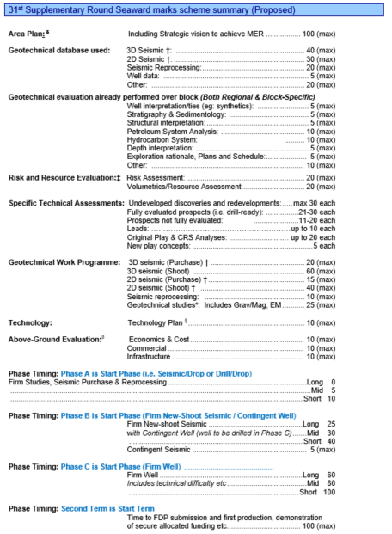
MARKS SCHEME
The marks scheme has evolved over time, and has been revised in consultation with industry.
Marks will be available for:
Area Plans
Geotechnical Database Used (Refer to SE-03)
Technical Evaluation Already Performed
Work Programme
Technology Application
Above Ground Evaluation (Phase C & Second Term)
Starting Phase and Phase Timing (rewarding faster work programmes)
Notes:
The marks scheme has evolved over time, and has been revised in consultation with industry.
A new category for Area Plans has been added to the Seaward Marking Scheme for consultation with the industry.
There is no breakdown of marks of Area Plan above as Alistair mentioned on slide 8 we would welcome your thoughts on this.
Other categories shown here are the same as the 30th and 31st Licensing Rounds.

Slide 15
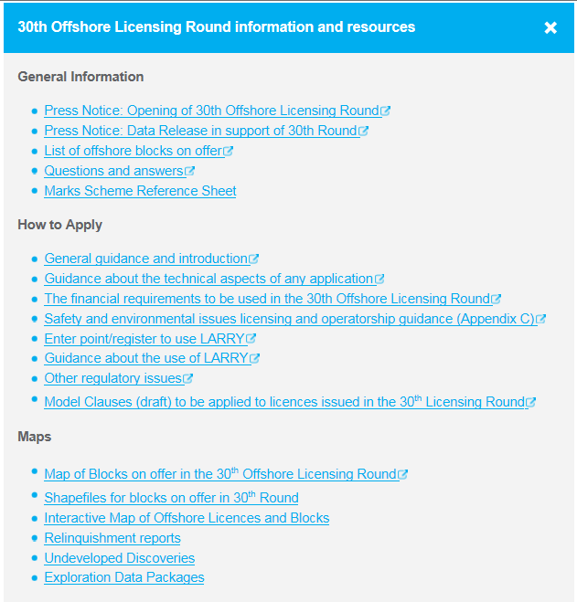
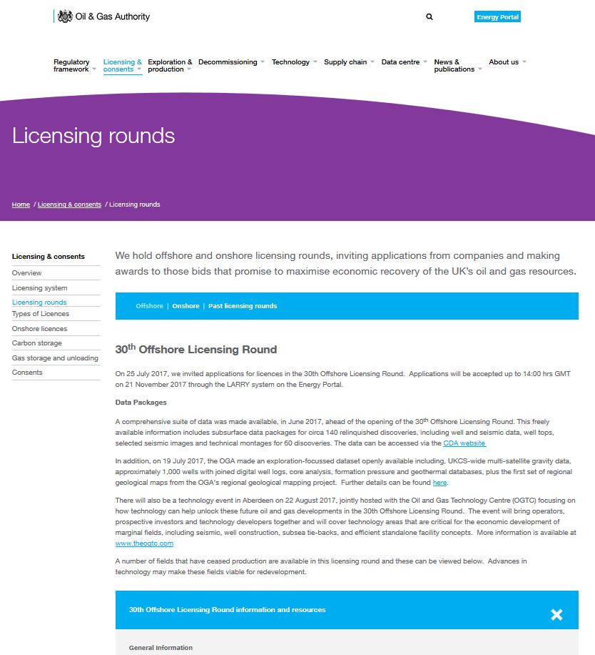
GUIDANCE
Guidance documentation and links to data will be made available online as for the 30th & 31st Licensing Rounds
https://www.ogauthority.co.uk/licensing-consents/licensing-rounds/
Notes:
Detailed Guidance will be made available on the OGA website to include:
the marking scheme,
list of blocks on offer
Q and A
maps and links to data packs.
The format of guidance and links will follow that of previous recent licensing rounds.

Slide 16
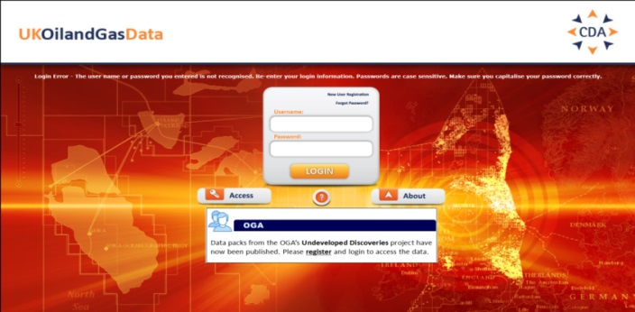
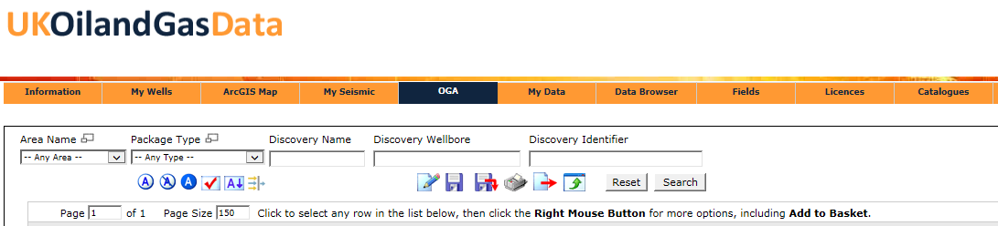
DATA RELEASE
Data release will be via the CDA website.
All data will be available through the OGA tab.
Data can be accessed by a guest account. CDA Membership is not a requirement.
Summary Montages and Data Packs available on UKOilandGasData.com
Notes:
The data pack will all be released via the OGA tab through UKOilandGasData.com.
CDA membership is not a requirement.

Slide 17
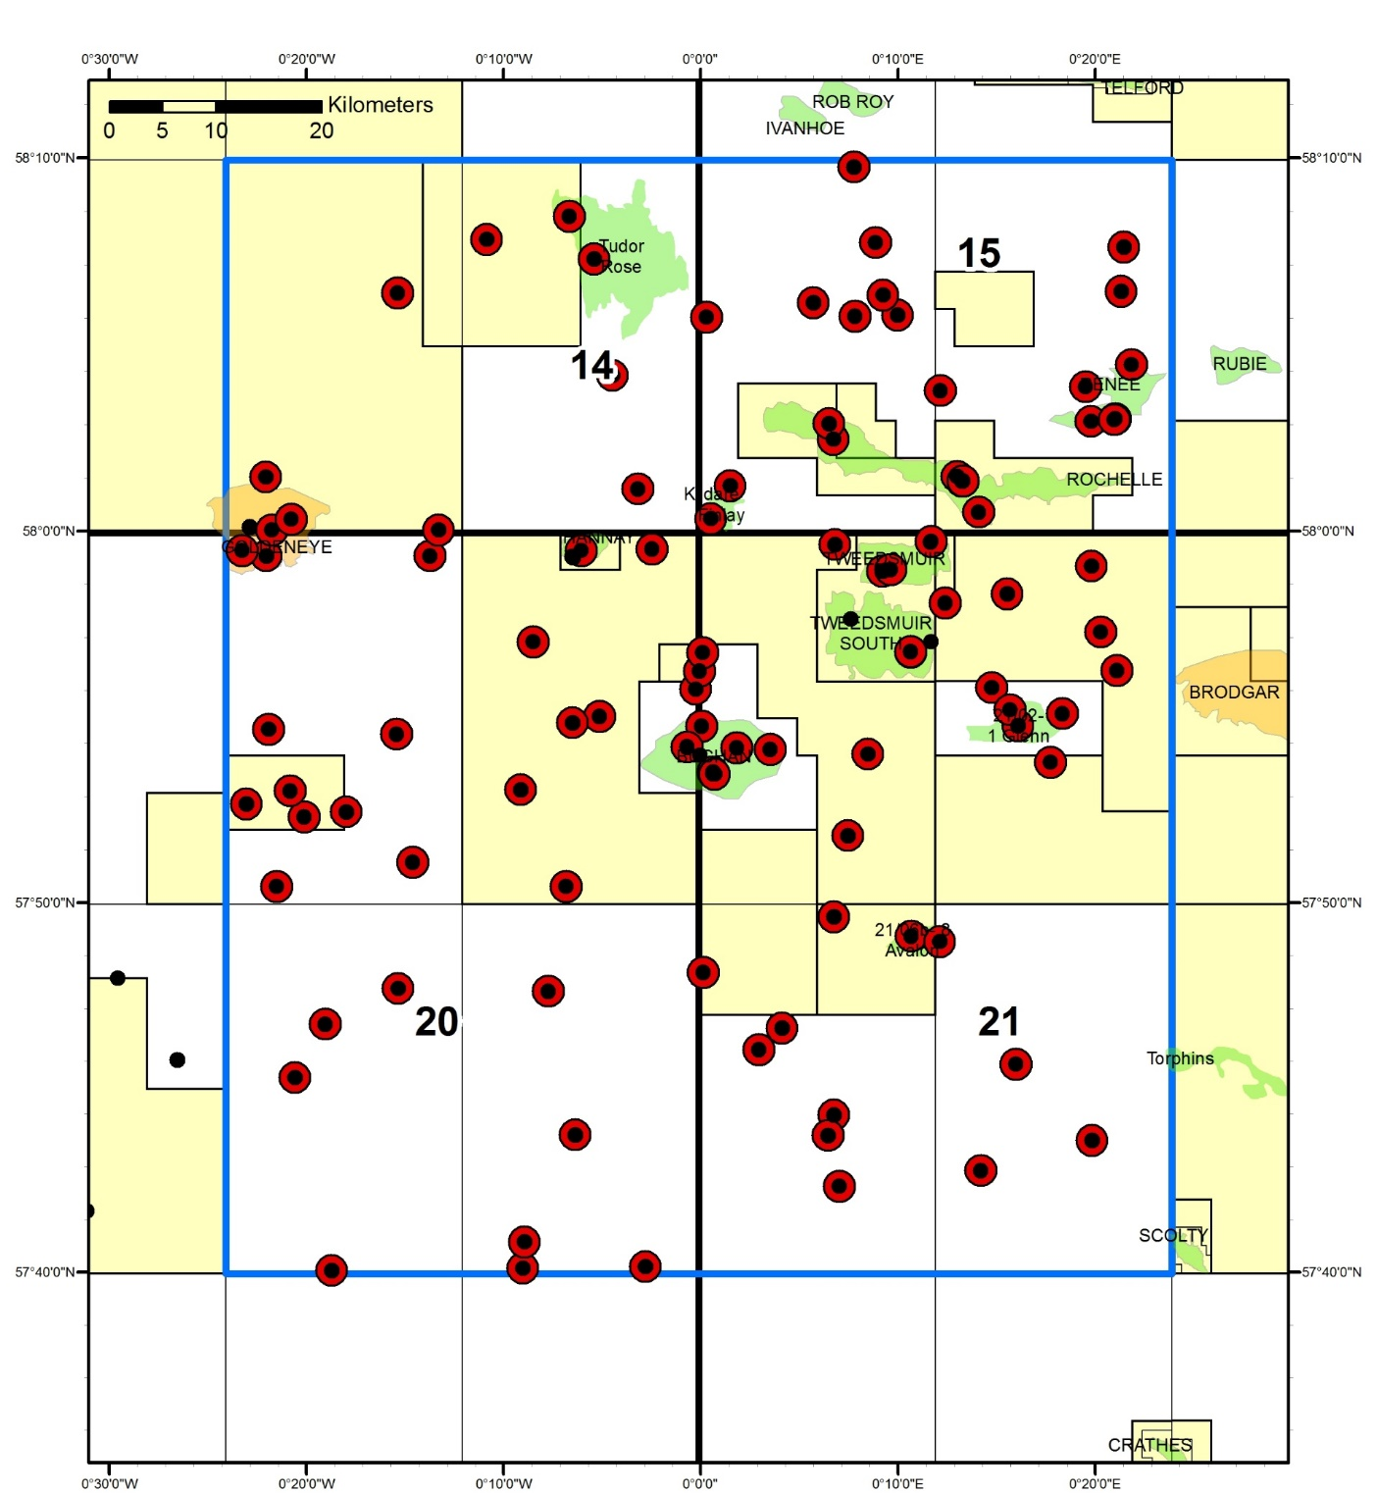

DATA - Wells
CDA Well Data to be Released (154):
Comp log
Digital well logs, including GR, Sonic, Density & Resistivity
VSP
Core data
CGG Well Data to be Released:
Digital well logs (121)
Notes:
The OGA will release a data pack for the AOI prior to opening the round.
In the data pack there are 154 wells in CDA comprising a minimum of comp logs, digital wells logs, vsp and core data.
In addition there will 121 digital well logs purchased for release from CGG.

Slide 18
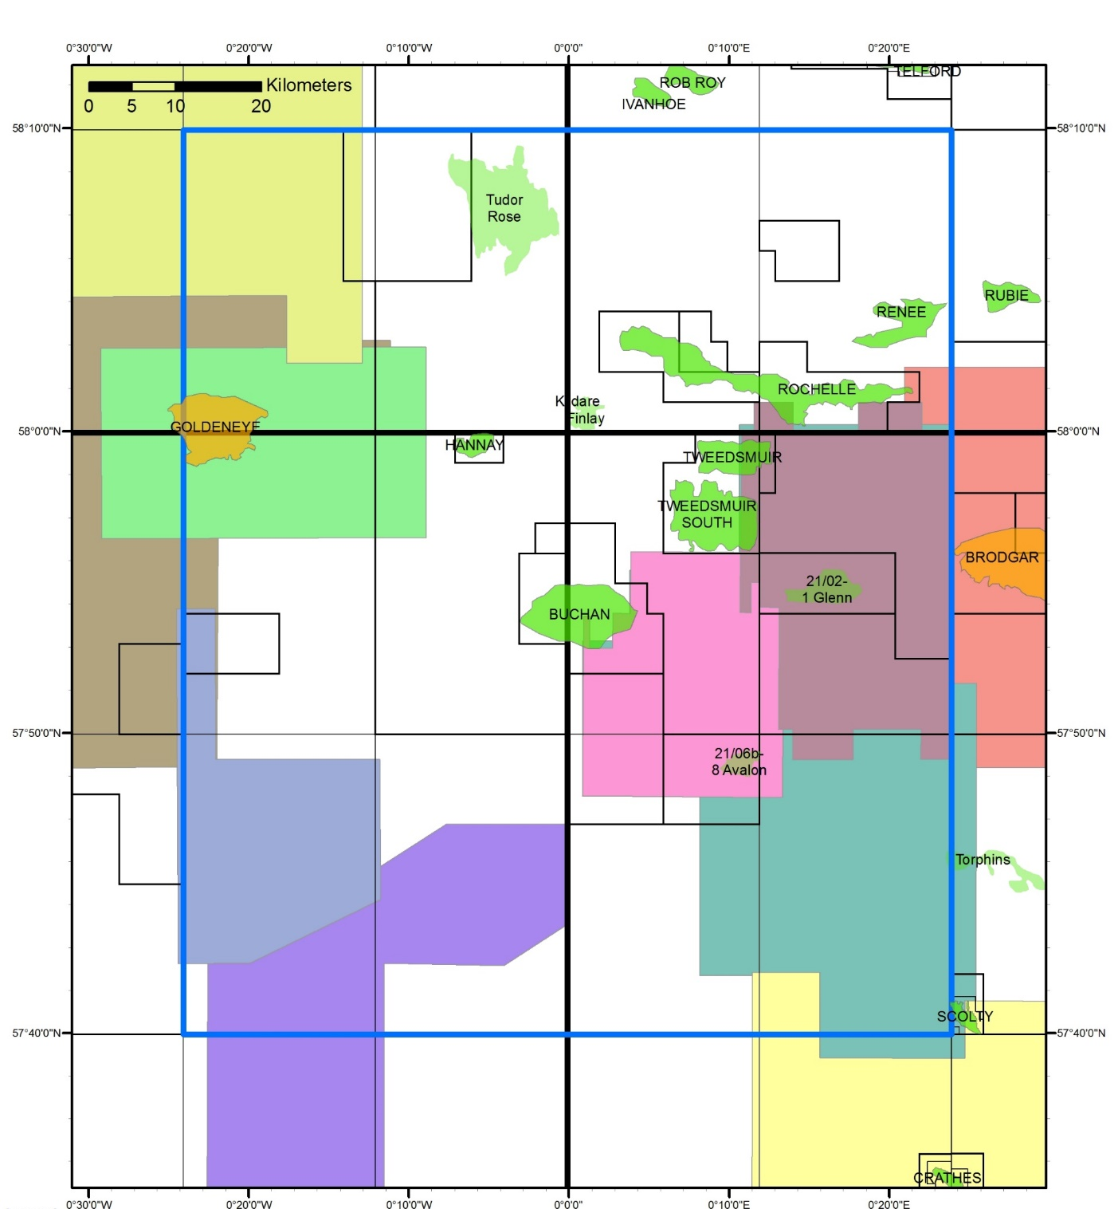
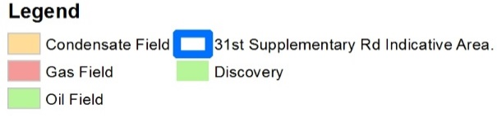
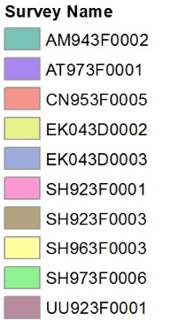
DATA - Seismic
CDA 3D Seismic Data Released (10)
Notes:
10 proprietary 3D seismic surveys will be made available via CDA.

Slide 19
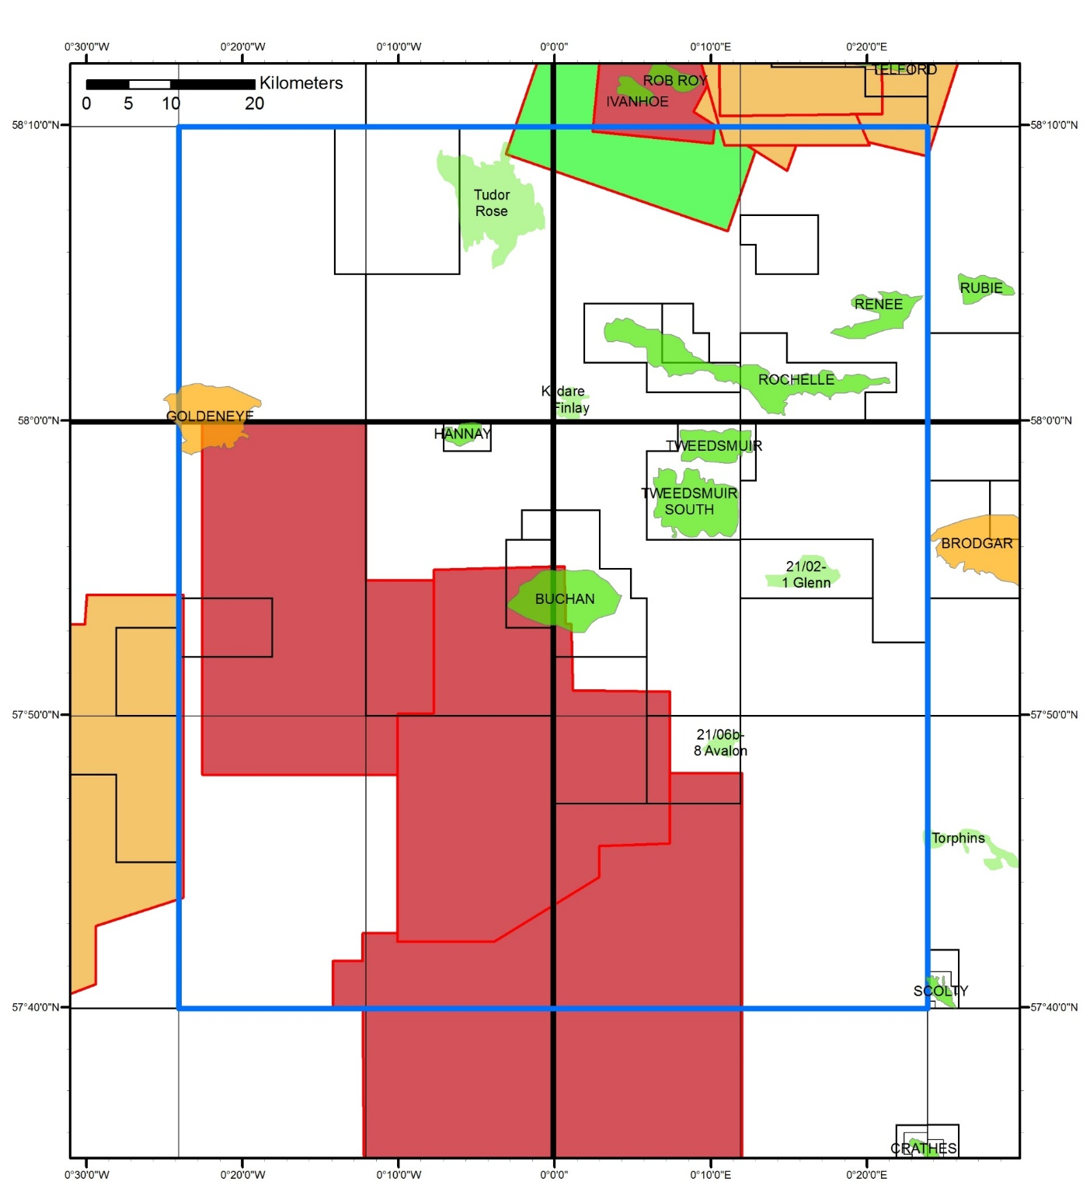
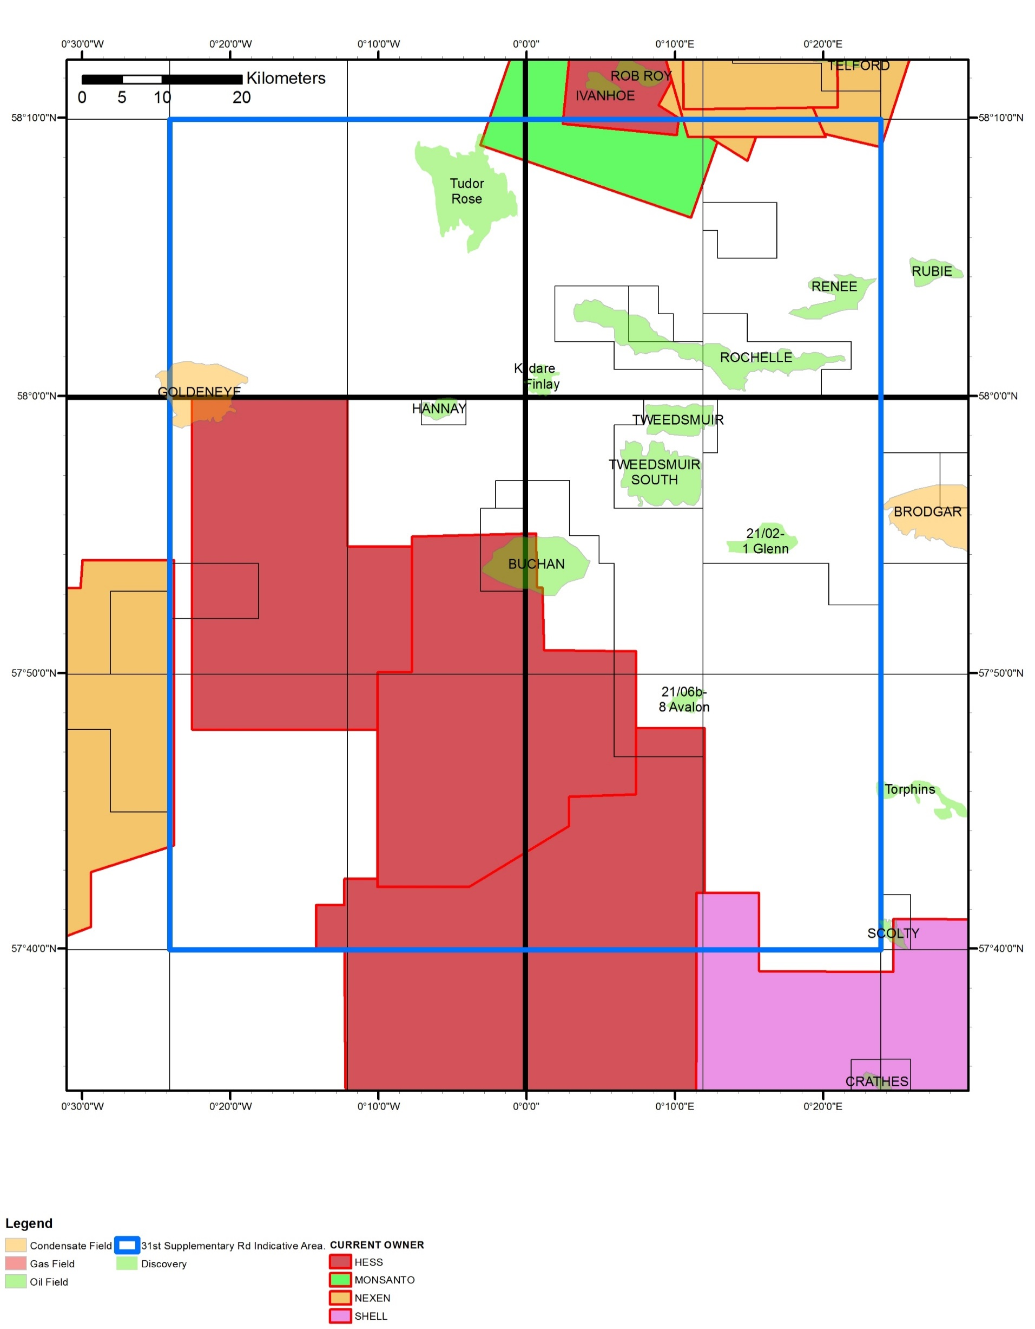
DATA - Seismic
Released Seismic, not available in CDA (10)
Available from the owner.
Hess surveys also requested by the OGA.
1984
1996
1997
1995
Notes:
Other released proprietary seismic surveys are currently available directly from the owner. These are currently NOT in the data pack.
Please note that the OGA has requested the HESS surveys to be released and will be included in the data pack if available.
If you want access to this data you need to request from the owner

Slide 20
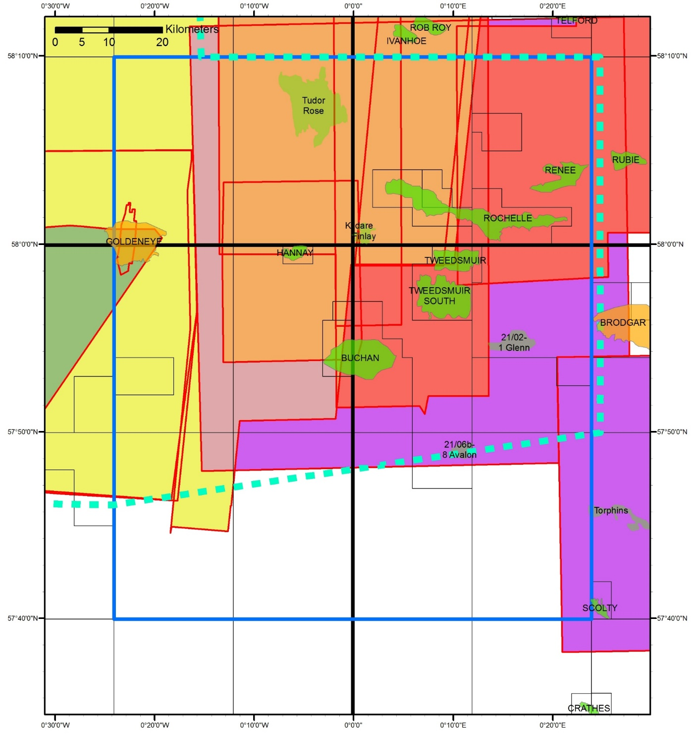

DATA - Seismic
Spec Seismic available through the provider (13)
Notes:
The area is also covered by Spec survey data, which is available through the provider.
Some of the companies are represented here in the room.
This slide shows coverage is good for most of the area.
Additionally, the southern part of the area is covered by 2014 CGG reprocessed data.

Slide 21
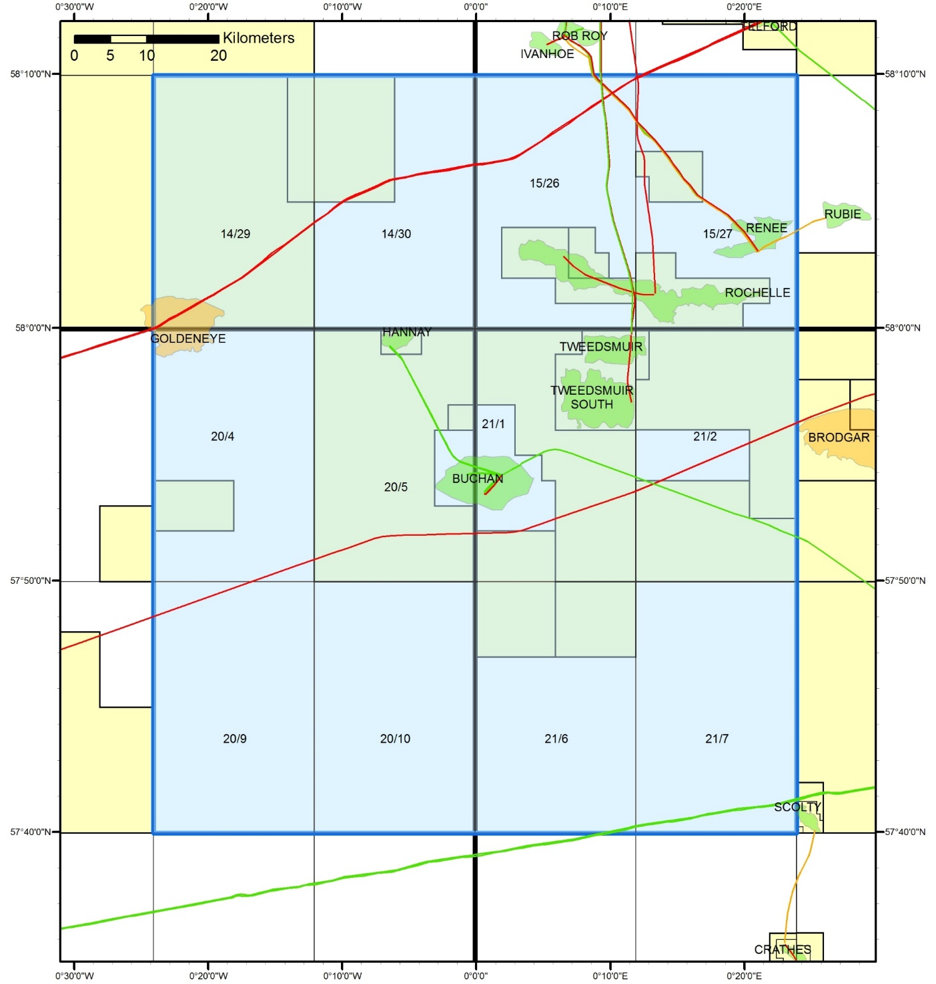


DATA– Relinquishment Reports
1
3
1
1
Relinquishment Reports (26)
1
3
3
2
1
2
3
5
Notes:
Relinquishment reports will be made available in the data pack.
The map illustrates the distribution of these reports across the Indicative Area. There are 26 released relinquishment reports.

Slide 22
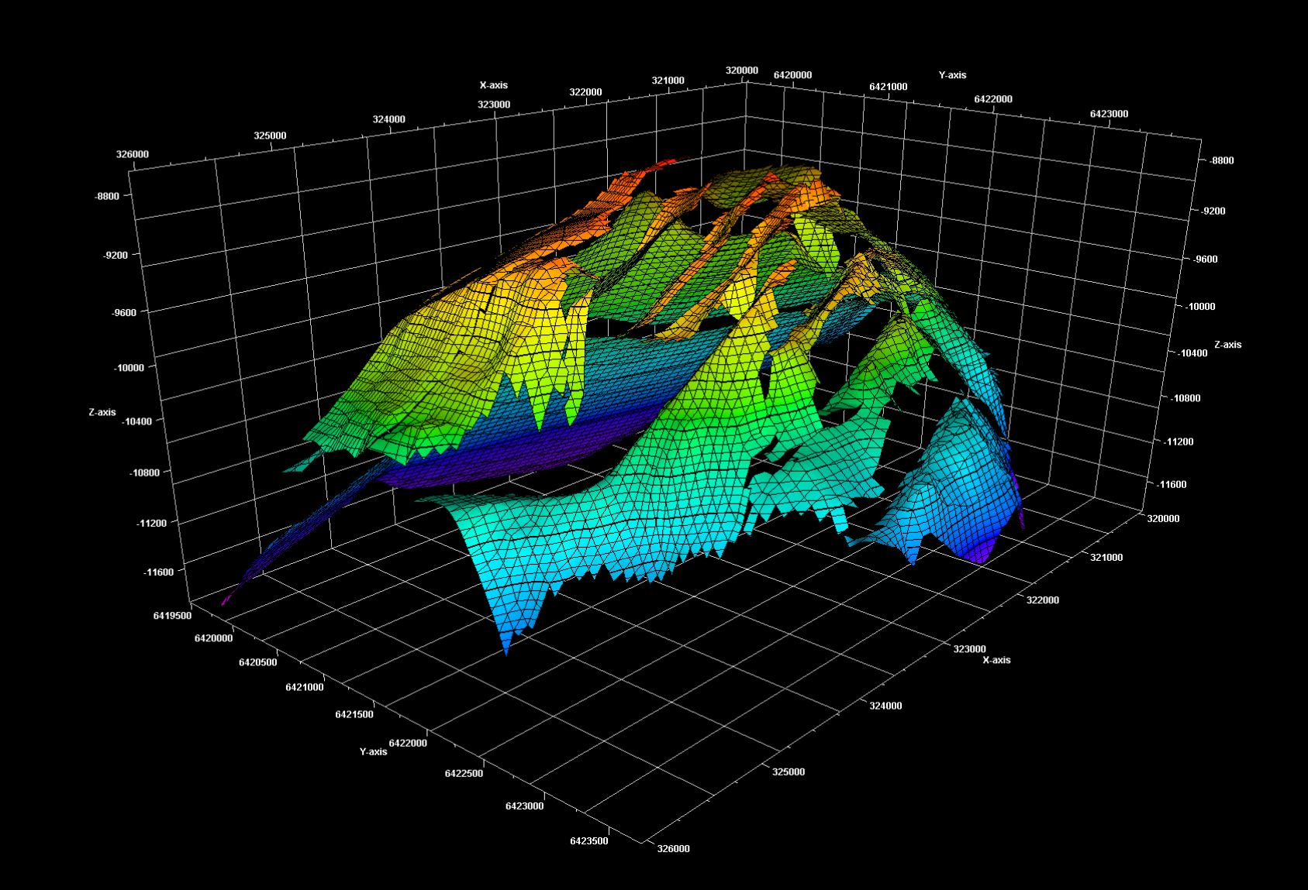
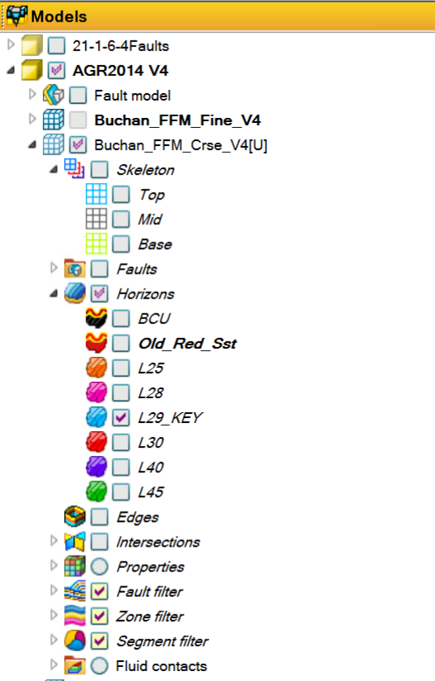
DATA - Other
Other Data, to include:
Buchan Petrel & Eclipse Models
Buchan COP Report
Daily Buchan well production data
Misc Reports
Notes:
The Buchan petrel and eclipse models will be released [which we are currently testing before publication].
Other information including the Buchan COP report and daily production data will also be made available.
Recognition to Repsol Sinopec for their support in releasing this.

Slide 23
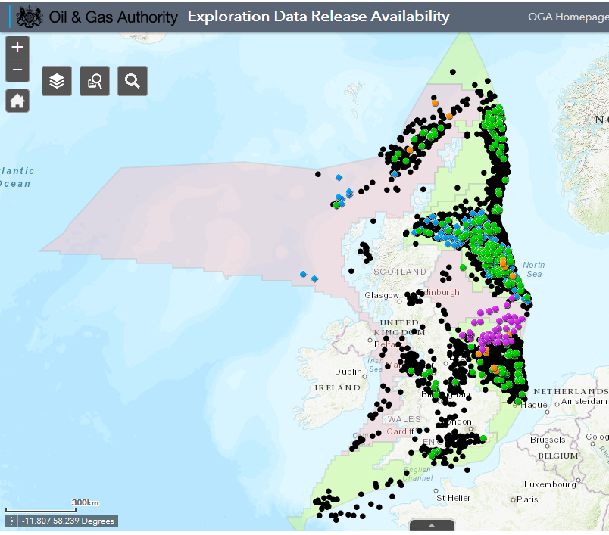

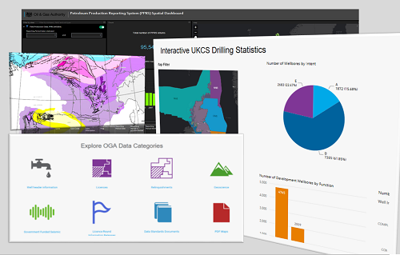
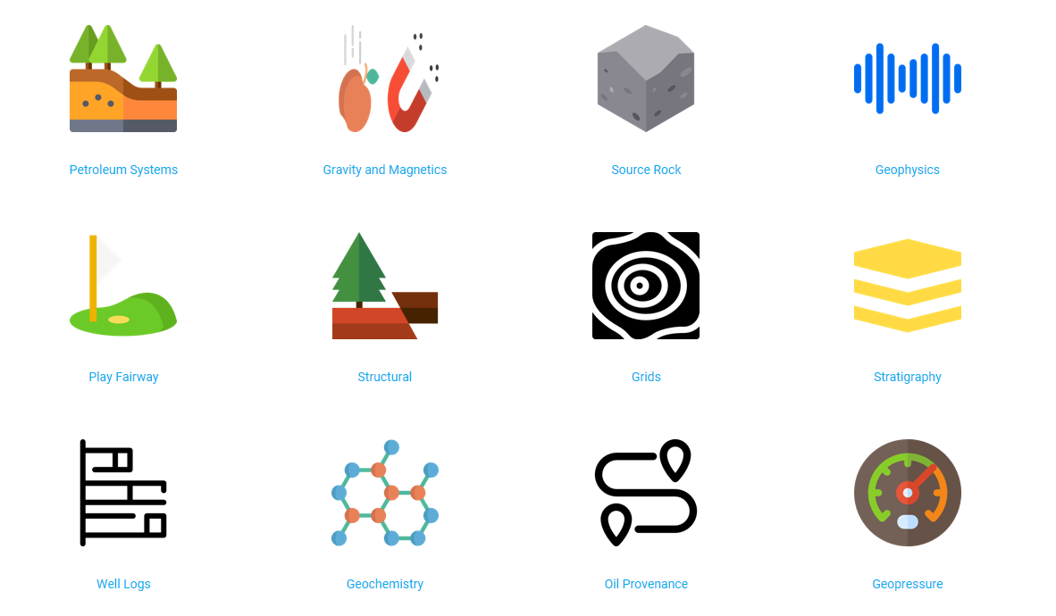
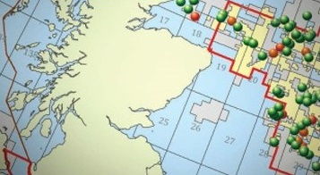
OGA Data Centre
Previous Exploration data releases and relinquishment reports via OGA Data Centre
Notes:
Previous data releases and all other relinquishment reports are publicly available via the OGA Data Centre so please refer to these web pages too.
Links to all of the above will be available on the OGA 31st Supplementary Round web page.

Slide 24
Questions - Received
Question | Answer
Envisaged timeline for Supplemental Round | Answered in presentation
Envisaged differences in style/content/level for this (Area Plan) application or more standard round application | Answered in presentation
Are the OGA planning to issue updated Guidance notes specifically for this process | Answered in presentation
Will a points system, similar to other licensing rounds, be issued and used to assess and rank applications? When will it be available ? | Answered in presentation
The GBA contains a range of maturity which under normal licensing rounds would probably result in different license types being applied for eg Initial Term Phase A, B or C for exploration/appraisal opportunities and Second Term for ‘already appraised, ready for development’ opportunities. How does the OGA envisage this mix being addressed in the application process | As per licence round guidance

Slide 25
Questions - Received
Question | Answer
Does an applicant/group have to apply for all open (blue) blocks within the Greater Buchan Area or will they be able to apply only for select areas ? | No, however to attract a high score for Area Plan it is likely that more than one block will have been applied for or linkage demonstrated to another block application or planned activity
At the application interview, how much time will applicants be allocated to present their applications | One hour envisaged but complexity/breadth of application will determine this.
Are there any changes to other requirements eg Environmental, Corporate, Financial, HSE etc compared to 31R ? | Not currently envisaged
What level of linkage to Area Plans are OGA expecting to be included in any application ? For example are the OGA expecting a draft Scope of Work, draft PEP or something more extensive ? | We would expect the linkage to Area Plan to be reflected in the number of opportunities applied for and the proposed development scenarios and activity plans. There is no need for PEP’s.
How does the OGA envisage Operators 'working together' and what ‘involvement' can industry expect from the OGA to develop the Greater Buchan area ? | Joint applications or demonstrating linkage to another application for example development concept utilising infrastructure another applicant proposes putting in place.
Will the OGA choose to offer marriages in situations where competing applicants have different focus ? | Answered in presentation

Slide 26
Questions - Received
Question | Answer
As a new entrant we can’t currently join CDA. What data will be made available and if additional data is required when will we be able to join CDA or its replacement? | Answered in presentation
Will PGS be presenting a new update on Moray Firth Basin mapping similar to what they undertook and published on the Witch Ground Graben to Fladen Ground Spur Basement high and the Crawford Skipper Basin? The aim being to stress the importance of addressing the underlying Devonian Syn-rift basins (interplay between fault trends and the additional lacustrine source rock proven in Buchan). | No, OGA would encourage individual engagement with seismic contractors
Can Independent Consultants download a ready made Seismic Data Package to interpret? | No, post stack data will be available in packages

Slide 27
Questions from participants
Notes:
We will capture these questions for those not present and if we cannot answer a question today we will post answer as soon as possible

Slide 28
Back Up

Slide 29
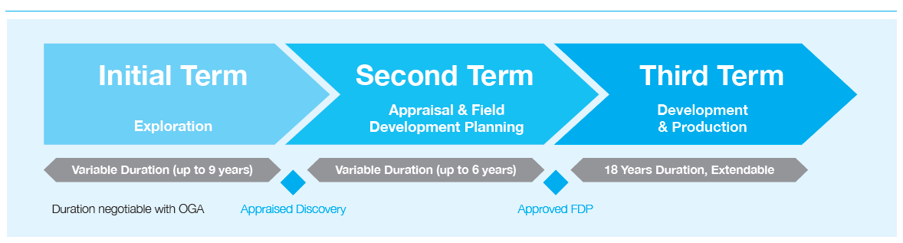
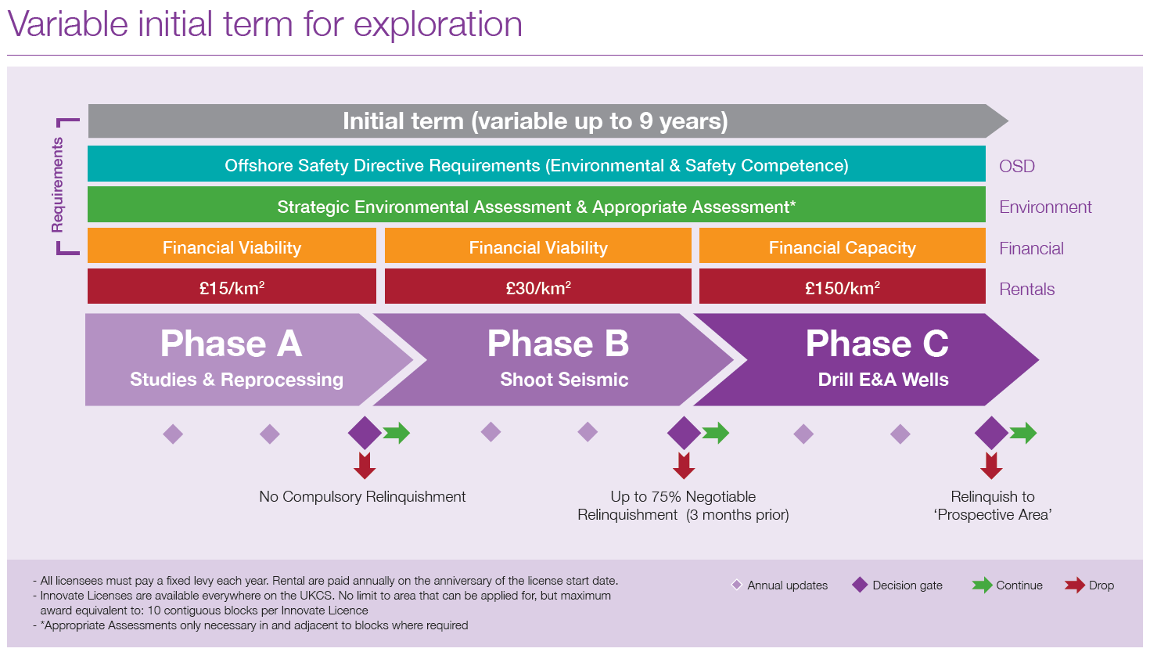
INNOVATE LICENCES
Approach:
Applicants devise required work programme to exploit resources
Structure licence phasing accordingly
Licence can start in any Initial Term Phase
Applications should address all prospectivity and development potential on the proposed licence
Licence can start in Second Term (Straight to FDP planning)
Applications will be assessed on a Strategic vision for how an area might MER over its lifecycle (Area Strategy).
Notes:
Innovate licences are flexible – applicants devise an appropriate work programme and the phasing is structured accordingly.
Licences can start in any Phase of the Initial Term or the Second Term.

