Slide 1
NDR User Group
Meeting One
9 March 2021

Slide 2
Meeting Etiquette
Please keep your microphone muted and video switched off unless you are speaking.
If you have any comments or questions please record these in the meeting chat. We will endeavour to answer at the end of the meeting or follow up with you.
Slides will be made available following this meeting on the OGA website.

Slide 3
Welcome and Agenda: NDR User Group 1
OGA Digital Energy Platform (AT)
Governance and Terms of Reference (AT)
Recent Service Improvements (MP)
Transition Project (AT)
What to expect (JN)
Preparation for Transition (AT)
Next steps (AT)

Slide 4
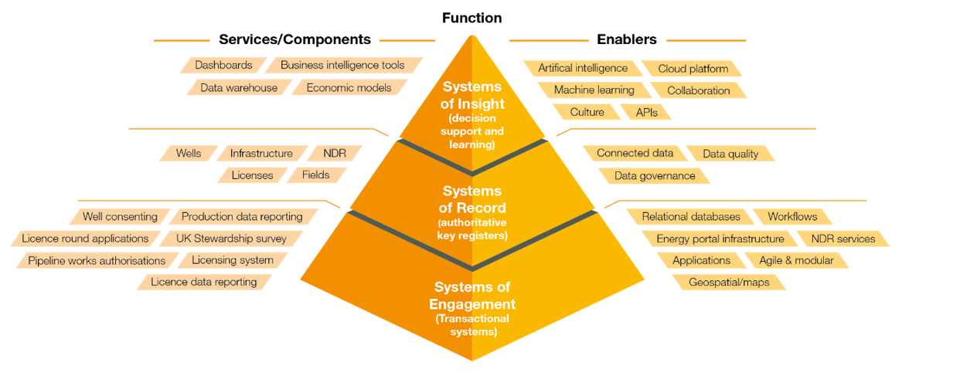
OGA Digital Energy Platform
The NDR is a component
of the OGA’s
Digital Energy Platform
Energy Portal
WONS (Well Operations)
PEARS (Licensing)
PWA (Pipelines)
etc.
Data Centre
Spatial, Production datasets, support for licensing rounds and so on.
Systems of Engagement, Record and Insight​
Incorporates 50+ applications, multiple databases and a wide variety of data types.
Varying in age, complexity and technology, they’re maintained by the OGA & service providers

Slide 5
NDR Foundations
2016
2017
2018
2019
2020
2021
2022
IM Strategy and Delivery
Digital Strategy and Delivery
I&S Powers
EA2016
Regulations

Slide 6
Agenda: NDR User Group 1
OGA Digital Energy Platform (AT)
Governance and Terms of Reference (AT)
Recent Service Improvements (MP)
Transition Project (AT)
What to expect (JN)
Preparation for Transition (AT)
Next steps (AT)

Slide 7
Governance and Terms of Reference
Endorse
Decide
Strategic Advice
DigX Gov Board
Security Board
Implement
Core IT Gov Board
DigX Stake Holders
DEP
AC
Energy Portal Gov Com
Influence
WONS User Grp
PEARS User Grp
ISC SIG
Digital Champs
OGA Board
NSTS Forum
NSTS Group
NSTS Taskforces
NDR User Grp
IS Steer Comm
DEP
AC
NDR User Grp

Slide 8
Governance and Terms of Reference
Reporting to the Digital Energy Platform Advisory Committee
NDR User Group scope includes:
Establishing a national archive of petroleum information
Enabling industry to fulfil obligations to report information
The process of disclosure of information to users of the NDR
Improving the quality, condition & availability of data for reuse
Scope does not include:
OGA policy in relation to information and samples or otherwise
Matters to do with OGA systems or any systems that inform, or are informed by, the NDR, except where the proper functioning of the NDR is not functioning as intended by the OGA
Budget or business case approvals
The User Group holds no decision-making authority
https://www.ogauthority.co.uk/media/7079/ndr-user-group-terms-of-reference.pdf

Slide 9
Governance and Terms of Reference
Objectives:
Collaborate on development of services
Identify and propose solutions to resolve issues with functionality
Propose solutions to issues with system usability / user awareness
Identify and characterise developments to existing functionality
Identify and characterise potential new functionality
Deliverables:
Information and communications to be shared with all NDR users
Reports to the DEPAC, outlining progress of User Group matters
Recommendations for the initiation of Task Finish Groups
Membership and Representation:
Open to all registered users of the NDR
Headcount at events & associated groups may be limited
Task Finish Groups will be open to any relevant NDR user
Frequency and arrangements:
Up to 4 User Groups annually
Arrangements and secretariat
provided by OGA’s NDR Team
https://www.ogauthority.co.uk/media/7079/ndr-user-group-terms-of-reference.pdf

Slide 10
Agenda: NDR User Group 1
OGA Digital Energy Platform (AT)
Governance and Terms of Reference (AT)
Recent Service Improvements (MP)
Transition Project (AT)
What to expect (JN)
Preparation for Transition (AT)
Next steps (AT)

Slide 11
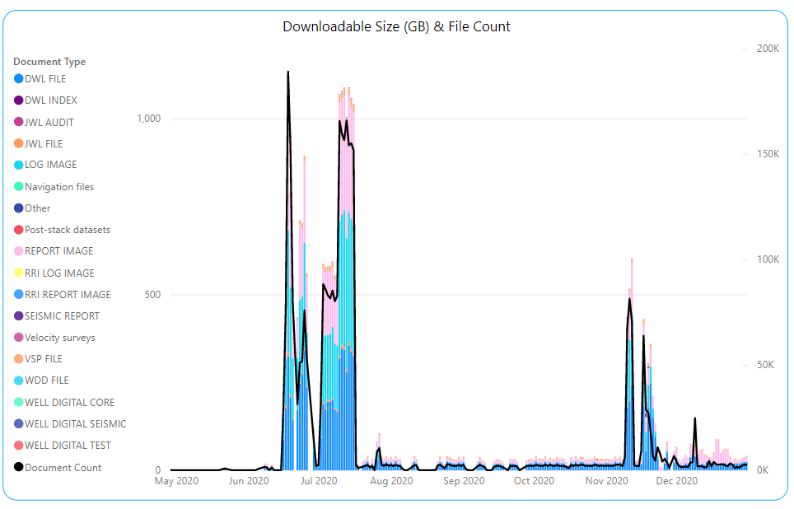
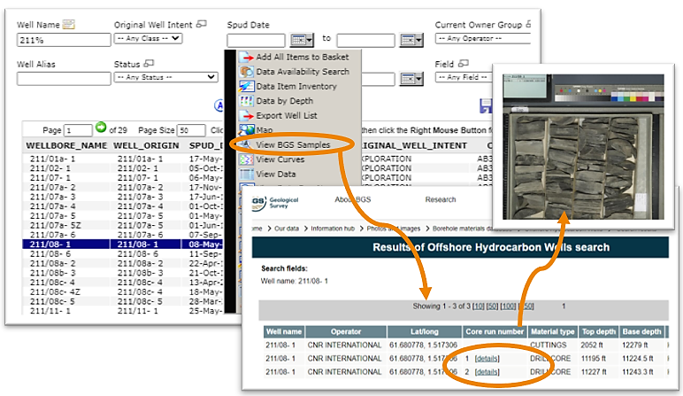
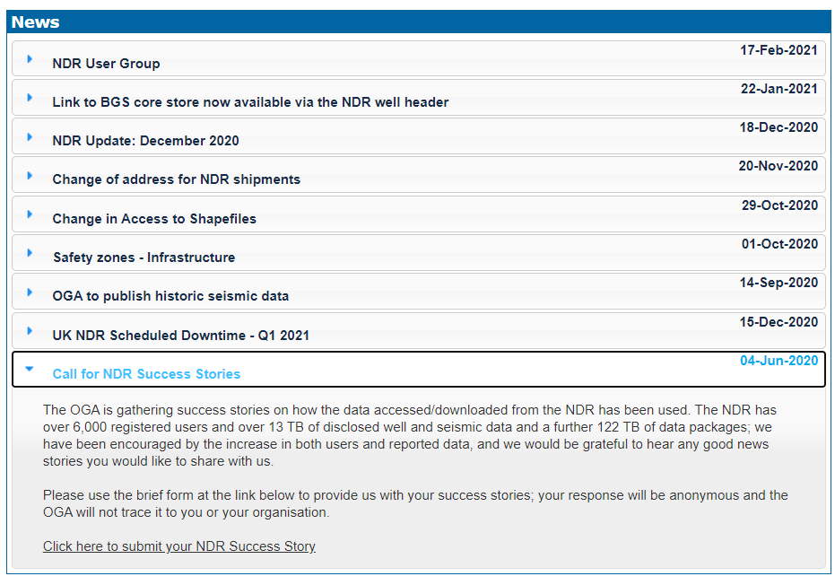
Recent Service Improvements
Whilst we transition towards a new NDR service we have continued to invest in the current system with the addition of an SFTP service, API and links to BGS samples index.

Slide 12
Agenda: NDR User Group 1
OGA Digital Energy Platform (AT)
Governance and Terms of Reference (AT)
Recent Service Improvements (MP)
Transition Project (AT)
What to expect (JN)
Preparation for Transition (AT)
Next steps (AT)

Slide 13
Transition Project
Suspension of survey loading
requiring tape transcription
or payment by invoice
Orders on Media
payment by invoice
Suspension of loading
Credit card payment
Orders on Media
Paid by credit card
OGA NDR MS Azure Subscription commissioned
“Soft Freeze”
of changes to transferred data
“Hard Freeze”
of addition and changes to all data
NDR 2 launch
“Regulatory” functionality available to entitled
users in new system
User
Group
Nov
Dec
Jan
Feb
Mar
Apr
May
Jun
Jul
Aug
Sep
NDR 2
Contract Signed
CDA Data Transfer Plan
Bulk Transfer
of NDR data & metadata starts
~26 TB
Delta Transfer of data & metadata
NDR 1
Service ceases
Permanent removal of data from NDR 1
Transfer of Data
on physical media
Ingress of ~100 TB OGA Gov. Funded Seismic

Slide 14
Agenda: NDR User Group 1
OGA Digital Energy Platform (AT)
Governance and Terms of Reference (AT)
Recent Service Improvements (MP)
Transition Project (AT)
What to expect (JN)
Preparation for Transition (AT)
Next steps (AT)

Slide 15
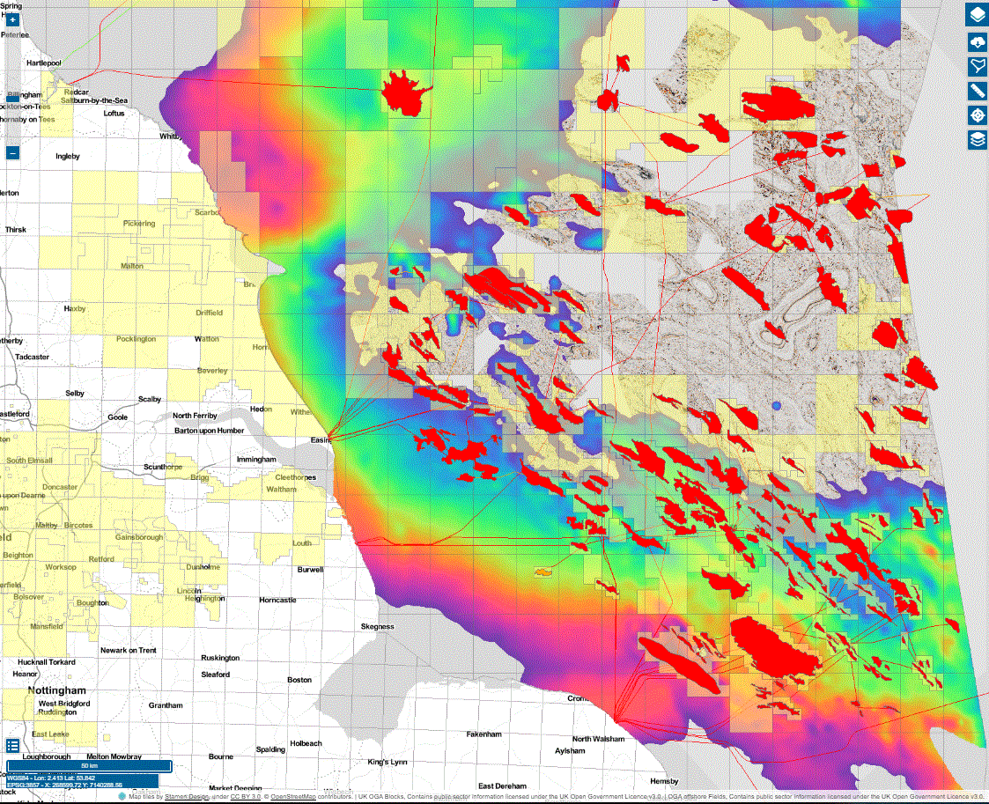
New NDR Platform - What to expect
Removal and reduction of barriers to data reporting
Visualisation of both well and seismic disclosed data
Tightly integrated with Digital Energy Platform systems
WONS, PEARS, Geospatial services, etc.
Azure cloud-based storage - future integrations possible
Minimise data movement
Maximise data access
Evolution not revolution
Don't throw away value invested in current NDR
Build a platform that has greater potential

Slide 16
The current NDR system...
“As Is” NDR
Data Storage
IT Hardware
Seismic information
Spatial information
Well information
User management
Self-service option
Data loading

Slide 17
What will be changing...
“As Is” NDR
“To Be” NDR
Data Storage
IT Hardware
Seismic information
Spatial information
Well information
User management
Self-service
Not available
Visualisation
Self-service option
Data loading
Self-service

Slide 18
How does it integrate...
“As Is” NDR
“To Be” NDR
Data Storage
IT Hardware
Seismic information
Spatial information
Well information
User management
Self-service
Not available
Visualisation
Well
Seismic
Self-service option
Data loading
Self-service
QC and Conditioning

Slide 19
What is changing with data delivery...
“As Is” NDR
Not available
Visualisation
Self-service option
Data delivery
< 20GB Download limit
Physical media delivery

Slide 20
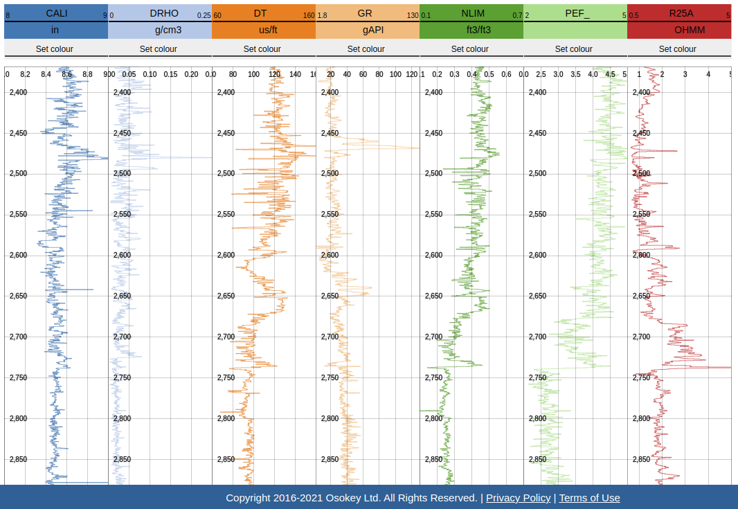
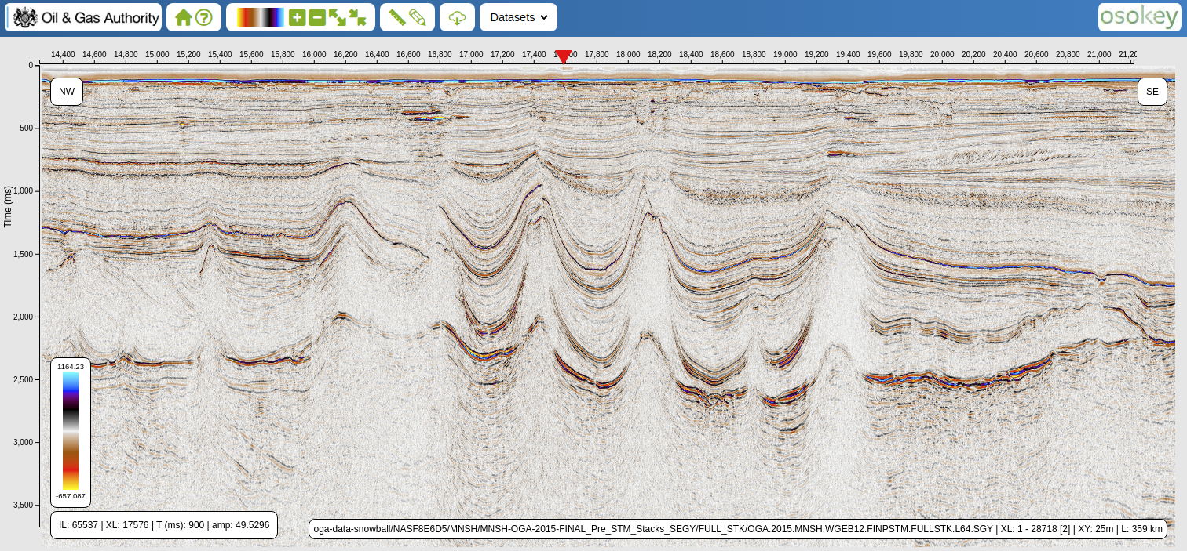
What is changing with data delivery...
“As Is” NDR
“To Be” NDR
Not available
Visualisation
Well
Seismic
Reports
Well
Seismic
Self-service option
Data delivery
Self-service option
Default
< 20GB Download limit
>>> 20GB Download limit
Physical media delivery
Physical media delivery
Digital Energy Platform

Slide 21
New NDR Platform – new ways of working
Online seismic reporting – No additional charge
Quality filters on submission
No duplicate entries
Filtered classification options
Broadening of compliant legacy data types
Integration with the OGA Digital Energy Platform
Visualisation of data is free
Generous download limit >>> 20Gb
FAQs
What's happening with current NDR spatial feeds? These will be replaced with OGA DEP hosted REST APIs.
Where will I send physical media shipments to? If you are unable to upload online, data can be uploaded by Moveout for a fee
Can I report data as soon as the new system is live? Yes, reporting will be actively encouraged; how can we help you?

Slide 22
Agenda: NDR User Group 1
OGA Digital Energy Platform (AT)
Governance and Terms of Reference (AT)
Recent Service Improvements (MP)
Transition Project (AT)
What to expect (JN)
Preparation for Transition (AT)
Next steps (AT)

Slide 23
Transition: Timeline and events
Soft Freeze
Hard Freeze
Who?
Components
Specifics
What changes?
Mid March
Mid April
Mid May
End May
Mid June
End June
Self Service
Wells, Surveys, etc.*
Surveys
Well data files, all documents, all metadata
New Survey Data Loading Requests
Update/Deletion
Payment by invoice
CDA
Tape Transcription
Any activity requiring transcription
Orders and Loading
CDA
Surveys
New Survey Data Loading Requests
Payment by Card
Self Service
All data types
Data files, all documents, all metadata
Entitlements
Inventory settings
Missing Data Request
Online loading
Create, Update and Delete
Helpdesk
All data types
Ownership Change Requests
Completion of approved changes to headers
Create/Update online
Surveys
Headers via OPRED Survey Closeout Form
Create
CDA
Orders on Media
Large volume i.e. Field/Pre-stack; NAS drive
Payment by Card
CDA
Orders on Media
All file types and sizes
Payment by Card
Self Service
User Accounts
Roles, permissions etc.
Create/Update online
Automated
Headers etc.
Wells, Licences, Fields, other auto services

Slide 24
Preparation for migration
Disclosure statuses
OGA Well Header
Duplicates and Formatting
DEP SoR
NDR 2
WONS
NDR 1
Surveys: Review of disclosure dates for PA1998 and EA2016 seismic (Prod Licences)
Wellbores: Review of items listed as “non-disclosable”
Augment with remaining NDR values
Current Owner values into SoR
Not replicated to NDR 2 – referenced
Changes with OGA oversight
Available from DEP Data Centre
Managing Data Quality
Duplication – up to 5% of files
Formatting – non-compliant formats are not ready to reuse
Communicating interventions and issues to data owners

Slide 25
Preparation for migration: Users
User Accounts
Spatial Data
Business as Usual
INACTIVE
INACTIVE
New system – new user accounts
Self-service user account creation on initial login
Administrator accounts to be set up for Licensees. Admin can create or users can via self-service
Web enabled downloads will change
Spatial data sets scaled back Q4 ‘20
Access to metadata - OGA SoR
Available from DEP Data Centre
Continue to:
Load new and legacy data until the Hard Freeze in Mid-May
Search and download data until end of current service at end of June
Note any changes to metadata
Direct your questions and requirements to ndr@ogauthority.co.uk

Slide 26
Agenda: NDR User Group 1
OGA Digital Energy Platform (AT)
Governance and Terms of Reference (AT)
Recent Service Improvements (MP)
Transition Project (AT)
What to expect (JN)
Preparation for Transition (AT)
Next steps (AT)

Slide 27
What happens next?
User Group:
Subscribe to our User Group mailing list
DEP AC 15th March
Summary of feedback to this meeting
Outcome communicated to User Group subscribers
Task/Finish Group Suggestions to ndr@ogauthority.co.uk
Project Updates:
NDR News – OGA website
https://www.ogauthority.co.uk/data-centre/national-data-repository-ndr/
Application components UAT – onboarding/training

Slide 28
Thank you

