Slide 1
UK National Data Repository
User Group Meeting No. 5
31st May 2022

Slide 2
Meeting etiquette & structure
Please turn your cameras off and remain muted.
The meeting will be recorded. The presentation materials will be made available.
Please use the meeting chat to post your questions throughout the meeting.
There will be three sections to the meeting.
Questions raised in Chat will be addressed at the end of each section, time permitting.
There are several topics today – we need to keep to time to cover all topics.
There may be time for discussion towards the end of the meeting.

Slide 3
Agenda
Introduction and general topics (14:30)
Version and documentation updates
Data availability updates
Missing Data Requests and User Roles
Task Finish Groups & Projects (14:50)
Project update - Moveout: Seismic field data - offline archive to NDR cloud
TFG003 - Web service access to NDR data/metadata
TFG004 - Entitlement to Protected Information
TFG005 - UI/UX Review
Next steps – 3 month outlook (15:45)
Development planning and delivery
Licensing Rounds

Slide 4
Version and documentation updates
Version deployed mid May v20220518_09 – notice to User Group and ISCs
1st since end of March
Reinstates ability for authorised users to edit metadata for TIFF and LIS files
Neither format is compliant with current requirements for file formatting. However both were compliant in the past.
Legacy data that has been reported needs to be maintained – updates to C Tags, Descriptions etc.
Documentation:
Revision to PON9 published earlier in May https://www.nstauthority.co.uk/media/8155/nsta_pon-9-final.pdf
No recent changes to the “Form & Manner for NDR” document – December 2021 version remains valid

Slide 5
Data availability updates
Wellbore information:
Increase ~ 100 GB from January to beginning of May
Includes ‘protected information’ – recently completed wells
Approximately 98% of UKCS wells are released
Data for 55 EA2016 wells disclosed by the NSTA so far in 2022
Field seismic information:
NSTA & Moveout collaboration – update to follow
User led self-service reporting – esp. site surveys
Processed seismic information:
Government funded repro seismic (2016) – previously only available to order on media ~2.8 TB
User led self-service reporting
Legacy/pre-2018 data – including responses to Data Requests
Routine reporting of recent ‘post-2017’ data – proactive fulfilment of regulatory reporting obligations
Seismic survey metadata updates – Revised 1,340 dates, 131 statuses; >4,600 migrated files accessible

Slide 6
‘Missing’ Data Requests & User Roles
Company Data Manager role:
intended for those users who are managing data.
Uploading data
Editing metadata for Company data
Having the role will means receiving system notifications that are pertinent to the role
Functionality | Public User | Company User | Company DM | Company Admin
Sign in | x | x
Request Download Access | x
List Released Files | x | x
List Own Company Files |  | x
Download Data |  | x
Submit MDRs, Edit Requests | x | x
Upload data to NDR |  |  | x
Edit Metadata |  |  | x
Add User to Own Company |  |  |  | x
List Own Company Users |  |  |  | x
Upgraded process deployed in Q1 2022
>300 closed out to date – process has improved NSTA handling, we will continue to develop
Request approvals – Provide information to support your request
– Be proportionate; articulate your requirements
– Commercial seismic requests – alternative process for pre-2018

Slide 7
Q&A General Topics

Slide 8
Task Finish Groups and Projects

Slide 9
Physical media to the NDR

Slide 10
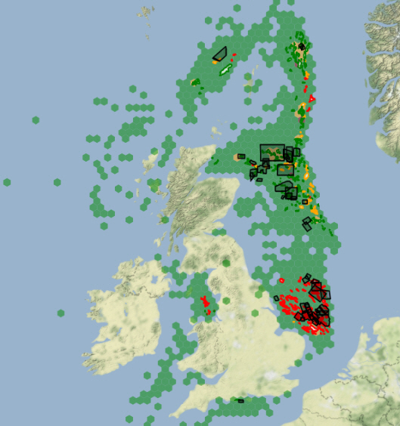
3D Field Data loaded to NDR
48 x 3D surveys nav-merged & uploaded to the NDR
~ 86 TB of data volume
7,520,637 SEG-D files >> 7,454 SEG-Y files
Accompanying Nav-Merge reports for all surveys

Slide 11
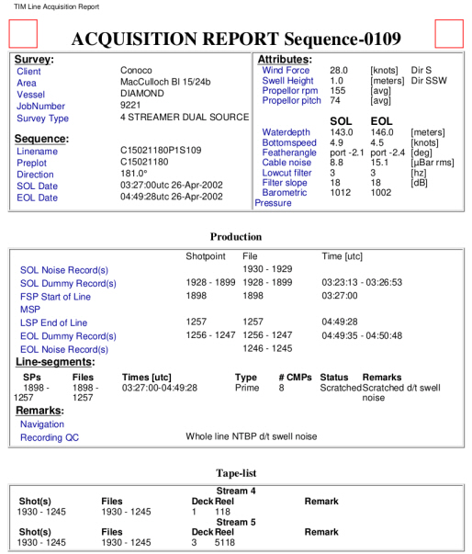
The Process...
Tape to Disk
Sort SEG-D files into line name directories
Split P1/90 data into individual line files
Merge and output single SEG-Y file per acquisition sequence
Three parts to this process - reports (observers logs, acquisition report), seg-d seismic & P1/90 nav
Nav file is matched with field data using SP/FFID number
If SP not available, we can use recording time and/or a lookup table to pair datasets.
Receiver number within a spread - older surveys follow 2D convention where channel numbers are streamer based
Output from this process are shot ordered navigation merged data gathers

Slide 12
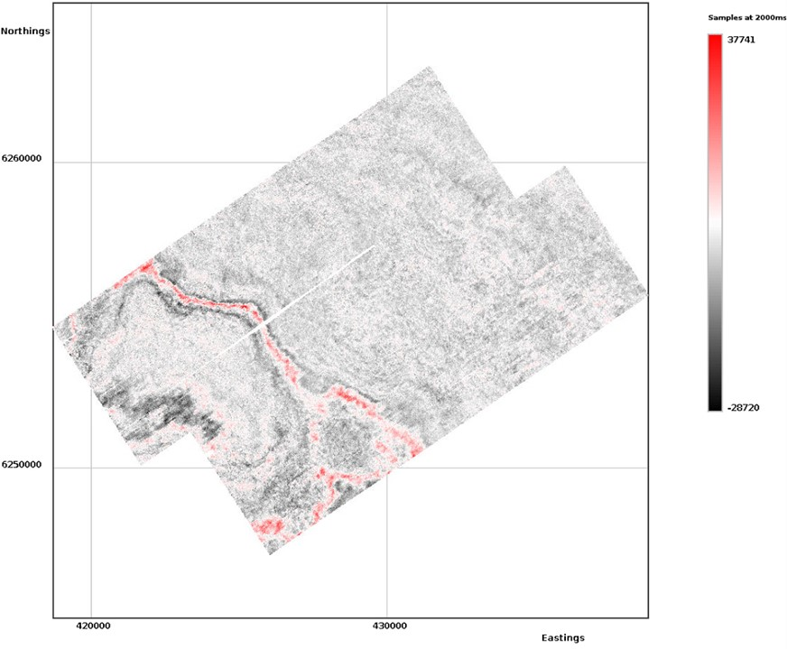
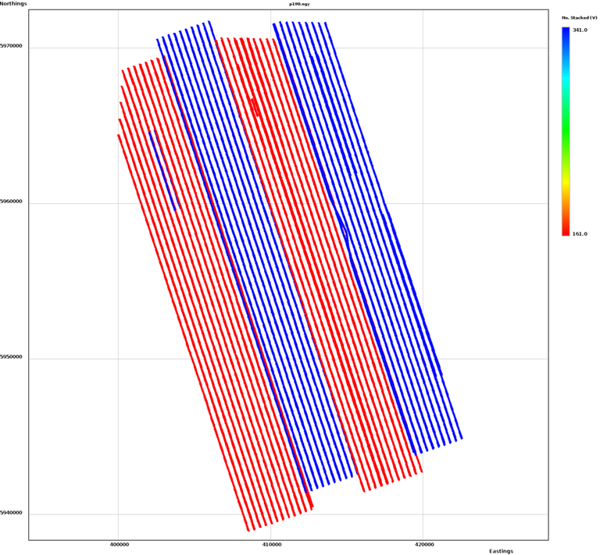
Quality Checks...
The following QC steps are taken for each merge :-
SEG-D – data sorted into line name subdirectories
NAV – P1/90 files split into individual line files
SEG-Y – output one SEG-Y file per line sequence
SEGYQC – files of near offset traces, one per seq
LOG – log files of the navigation merge
LMO – screen grabs of the navigation QC
FINAL QC REPORT –
Timeslice display
Sail line direction display

Slide 13
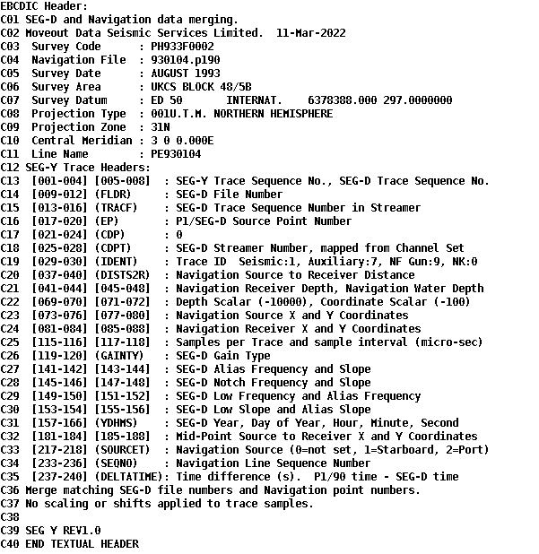
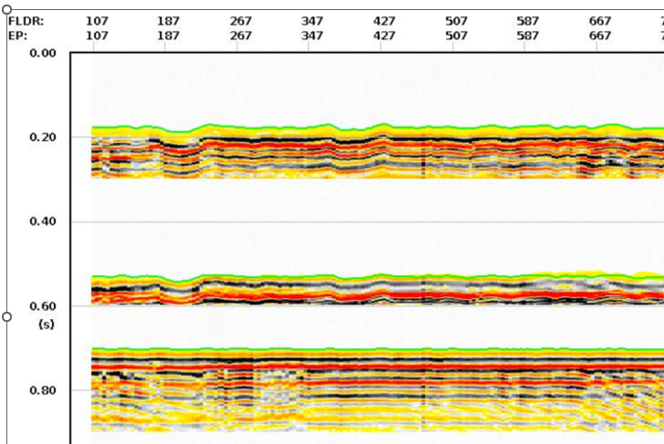
Examples of quality control artefacts
EBCDIC header display
LMO QC displays
QC spreadsheet comparison tables

Slide 14
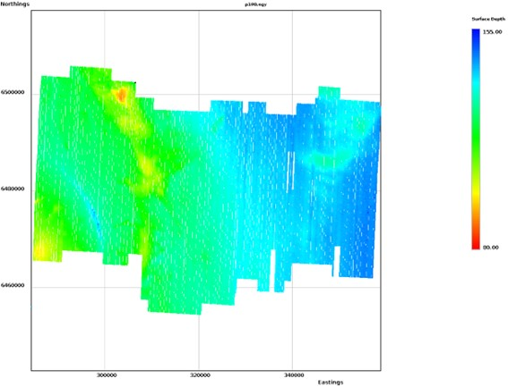
Issues encountered...
Missing observers logs, navigation data, seg-d field data
Navigation data in a proprietary contractor format
TAR zip archive files over written with incorrect files
Wrong tapes supplied – incorrectly listed in spreadsheet
Data supplied as ‘TAP’ format files
Raw navigation data only – not processed
Water depth display (from P1/90)

Slide 15
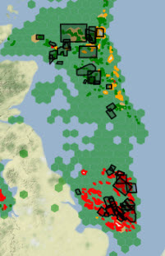
Support...
Please use the Support Desk and access Moveout’s expertise.
For assistance with any physical media data upload to NDR -
Nav-merge, data reformat, standardisation and conditioning
Navigation processing / reprocessing / transformation
https://support.uk-ndr.co.uk

Slide 16
TFG003 - Webservice Access (API)
Initiated with an online meeting in March – outline requirements:
Preference to start with fundamentals and build out
Some interest in developing upload via API – honouring validation rules
Interest in enabling download of recently available wellbore data
Development services include:
Metadata for ‘Completeness’ (Seismic, Well, Site Surveys)
Project and File metadata for the entire NDR data collection
SharePoint lists - Generic output to allow user defined incorporation
NSTA Compliance Team and 3 licensees initially registered:
Confirmed access – positive feedback, but limited
Wider involvement of licensees invited
8 companies now participating – encouraging collaborative feedback

Slide 17
TFG004 – Entitlements (Protected Information)
Initiated with an online meeting in March
Limited attendance – just one user from a reporting company
Good conversation – but development requirements not full established
Action: Survey to licensees to encourage wider response
Initial response from 10 contacts
Reminder led to a further 3 responses
Outcome: Clear interest from some to reinstate, but no coherent statement of requirements
Articulates efficiency gains from a DM perspective
Less so Legal and commercial perspectives
Confusion with other processes – disclosure, data requests, asset transfer etc.
Reference to terms and conditions that are no longer in place
To be reviewed with NSTA management to consider options

Slide 18
TFG005 - UI / UX Review i
User Interface and User Experience review (UI/UX) initiated in March
Fivium Digital – NSTA Service Partner
Energy Portal and broader UK public sector experience
Independent and objective
130 responses to the online survey
15 one-to-one interviews with a range of user profiles (Licensee, Consultant, Academic, Public, NSTA)
Emerging themes:
Presentation and Layout
User awareness of existing functionality
Search and Find
Download
Workflow optimisation
Upload and Data Management
Compliance
Accessibility

Slide 19
TFG005 - UI / UX Review ii
Examples of feedback contributing to themes:
Presentation and Layout
Reconsider the use of abbreviations / other unfamiliar terms / Project IDs
Disable or ‘fade’ interactive buttons when not in use – as with “View Files”
‘Sticky headers’ for scrolling views
Search and Find
Project table: swap out low priority attributes, e.g. Spud date in place of Release Round
Map – consider alternatives to existing spatial searches, pre-set and user defined
Curve metadata made available to search
Accessibility
Consider alternate ways to present of colour coded information

Slide 20
TFG005 - UI / UX Review iii
Examples of feedback contributing to themes:
User Awareness & Information
Conducting spatially constrained searches on the NDR map
Effective use of filters and summary C-Tags as search criteria
Adding external web map services to the map
Submitted data - confirmation of upload
Display recently disclosed wellbores (and forthcoming)
Download
Consider extending the Direct Download function
Streamline the Session Basket to Download process
Structure of downloads – can this be simplified

Slide 21
TFG005 - UI / UX Review iv
Examples of feedback contributing to themes:
Workflow
Requests to enable bulk upload and editing of file metadata such as C Tags
Interactivity between the tables and map
Populate files table from well summary menu on the map
Free text search capability (dependency on metadata and classification)
Upload and Data Management
Review available attributes for e.g. log files (depths, dates, units)
Review of mandatory attributes - Description
User workflows for management of ‘one to many’ relationships between a file and two or more wells
Review of constraints to uploading and managing non-compliant file formats

Slide 22
TFG005 - UI / UX Review v
Examples of feedback contributing to themes:
Compliance
Completeness reports – optimise for users
Data requests – communications (requestor and reporter), (NDR to requestor).
Development Plan
Prioritisation - impact, risk of not acting, complexity, costs, benefits, “Strategy” etc.
Dev options - NSTA and Osokey to determine how to address
Governance - projects under NSTA PMO
Schedule - realistic timeline for delivery over coming months, dependencies and other work
Initiate - Small, Medium and Large projects

Slide 23
Q&A TFG and Projects

Slide 24
Next steps

Slide 25
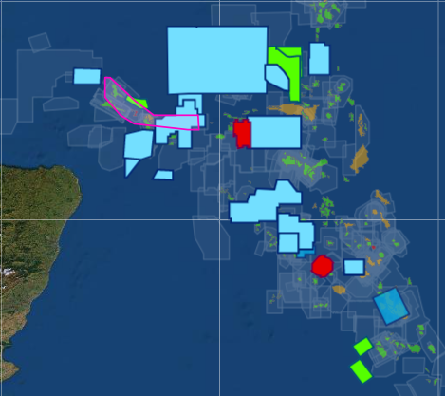
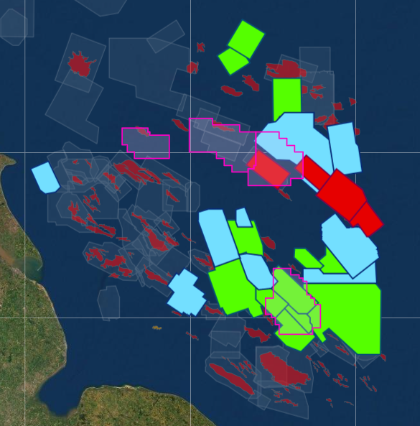
Next steps – 3 month outlook
Development planning
Prioritisation and governance
Technical solution options
Quick wins and more complex developments
NSTA strategic projects
Machine assisted classification of data
Licensing Rounds
Carbon Storage – June 2022
Well Abandonment & Nav-merged seismic
Offshore Petroleum – Autumn 2022
Discussion - requirements and expectations

Slide 26
Q&A Next Steps

Slide 27
Dates For Your Diary
NDR UG Meeting
September 2022 | Tuesday 6th September*– NDR User Group Meeting 6 Note: Scheduled to occur after summer 2022 to allow more attendees.
November 2022 | Tuesday 29th November* – NDR User Group Meeting 7
*Provisional date

Slide 28
Thank You

