Slide 1
Measurement, Monitoring and Verification (MMV) of Carbon Capture Storage (CCS) Projects with Co-Location considerations
TECHNICAL REPORT
A technical study on the Monitoring, Measurement and Verification (MMV) Activities with reference to the co-existence of Offshore Carbon Capture Storage Wind and Oil/Gas Projects
July 2022

Slide 2
Contents
Executive Summary
Project Scope
Background & Acknowledgements
Operational Scenarios & Monitoring Objectives
Seismic Surveys & Monitoring
Seismic Surveys Around Windfarms
Other Active Seismic Options
Wider Range of Monitoring Technology
Conclusions & Next Steps
References
11. Appendix - Acronyms

Slide 3
1. Executive Summary

Slide 4




Executive Summary
This document represents an internal NSTA technical study into the role of MMV for CCS sites, with a particular emphasis on those sites with restricted access owing to co-location with other seabed infrastructure users (e.g. windfarms). It is intended to provide both high level industry guidance and detailed examples of the type of technology to be considered around a CCS site
There are no one-size-fits all solutions. Monitoring, Measurement and Verification (MMV) activities must be tailored to clearly identified Carbon Storage site risks and uncertainties, taking into account store type, geometric arrangements/scenarios, injection strategies, met-ocean/seabed conditions, etc.
Seismic is the key geophysical monitoring technology providing best resolution. Surveying activities for carbon storage sites in and around offshore windfarms can be extremely challenging, and unacceptable collision risk if deploying long towed seismic streamers (receivers). There are some potential mitigating seismic solutions (e.g. Ocean Bottom Nodes OBN) although with higher cost and more limited coverage.
MMV strategies and tools for carbon storage sites need to address conformance irregularities and containment breaches using a risk-based approach. A robust suite of surface, marine and downhole tools/methods needs to be tested and deployed to support these strategies, including through trials.
First-of-a-kind (FOAK) projects may be expected to be potentially over-engineered, particularly as MMV methods are tested and certified, and maintaining public confidence is crucial. Each project requires a robust environmental baseline.
Periodic access to Carbon Storage infrastructure within Offshore Windfarms is a more significant obstacle. The siting of platforms and wells with their associated access requirements for routine and emergency operations requires sufficient stand-off. Consequently, largely overlapping carbon storage sites and wind farms are presently considered not to be feasible with current technology.
Co-existence of carbon storage and offshore windfarms requires active collaboration, and could be enabled through early establishment of cross-disciplinary teams of specialists to optimise co-location/ seabed access design on a project-by-project basis.

Slide 5
2. Project Scope

Slide 6
Project scope
The primary objective of this project was to identify and scope specific issues associated with offshore geological/geophysical surveying and monitoring activity.
Technical Study Aims
Provide a general view of MMV activities for carbon storage sites in proximity to offshore wind farms. It is not specific to any particular carbon storage site, Offshore Windfarm, or Oil/Gas project, however, individual project developers have contributed key learnings and insights from existing and planned projects.
Build on work undertaken by the OGA/NSTA-led Energy Integration Project and with The Crown Estate’s ‘Project Vulcan’, covering generic CCS vs Offshore Wind engineering interactions.
While this project identified potential solutions, the intent was to identify further studies that could provide more detailed recommendations or actionable results in support of industry and regulatory activities.
Report Method
This report is largely based upon insights gleaned and distilled from ~ 30 meetings with a selection of over 20 relevant and interested parties in early 2021
Parties ranged over oil and gas operators and others with CCS licences/leases (or an intent to enter this market), seismic/geophysical contactors, site survey contractors, academia, other regulators/government bodies, geophysical service analysis providers, wind farm operators, suppliers of novel geophysical acquisition and processing techniques.
Whilst not every possible interested party was consulted, it is believed that a fair cross-section of views was likely sampled.
This MMV report was revised, prior to public release, after a subsequent 2022 project considering OBN technology.
(Reference 1)
This document is for illustrative purposes only. The NSTA makes no representations or warranties, express or implied, regarding the quality, completeness or accuracy of the information contained herein. All and any such responsibility and liability is expressly disclaimed. The NSTA does not provide endorsements or investment recommendations.

Slide 7
3. Background & Acknowledgements

Slide 8
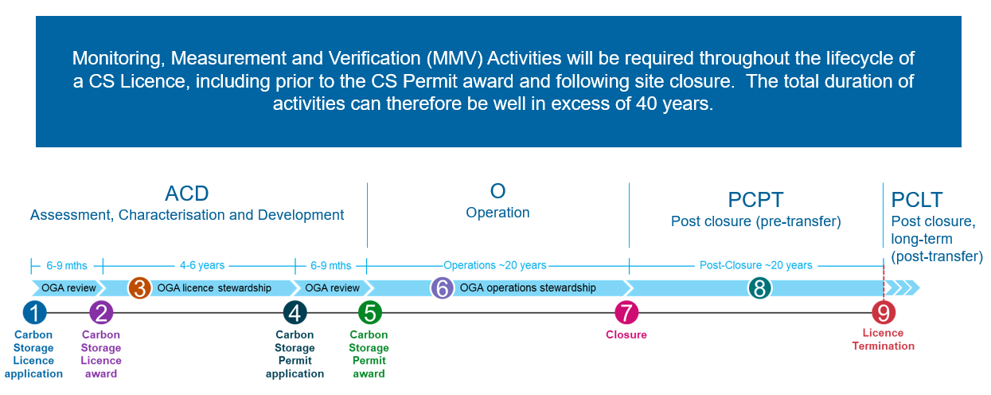
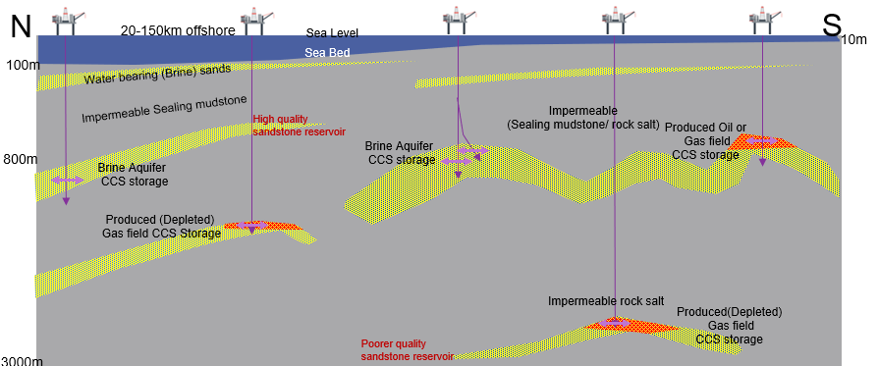
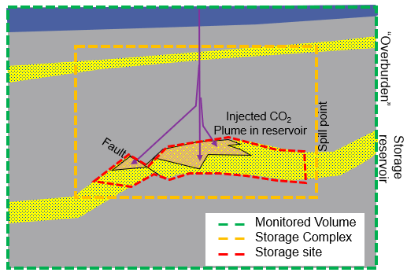
Background: CO₂ storage
The UKCS is a critical energy and carbon storage resource, with oil and gas exploration and production, offshore wind generation, and significant potential for carbon storage and energy hubs integrating these activities. With government’s ambitious net zero targets, the demands on the seabed are expected to increase – while there are huge opportunities for energy transition, there will also be challenges around the spatial and temporal coordination through the project lifecycles.
Offshore subsurface carbon storage sites cover a significant area of seabed, that will require ongoing surveying and monitoring. Before the NSTA can award a Carbon Storage (CS) permit, a licence holder needs to complete a full geological characterisation of the storage site and provide an MMV monitoring plan to understand and verify if the distribution of injected CO₂ within the reservoir rocks matches modelled predictions, and identify any potential risks which may lead to leakage from the wider storage complex.
Collectively, the operational Monitoring, Measurement and Verification (MMV) plan is used to demonstrate that the storage site performance and the wider storage complex complies with regulations. This means monitoring for the duration of the site operation (~ 25 years), and to ensure environmentally safe storage of the carbon dioxide a further ~20 years post-injection.
Schematics showing
Range of UKCS storage sites
& more detailed CO2 injection site
configuration

Slide 9





Potential Risks which can be monitored by seismic
The MMV plan establishes the pre-injection baseline data acquisition, and describes periodic monitoring required during the injection phase.
This is undertaken with a spectrum of MMV technologies, but most likely a combination of “remote sensing” geophysical data acquisition and physical/chemical measurements and sampling. These data are used to assess and verify conformance with reservoir fluid distribution computer models; early identification of any unexpected behaviour of CO₂ allows corrective measures for storage risks within and around the complex to be implemented. The OGA/NSTA-sponsored report led by Quintessa indicates the range of potential risks that may require monitoring throughout the lifecycle of a Carbon Storage project.
(Reference 2)
3.5 Monitoring inhibited by unexpected plume migration
Seabed
Well Heads
(CCS or Oil/Gas)
5.6 Migration thru intact seal
By capillary entry pressure exceeded or
5.7 diffusive leakage
Wellbore
5.2 Up dip & 5.3 lateral movement of CO2 out of storage reservoir (leakage)
2.2 Injected CO²
Merges with plume from
Nearby CCS project
Wellbore
5.1 Leakage out of storage complex though primary and secondary seals by faults /factures
>800m below seabed
Fault
Carbon
Storage Site
Induced seismicity in 4.4 near wellbore or 4.5
In storage complex
2.5 Induced seismicity due to nearby operation
6.4 reservoir pressurisation due to unexpected compartmentalisation
Existing oilfield
6.3 unexpected plume migration
3.4 Accidental over-filling
2.3 Resource exploitation elsewhere
disturbs CO²
Not to scale
1.1 Natural seismicity
>4000m below seabed
The area of the carbon storage complex will require careful consideration of any co-location interfaces and impacts with other users of the sea-bed, such as offshore wind farms, to avoid undue interference with other surrounding users.

Slide 10























Acknowledgements
Engagements with the following companies and organisations helped to inform the content of this report, and the NSTA gratefully acknowledges all consultees for the time, effort, and insights freely and openly given. However the final content and conclusions are those of the NSTA.
This document is for illustrative purposes only. The NSTA makes no representations or warranties, express or implied, regarding the quality, completeness or accuracy of the information contained herein. All and any such responsibility and liability is expressly disclaimed. The NSTA does not provide endorsements or investment recommendations.

Slide 11
4. Operational Scenarios & Monitoring Objectives

Slide 12


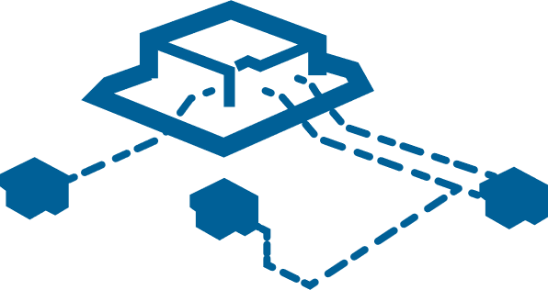
Operational Scenarios
Aviation
Fixed Installation
(CCS or Oil/Gas)
Windfarms
(Fixed/Floating)
Temporary Installation
(CCS or Oil/Gas)
Support
Vessels
Seismic Vessels
(with streamers)
Seabed
Subsea Infrastructure
(CCS or Oil/Gas)
Ocean Bottom Nodes/Cables
(CCS or Oil/Gas)
Well Heads
(CCS or Oil/Gas)
>800m below seabed
Carbon Storage Site
>4000m below seabed
Not to scale
There is no one-size-fits all MMV solution. Monitoring every offshore co-location scenario have different critical risks to be managed and different geometric arrangements including subsurface constraints (reservoir type, extent and depth, fluids displaced), installation designs (new and existing well stock), marine (incl. fishing) and aviation traffic, met-ocean/seabed conditions, etc.

Slide 13
Operational Scenarios - Infrastructure
Fixed Installation
(CCS or Oil/Gas)
Windfarms
(Fixed/Floating)
Temporary Installation
(CCS or Oil/Gas)
Support
Vessels
Seabed
Subsea Infrastructure
(CCS or Oil/Gas)
Well Heads
(CCS or Oil/Gas)
Not to scale
Marine CCS or Oil/Gas infrastructure types are broadly similar, with their location predominantly determined by the location of the subsurface fields or stores (immovable).
Offshore windfarms can be fixed or floating depending on the water depths, and the locations are predominantly determined by wind conditions and environmental constraints. Current turbine spacings areup to ~1km, and arrays can spread over large areas. They are generally on a regular grid, but additional turbines can be located around the edge to maximise yield.
All operation types require vessel and aviation support/supplies.
CCS or Oil/Gas operations require the drilling of wells, initially with temporary installations, but with fixed surface installation or subsurface equipment during injection/production.
Wells require a clear zone around them for maintenance and emergency operations, including the drilling of relief wells and final abandonment.

Slide 14
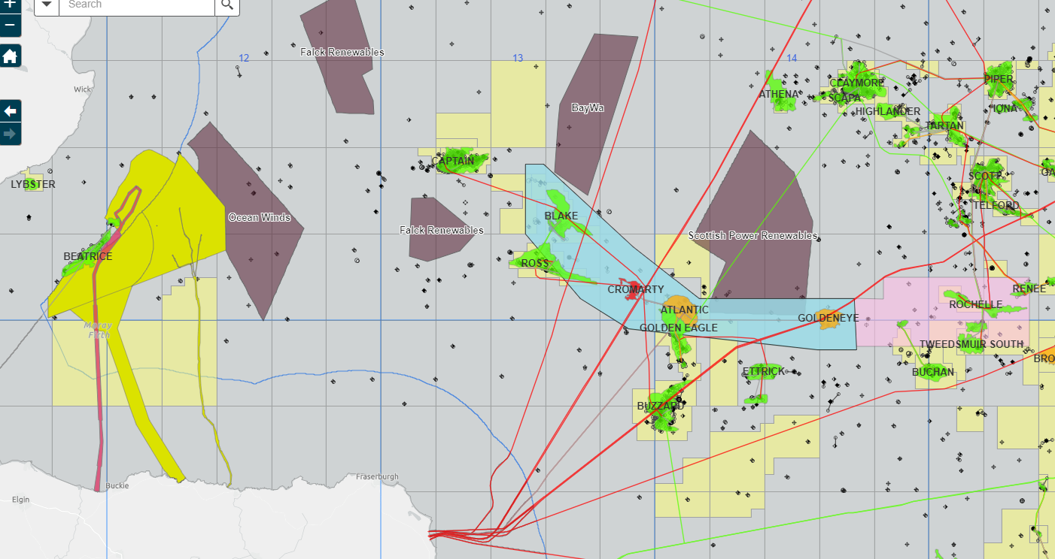
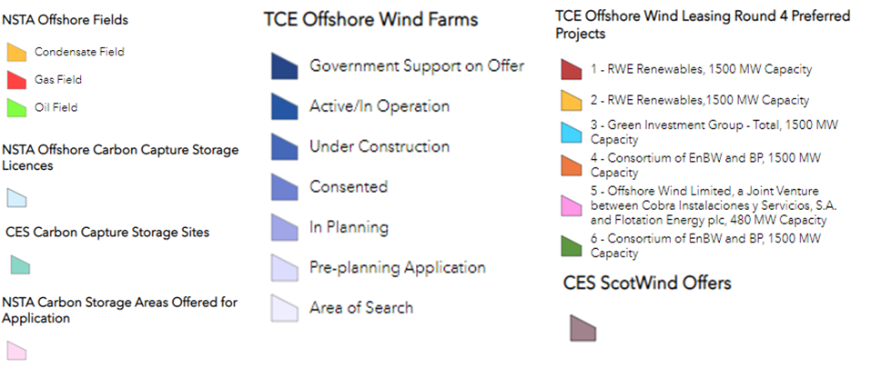
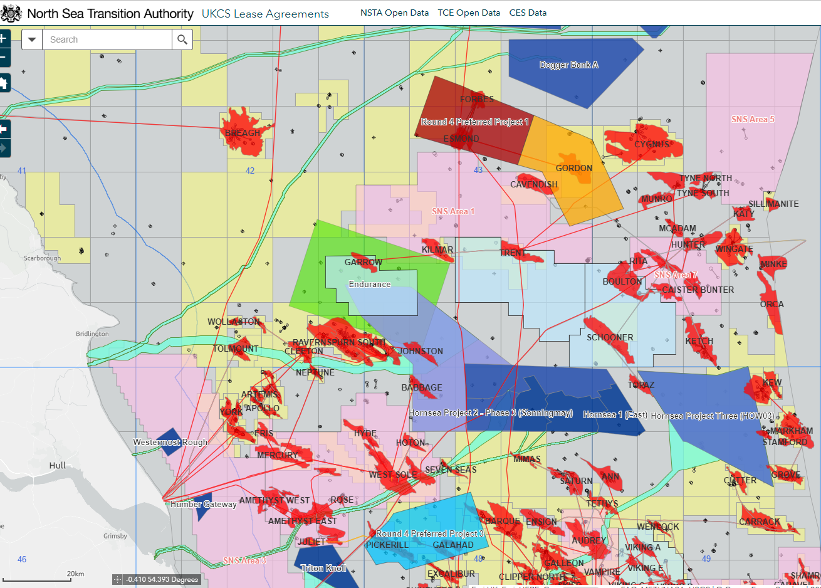
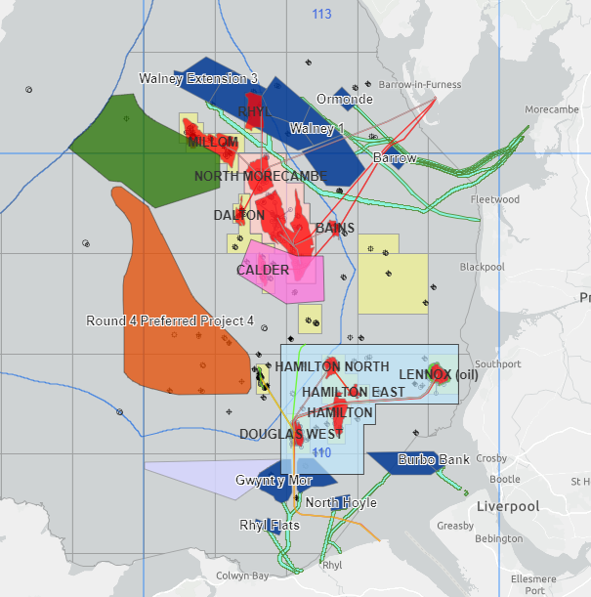
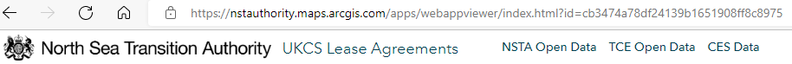
UK Offshore Current Co-location areas
NE Scotland/ Moray Firth
Acorn CCS
Moray Firth
Depleted gas field
Southern North Sea
East Irish Sea
Endurance.
Triassic aquifer
BP/Equinor 2022
licence.
Hynet CCS.
Liverpool Bay
Depleted gas fields
“V” fields SNS
Depleted gas fields

Slide 15
Operational Scenarios - Aviation
Aviation
Fixed Installation
(CCS or Oil/Gas)
Windfarms
(Fixed/Floating)
The details of aviation constraints were beyond the scope of this study. This requires further engagement with the CAA.
CAA Policy and Guidelines on Wind Turbines
(CAA 764)
Consultation zones around offshore helidecks
3.30. For many years, the CAA has emphasised the importance of operators and developers taking into consideration all existing and planned obstacles around offshore helicopter destinations that might impact on the safe operation of associated helicopter low visibility approaches in poor weather conditions. In order to help achieve a safe operating environment, a consultation zone of 9 NM radius exists around offshore helicopter destinations. This consultation zone is not a prohibition on development within a 9 NM radius of offshore operations, but a trigger for consultation with offshore helicopter operators, the operators of existing installations and exploration and development locations to determine a solution that maintains safe offshore helicopter operations alongside the proposed development. This consultation is essential in respect of established developments. However, wind energy lease holders, oil and gas developers, and petroleum licence holders are advised to discuss their development plans with each other to minimise the risks of unanticipated conflict at a later date.
Topics for discussion within any such consultation should include, but are not limited to:
1. Prevailing weather conditions, including predominant wind direction;
2. Manning status of the installation;
3. Frequency of flights to the installation and predominant routes;
4. Performance limitations of offshore helicopter types utilising the helideck;
5. Established helicopter instrument and low visibility approach procedures;
6. Mandated constraints on approaches to helidecks on installations;
7. Long term access to well and subsea infrastructure;
8. Concurrent wind farm operations and oil and gas operations to well and subsea infrastructure;
9. SAR operations to the installation in the event of an emergency;
10. Location and height of potential obstacles including proposed wind turbines
References (4& 5)

Slide 16
5. Seismic Surveys and Monitoring

Slide 17
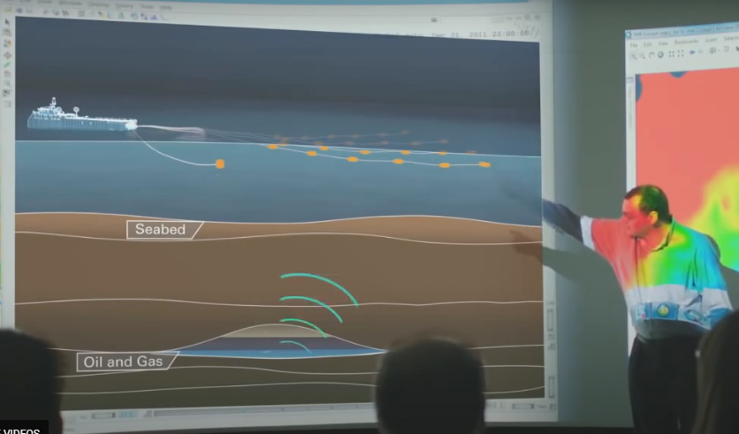
Operational Scenarios – Seismic Surveys
Seismic surveys remain the primary geophysical tool of choice for imaging the subsurface.
  Essential for mapping the geometry and extent of storage sites and complexes which underpins dynamic fluid prediction models.
  A high-quality baseline survey is expected for all CO₂ Storage Sites, since this data will be used for decades beyond post-closure Seismic Acquisition parameters will depend on the subsurface scenarios that need to be addressed
  Reprocessed old surveys (>~15 years) are unlikely to adequately address risks.
  Streamer surveys are lower cost, but use of long streamers are impossible close to & within dense turbine infrastructure
  Ocean Bottom receivers (nodes) surveys are available at a much higher cost. They can be deployed within infrastructure, if seabed conditions are conducive. A high specification/more manoeuvrable (dynamically positioned) seismic source boat is still required.
In some situations, seismic may also be able to directly image fluids (inc. CO₂ )
  Time lapse monitoring its movement in the subsurface (a.k.a. 4D seismic)
Towing large array of equipment severely restricts vessel manoeuvrability and poses unacceptable collision risk
Windfarms
(Fixed/Floating)
Seismic Vessels
(with streamers)
Seismic source
towed 100m behind boat
Wide (<1km) array of long (<6km) receiver cables
Seabed
Ocean Bottom Nodes/Cables
Cost of node surveys highly dependent on spacing
(i.e. spatial resolution of the final image)
Imaging of CO₂ migration into shallower rocks need shorter but more densely sampled cables (High Res seismic)
>800m below seabed
Carbon Storage Site
Deeper stores require longer receiver cables
Typical Depths for Dense-Phase Storage
Introduction
to Seismic video
Not to scale
>4000m below seabed
Reference (6)

Slide 18
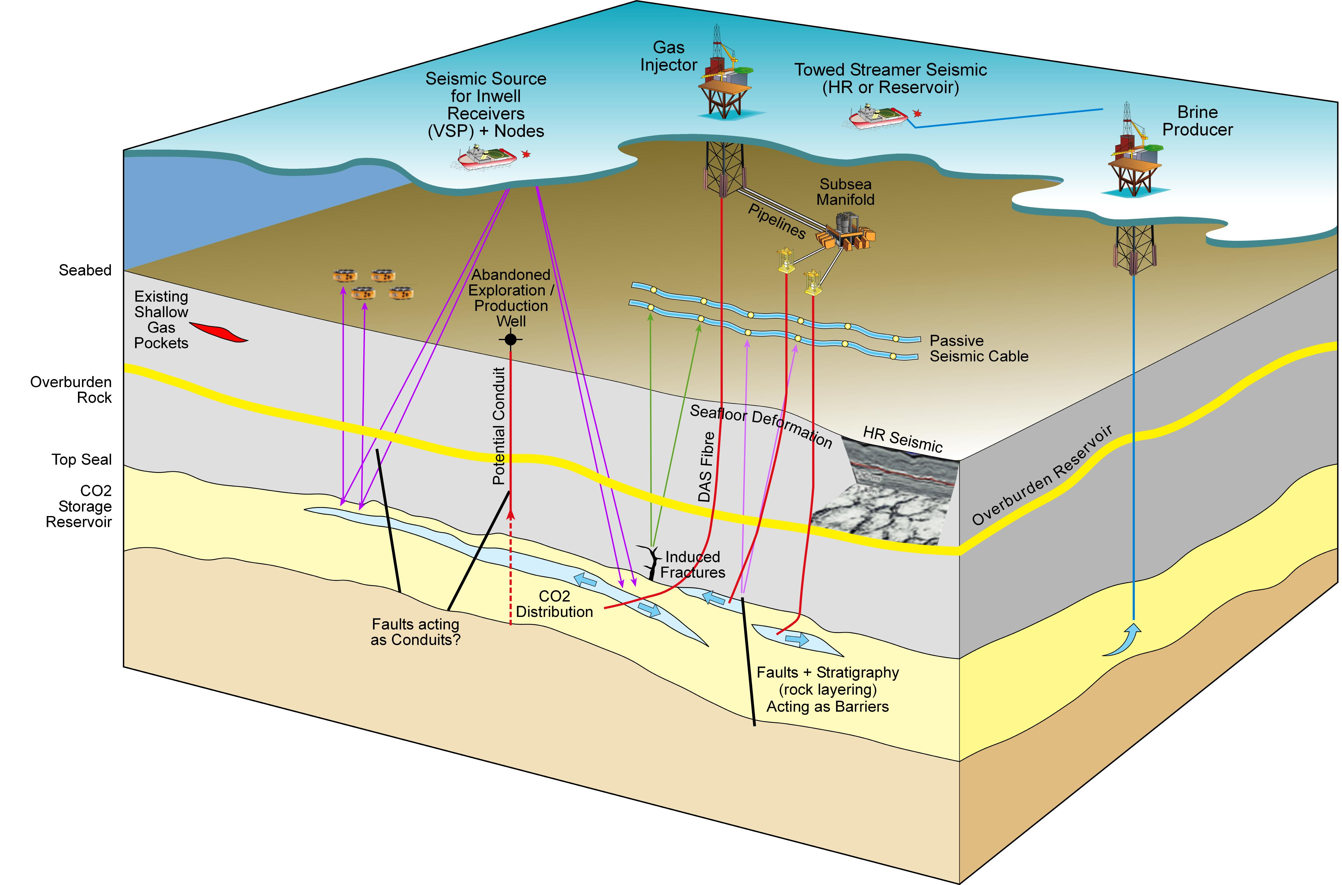
Seismic MMV summary
Active source (towed streamer, OBN, in-well VSP) and passive (microseismic) monitoring

Slide 19
Seismic – Regulatory Requirements
Framework
Legislation is not prescriptive with respect to specific MMV solutions
MMV scope is subject of NSTA stewardship discussions up to the Carbon Storage Permit stage
Ensures a fit-for-purpose approach according to specific site and complex risks
Geophysical Monitoring
Most potential UK CCS operators are assuming that repeating seismic is the main tool for ongoing MMV
Seismic monitoring widely accepted as a hydrocarbon field management tool, for many, but not the majority of fields.
    Some O&G fields were developed after 4D seismic technology invented (late 1990’s)
    Some fields and future CCS stores will not have sufficiently detectable response
  Mixed approach non-UK CCS pilot projects:
    Onshore US: expected to have time lapse 4D
    Dutch sector: Emphasis on classical reservoir engineering (pressure, temperature, volume of fluids) with minimal seismic
  The NSTA and UKCS operators generally acknowledged FOAK surveys should be over-engineered
  Non-seismic geophysical remote sensing techniques can complement, but are unlikely to replace active seismic acquisition
Monitoring objectives & specification need to be closely aligned to anticipated risk/uncertainties from project register
A large 4D be acquired across the entire site closure for direct fluid detection? OR / AND
  More targeted monitoring to help calibrate reservoir simulator calibration near an injection site? OR / AND
  A single survey imaging from seabed to base reservoir? OR
  2 separate surveys: deep reservoir seismic and contingent HR overburden?
  Role of In-well seismic? : Excellent vertical resolution, but very limited spatial extent
  Can Gravity and passive seismic play an intermediate role?

Slide 20
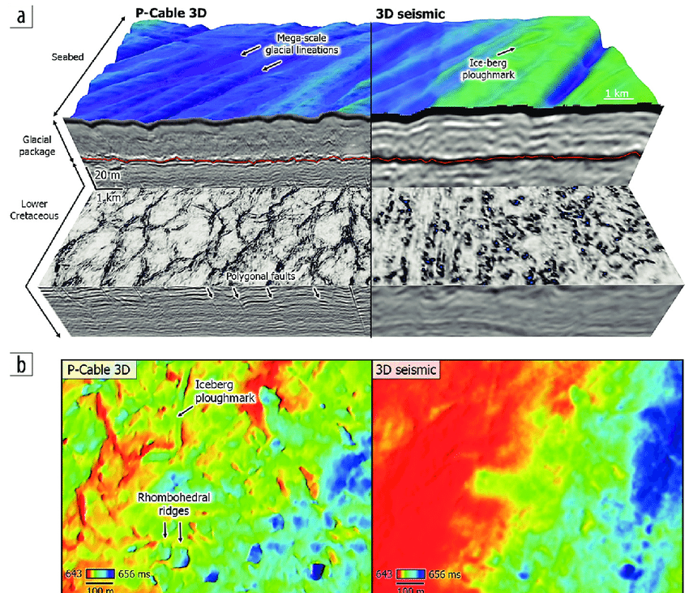
Seismic Vertical (Temporal) and Spatial Resolution
Seismic surveys fall into 2 broad types: Reservoir/Deep imaging & Site Survey/High resolution (HR)
Modern reservoir 3D seismic is critical for characterisation of the deeper injection site
  Detailed vertical (~10m) & spatial (12.5x12.5m) 3D-subsurface image
  Can be acquired via streamer or OBN receivers
HR3D provide higher vertical & spatial resolution for upper 2km
  Higher frequencies (<400Hz) imposes depth restrictions
  Short offset (Small distance between seismic source & receiver) acquisition
    Nosier image (Lower fold & processing/ demultiple challenging)
    No AVO (Amplitude vs Offset a.k.a. no advanced geophysical analysis)
3D HR image
Reservoir 3D seismic
3D HR Map
Reservoir 3D Map
Comparison of 3D HR and reservoir seismic Reference (7)
Seismic Streamer surveys remain the obvious choice where clear water access is available
(i.e. there are no windfarms anticipated over CCS site)

Slide 21
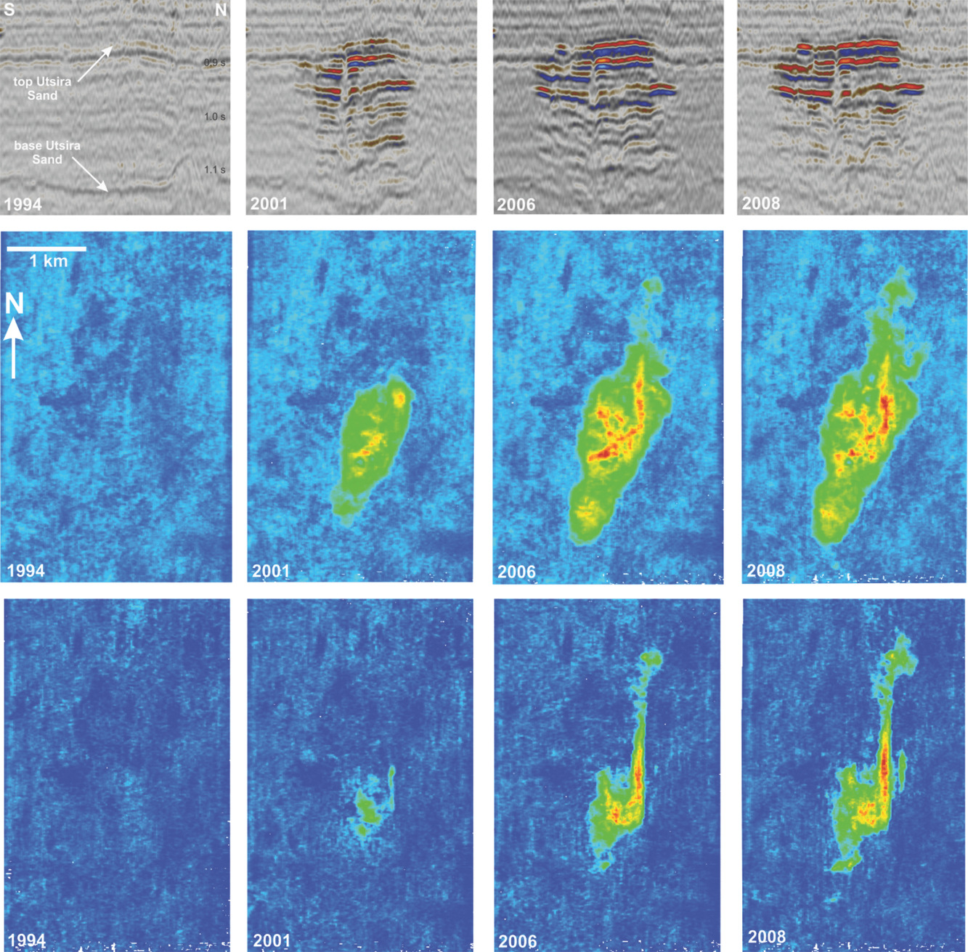
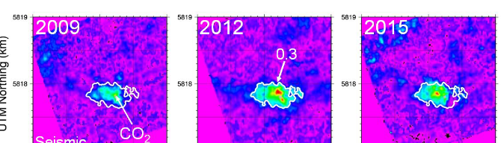
Seismic Signal Detection Capability
  Undepleted aquifer CO₂ site: Clear rationale for seismic monitoring
    Uncertainty about vertical distribution,
    Lateral containment,
    Pressure build-up
    Expecting “should see” time lapse effects (like Sleipner & Ketzin examples)
    Seismic monitoring expected to provide critical role in MMV strategy
  Depleted Gas Field injection site: More difficult justification
    Prior Gas containment supporting CO₂ containment model
    Underfilled & low-pressure structural closure provides injection limits
    Marginal seismic detectability,
      CO₂ injected into residual gas expected to generate small seismic signal
      Main benefit any displaced hydrocarbons/CO₂ into aquifer
  Overburden Monitoring: Technically sound reasoning
    If CO₂ has significantly escaped expected into an overlying aquifer
      Potential for fault or near well bore escape imaging
    Expecting high resolution “should see” effects
    Baseline critical to rule out natural pre-existing shallow gas pockets
Two examples of direct CO₂ Seismic Detection
Sleipner CO₂ injection
Seismic cross sections
CO₂
plume
~ depth
Seismic Maps
1km
CO₂ plume
expanding
1994
2001
2006
2008
Pre CO₂ injection: weak seismic response
Post injection surveys: Complex CO₂ “bright spots”
Direct detection of CO₂ plume distribution
Ketzin CO₂ Test
Seismic Maps
1km
Important Notes: Very few actual CCS studies worldwide to underpin guidelines
  Guidance based around 20 years 4D technology deployment in O&G industry
  CO₂ has a complex behaviour in the subsurface (e.g. dissolution)
  Limited rock/ fluid substitution examples to predict response
    NSTA Seismic Detection study in prep (2022)
Post Injection plume increase with time & CO₂
2015 Shrinking response = fast dissolution of the CO₂ .
Could only be detected with an intermediate (2012) survey
(References 8 & 9)

Slide 22
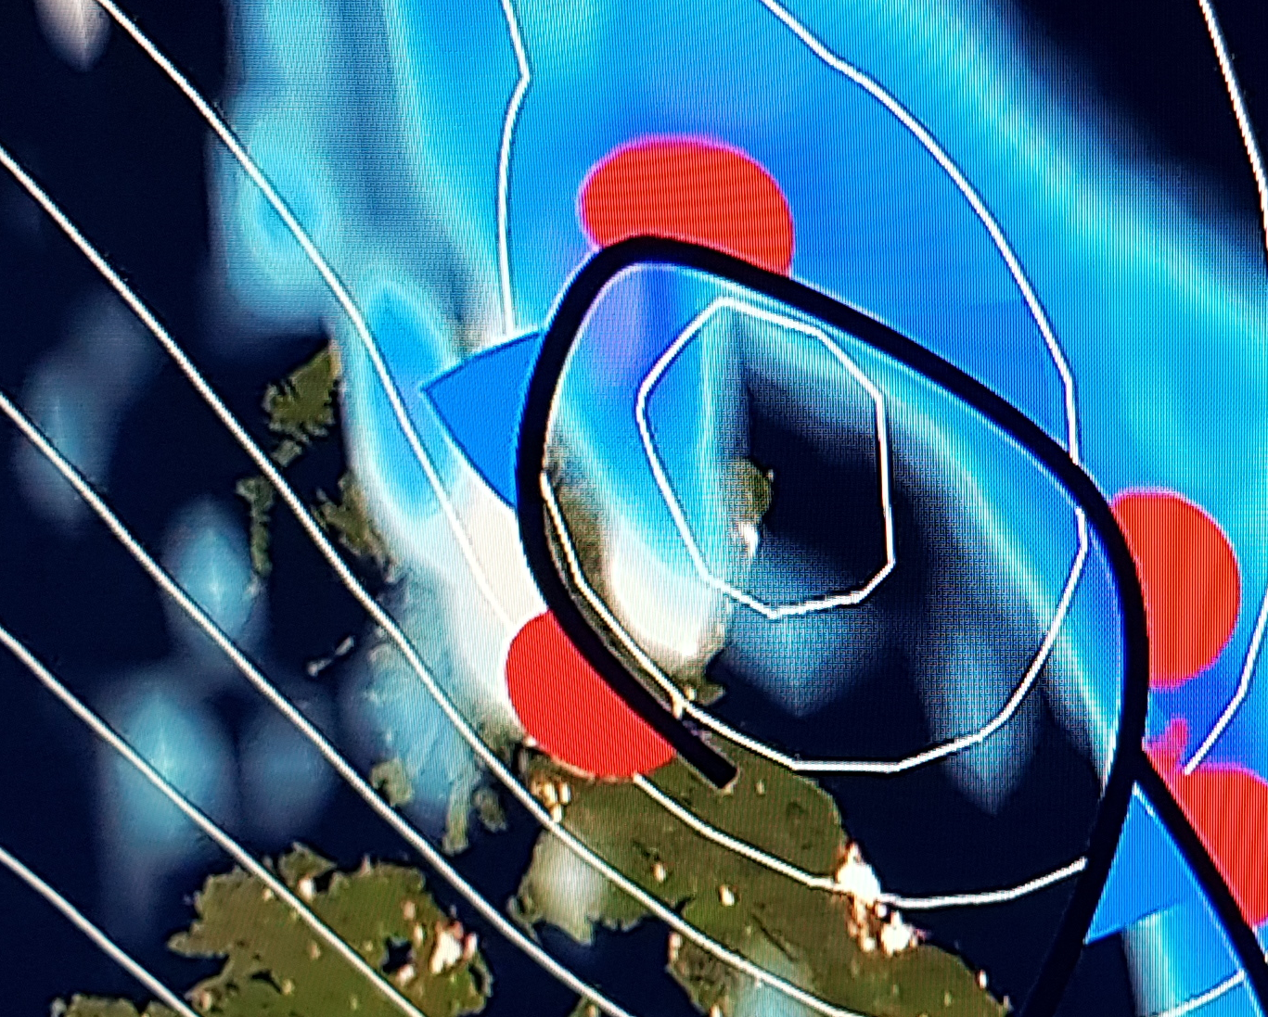
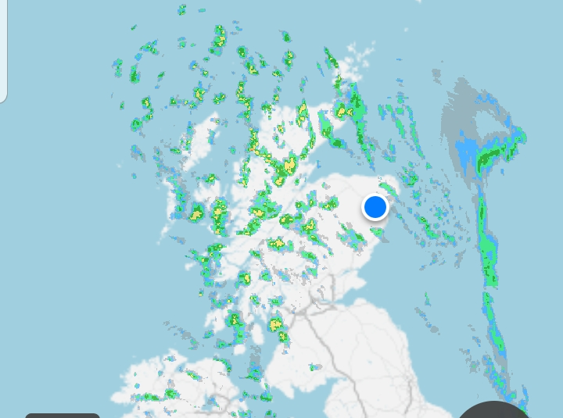
Seismic Monitoring for CCS
4D (Time Lapse 3D) seismic remains the principal, proven, reliable monitoring method supporting
  Conformance/ Reservoir management- Where is the CO₂ distributed within the reservoir?
    Weather Analogue: Modelling predicts fluid distribution, rainfall radar verifies
  In-fill well targeting: Which subsurface locations have not yet been CO₂ saturated?
  Containment: Is fluid migrating laterally outside planned site, or vertically into overlying rock?
  Public awareness: 4D seismic images can be intuitive (c.f. time lapse photography)
There are two approaches to demonstrating conformance:
1) Data Led Conformance Demonstrate agreement between predictive reservoir models & monitoring observations
  Very difficult to match predictive fluid distribution models solely with well based monitoring
    A perfect, unique match to injected flow rate and pressure is virtually impossible to achieve
  Seismic monitoring always shows unexpected fluid distributions, usually within an acceptable range
  CO₂ sequestration & hydrocarbon extraction projects both have the same issues.
2) Refresh Predictive model with monitoring data
  Progressively improve predictive reservoir simulation modelling capability as more dynamic data becomes available
  Seismic monitoring indicates the geological and simulation model assumptions are basically robust
    Additional data leads to progressive model improvement and refinement
    Provides increasing confidence and potentially decreasing need for mid/late life seismic
The latter is the generally accepted approach in hydrocarbon reservoir management & applied to Sleipner CO₂
  Implications for future MMV regulations
Weather analogue
Predictive reservoir model
Rainfall radar
Simulation models are most accurate
with regular update
of direct observations
(Reference 8)

Slide 23
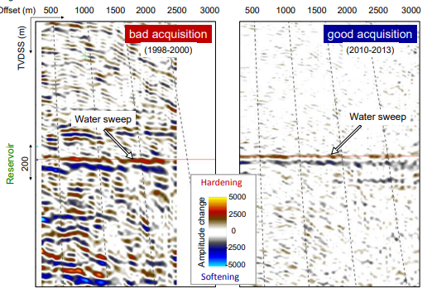
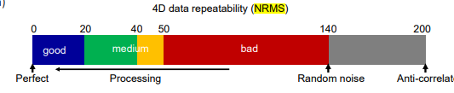
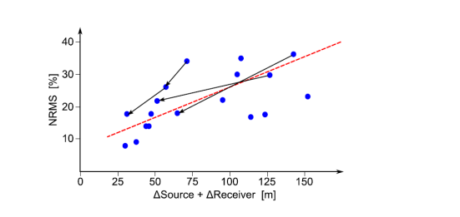
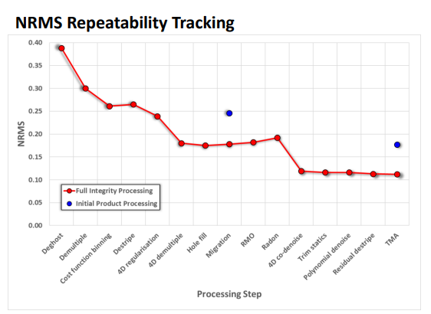
CCS Seismic Monitoring Considerations
Seismic monitoring reliant upon consistent, repeatable acquisition & careful processing
Quality of differences will be driven by (pre injection) baseline acquisition specification is not prescribed, assumes
Post 2010 broadband acquisition ( broad range of seismic source frequencies) &
Accurate source/receiver positioning
Modern Pre-Stack Depth Migration processing
NRMS is a measure of repeatability
Forties oil field 4D repeatability
2000-1998 Difference
2013-2010 Difference
Minimise Towed Seismic 4D Geometrical differences improves repeatability
Processing can improve Repeatability
Lines connect repeat
surveys over same field
Repeatability (NRMS)
Legacy 3D technology
Water swept response subtle
Above considerable
background noise
Steerable streamers replicate
positions
Very clear 4D seismic difference
Each dot represents a 4D survey
(Reference 10)
4D Mispositioning distance
Improving Repeatability (lower NRMS) with better
source and receiver positioning
Certain processing steps improve repeatability
(Reference 10)
(Reference 11)

Slide 24
6. Seismic Surveys Around Windfarms
24

Slide 25


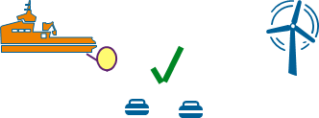
Seismic Options around Offshore Windfarms
Co-existence using reservoir towed streamer seismic is not considered safe nor practicable.
  Schematics show challenges of acquiring streamer seismic (towing long receiver cables) within confines of windfarm
  Long cables and their unpredictable lateral movement / "feathering" presents unacceptable collision risk
  Potential monitoring acquisition options
  Very Restricted HR towed source only or very short streamer length seismic may work amongst turbines.
    Requires shallow targets with large expected response
      Short offset HR seismic which may not deliver reservoir image
      Cannot provide fieldwide 4D
    HR contractors currently hesitant to commit to minimal HR scope (any more than 1 x 600m cable) between turbines
    Alternative P-Cable arrangement (multiple ultra-short cables) / still does not present full spatial data
    “2.5D” monitoring gives very limited image
  Ocean Bottom nodes (OBN) could be deployed amongst turbines
    Differencing Baseline Streamer & Monitor OBN currently not effective.

Slide 26
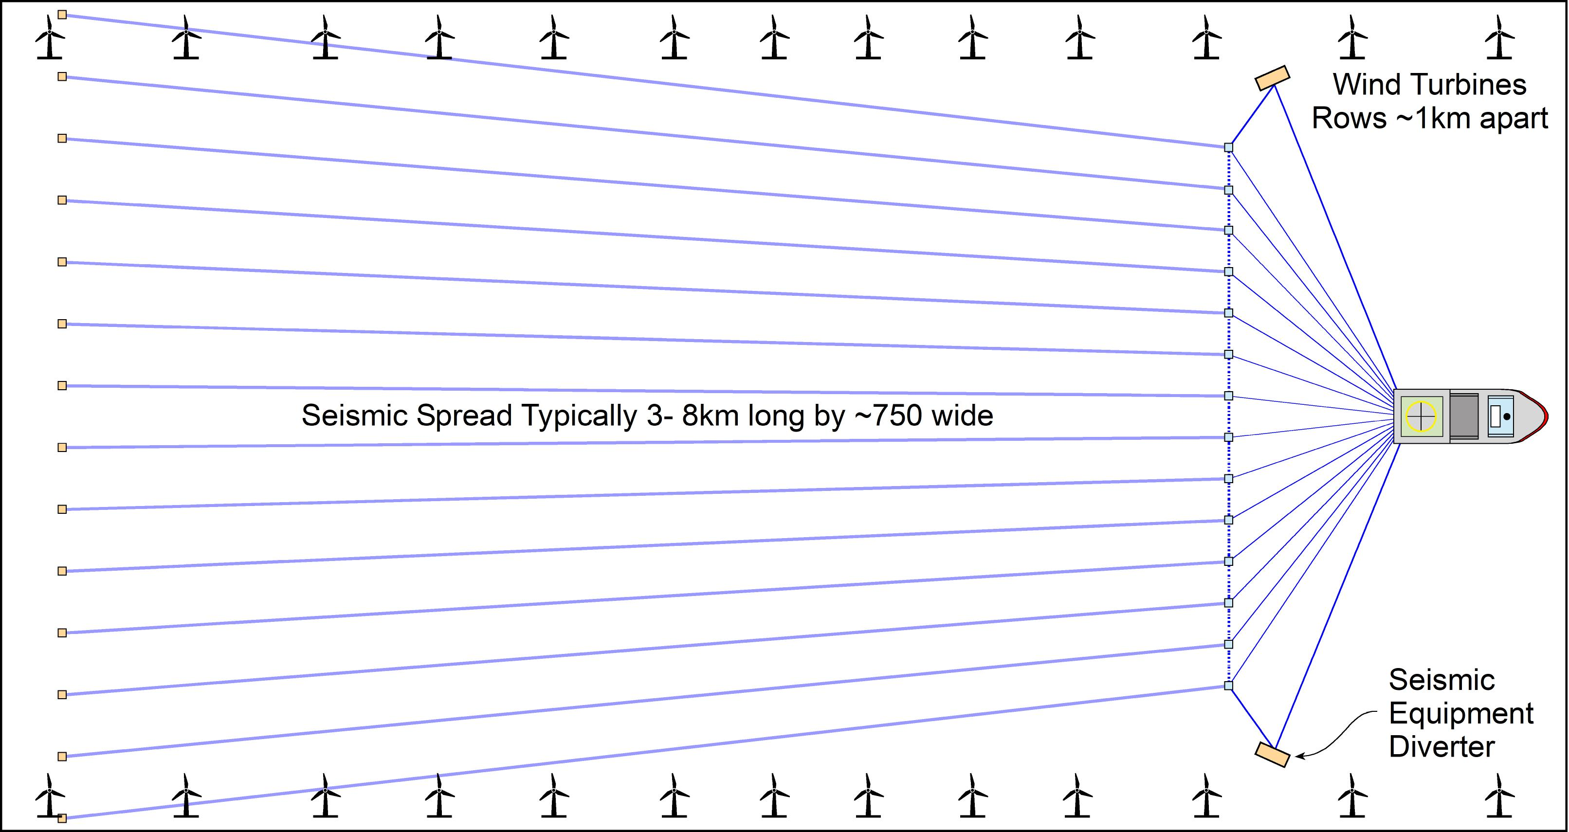
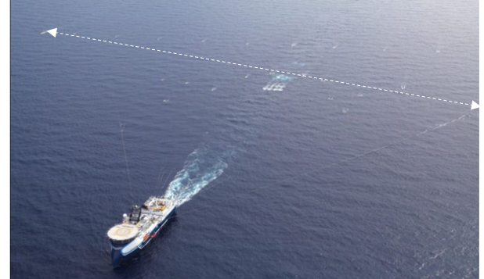
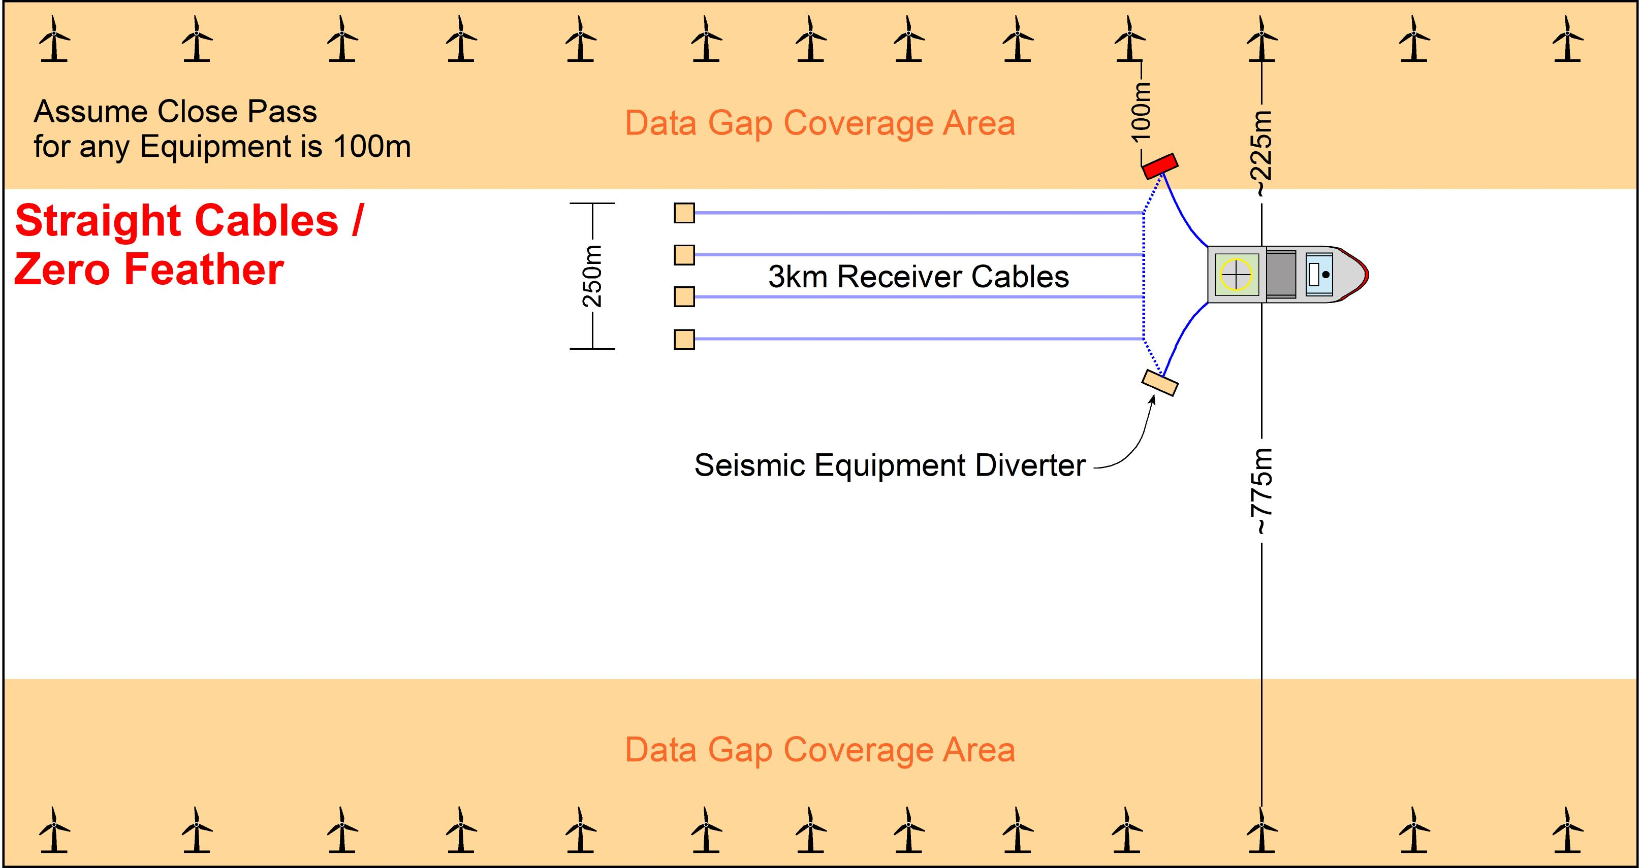
Marine Seismic Operations around Windfarms #1
1) Streamer spread width along turbine corridor: Impossible
Collision!
Fantail spread: Streamers wider at tail -> collision risk +
Feathering (lateral drift) displaces tail 100’s m -> collision risk +
No vessel escape route unacceptable for captain
<1km
m
Collision!
Not to scale: X is 3 time longer than y’s width
2) Very much reduced equipment spread. Theoretically possible, but practically impossible
Transition point to HR contractors
Even with zero feather-> Significant data gaps
Furthest point for vessel is only 775 m Still very little escape room
250m
Not to scale: X is 3 time longer than y’s width

Slide 27
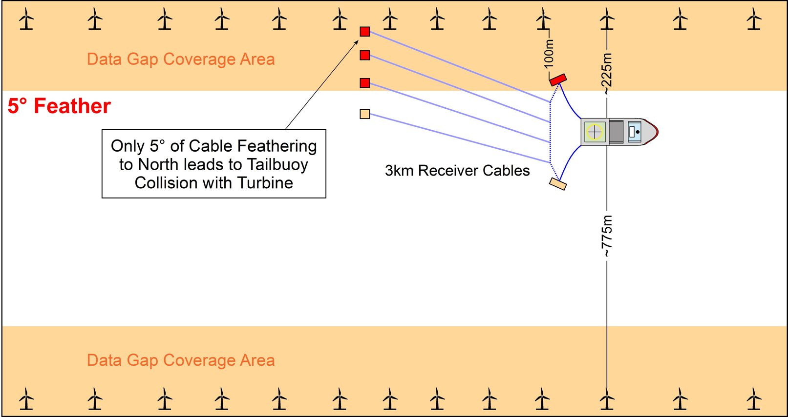

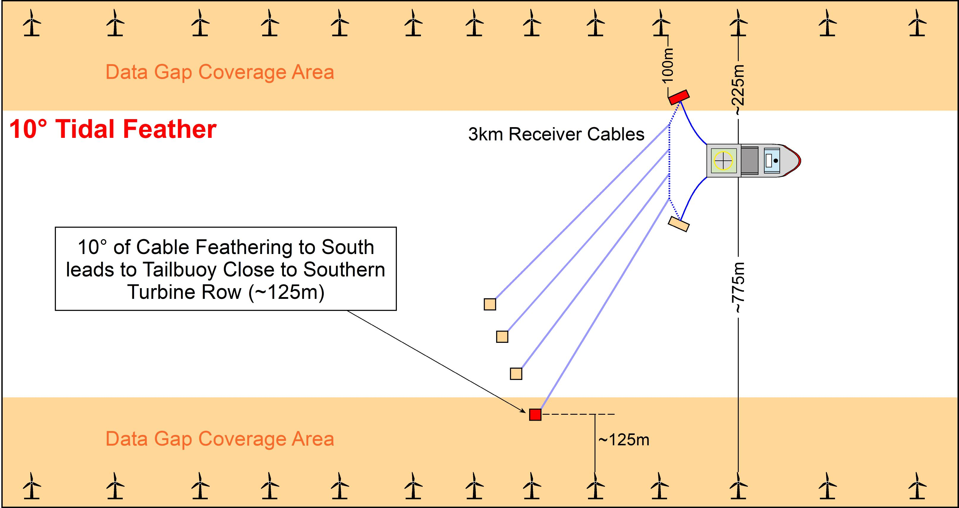
Marine Seismic Operations around Windfarms #2
Collision!
3) Very small & predictable feather:
May be acceptable in exceptionally good situations, (less strong or more predictable tide)
Subject to risk assessment acquisition may be possible in low predicted feathering,
  Short as feasible streamers,
  large turning circle (2.5-3.5km radius)
  Acceptable vessel capability & escape routes.
Large data gaps remains
Note:
In high current/tidal areas (e.g. SNS) high feather often occurs
  > 5º feather-> collision would occur
  Seismic contractor utilise tides to provide safe streamer drift to “south”
  but this further enlarges the data- gap
Not to scale: X is 3 time longer than y’s width
  4) High or unpredictable currents -> moderate/large feather: Impossible
  Very high tidal flow (e.g., 10º) gives very little room to manoeuvre:
  Plan for vessel drift-off to north, but tailbouy drift-on to the turbines in south
  Data coverage further squeezed to N & S
3km long receiver cables
Note: all these scenarios are simplifications and do not show:
Vessel escape routes and
Turbines in more complex arrangements
NSTA is aware of only one, carefully planned field example of intra-windfarm 2D HR survey acquistion
Not to scale: X is 3 time longer than y’s width

Slide 28
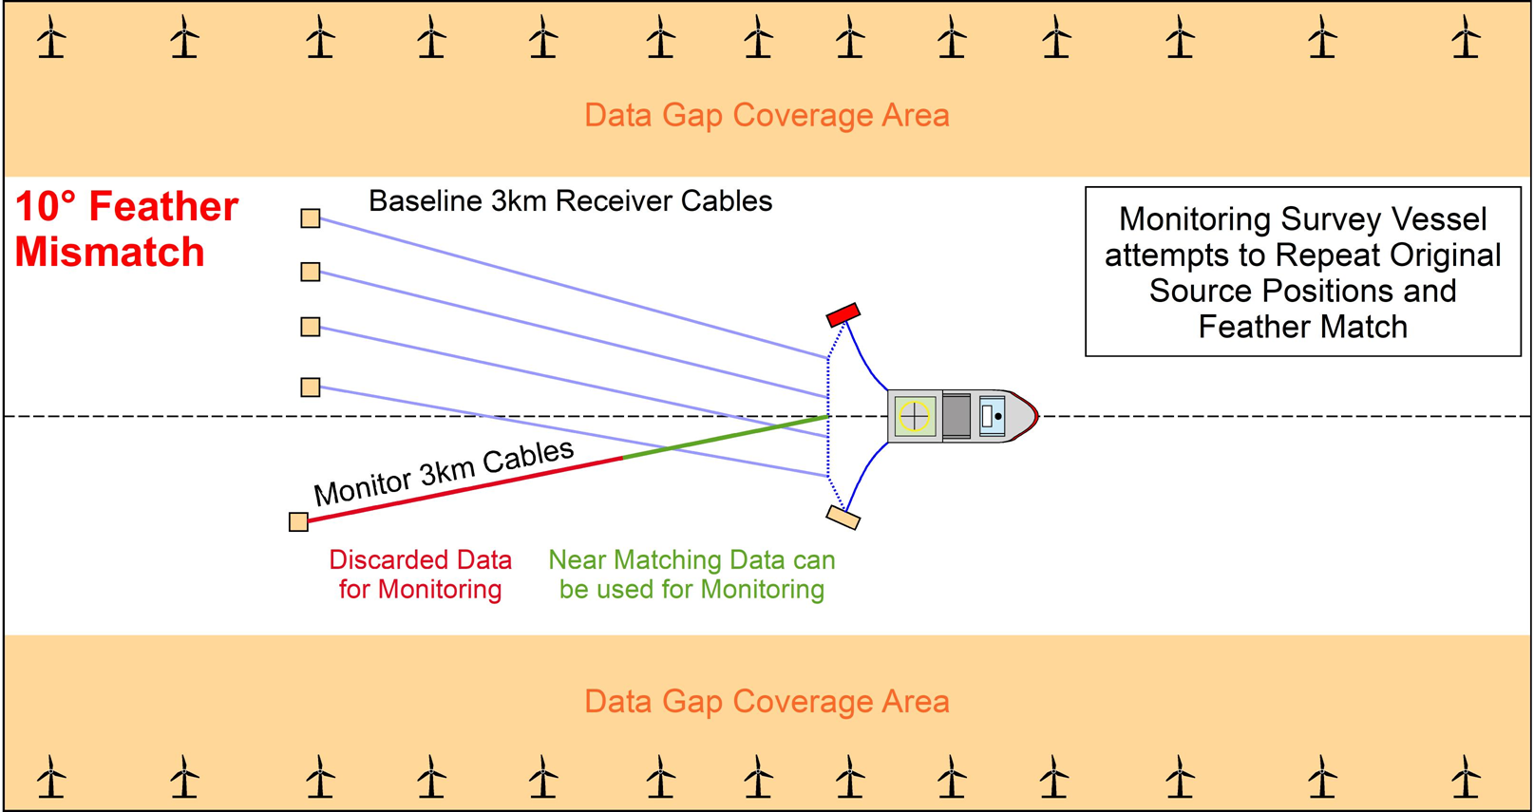
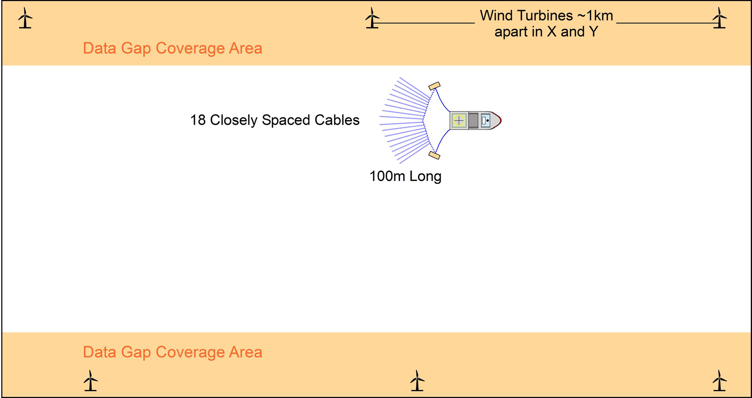
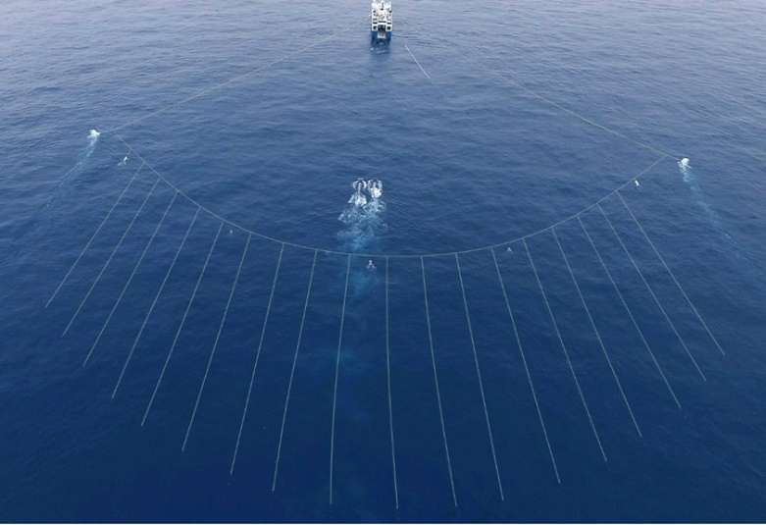
Marine Seismic Operations around Windfarms #3
5) Highly reduced (2.5D) monitoring: Possible
  If a clear water baseline streamer survey is acquired, then
  A restricted 2.5D monitor survey may be acquired with turbines using selected subset of matching data with reduced acquisition
  Monitor survey vessel attempts to replicate baseline acquisition.
  Green data can be matched to existing baseline
  Red data discarded: no feather match between baseline and monitor
  Result: restricted short offset 2D seismic line
  Positives
    Very small footprint, but ~ same towing width
    May be more acceptable for Captain/Party Chiefs working amongst windfarms.
    Potentially very high resolution in shallow section
    Smaller airgun sources so more marine mammal friendly
  Negatives
    Smaller power need to be tested for penetration and resolution over target
    Lot of equipment remains in the water at (lessened) collision risk
    Diminished escape routes
    Still data gaps along lines of turbines
    Only near offset data
6) P-Cable acquisition: Possible
Not to scale: X is 3 time longer than y’s width
(Reference 12)
Aerial view of 18 x 100m cables closely spaced for tow width of about 200m
Approximately to scale

Slide 29
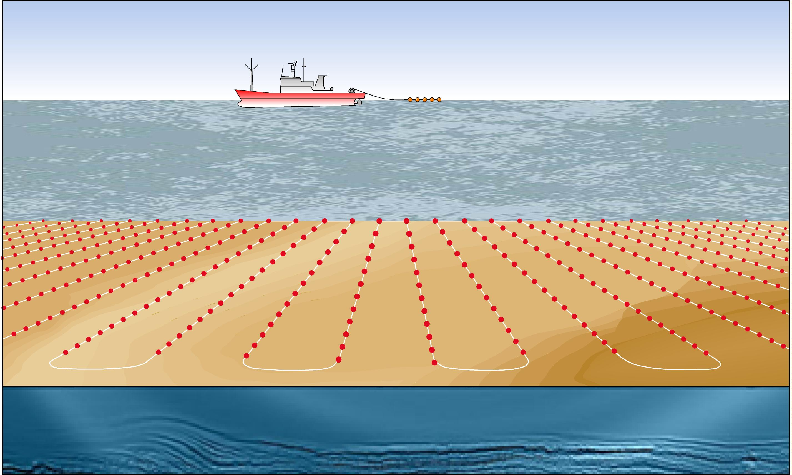
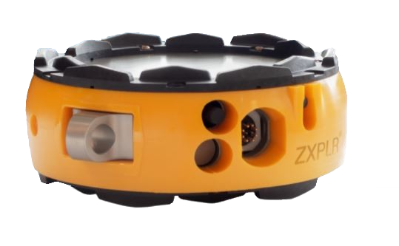
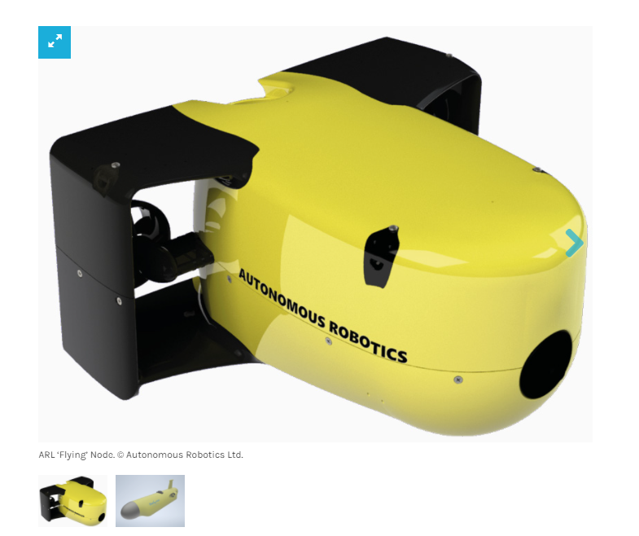
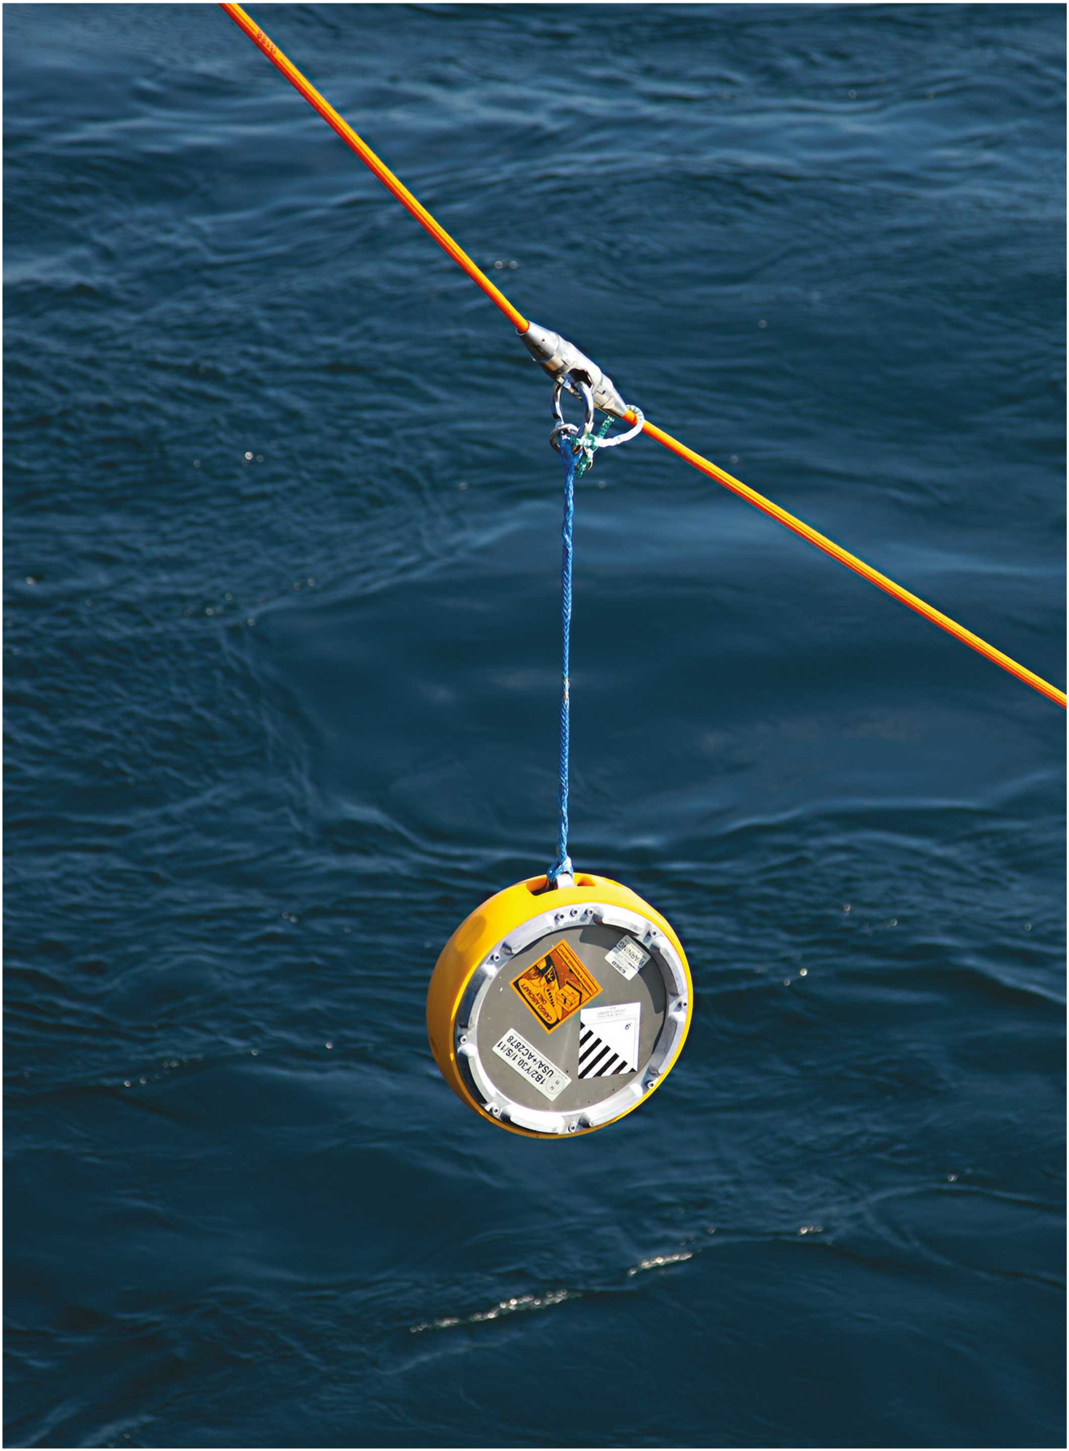
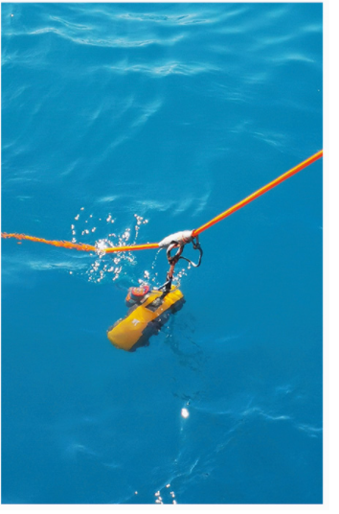
Ocean-Bottom Seismic
Introduction to ocean bottom cables (OBC) and ocean bottom nodes (OBN)
Please see References 13,14,15
Surveying node array
Ocean Bottom Node most likely provide robust & future proofed MMV co-existence solutions.
Technologies
      Ocean bottom cables
      Nodes:
        Autonomous recording unit
        Contains a hydrophone and three directional geophones,
        Lightweight nodes on rope OR
        ROV placed carefully around infrastructure
Current developments
      Node count increasing/ Costs decreasing
      Targeted/ localised intra-turbine solutions in development.
      Hybrid: HR streamer or P-Cable with OBN may provide more widescale data
  Autonomous Underwater Vehicles (AUV)
    Small number of self- directing nodes “e.g. Spicerack" / Autonomous Robotics
    Fully autonomous sources and nodes
  Nodes on “parachute”
  More detail on the status of OBN technology is available in a separate NSTA publication (2022 in prep.)
Node
Autonomous node
Node on rope
References 16& 17

Slide 30
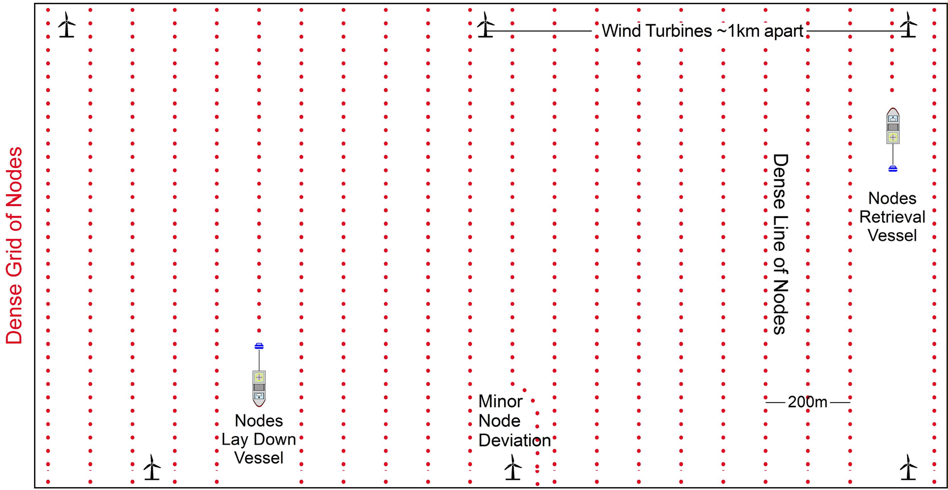
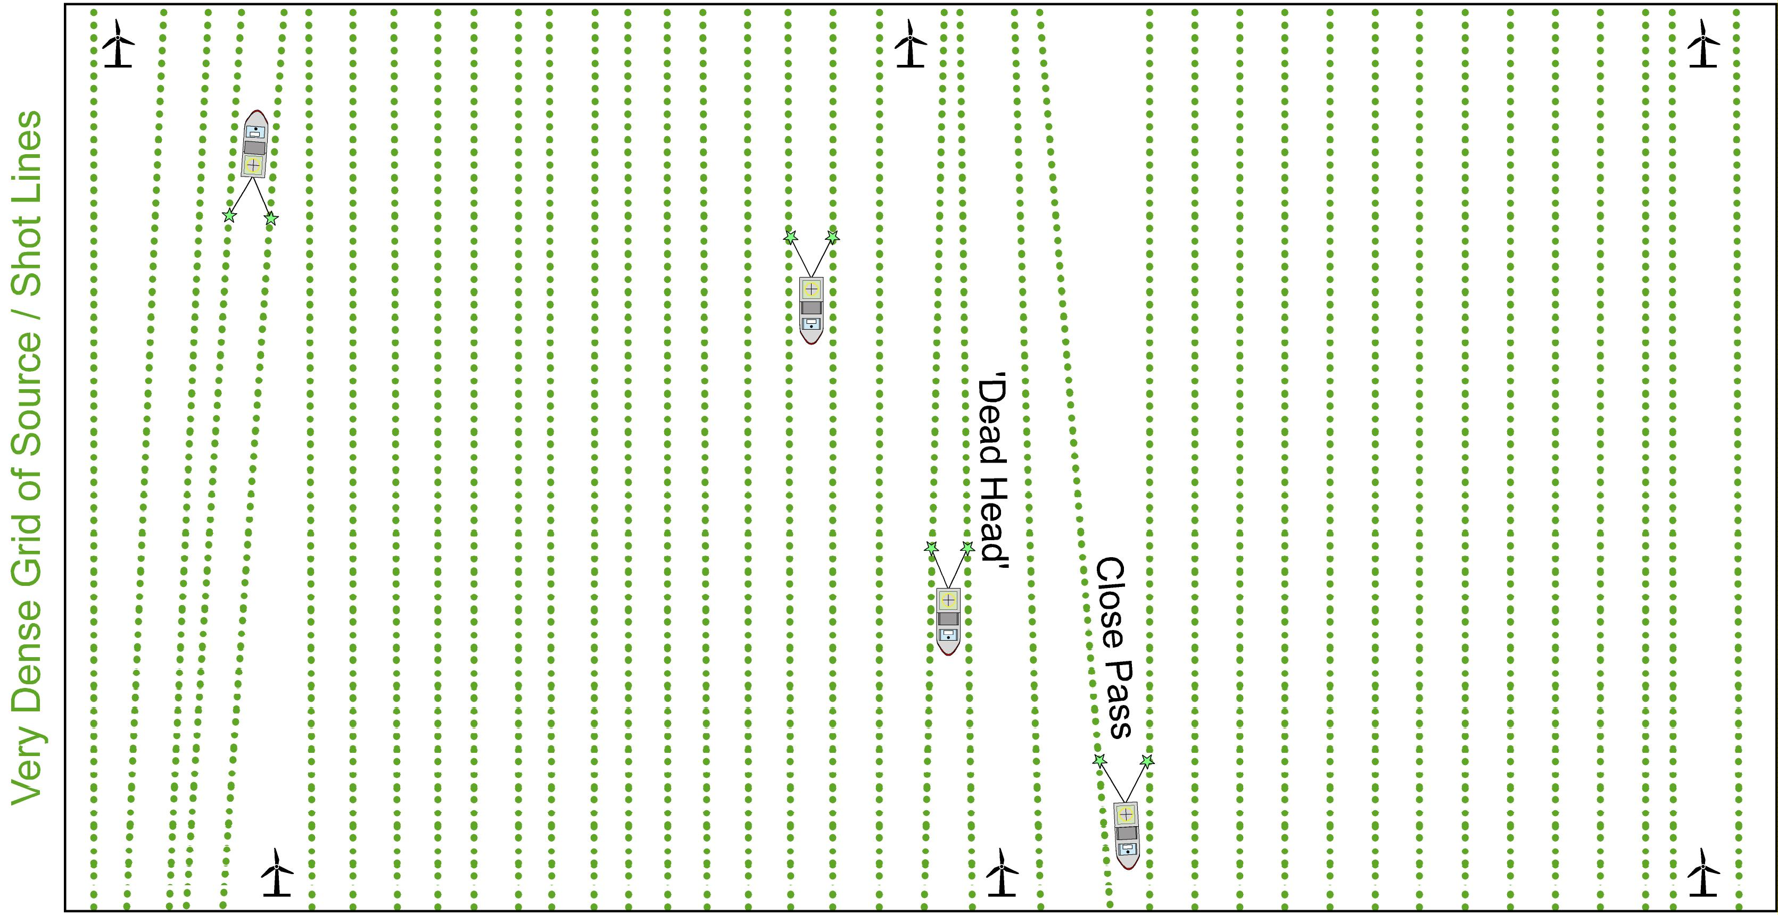
Ocean-Bottom Nodes Acquisition within Windfarm
Operationally challenging, but feasible
  High density /quality broadband baselines to enable future 4D differencing
  Vessels capabilities entering close turbines
  SIMOPS (Simultaneous Operations)
Positives
Robust to exclusions
Node vessels lay in very controlled manner
Can easily and safely make minor deviations
Orderly grid and complete coverage
Greater 4D repeatability
More comprehensive seismic acquisition
  Increased data type collection: 4 Component data (Hydrophone + 3x geophone)
    Useful for imaging below gas cloud (e.g. shallow CO₂ plume)
  Complete illumination: Multi-azimuth seismic Quieter environment (no wave action)
  Data can be acquired in very shallow water
Negatives
Cost & duration
Deployment Speed
  Placing receivers much slower than towing streamers
  Ocean bottom nodes are much bulkier and heavier than cables
  Individual placing/ retrieval by ROV deployment is very slow
Multiple vessels (source, lay-down pick-up, guard)
Completion of survey within seasonal weather window
Coverage gaps @ seabed & shallow section
  Needs High density/ very narrow receiver line spacing to compensate
  Significant cost factor

Slide 31
Seismic Monitoring Considerations
Frequency and timing of 4D surveying is project dependent
  CCS survey frequency determined case-by-case basis. Estimated 3-10 years
    More frequent lower cost streamer vs Infrequent costly OBN
    Identification of CO₂ dissolution within reservoir may require more frequent surveys (e.g. Ketzin Site Pilot)
    Monitoring Survey frequency every 3-5 years typically assumed for hydrocarbons,
  Separate deep reservoir monitoring seismic and targeted overburden imaging?
    As & when required HR to test if CO₂ migrated above the reservoir / into the top seal
    Periodic low-density node for reservoir imaging/ initial fluid distribution
Future proofing technology for 60 years is a significant concern
  Pre-injection surveying (<5 years) + Active Site (25 years) + Post closure monitoring (30 years)
    Seismic monitoring requires consistent acquisition and processing
      Hydrocarbon 4Ds often have to reprocess all surveys to bring them to modern standards
    Seismic Imaging and OBN acquisition still rapidly evolving
    Contrast modern seismic acquisition, processing and imaging barely recognisable from 1960’s:
      Crude 2D Acquisition ->3D ->4D. Single -> 16 Streamers -> OBC-> OBN -> UAV/USV seismic
      Limited manual Unmigrated Processing -> highly complex, computer intensive . Post stack-> Pre stack Time –> Pre stack depth migration
      Fluid and lithology/ AVO analysis and inversion were not invented.
Environmental
To avoid collateral damage to marine environment CCS operators strongly encouraged to reduce seismic acoustic output
  Current surveys generally looking at smaller sound sources/ new technology development
  Shared noise budgets with windfarm operators likely
  Operator awareness of extended consent timeframe in SAC (Special Areas of Conservation)

Slide 32
7. Other Active Seismic Options

Slide 33
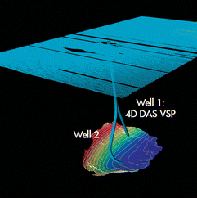
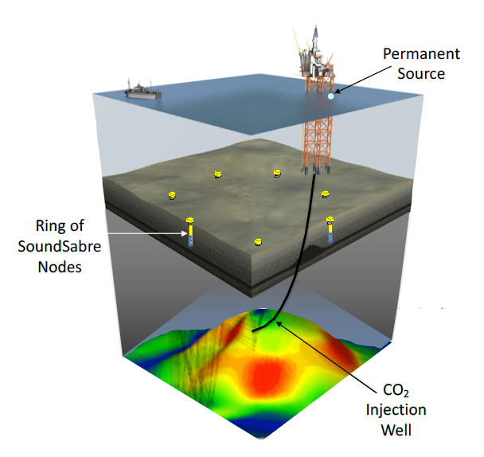
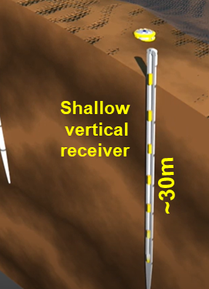
Localised / Spot Seismic Monitoring
Monitor DAS VSP acquired during OBN
Rather than illuminating a full 3D volume of rock, it is possible to target a particular subsurface point, near a CCS well.
Repeated VSP (Vertical seismic profiles)
  Enabled by DAS cables & Surface seismic survey
  Images a narrow corridor around a wellbore
Soundsabre:
  Node based permanent reservoir monitoring system.
  Vertical array of 4C sensors in shallow boreholes around specific well target
  Possible for passive seismic monitoring
Subsurface spot illumination
  Minimal source and receiver pairs,
  Located upon 3D illumination study & sufficient repeated data (fold) to form a common spot gather.
  Potential for continuous (e.g. daily) monitoring
OBN survey (blue shots)
Dense shot carpet provides small 3D cube around wells
Reference 18
Reference 19
Soundsabre targeted imaging
Reference 20

Slide 34
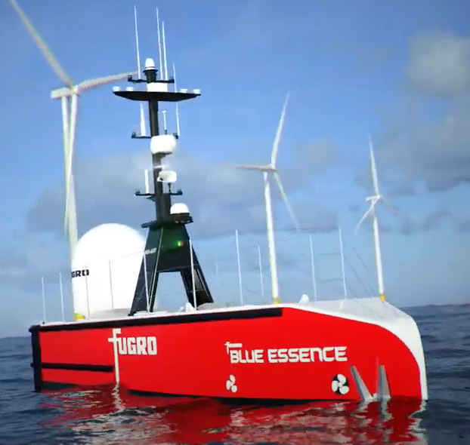
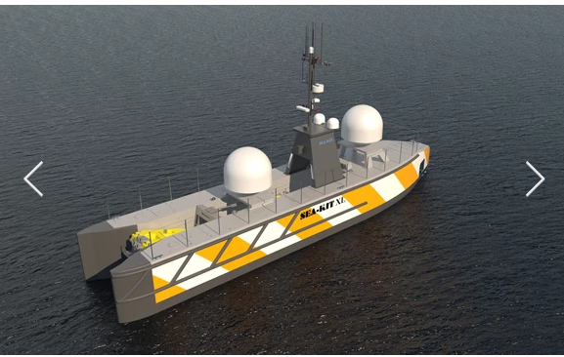
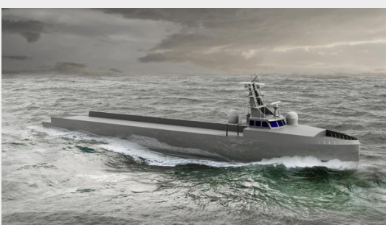
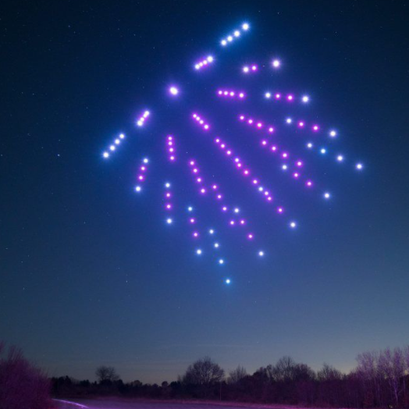

Role of Un-crewed Surface Vessels (USV)
  Flotilla of smaller surface unmanned vessels be developed to provide a viable and safe surface tow replacement?
  Targeted illumination: build up coverage/fold with a low intensity over an entire acquisition season
References 24, 25
Analogous aerial
drone swarms choreography
Range of developing USV’s
Reference 21
Reference 22
Reference 23
Flotilla of smaller USVs with short streamers
provide targeted subsurface imaging
Medium sized USV towing a conventional air gun source or marine vibrator
Receivers maintain critical offset separation from source
Mother Duck and
duckling concept

Slide 35
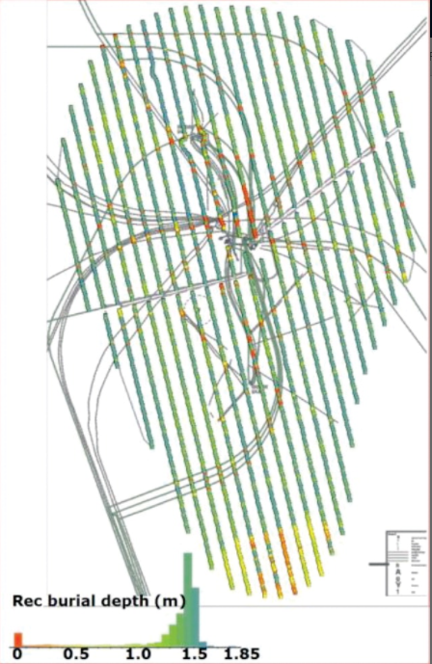
Permanent Reservoir Monitoring (PRM)
PRM involves the fixed installation of monitoring equipment on the seabed for multi-season acquisition
Useful for frequent monitoring when tracking very rapid fluid distribution changes
  Aimed at 3-6 month frequency compared to 3-10 years with streamers
Globally very few permanent installations only associated with very large scale projects . Clair in UKCS, Valhall and Ekofisk in Norwegian waters
Positives:
  Provides very high repeatability
  Lower repeat monitoring costs
  Containerised seismic source from supply vessel
Negatives:
  Very High up front capital expenditure,
  Equipment durability,
  Cable based systems inflexible to expansion
  Permanent installation prevents CCS subsea development/ windfarm expansion
  Seafloor PRM is likely to exacerbate the coexistence issue and is unlikely to have a significant role in congested areas.
Possible Future Fibre optic development as PRM
  Currently used in-well
  Noisy seafloor environment for untrenched light weight cable
Ekofisk PRM array
Reference 26

Slide 36
8. Wider Range of MMV Technologies
36

Slide 37
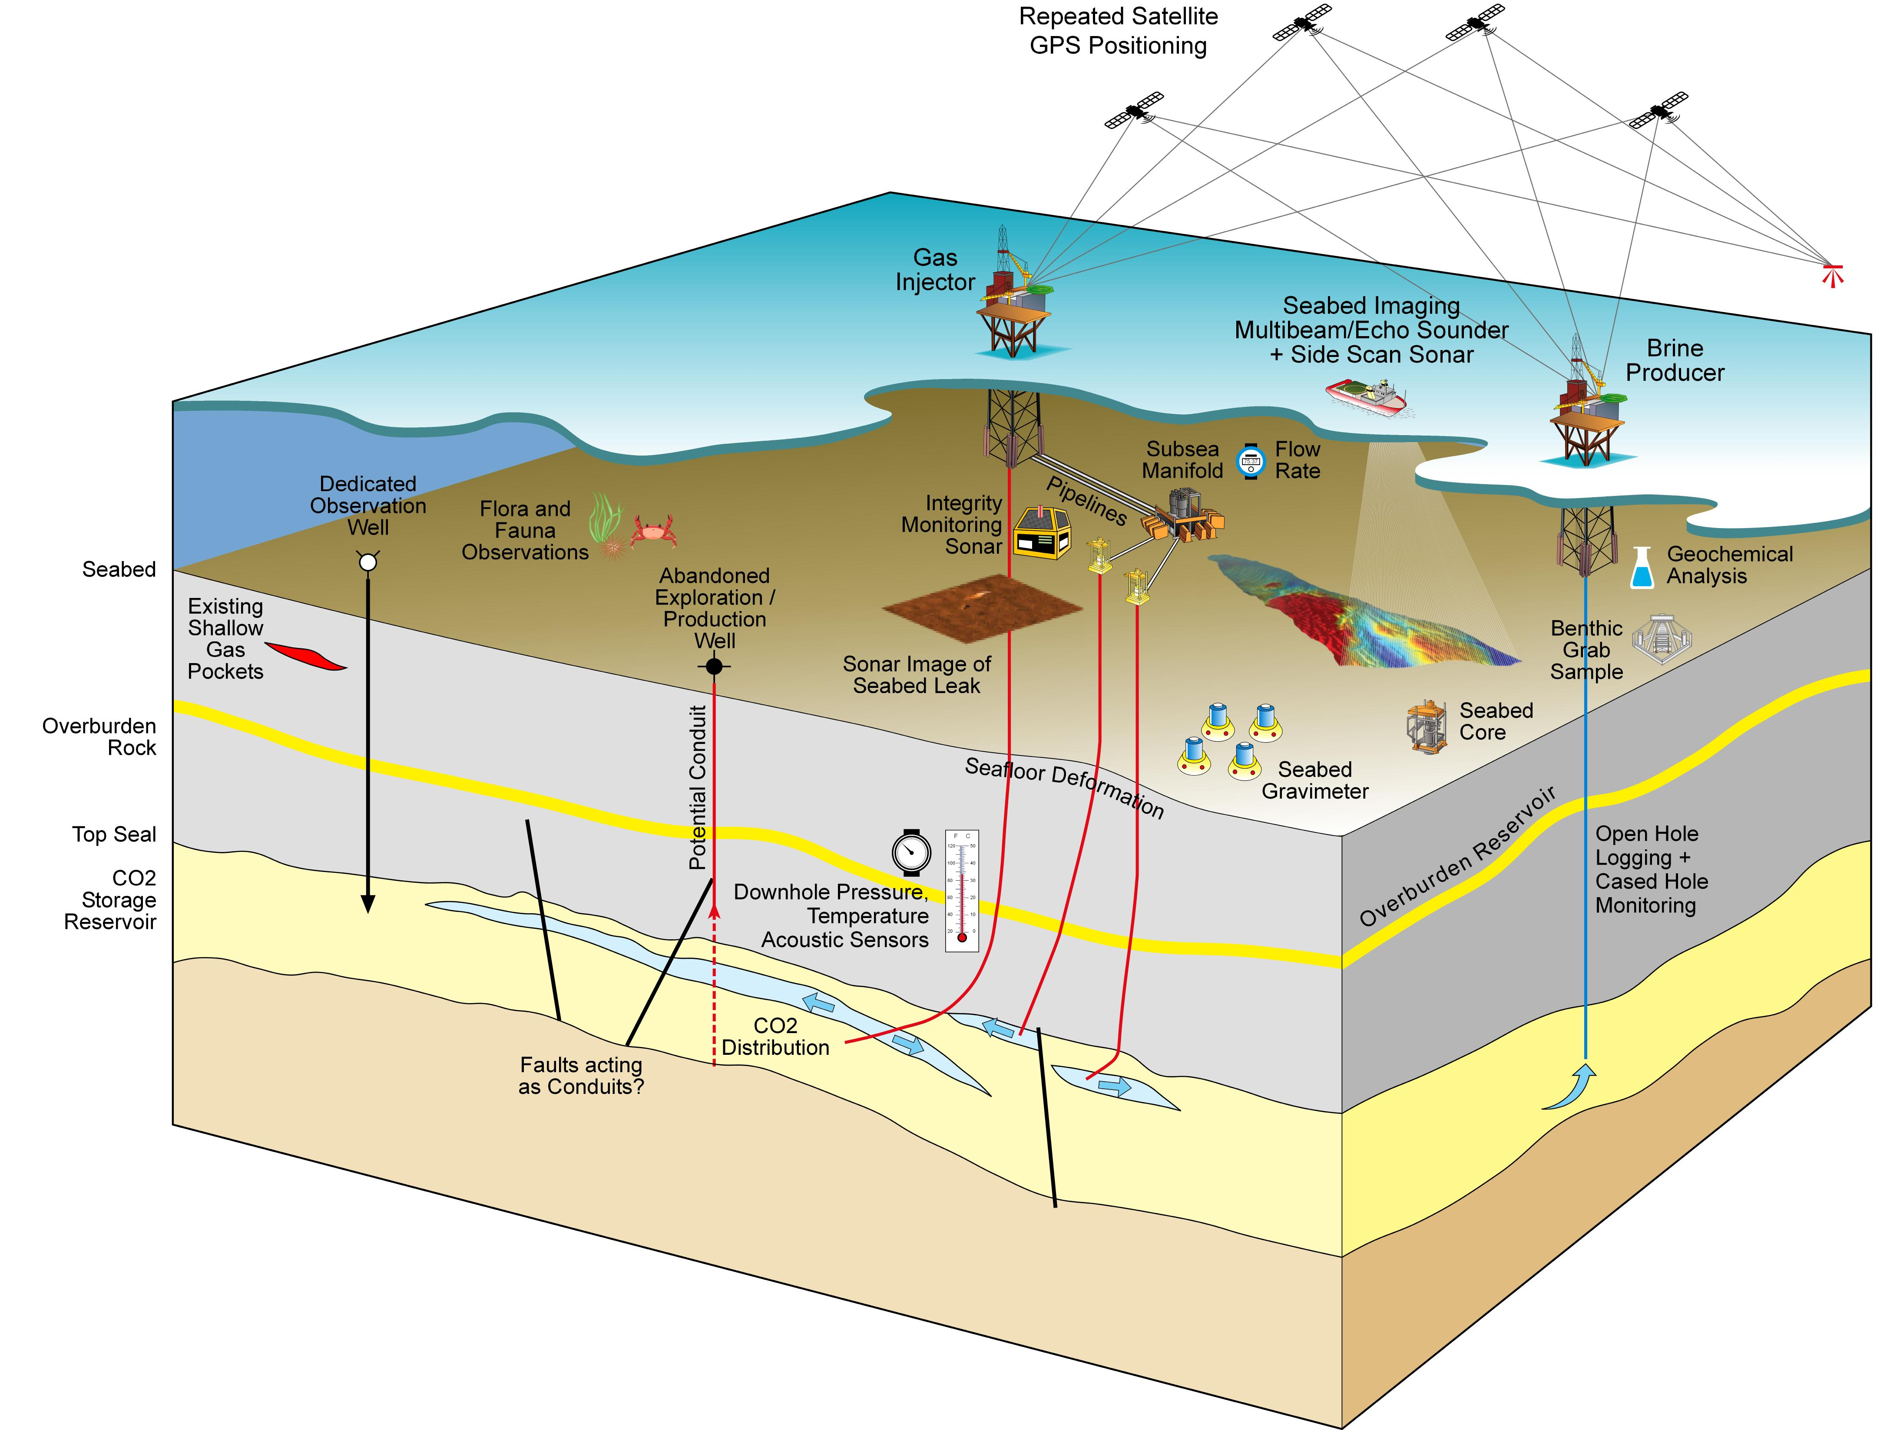
Range of Other MMV Technologies
There is a broad range of complementary MMV technologies which could be routinely applied or could be applied for specific purposes.

Slide 38
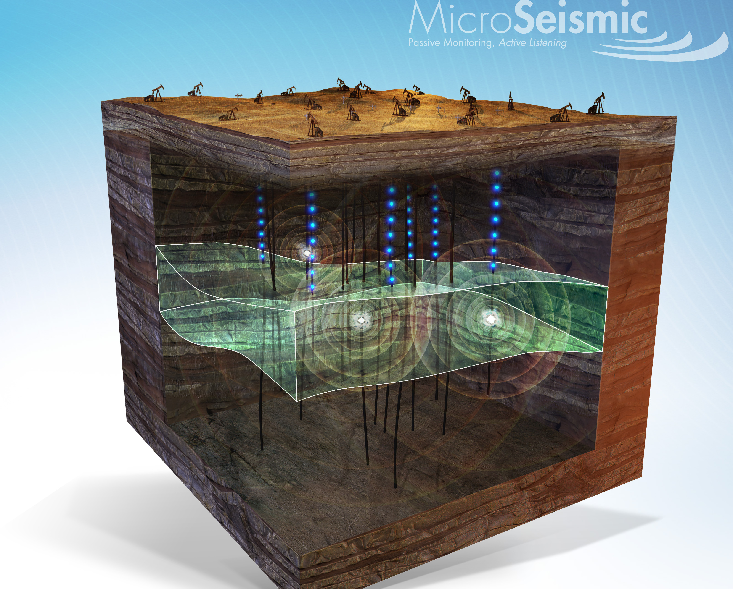
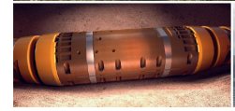
Passive Seismic (Microseismic) Monitoring Technologies
Onshore example
CO₂ Injection is likely to trigger extremely small earth tremors
    High pressure fluids break down lateral or vertical barriers.
    Continuous real time seismic monitoring
    Analysis of passive seismic events help track CO₂ plume migration
Passive Seismic Array
    UK seismometer network used for onshore fracture injection monitoring
      Usually onshore receivers too remote from distant offshore CO₂ injectors
    Offshore Receivers can be located
        Vertically in an observation well above/ close to the CO₂ storage reservoir to detect smallest tremors
        Nodes located around an injection site
          High marine noise environment?
          Mobile seabed?
        Semi-permanent or Permanently installed seabed array around reservoir to triangulate the position of the events
          Cuttlefish Tenzor Geo
Fracture events create very small tremors, detectable with surface array or in-well seismometers
Reference 27
© 2017 MicroSeismic, Inc
3 component seismometer and hydrophone receivers linked by fibre optic cable on seabed
Reference 28

Slide 39
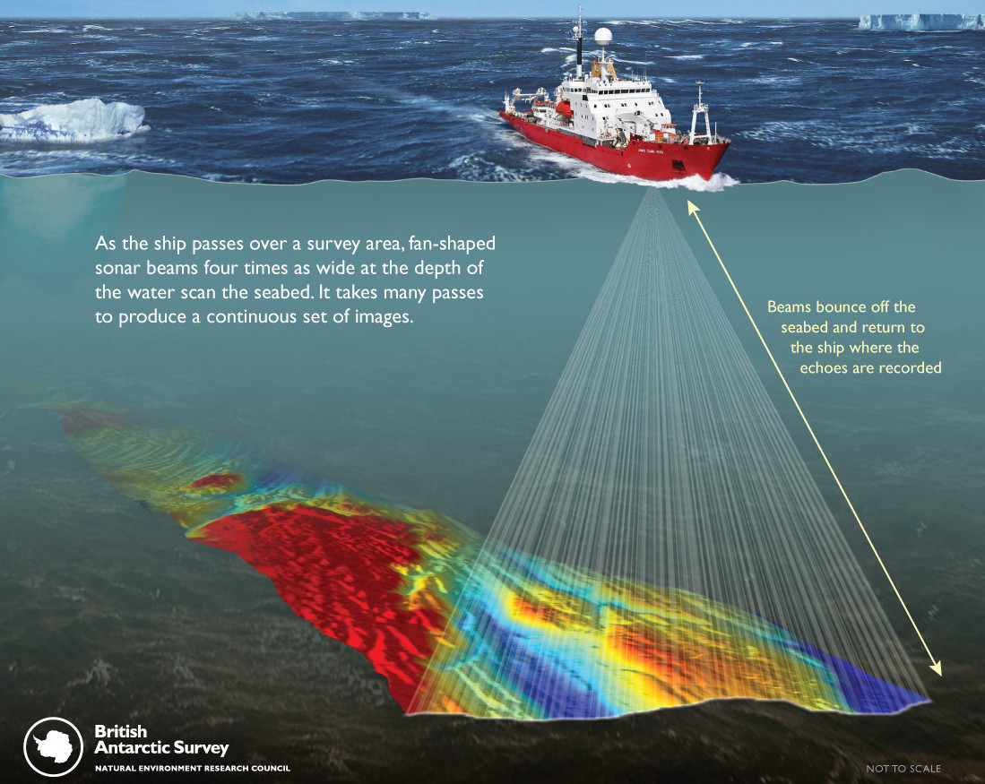
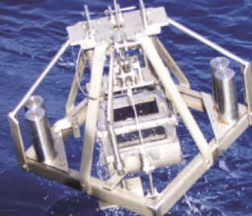
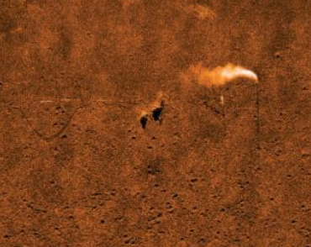




Marine Monitoring Technologies
Marine surveys investigate the water column/ seabed (Bathymetry)
Collect samples of the flora and fauna to monitor marine habitat (benthic study)
Form part of baseline environmental and geological data.
Bathymetry Multi Beam EchoSounder (MBES)
Benthic Grab Sample - Sea floor sampling
Seabed Coring
Sidescan Sonar (SSS)
Detecting CO₂ plume leak trial
Reference 29
Reference 30
Reference 31
Reference 32
Examples of Benthic Studies
Reference 33

Slide 40



Understanding Shallow Migration Pathways
Multi-beam & High resolution seismic can be used to identify pockmarks/ natural methane gas escape features on the seabed.
Baseline surveys required to understand the pre-existing pathways, prior to potential CO₂ disruption
Multi-beam Depth Map
Slices through a 3D coherency cube
3D seismic image of the pipe structure
underneath the Scanner pockmark
Reference 34
Reference 35

Slide 41



Water Column Monitoring Technologies
Geochemical sampling (laser) of water column to identify monitor leaks and seeps
Photographs of bubble stream
Shallow Chirp profiler acquisition
Laser measurements via AUV paired with surface USV
Optodes measuring pH or pCO₂ (the partial pressure of CO₂) as indicators of CO₂ in both the water column and seafloor sediment.
Goldeneye trial: CO₂ concentration greater than baseline and seasonal variation
STEMM CCS
Goldeneye trial
Reference 36
2D seismic reflection (Chirp) data
Reference 37-42
CO² outflow pipe experiment

Slide 42



Geochemistry/ Geochemical Analysis
CO₂ interacts with the rock and existing pore fluid
  Dissolution and precipitation of minerals in the reservoir and seal rocks
  Modification of the properties of mineral surfaces occurs
  Effects occur on fluid flow and capillary trapping
Geochemistry traces fluid-fluid interactions and fluid-rock processes
Analysis includes:
  Gas Ratio data
  Carbon and Oxygen isotopes
  Isotopic changes in Calcium and Magnesium in the rock
  Trace metals in overlying aquifer waters
    upward migration & acidification of CO₂ from storage formations
Reference 43

Slide 43



Downhole Well Monitoring Technologies
Downhole logging schematic
Downhole gravity tool
Baseline rock and fluid formation data is collected during and immediately after a well is drilled
  Gives very high resolution, but only very close to well bore (<~5m)
  Routinely collected “open-hole” prior to running production steel casing
Injection/production well access can provide time lapse reservoir fluid saturation or production logging
  Restricted to very occasional access to offshore wells (cost and risk)
  Virtually no access to subsea wells
CO₂ wellbore measurements have included:
  CO₂ saturation in brine reservoirs estimated from decrease in sonic (P-wave) velocity & increase in resistivity (induction tool)
  Repeat Reservoir Saturation Tool (RST) using pulsed neutron capture to determine changing brine saturation
Future downhole gravity may sense density changes further into reservoir
Time Lapse Saturation logging
Reference 44
Reference 45
Saturation increasing with time

Slide 44


Realtime Wellbore Monitoring Technologies
Wellhead measurements routinely provide pressure and CO₂ injection rates
Downhole gauges located near casing perforations (open sections to reservoir)
  Usually provide continuous downhole pressure and temperature
  Well pressure correlates between the injection rate vs. the reservoir pressure.
    Ensures overall dynamic equilibrium within the reservoir.
Distributed sensors continuously measure physical properties along an entire fibre optic cable.
  Vibrations from the surrounding environment, disturb the light in the fibre and observed (Distributed Acoustic Sensing or DAS)
    Permanent installation with well completion
    Mitigate tube ringing noise: preferable deployed behind casing rather than via tubing
  Detection of leaks/seeps in and near wellbore
  Temperature (Distributed Temperature Sensing/ DTS) and
  Strain (via Distributed Strain Sensing or DSS)
  DAS – Vertical Seismic Profile (VSP) can provide early indications of CO2 plume development
Risk of near wellbore leakage means that DAS could play a significant low cost monitoring role.
Quartz Crystal Pressure gauge
Reference 47
Rig up for DAS installation
Reference 46
Reference 48

Slide 45




DAS- Vertical Seismic Profile
  DAS – Vertical Seismic Profile (VSP) can provide early indications near wellbore CO₂ plume development
  Lower cost 2D “walkway” (from wellbore)
Reference 50
Reference 49
Seismic Cross section
DAS-VSP Time lapse difference
Seismic Cross section
DAS-VSP Time lapse difference
Permanent In-well
Seismic concept
TWT ~ Depth
Map CO² Plume development from
Sparse 2D walkaway VSP
Reservoir
difference
Extent of Plume ~150m
Lateral uncertainty +/-70m
Min CO₂ concentration 5%
Vertical resolution 20m
As volume of injected CO² increase the amplitude relative to baseline increases
Reference 51

Slide 46




Seafloor Deformation Monitoring
Hydrocarbon extraction occasionally generates minor subsidence, expected
that CO₂ injection/ sequestration may create seafloor inflation.
  Average subsidence Ekofisk 10-15cm/year, Deep water US/Brazil fields ~ 2-5cm/year
  CCS related predicted inflation has not been studied, but likely small
Long term subsea seafloor deformation monitoring
  Vertical displacement by Pressure Monitoring Transponder (PMT)
    Self calibrating/ Currently being trialled on Ormen Lange
  Autonomous Monitoring Transponder (AMT)
    Pressure, Temperature, sound velocity and dual-axis inclinometer
    Horizontal accuracy of <15mm
    Long endurance: < three years deployment
Marine Geodesy
Reference 52
Time series geodesy data (Mt Etna)
Volcano 4cm slip
May 2017
Reference 53
Repeated Satellite GPS Positioning
Continuous satellite GPS on fixed platforms detect mm scale changes
  Onshore: Humbly Grove (Reference 54)
  Onshore InSar (Interferometric Synthetic Aperture Radar) measures ground deformation / In Salah CO₂ sequestration demonstration (Reference 55)
  Offshore InSar provide low-resolution seabed topography data (Reference 56)
    Probably insufficient definition for CCS monitoring

Slide 47


Seafloor Gravity Monitoring
Seabed Gravimetry
Periodic measurements of strength of the earth’s gravitational field
  Gravimeter deployment on concrete plinth to ensure repeatability.
    May not be practical for very long term stability/ mobile seabed
  Gross changes may be detectable/ subject to modelling
Ormen Lange undertaken 7th G-watch survey
  Claim 1/10 of the price of a 4D seismic survey and 1/3 of the delivery time.
OCTIO Gravitude
ROV holding gravity meter ready for deployment
Reference 57-59

Slide 48





Electromagnetic / CSEM
Electromagnetic measurements are routinely used in wellbore data acquisitions
to determine the electrical resistance (resistivity) of the rock/fluid mixture.
  Function of gas saturation, amongst other parameters.
  Rock physics models predict resistivity changes by several orders of magnitude
  with changing CO₂ saturation.
Controlled Source Electromagnetics (CSEM) used to measure large resistivity
variations below the seabed
  Used on the onshore Ketzin CO2 storage site
  Very limited testing use offshore CCS (Sleipner)
  Tested on pockmark for shallow gas detection
Usually employed as complementary technique to seismic
CSEM still requires towing significant source may be an operational problem in a constrained environment.
Impact of changing CO2 saturation
on seismic and EM properties
High CO₂ gives High resistivity in good quality (high porosity)
reservoirs
Reference 62
Reference 61
CSEM acquisition configurations
CSEM Resistivity results overlain on seismic
High resistivity hydrocarbon reservoirs picked out in red
Reference 63
Reference 64

Slide 49
9. Conclusions and Next Steps

Slide 50


Conclusions & Recommendations
Each carbon storage project has a different risk priority/ranking
Carbon Storage Project Monitoring objectives will have a slightly different emphasis depending on subsurface and surface factors, and their relative risk.
A consolidated list of monitoring objectives is recommended, cross-referenced to
  subsurface risks and other project risks
  monitoring technologies/techniques/tools and
  their technology readiness levels (including availability and cost).
Monitoring strategies will evolve over a project’s lifetime
  More frequent seismic monitoring will likely be required during early storage development, with learning and adaptation through the operational phase.
NSTA/TCE/CES to establish and publish ‘Greater Working Areas’ for Carbon Storage sites and complexes to
Demarcate areas where surveying activities (especially using seismic streamers) can be expected.
Areas should be established on a site by site basis in collaboration with the licence/lease holder.
Expansion of Project Vulcan co-location risk assessments to include more operational disciplines (e.g. operations geophysicists, marine & aviation experts, drillers, rig tow masters, hydrographic surveyors, fishing bodies, Nature Conservation bodies, etc).

Slide 51


Ongoing & Next Steps
Current 2022 studies
Ocean bottom seismic, technology assessment for the use for CO₂ storage monitoring
  Operability, costs and ability to mitigate colocation issues with windfarms
Rock Physics Fluid Substitution study,
  Ability of seismic to detect CO₂ plume migration within CCS target intervals of interest
  Across range of potential storage sites
  Review of literature and on the effect of windfarm noise on seismic acquisition
2023+ Potential studies
Deploy Field Trial measuring equipment to measure windfarm noise signature.
  Test a range of scenarios to assess impacts and potential uses for seismic acquisition
Carry out a 4D Seismic Repeatability Field Trial (HR 3D vs 2.5D) to evaluate if data acquisition approaches/methods can be scaled back to greater enable wind turbine placement.

Slide 52
10. References

Slide 53
References
(1) ORE Catapult & NZTC (2021) CCUS & Offshore Wind Overlap Study Report PN000452-LRT-002. Energy Transition Alliance (ORE Catapult and OGTC/NZTC) report for The Crown Estate.
(2) Quintessa (2021) UKCS Carbon Capture Risk Register and Global Lessons Learned REPORT QRS-10053A-Report. Internal report for the Oil & Gas Authority.
(3) Oil and Gas Authority: Interactive Energy Map for the UKCS - The move to <br/>net zero (ogauthority.co.uk)
(4) CAA Policy and Guidelines on Wind Turbines (CAA 764) https://publicapps.caa.co.uk/docs/33/CAP764%20Issue6%20FINAL%20Feb.pdf
(5) Offshore Renewables Aviation Guidance (ORAG) Good Practice Guidelines for Offshore Renewable Energy Developments https://events.renewableuk.com/images/documents/GOW/ORAG_Aviation_Guidance_FINAL.pdf
(6) Meet Ronnie Parr, BP’s geophysicist in the North Sea – YouTube
(7) Toward one-meter resolution in 3D seismic | The Leading Edge (seg.org), Nina Lebedeva-Ivanova et al 2018
(8) Underground CO2 storage: demonstrating regulatory conformance by convergence of history‐matched modeled and observed CO2 plume behavior using Sleipner time‐lapse seismics - Chadwick - 2015 - Greenhouse Gases: Science and Technology - Wiley Online Library Chadwick and Noy 2015.
(9) 4D seismic monitoring of CO2 storage during injection and post-closure at the Ketzin pilot site, Stefan Lüth, 2017
(10) The quantification of pressure and saturation changes in clastic reservoirs using 4D seismic data (hw.ac.uk), Omofoma
(11) 4D Seismic in the Catcher Area – Shining a new light on reservoir management in complex injectite sands. Gary Marsden, Harbour Energy, Seismic 2022 - SPE Aberdeen (spe-aberdeen.org)
(12) P- Cable 3D Seismic/NCS Subsea NCS-SubSea - | P Cable 3D Seismic | Marine Seismic Imaging Technology
(13)“Ocean bottom cable acquisition - SEG Wiki” and “Ocean-bottom node - SEG Wiki”;
(14)Ocean Bottom Nodes in Action – YouTube
(15) GEO ExPro - Ocean Bottom Seismic: Robots on the Seabed
(16) Autonomous Robotics | Autonomous underwater vehicle solution (autonomousroboticsltd.com)
(17) GPR, a seabed nodal solution for seismic acquisition - Sercel – YouTube
(18) 4D DAS VSP as a tool for frequent seismic monitoring in deep water | The Leading Edge (seg.org)
(19) Soundsabre vertical array (20-30m) SoundSabre Technology – YouTube https://www.newwave.energy

Slide 54
References (cont. 1)
(20) Focused and continuous ultra-light seismic monitoring: a gas storage example. Morgan et al. 2020. EAGE Conference & Exhibition (spotlight-earth.com)
(21) Fugro launches its new generation of uncrewed surface vessels in the Netherlands – Energy Northern Perspective Fugro Blue Essence – YouTube
(22) USVs for commercial sector | SEA-KIT
(23) L3Harris Technologies Awarded Medium Unmanned Surface Vehicle Program from US Navy | L3Harris™ Fast. Forward.
(24) ASV, Shell in unmanned seismic vessel project push - Offshore Energy (offshore-energy.biz)ASV, Shell in unmanned seismic vessel project pus
(25) USV for seismic operations - Brattørkaia 11, 7010 Trondheim, Norway (nauticexpo.com)
(26) Ekofisk life-of-field seismic: Operations and 4D processing, Bertrand Ekofisk life-of-field seismic: Operations and 4D processing | The Leading Edge (seg.org)
(27) British Geological Survey Seismology Monitoring Page (https://earthquakes.bgs.ac.uk/monitoring/home.html)
(28) Real-time passive monitoring with a fibre-optic ocean bottom array fb_goertz_etal_april2018_prmfjordtest.pdf (pgs.com)
(29) British Antarctic Survey https://www.bas.ac.uk/polar-operations/sites-and-facilities/facility/rrs-james-clark-ross/multibeam-echosounder-2/
(30) Picard, Kim et. Al... (2014). Seabed environments and shallow geology of the Leveque Shelf, Browse Basin, Western Australia
(31) Geological research methods | Explore the Seafloor (wessexarch.co.uk)
(32) Baseline issue 18 by Sonardyne International Ltd
(33) Autonomous marine environmental monitoring: Application in decommissioned oil fields, Jones et al. 2019, Science of the Total Environment ScienceDirect
(34) Geological investigation of pockmarks in the Scanner Pockmark SCI area, JNCC 2015 Scanner Pockmark MPA | JNCC - Adviser to Government on Nature Conservation
(35) Pockmarks in the Witch Ground Basin, Central North Sea; Christoph Böttner. Geochem Geophys Geosyst, Volume: 20, Issue: 4, Pages: 1698-1719, First published: 14 March 2019, DOI: (10.1029/2018GC008068) STEMM-CCS_research_highlights_r.pdf
(36) Using autonomous underwater gliders for geochemical exploration surveys Louise M. Russell-Cargill CSIRO PUBLISHING | The APPEA Journal
(37) Assuring the integrity of offshore carbon dioxide storage Connelly, D.P in prep. Journal: Renewable and Sustainable Energy Reviews
(38) Sub-seabed carbon dioxide storage | STEMM-CCS
(39) Strategies for Environmental Monitoring of Marine Carbon Capture and Storage STEMM-CCS_research_highlights_r.pdf

Slide 55
References (cont. 2)
(40) Deviations from environmental baseline: Detection of subsea CO2 release in the water column from real-time measurements at a potential offshore Carbon Dioxide Storage site. - OceanRep (geomar.de)
(41) Time-lapse imaging of CO2 migration within near-surface sediments during a controlled sub-seabed release experiment | Elsevier Enhanced Reader Ben Roche et al. https://doi.org/10.1016/j.ijggc.2021.103363 International Journal of Greenhouse Gas Control 2021
(42) International Journal of Greenhouse Gas Control | Special Issue on Monitoring, Measurement and Verification for Offshore CCS: Outcomes of the STEMM-CCS project | ScienceDirect.com by Elsevier
(43) Geochemistry of Geologic CO₂ Sequestration, Ed. de Paolo. Reviews in Mineralogy and Geochemistry Vol 77
(40) Recent advances in well based monitoring of CO₂ sequestration, Friefeld et al. 2008
(44) Silicon Microgravity | SMG | Reservoir (silicong.com)
(45) Monitoring CO₂ injection for carbon capture and storage using time-lapse 3D VSPs | The Leading Edge (seg.org)
(46) Using a Walk-away DAS Time-lapse VSP for CO<sub>2</sub> Plume Monitoring at the Quest CCS Project | Apr. 2017 | CSEG RECORDER
(47) Downhole Pressure Measurement Gauges - Reservoir Testing | Schlumberger (slb.com)
(48) Operational Demonstration of Distributed Pressure Sensing Ekechukwu, G.K., Sharma, J. Well-scale demonstration of distributed pressure sensing using fiber-optic DAS and DTS. Sci Rep 11, 12505 (2021). https://doi.org/10.1038/s41598-021-91916-
Using a Walk-away DAS Time-lapse VSP for CO<sub>2</sub> Plume Monitoring at the Quest CCS Project | Apr. 2017 | CSEG RECORDER
While 2020 Expanded abstracts, reproduced in Seismic applications of Downhole DAS, Lellouch et al. Sensors 2021, 21(9), 2897; https://doi.org/10.3390/s21092897
Carina Subsea 4D - ultra HD subsea in-well seismic data acquisition | Silixa Ltd
(52) Marine Monitoring for CCS using Cost Effective Autonomy, Kim Swords, Sonardyne 2017
(53) GEOSEA SEAFLOOR GEODESY NETWORK Seafloor Geodesy - GEOMAR - Helmholtz-Zentrum für Ozeanforschung Kiel4
(54) Enhanced Oil Recovery as secondary revenue stream in a gas storage facility: Understanding and monitoring the Humbly Grove Field, Hampshire, UK< A Satterley et al. First Break, Vol 38, Sep 2020 DOI: 10.3997/1365-2397.fb2020069
(55) Carbon capture and storage - CCS - at In-Salah - TRE ALTAMIRA (tre-altamira.com)
(56) Wiehle, 2019 Automatic bathymetry retrieval from SAR images | SpringerLink

Slide 56
References (cont. 3)
(57) GRAVIMETRY AND SEAFLOOR DEFORMATION SURVEY Technology | Monviro; ;
OCTIO Gravitude's technology for gravimetry and seafloor subsidence monitoring - YouTube
(58) Ormen Lange Gravity survey https://www.offshore-mag.com/geosciences/article/14177648/norske-shell-approves-gwatch-for-deepwater-ormen-lange-gravimetry-survey
(59) Equinor/ IEAGHG FUNDS RESEARCH INTO THE DEVELOPMENT AND DEPLOYMENT OF CARBON CAPTURE AND STORAGE (CCS) TECHNOLOGIES IEAGHG.org
(60) The Use of GNSS GPS Technology for Offshore Oil and Gas Platform Subsidence Monitoring https://www.intechopen.com/chapters/59144
(61) Introduction to CSEM | Earthdoc
(62) Strategies for Environmental Monitoring of Marine Carbon Capture and Storage STEMM-CCS_research_highlights_r.pdf
(63) Introduction-to-CSEM_First-Break-November-2020.pdf (allton.no)
(64) Multiphysics Towed CSEM Streamer Data with Seafloor CSEM/MT Nodes - Ocean Floor Geophysics

Slide 57
11. Appendix

Slide 58
Acronyms Used in this Report
AA- Appropriate Assessment
AVO – Amplitude Versus Offset, AI – Acoustic Impedance
AUV- Autonomous Underwater Vehicle
BEIS – Department for Business, Energy and Industrial Strategy
CCS – Carbon Capture and Storage
CSEM - Controlled Source Electro-Magnetic
CES – Crown Estate Scotland
CO₂ – Carbon Dioxide
CCUS – Carbon Capture Usage and Storage
CSEM - Controlled source Electromagnetics
DAS – Distributed Acoustic Sensing
DTS/ DSS – Distributed Temperature/ Strain Sensing
EM – Electro Magnetic
EU - European Union
FOAK – First of a kind
GPS - Global Positioning system
HR – High Resolution
Hz – Hertz measure of frequency
InSar - Interferometric Synthetic Aperture Radar
JNCC – Joint Nature Conservation Committee
MBES - Multi Beam Echo Sounder
MMV – Measurement, Monitoring and Verification
NM - Nautical Mile
NSTA – North Sea Transition Authority
OBC - Ocean Bottom Cable,
OBN – Ocean Bottom Node
O&G - Oil and Gas
OGA - Oil and Gas Authority – now known as the NSTA
OPRED - Offshore Petroleum Regulator for Environment & Decommissioning OGTC/NZTC- Oil and Gas/ Net Zero Technology Centre
OREC – Offshore Renewable Energy Catapult
PRM- Permanent Reservoir Monitoring
ROV – Remotely Operated Vehicle
RST – Repeat Saturation tool
SAC - Special Area of Conservation
SIMOPS – Simultaneous Operations
SNS – Southern North Sea
SSS – Side Scan Sonar
SUV Surface Unmanned Vessel
TCE – The Crown Estate
UKCS – United Kingdom Continental Shelf
VSP – Vertical Seismic Profile
2D/3D/4D – 2/3/4 Dimensional (aka time lapse 3D) Seismic
2.5D – 2.5 Dimensional Seismic
3C – 3 Components
4C - 4 Components (3 geophones + hydrophone)

