Slide 1

UK National Data Repository
User Group Meeting No. 6
13th September 2022

Slide 2
Meeting etiquette & structure
Please turn your cameras off and remain muted.
The meeting will be recorded. The presentation materials will be made available.
Please use the meeting chat to post your questions throughout the meeting.
There will be three sections to the meeting.
Questions raised in Chat will be addressed at the end of each section, time permitting.
There are several topics today – we need to keep to time to cover all topics.
There may be time for discussion towards the end of the meeting.

Slide 3
Agenda
Introduction and general topics (10:30)
Version documentation and other updates
How to… add Well metadata
Data availability updates
How to… Filter Project and File tables, and download large files
Task Finish Groups & Projects (10:50)
TFG003 - Web service access to NDR data/metadata
TFG005 - UI/UX Review
How to… discover data with the map
TFG006 – Cloud to Cloud seismic data reporting
TFG007 – Proposed - Legacy Seismic Data Reporting
TFG008 – Proposed - Data Management Best Practices for Licensees
Next steps – 3 month outlook (11:45)
Development planning and delivery
Licensing Rounds

Slide 4

Version, documentation and other updates
Version deployed mid August v20220820_12 notice to Company Administrators and September Update to NDR User Group subscribers
Release notes in the Notifications section of NDR Login page:
https://support.uk-ndr.co.uk/hc/en-gb/articles/7233118874898-Release-notes-22nd-August-2022
Documentation:
No recent changes to the “Form & Manner for NDR” document – December 2021 version remains valid
Revision is in progress, to align to NSTA branding and accessibility – there may be changes in relation to data reporting, which will be announced at the time.
Data As A National Resource (DANR):
Powered by PPDM. Network of NDRs, regulatory organisations, NOCs
Collaboration on the stewardship of data for established and emerging purposes

Slide 5

How to… add Well metadata

Slide 6
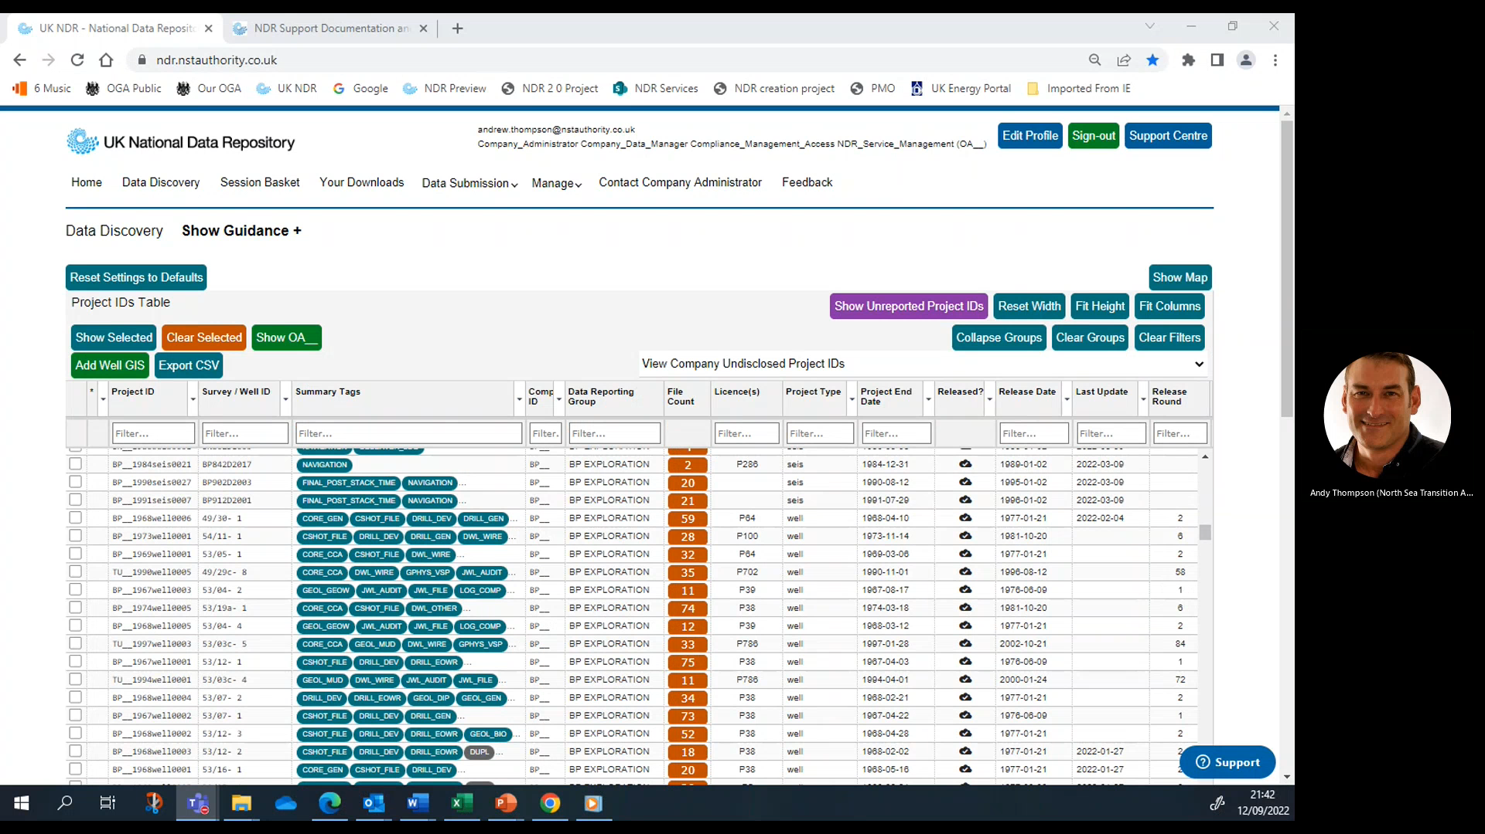
Video 1

Slide 7
Data availability updates
Wellbore data:
193GB Well data released since NDR launch
Over 666,000 files and 5TB of well data available
Over 1,000 well files downloaded in last three months
Field seismic data:
NSTA & Moveout collaboration – WoS surveys in progress x 5
User led self-service reporting – esp. site surveys
Processed seismic data:
Lyme Bay Consulting donated merged post stack seismic data
Central North Sea; Outer Moray Firth; Northern North Sea; Faroes Shetland Basin
Four Projects OA__2022seis0001 to 0004 - two SEG-Y versions of each (original and conditioned)
CNS data was released on Monday 12th September and is already being downloaded

Slide 8
How to… filter Project & Files Tables

Slide 9
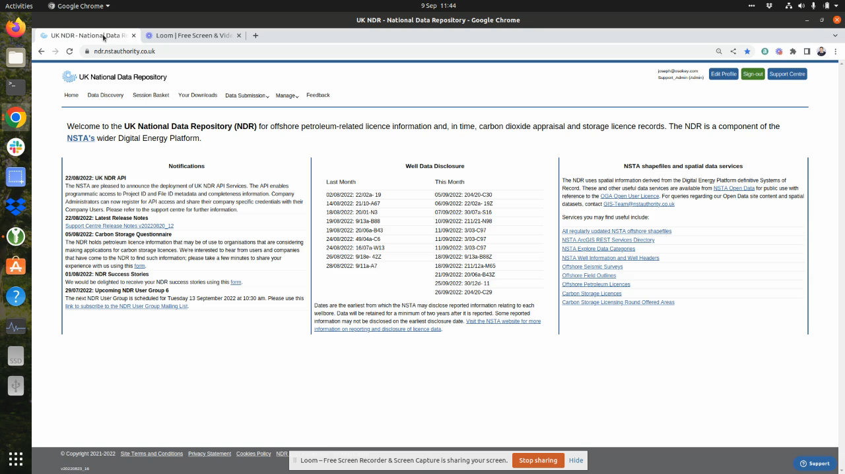
Video 2

Slide 10
Q&A
General topics

Slide 11
Task Finish Groups and Projects

Slide 12
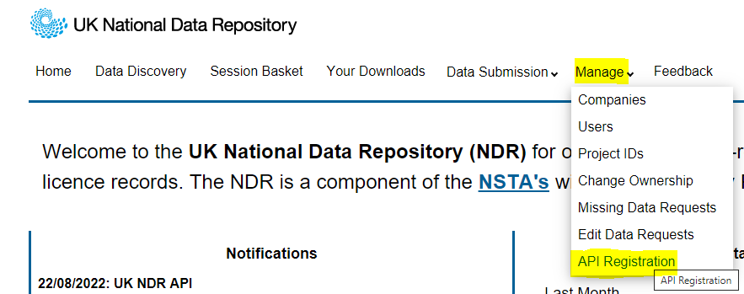
TFG003 - Webservice Access (API)
API Services have been deployed and include access to:
  Metadata for ‘Completeness’ (Seismic, Well, Site Surveys)
  Project and File metadata for the entire NDR data collection
Company Administrators can now register for API access and share their company specific credentials with their company users.
19 Companies have registered for access in the first three weeks.
8 Companies are currently actively using the API.

Slide 13
TFG005 - UI / UX Review
User Interface and User Experience review (UI/UX) initiated in March
  Workflow optimisation
  Upload and Data Management
  Compliance
  Accessibility
Themes – now Workstreams in our Prioritised Development Plan:
  Presentation and Layout
  User awareness of existing functionality
  Search and Find
  Download
August release: Additional Wellbore Attributes
“Add Well GIS” button - imports values directly into Project IDs Table from the NSTA’s SoR
  The six new well metadata columns are:
  Spud Date Target Field Current Well Intent
  Measured Depth True Vertical Depth Completion Status

Slide 14
TFG005 - UI / UX Review (Slide 2)
Presentation and Layout
Renaming of columns in Projects and Files tables; Clarifications in mouseovers and ‘Group By’ drop downs.
Examples of recent changes to align with SharePoint lists (metadata API) include:
  Owner is now Data Reporting Group which more accurately reflects the role of the company listed against each project.
  Rel. Date column label is now Release Date
  Group By Release Date rather than Group By RDAT in the drop down function
  Well ID and Survey Name combined in one column making better use of space in both tables.
  Files Table shows similar changes for consistency and clarity.
  Additional columns for Log Run Date, Top and Bottom depths and Depth Type (MD, TVD etc.)

Slide 15
How to… discover data with the map

Slide 16
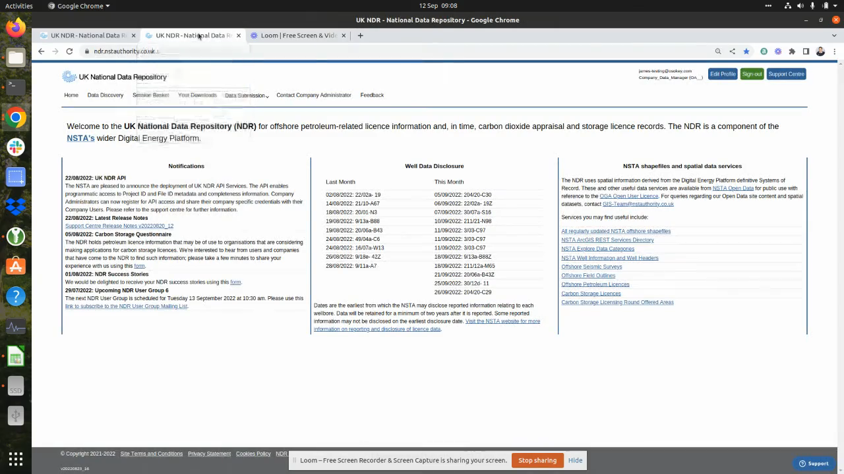
Video 3

Slide 17
TFG006 – Cloud to Cloud Seismic Reporting
Initiated over the summer - NDR Team approached a short list of licensees
    Significant holdings of legacy and current seismic data
    Thought to be hosting seismic data in cloud based systems
The conditions exist for licensees to report data directly from their cloud systems to the NDR
We expect there are efficiencies to be had from direct data transfer – time and/or costs
We don’t know for certain – we don’t have visibility of licensee systems, commercial arrangements with suppliers etc.
If there are ways to leverage technology to enable efficient, effective and less costly reporting, then we’d like to see them being used
Licensees, DM and cloud hosting service providers – contact ndr@nstauthority.co.uk if you would like to participate in this group.

Slide 18
TFG007 - Legacy Seismic Reporting
We’re considering how to enable reporting of legacy seismic data while maintaining standards
Is it better to have legacy data in the national archive, or licensees archives?
  Plenty of good reasons to have data reported to the NDR
  Create an enduring archive of a nationally significant asset
  Make data available to a growing and diverse range of use cases
  Enable licensees to gain relief from the obligation to retain data in perpetuity
Recent NSTA exercise to understand the landscape:
  Particular focus on acquisition data – SEG-D
  Mixed situation and responses to NSTA colleagues still to be finalised
NSTA is considering options:
  Legacy data in legacy formats – according to the retention requirements of the time
  Ensuring quality and completeness, for future reuse

Slide 19
TFG008 – DM Best Practices (Licensees)
We’re proposing to run a series of workshops for licensees, looking at best practices for Data Management in the NDR
Small-ish groups to encourage open active participation – everyone to have their say
Potential topics: Loading seismic data
Editing Classification Tags
Confirmation of loading success
Managing the Inventory
Who’s up for this? What do you want to cover?
Have you any suggestions for other TFGs?
Contact ndr@nstauthority.co.uk

Slide 20
Q&A
Task Finish Groups and Projects

Slide 21
Next steps

Slide 22
Next steps – 3 month outlook
Development plan – continuous improvement
  Further development of the Data Discovery UI
  Looking towards development of the NDR Map
  Review Missing Data Request workflow
NSTA strategic projects
  OCR of legacy data collection (following 2021 PoC)
  Interim ‘enabler’ for several subsequent development projects
Licensing Rounds
  Carbon Storage – June 2022
    Questionnaire – how did you find it??
    https://forms.office.com/r/ywpf7RJAas
  Offshore Petroleum Licensing Round – Autumn 2022

Slide 23
Q&A
Next steps

Slide 24
Dates For Your Diary
November 2022 | Tuesday 29th November* – NDR User Group Meeting 7
February 2023 | Tuesday 28 February* – NDR User Group Meeting 8
Date TBC | TFG007 – Legacy Seismic Reporting – get in touch at ndr@nstauthority.co.uk
Date TBC | TFG008 – DM workshops for licensees – get in touch at ndr@nstauthority.co.uk
*Provisional date

Slide 25
Thank You

