Slide 1

Annual Consents Exercise 2024
Presentation to Industry
NSTA Consents & Operations Teams
OPRED EMT
22 June 2023

Slide 2


Ground Rules
MS Teams – This is being recorded
Turn off video.​
Mute when not speaking.​
Use ‘raise hand’ button to ask any urgent questions.​
Use the chat to park questions (preferred option).

Slide 3
Annual Consents Exercise (ACE) 2024
What we will Cover
Welcome / Ground rules & Context – 5 minutes
ACE 2024 – 50 minutes
  The Consents team
  Context
  Overview
  Production Applications
  OPRED Environmental Requirements
  Flare and Venting Applications
  Onshore
  Consents for Facilities
  Key Messages & Links
  Q&A
Field Consents Project – 15 minutes
  Presentation
  Q&A

Slide 4
Consents Organogram
Malcolm Cowie
(Interim C&A Manager)*
Terri Kelbie
(Consents Case Manager)
Matthew Armstrong
(Consents Case Manager)
Patrycja Kupniewska
(Consent Case Officer)
Simon Churchfield
(Interim C&A Team Lead)
Amy Duncan
(Consent Case Officer)
Andrew Carle
(Consents Case Officer)
June Wallace
(Consents Case Officer)
NOTE: *Ensure queries are routed to the Consents inbox (consents@nstauthority.co.uk ) or to Malcolm Cowie as the Interim Consents & Authorisations Manager.

Slide 5
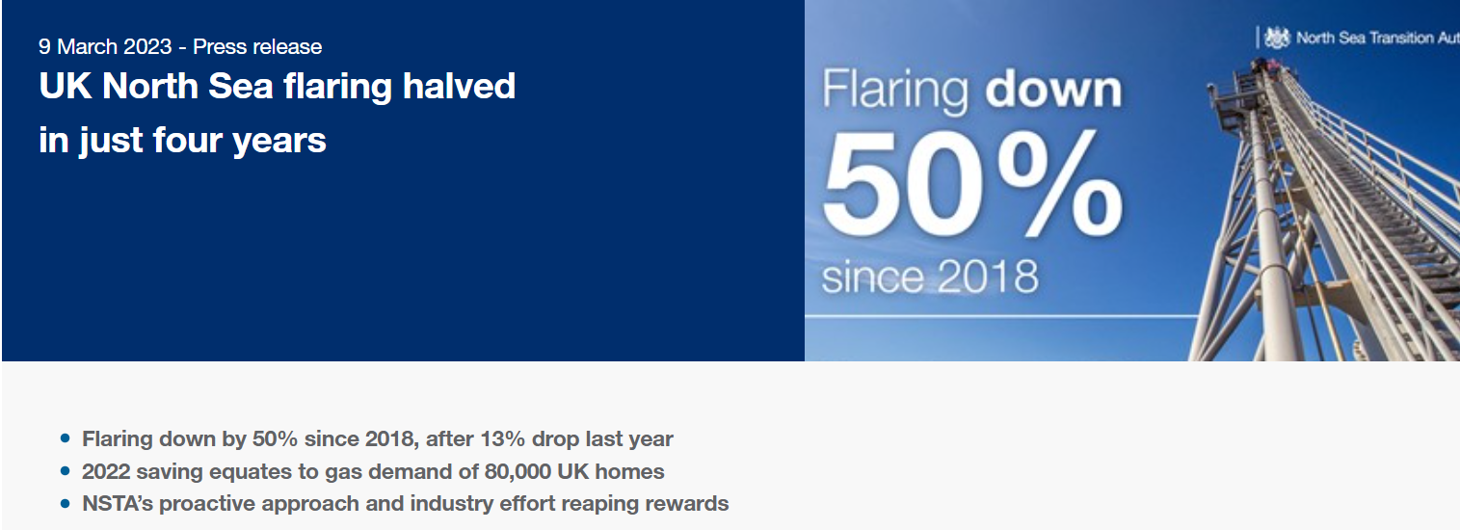
Headline achievement…
… but flaring still contributes circa 20% of overall emissions from oil and gas activities.

Slide 6

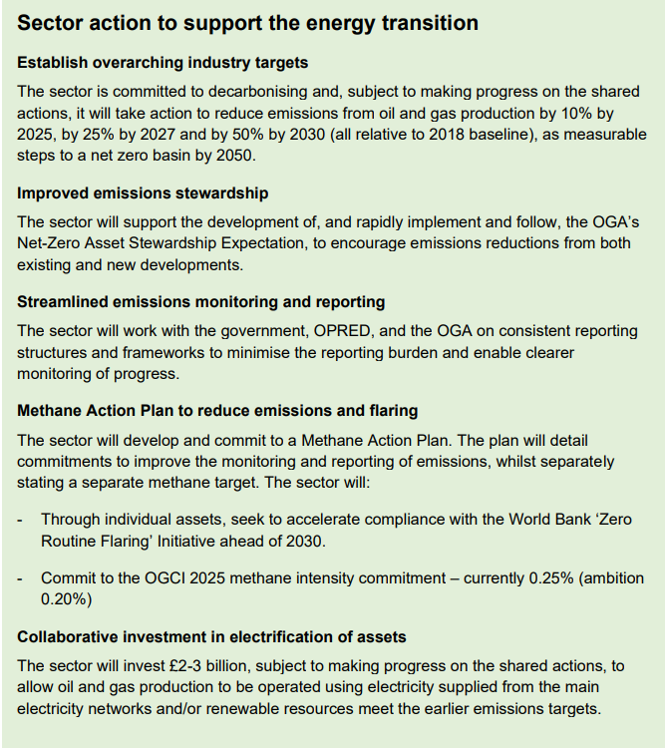
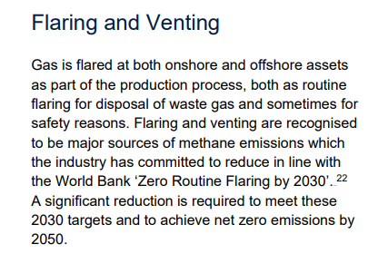
Context: Zero Routine Flaring by 2030
22: Zero Routine Flaring by 2030 (ZRF) (worldbank.org)
* The Oil and Gas Authority (‘OGA’) operates under the name North Sea Transition Authority (‘NSTA’). The OGA remains the legal name of the company. References to the NSTA should be interpreted as the OGA.
Source: North Sea Transition Deal, March 2021: North Sea Transition Deal (publishing.service.gov.uk)

Slide 7
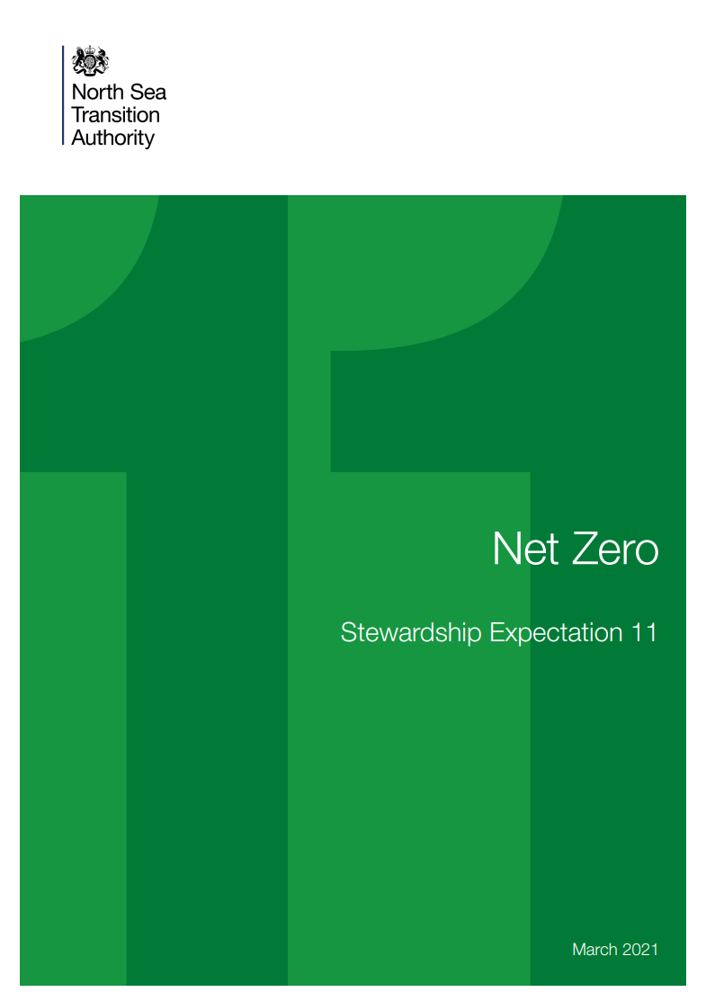
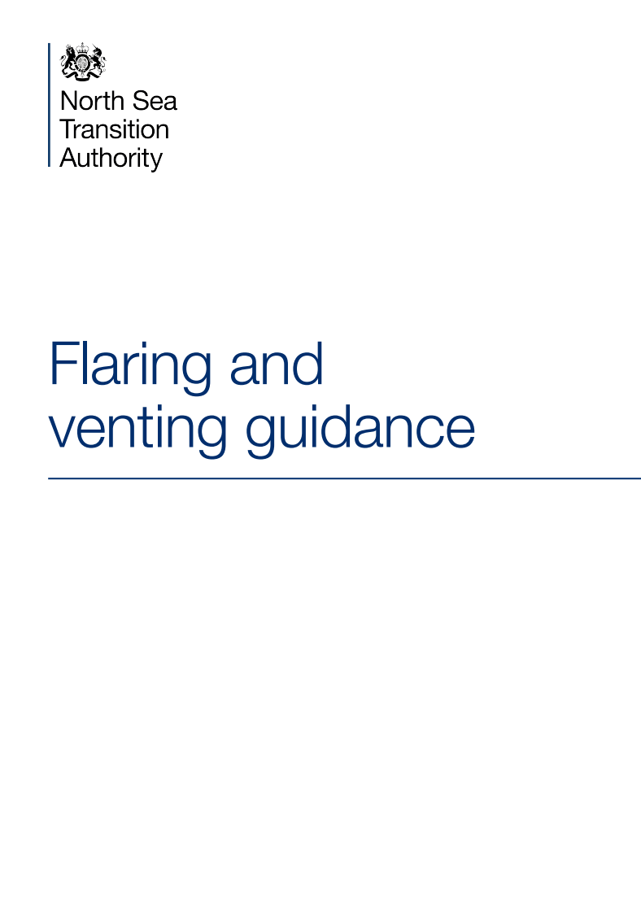
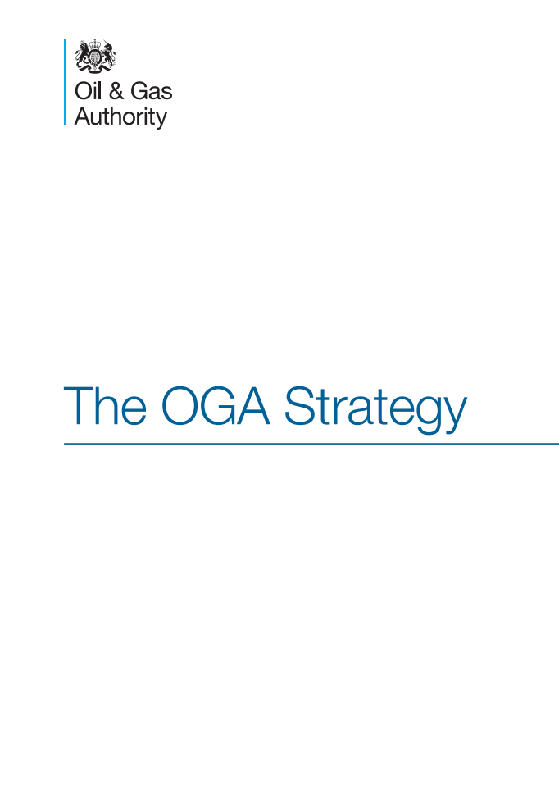
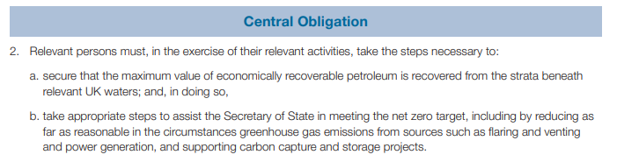
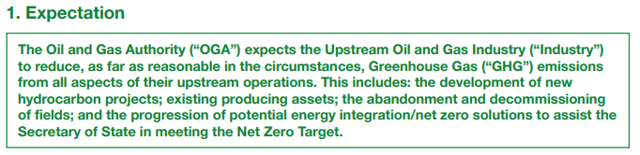
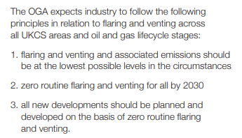
Context: Regulatory Tools

Slide 8
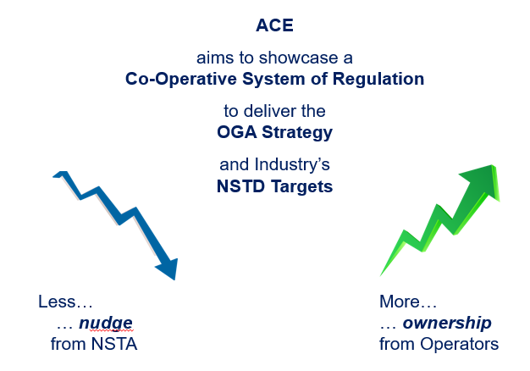
Evolving approach to ACE / Consents
Key change effected for ACE 2023:
Key Messages for ACE 2024:
Own the process of securing your consents
– they are prerequisites to ‘getting’ petroleum.
Reflect plans to reduce flare and vent emissions in your applications
– emissions reduction is not optional.
Monitor performance and delivery against consent
– compliance remains a key focus for NSTA.

Slide 9
Keeping the process on track
  Failure:
  to submit compliant applications by the requested deadlines;
  or
  to cooperate in a timely fashion with the NSTA’s review of the applications,
  May put at risk the timely approval of the consent;
  or
  May mean you do not get the consent requested;
  and
  May be regarded as a failure against the Petroleum-Related Requirement to act in accordance with the Strategy.

Slide 10
Annual Consents Exercise 2024
ACE Overview
ACE is the process to apply for consent to produce Oil & Gas and Flare or Vent Gas in the; UKCS, Onshore & Facilities for the upcoming year, after expiry of the current consents.​
Operators are reminded, that if they identify any requirement for a revision to their current consents, then apply for this in a timely manner, for consideration by the NSTA and its consultees (where applicable) ​
The NSTA's guidance and the key dates for the 2024 Annual Consents Exercise will be on the NSTA website by end of week commencing 17 July:
https://www.nstauthority.co.uk/licensing-consents/consents/annual-consents-exercise/
This webpage is the NSTA's key method of communication, with details of the supporting requirements and assist industry to be able to plan with certainty.​ It is recommended that Operators set a reminder each year for early-mid July to check for updates on the website regarding the upcoming ACE for that year.

Slide 11
Annual Consents Exercise 2024
ACE 2023 Overview
309 consents Production (116), Flare (85) and Vent (108) annual consents issued on time / before year end.
Offshore applications account for 80% of consents. Onshore 13%, Facilities, 7%. ​
Operators submitted 92% of PCONs on time, 94% of FCONs on time and 92% of VCONs on time. ​
25 applications (8% submitted late).

Slide 12

Annual Consents Exercise 2024
ACE Production Consents
There are two templates for Production Consents:
  For revisions to the volumes (not dates) in an existing Production Consent, or
  To apply for a new Production Consent commencing in 2024 or to extend an existing consent beyond 31 December 2023.
The second category is covered by ACE 2024 and applications are to be submitted by 31 August 2023. ​
If Operators apply using the wrong template, you will be requested to withdraw it and will be charged, along with the additional cost for the correct application. If in doubt, please contact the consents@nstauthority.co.uk email box for advice.​
The NSTA will need confirmation of Secretary of State (“SoS”) agreement prior to issuing field consents which include project activity. Therefore, please engage with DESNZ regarding Project activity early and ensure that associated environmental submissions are made in sufficient time. DESNZ will discuss the Project question in the next section of this presentation.

Slide 13
Annual Consents Exercise 2024
ACE Production Consents (cont.)
Input minimum and maximum figures for the consent. Minimum figures are to be greater than 0 (unless it has been agreed with the NSTA).
Make full use of the ‘Additional Information’ boxes to provide supporting detail/rationale for forward profiles, particularly if there is an increase resulting from a project.
Long Term Production
  Input maximum and minimum figures for each year of the consent. This is to be in thousand standard cubic metres/day (kscm/day) for both oil and gas (as required).
Annual & Short Term Production
  Figures should be in standard cubic metres/month for oil and this will convert to thousand standard cubic metres/day once totals have been calculated.
  Gas figures should be in thousand standard cubic metres/month and this will convert into a daily average once the totals have been calculated. Calculated totals will automatically populate onto the Cover Info page.

Slide 14
Any Questions?
Any Questions?​

Slide 15

For Production Consents, there is no requirement for developers to submit an EIA (ES) or Screening Direction unless the proposed changes to the consent can be defined as a project under the 2020 EIA Regulations:
Schedule 1
Extraction of oil and natural gas for commercial purposes where the amount extracted exceeds 500 tonnes per day in the case of oil and 500,000 cubic metres per day in the case of natural gas [compared to 2023 figures].
OR
Schedule 2
Extraction of oil or natural gas for commercial purposes where the amount extracted is equal to or less than 500 tonnes per day in the case of oil and equal to or less than 500,000 cubic metres per day in the case of natural gas [compared to 2023 figures].
Flaring and Venting are not considered ‘projects’ under the 2020 EIA Regulations and therefore no assessment is required, and no Secretary of State agreement is required before the NSTA can issue consent.
ACE 2024 Industry Event – 22 June 2023
Notes:
Cover style 2 (delete if using cover style 1)

Slide 16
AND there is:
- the execution of construction works or of other installations or schemes,​
- other interventions in the natural surroundings and landscape including those involving the extraction of mineral resources
Common examples:
Drilling of a well
Well intervention works
Enhanced oil recovery
Not isolated to increases in production. Production consents applications may be seeking current/decreased levels, but if there are ‘enabling works’ this would also constitute a project and require a 2020 EIA Regulation application.
ACE 2023 Industry Event – 22 June 2023
Notes:
Cover style 2 (delete if using cover style 1)

Slide 17
Any Questions
Any Questions?​

Slide 18

Annual Consents Exercise 2024
Flare and Vent – ACE and Short Term.
All new annual Flare and Vent Consent applications to be submitted before 29th September 2023.
Applications for both ACE Flare/Vent consents and short-term consents must be submitted using a new application template. (They cannot be processed as revisions to existing consents.)
A revision is only for a change in volumes (no change of dates). Revisions to existing consents should be completed before applying for the new consent which will start on 1st January 2024.
If Operators apply using the wrong application template, they will be requested to withdraw it, but will be charged, along with the cost for the correct application. If in doubt, please contact the consents@nstauthority.co.uk email box for advice.
The Flaring and Venting Guidance Document was published June 2021. It is on the NSTA website and details the current requirements.

Slide 19
Annual Consents Exercise 2024:
Reminder of 2021 Flare & Vent Key changes
Flare and Vent consent figures both need to be split into Categories, aligned with World Bank definitions
  Category A – Routine Category B – Non routine Category C – Safety related
Cold flaring (e.g., before a flare is lit or when it goes out) must be classed as Venting (not flaring).
If in any doubt on any of the above, contact the NSTA Senior Facilities Engineer for advice.
Prior 12 months data is required: operators to report a full 12 months of actuals* up to the application date. This is for both short term and annual Flare and Vent consents and will be supported by monthly comments.
The NSTA will review/consider all consent requests: irrespective of quantities, all applications will be must include information that explains the basis of the figures and may be challenged.
* Clarification: ACE flare and vent applications automatically request reporting from Oct 22 - Sept 23. In this section only include months that have completed data. Use the functionality to delete any months that do not have completed data at the time of submission.

Slide 20
Annual Consents Exercise 2024 –
NSTA Considerations in F&V Applications
Reasonable applications must include:
Explanation of the basis for requested Consent (either in notes or in a supporting document attached to application)
  Forecast requirements reflect delivery of all in-year emissions reduction activities (aligned to your SE-11 ERAP)
Reported Actuals and Requested Consent figures split into Categories as per NSTA Guidance
Explanation of how the Categorisation has been done
Immediate areas of concern, likely to result in application being returned:
No monthly comments included in the Flare/Vent report
No monthly comments included in the Flare/Vent consent request
No comments included in Additional Info >> Notes section
No attachments and/or no explanation on the basis for the requested figures
Significant variation in month-by-month categories with no explanation
Significant difference in Flare/Vent consent request vs. Flare/Vent report actuals

Slide 21
Annual Consents Exercise 2024 –
Categorisation of Flare and Vent figures
As part of the journey towards Zero Routine Flaring, there will be an increasing focus on categorisation of emissions.
NSTA recognises that this will be a journey of continuous improvement towards the 2030 target, and that there is currently no consistent methodology.
2024 Applications Tell us how you’ve done category split on Actuals and Request.
e.g. Engineering judgement based on totals, systematic source identification and categorisation, blend of calculation and by difference allocation.
2025 Applications Have a documented process in place on how categorisation is done
Level of rigour should be proportionate to emissions levels, clear on how areas of uncertainty are handled
Direction of travel Operators & Regulator have robust, auditable system in place to support commitments.

Slide 22
Any Questions?
Any Questions?​

Slide 23
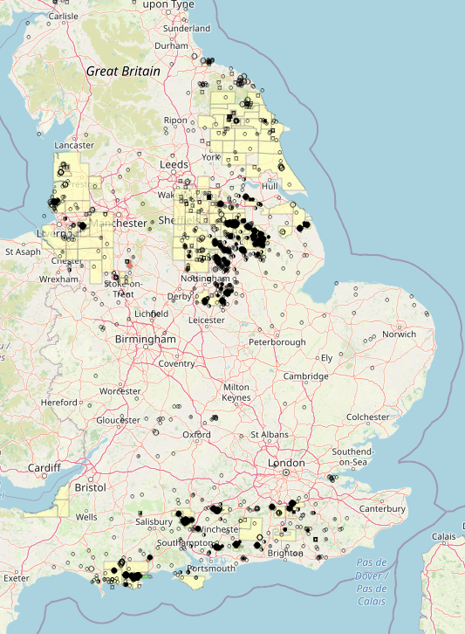
Onshore
35 Onshore consents expected for renewal in 2023
Will follow the same schedule as offshore consents
Following government commitment to net zero and reducing waste of hydrocarbons, we will be phasing into annual F&V consents starting next year
Provide FDPA if requesting further production consent
Well stewardship continuing with focus on wells within fields that are not being actively used

Slide 24
Any Questions?
Any Questions?​

Slide 25
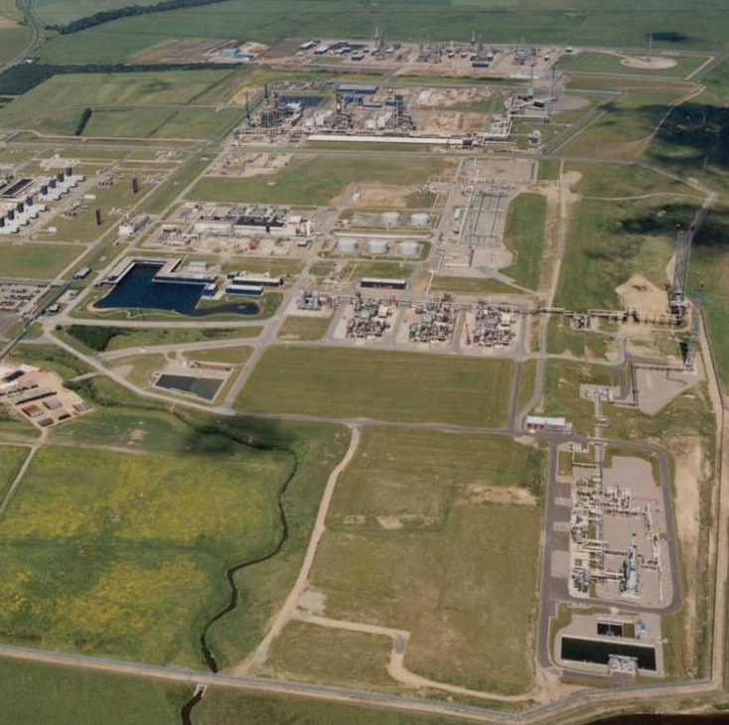
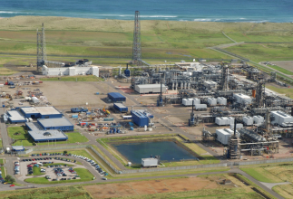
Annual Consents Exercise 2024 - Flare & Vent – Consents for Facilities
Required by section 12A of the Energy Act 1976 for flaring and venting at oil and gas processing facilities which typically include terminals
Applications are not submitted in the UK Energy Portal; should instead be submitted via email to consents@nstauthority.co.uk by 29th September 2023
See section 4.6 of the guidance for the required information to be included (broadly similar to that for fields):
  List of fields or other facilities sending hydrocarbons to the facility
  Actual flaring and venting quantities for the last 12 months
  Expected flaring and venting quantities for the next calendar year in Categories A, B, C
  Summary of measures being considered or implemented to reduce flaring & venting emissions
Consents are normally annual unless particular issues require more frequent monitoring
Payment required for consents for facilities, typically through an invoice sent after issue of the consent
Likely to be the last year of this separate approach – should be included in the Energy Portal for ACE 2025

Slide 26
Any Questions?
Any Questions?​

Slide 27
Annual Consents Exercise 2024 - What we need from Industry - Key Messages & Deadlines
If you are unable to meet any of the deadlines, please email consents@nstauthority.co.uk for the attention of the NSTA Consents & Authorisations Manager with the background, ensuring this action is taken before the deadline, requesting guidance on next steps – at the very earliest opportunity.
‘Non or late responders’ will be noted by the NSTA, but we will no longer be issuing reminders 5 days prior to or after the deadlines for submissions. In terms of ‘non or late responders’ this may put at risk the timely approval of the consent or may mean you do not get the consent requested; and may be regarded as a failure against the Petroleum-Related Requirement to act in accordance with the Strategy.
NSTA strongly advises Operators to have a minimum of two working contacts on the UK Energy Portal, who can then action applications if they are returned.
Please ensure that all NSTA requests and comments are addressed promptly. Failure to do this will delay your application being progressed.
Please engage early with DESNZ EMT so that they can consider and if appropriate issue SoS agreement in good time to align with the NSTA deadlines.
Revisions to current Production, Flare and Vent consents are to be submitted before applications for the new consent is submitted.
Deadline for Development & Production Consent Applications – 31 August 2023.
Deadline for Flare & Vent Consent Applications – 29 September 2023.

Slide 28

Annual Consents Exercise 2024 – Key Links
UK Energy Portal Login:
https://itportal.nstauthority.co.uk/eng/fox/nsta/NSTA_LOGIN/login
Annual Consents Exercise Guidancee and Information:
https://www.nstauthority.co.uk/licensing-consents/consents/annual-consents-exercise
Production Consents and Field Development Plans Guidance:
https://www.nstauthority.co.uk/licensing-consents/consents/production-consents/
Guidance on Applications for Flaring and Venting Consents:
https://www.nstauthority.co.uk/licensing-consents/consents/flaring-and-venting/
Field Consents System User Guidance:
https://www.nstauthority.co.uk/media/7646/field-consents-system-user-guidance-update-june-2021-final.docx

Slide 29
Any Questions?
Any Questions?​

