Slide 1
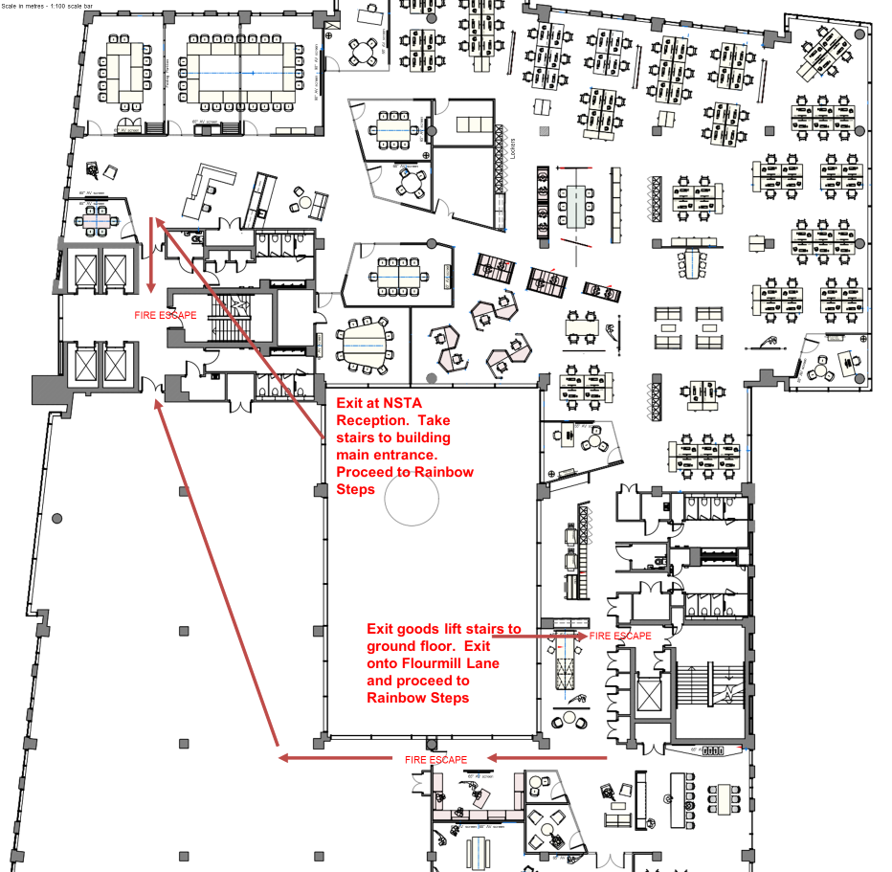
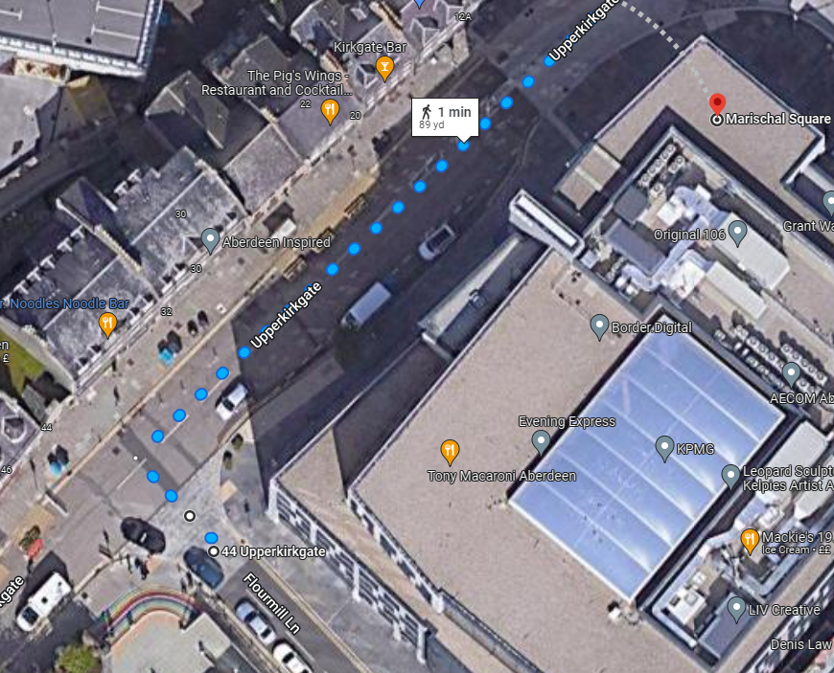
Safety Moment Please take note of the fire exits. The assembly point is the rainbow steps on Flourmill Lane. There is a planned fire alarm test at 12pm.
You are here

Slide 2
UK National Data Repository
User Group Meeting No. 11
14 November 2023

Slide 3
Meeting etiquette & structure
Please turn your cameras off and remain muted.
Please use the meeting chat to post your questions throughout the meeting.
Questions raised in the meeting chat will be addressed at the end of each section of today’s presentation, time permitting.
Please feel free to ask questions at the end of each section of today’s meeting.
Should there be time remaining after all planned sections, we can use that for general discussion.
The meeting will not be recorded - slides to be shared on the NDR User Group web page
https://www.nstauthority.co.uk/data-and-insights/data/uk-national-data-repository/ndr-user-group-and-updates/

Slide 4
Agenda
Introduction and general topics (10:30)
Last meeting Recap, Version releases, Updates to documentation
Discussion Points (10:35)
Reporting Exploration licence data – how is confidentiality managed? Andy Thompson
Reporting Data Files for Wells – Core Analysis,Well Test and data Jayne Scarisbrick
Compliance Reports Robert Swiergon
Reporting OBN seismic data – what to report? Lewis Faryma
Wells missing from WONS and from the NDR Andy Thompson
Reporting Generic Field Reports and Studies etc. Andy Thompson
Planned Updates and Developments (12:05) FIRE ALARM TEST (12:00)
Project - NHDA collection to the NDR
Project - File Format corrections – status and procedure - PDF
Next steps – 3-month outlook (12:20)
Development plan summary, Dates for your diary and Contact information
AOB

Slide 5
September meeting – Recap and Activity
Development plan – continuous improvement
Legacy SEG-D reporting solution and procedure
NHDA archive to NDR - seismic, well and other information
Edit Data Request UI for DMs – track status of your Project/File Edit requests
CRS assignment workflow for surveys
File Format label corrections
NSTA strategic projects
Licensee specific NDR User Group events
Review and plan to migrate remaining offline data collection
Review and plan to migrate ‘other’ sources of licence information

Slide 6
Version, documentation and other updates
Version release - v20231101_15 Interim release – No notice to NDR stakeholders yet
Functionality - Basemap update, Improvements to Clear Filters, Well ID filter recognises “space”
Usability - Project IDs Table: Multi select options for Area - Project Type - Seismic Type
- Suggest/Edit: Set CRS drop down includes EPSG codes
Reporting - Submit Data screen includes Well/Survey ID next to Project ID
Information Reporting – ‘Form and Manner’ Notice to NDR stakeholders 08.11.23
Table 15 Redundant C Tags removed (Horizon and Data_Processed)
Section 9 TAR-SEG-D Specification section – detailing components and naming conventions etc.
Table 16 Definition of FFID – Field File ID, filename for raw data files
https://www.nstauthority.co.uk/media/cytbo5r4/information-reporting-form-and-manner-for-ndr-november-2023.pdf

Slide 7
Q&A
General topics

Slide 8
Discussion Points

Slide 9
Reporting Exploration Licence Data

Slide 10
Reporting Exploration licence data i
Disclosure rules are dependent on the type of licence that the data has been acquired in relation to.
There are two types of Petroleum licence, Exploration and Production
Seismic surveys may be acquired in relation to either.
Exploration licences are prefixed with the letter E. Production licences are prefixed with the letter P
Regulations state that seismic data must be reported for both types of petroleum licence
Production licensees are usually energy companies engaged in the development of hydrocarbon resources
Exploration licensees are usually commercial geophysical acquisition companies, although it is usual for certain larger energy companies to hold both exploration and production licences
It is important to be clear about which type of licence, and preferably which actual licence, a survey was acquired in relation to before reporting derivatives of the survey to the NSTA
Derivative and reportable information includes survey data that has been processed or that has been reprocessed as a commitment on the behalf of the licensee in fulfilment of their licence terms

Slide 11
Reporting Exploration licence data ii
Data reported to the NSTA via the NDR must have an associated NDR “Project”
Projects may be created by the NSTA or by the Licensee
Seismic Project creation requires: Data Reporting Group
Coordinate Reference System and polygon coordinates
Processing completion date (determines release date)
Survey type: 2D, 3D, 4D, OBS, Site
Licence ID: e.g. P123, P5678 or E765
Description: Survey area, associated field etc.
Survey ID: otherwise called CS9 / NDR9 code
Adding the Licence ID when the project is created determines which Release Rules are applied.

Slide 12
Reporting Exploration licence data iii
Examples:
Adding P5678 will apply Production licence rules
The survey and data will become eligible for release 5 years from the Processing completion date
Adding E765 will apply Exploration licence rules
The survey and data will become eligible for release 10 years from the Processing completion date
(15 years for Field data, which is not routinely reported)
Note that records without any information in the Licence(s) field in the Projects Table were migrated from the previous system.
These can be updated using Suggest/Edit workflows. Edits do not update the Release Rules and Dates

Slide 13
Reporting Exploration licence data iv
NO NDR PROJECTS ARE AUTOMATICALLY RELEASED
When routinely releasable projects become eligible for release, the NSTA NDR Team reviews and, at their discretion, approves the release of a Project.
This applies to well, seis, mhaz, rems and intp projects
A query identifies any projects that have become eligible for release since the last check
An authorised NSTA user can then “Approve” the release of the data
Once an NDR project has been released, it will be visible to all NDR users in Data Discovery
All available Files for a released Project will be visible in the Files Table
Files that have not yet reached their Release Date cannot be previewed or downloaded
Projects that associate to an Exploration licence ID ARE NOT ROUTINELY RELEASABLE
Such projects cannot be released via the NDR User Interface
Exploration licence data can only be released through changes to the database
On specific instruction by authorised NSTA staff

Slide 14
Reporting Exploration licence data v
All data pertaining to surveys acquired by Exploration licensees is to be reported to NDR Projects that have an E licence in the Licence(s) field, and that consequently have Exploration licence release rules applied.
Meaning:
They have a Release Date set that is 10 years later than the Processing Completion Date
AND
They are not routinely processed for release when the Release Date arrives.
From time to time, Production licensees reprocess data from existing surveys, including those that have been acquired in relation to Exploration licences.
In such circumstances, the Production licensee must either include the appropriate Exploration licence ID when creating the Project or inform the NSTA if the NDR Team is to create the Project.
If the Production licensee does not know the correct E licence ID, the appropriate release rules can be set by adding “E0” during project creation.
This is not the preferred option – we aim to establish correct references, so if E0 is to be used it should be on the understanding that it will be corrected at the earliest opportunity.

Slide 15
Reporting Ocean Bottom Seismic

Slide 16
Reporting OBN Seismic
In 2022 bp acquired an OBN survey over Schiehallion.
Consisting of 1.5 million files (>800TB) direct to our cloud, including:
raw NFH field data
raw continuous field data
nav merged chunked field data
various gathers
post-stack products
navigation
observers logs
reports
various misc. supporting files
Such data volumes not unusual with modern OBN acquisition.
NDR User Group – 14th November 2023

Slide 17
Reporting OBN Seismic (2)
Issues
Sheer scale
Reporting timescales via standard route unworkable
Receipt to cloud
Can incur additional charges for rehydration if reporting delayed
More moving parts, various storage levels
End of processing date requirement to create ProjectID
Delayed reporting of acquisition datasets by several months
Data loading order controlling ctag availability
bp large entity with several teams involved
coordinating data in this order is a challenge (at the moment)
Current framework not set up for OBN
Testing tar workflow with NDR
Reporting requirements not clear for OBN products
NDR User Group – 14th November 2023

Slide 18
Reporting OBN Seismic (3)
Current situation for Schiehallion OBN 2022
NSTA and NDR teams supportive and engaged
Currently testing use of NDR tar workflow
ProjectIDs now set up and data loading ongoing
NDR User Group – 14th November 2023

Slide 19
Reporting OBN Seismic (4)
What are we actually reporting?
raw NFH field data
raw continuous field data
nav merged chunked field data
various gathers
post-stack products
navigation
observers logs
reports
various misc. supporting files
But - does reporting this subset grant us relief of retention for the survey?
NDR User Group – 14th November 2023

Slide 20
Reporting OBN Seismic (5)
Proposal
Significant benefit can be derived at an Industry level if we:
Collaborate across all stakeholders
We need everyone in the room:
Geophysicists, Contractors, Data Managers, NDR team, Regulators, Stakeholders…
May enable cohesion between stakeholders:
MEDIN, OPRED, NSTA
Develop best practise
Streamline receipt of deliverables and reporting
Could acquisition contractors report directly on our behalf?
Reduce touch points
Ensure data reported before “data entropy” begins
Support clarity on OBN regulatory position (retention relief through reporting)
NDR User Group – 14th November 2023

Slide 21
Reporting OBN Seismic (6)
Proposal
NDR Work Group – OBN Seismic Reporting
NDR User Group – 14th November 2023

Slide 22
Compliance Reports

Slide 23
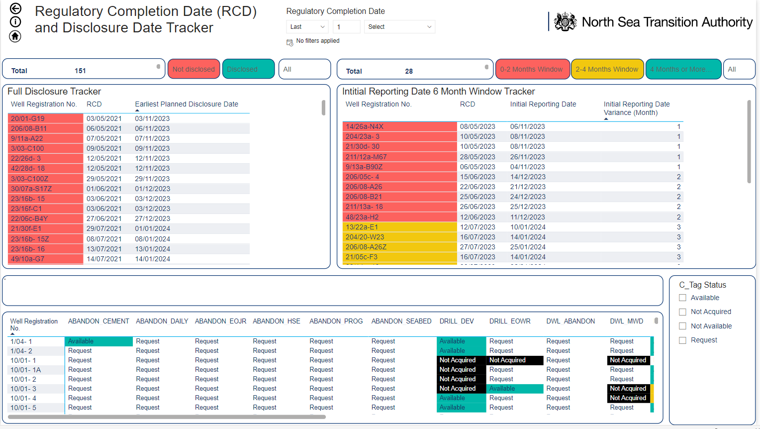
Compliance Reports (2)
NSTA use of WONS data is evolving, using data from WONS notifications & NDR APIs we’ve create several Power BI reports some of which we aim to publish on our new website
These reports will cover different aspects of wellbore compliance
By publishing this data, the NSTA’s hope is that operators will be able to identify gaps in their reporting in ‘real time’
This report allows the NSTA to prioritise the reporting of items to wellbores close to the initial six-month reporting deadline
Publishing this data will allow operators to review their compliance in real-time

Slide 24
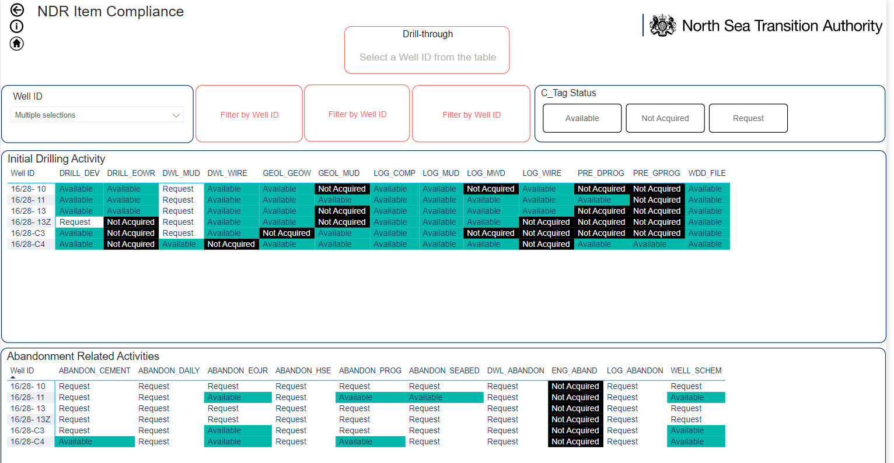
Compliance Reports (3)
We have created a report where you can review multiple wellbores at the same time
You can also search via multiple criteria
Currently this report only looks at a select number of items

Slide 25
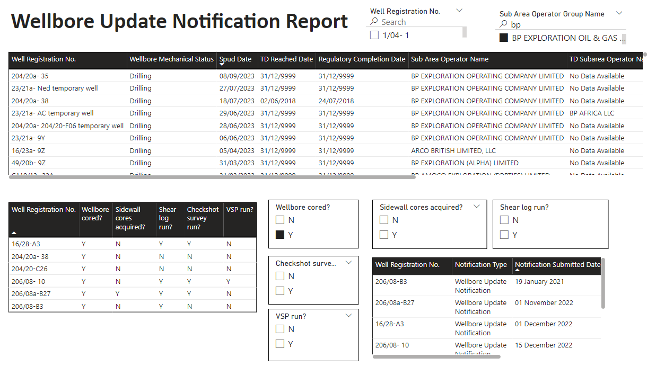
Compliance Reports (4)
Using our internal Data Warehouse we are now using data submitted in WONS notifications
We are now able to QC notifications submitted against items loaded to the NDR
We use the NDR API
This allows us to identify missing data, targeting specific items and improving data availability
Notification UAT Data

Slide 26
Reporting Data Files for Wells

Slide 27
Reporting Data File for Wells (2)
Reporting core analysis data to the NDR
Core Analysis data, routine and special is usually delivered from 3rd party as pdf report along with the data values in
excel sheets. These data may be loaded to software for interpreter use.
Current CTAGS for this type of data from guidance (section 5 & section 6) is inconsistent i.e. not mentioned in both sections
and only allows for PDF form and manner
Section 5
Section 6

Slide 28
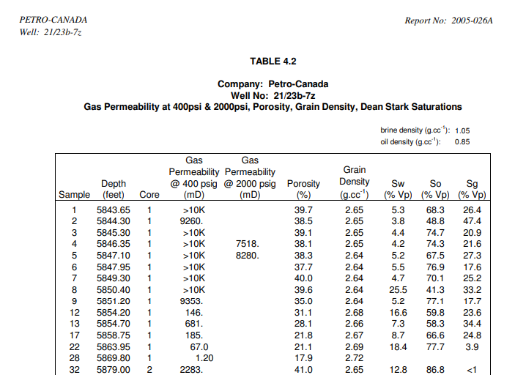
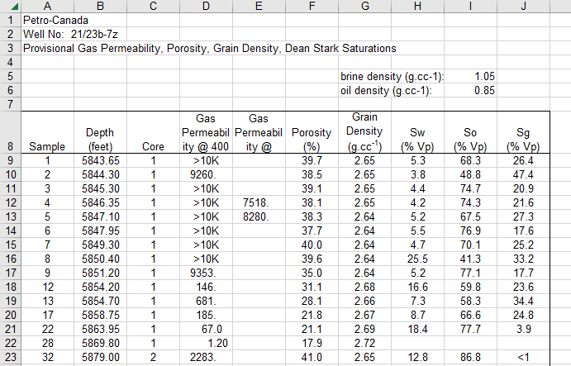
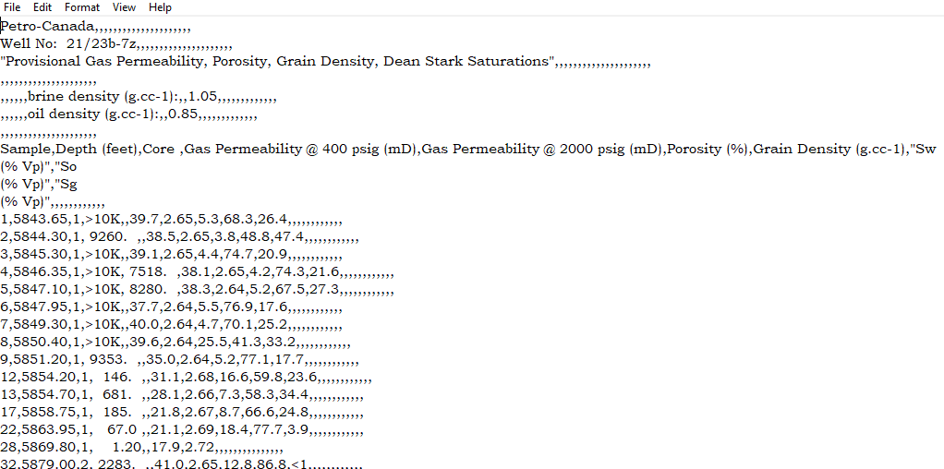
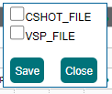
Reporting Data File for Wells (3)
Reporting core analysis data to the NDR
Believe should be able to report as .txt or .csv but cannot currently do this as this form and manner only allows CTAG
of type CSHOT_FILE or VSP_FILE to be assigned
CORE_CCA
CCA_FILE

Slide 29
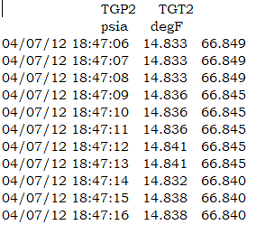
Reporting Data File for Wells (4)
Reporting DST well test data to the NDR
Digital Well test data, DST, can only be reported if reported to las or dlis
Issue is legacy DST data is often in ascii format depth or time indexed. Currently no ability to report test data as .csv or .txt
TEST_FILE as DST not DWL_TEST although could report digital test data by reformatting to las – experience of working with time indexed data to convert to las?
Inconsistence guidance – TEST_FILE not scanned image but can only be a scanned image.
Propose requirement to be able to report other digital data as .csv or .txt as is possible with VSP/Time-depth data

Slide 30
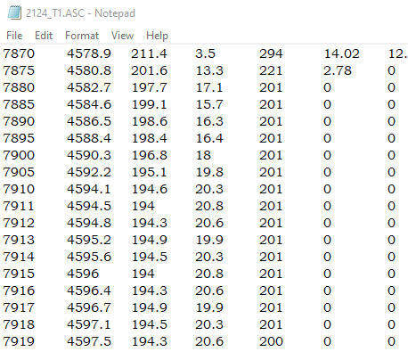
Reporting Data File for Wells (5)
Reporting mud data to the NDR
Digital mud data can only be reported as las
Issue is legacy mud data is often in ascii format with depth, tvd as opposed to md and also may have mixed sample
Interval down the file. Currently no ability to report test data as .csv or .txt
Have to rely on the reporter reformatting data from original form into .las without “changing the data”
IE las files are usually depth indexed by MD so if using TVD which well position data has been used. When converting
The data with mixed sample intervals has there been interpolation of the data between points etc?
Is this an issue?
Sample interval changes
from 5ft to 1ft

Slide 31
Reporting Data Files for Wells (6)
We need to define the file format (e.g. .csv, .ascii) and the data format (preferably and industry standard)
An option for reporting DWL is LAS; the file format is an ASCII file type – the industry standard is LAS
PDF is suitable for Reports preferable that data files are reported in an accessible format,
that accommodates includes structured tabular data.
DRILL_DEV is the deviation survey report, WDD_FILE is a P7/2000 formatted ascii file
TEST_FILE, CCA_FILE and SCAL_FILE can currently only be reported as PDF, which is convenient neither for the submitter, nor the recipient (and MUD_FILE has never (?) been defined).
What are the correct formats for reporting these types of information?
How are they recorded/provided by acquisition contractors?
How are they consumed by users of this information?
What header information should be included to ensure data is fit for reuse?
Digital, Accessible, Validated and Improved

Slide 32
Reporting Data Files for Wells (7)
NDR principals require that the correct file type and appropriate data formatting standards are determined and documented.
Where both are agreed by the NSTA, we can configure the system to accept data that is formatted accordingly.
Data that preceded Data Quality requirements (summer 2021):
FFMT often misleading or incorrect
ASCII and UNK/UNKN/UNKNOWN are mostly csv and xls, but also Zip, Jpeg, TXT and ASCII etc.
FFMT Label* | CCA_FILE | SCAL_FILE | TEST_FILE
ASCII | 1,260 | 432 | 1,247
CGM | 1
CSV | 1
DLIS | 11 |  | 43
DOC | 4 | 2 | 3
LAS | 54 | 43 | 183
LIS | 8 |  | 1
MS EXCEL |  |  | 1
P7/2000 | 6 |  | 2
PDF | 64 | 24 | 33
PLAIN |  |  | 4
TIFF | 8 |  | 41
UNK/UNKN/UNKNOWN | 278 | 189 | 323
Excel | 821 | 551 | 732
Digital, Accessible, Validated and Improved

Slide 33
Reporting Field or Regional Studies

Slide 34
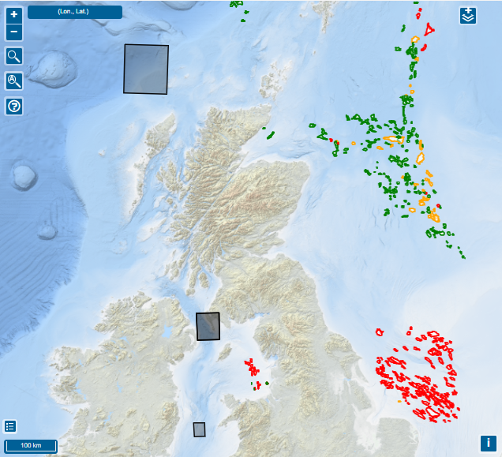
Reporting Generic Field Reports and Studies etc.
Functionality is in place to enable reporting of “other licence information” that does not relate to a specific wellbore or survey.
The ability to create “Interpretation” projects has been in place for some time
Only recently have we created intp projects, to accommodate regional studies and reports migrated from the NHDA
Reporting Guidance refers to “Other Licence Information” which is not always routinely reportable,
This includes:
Subsurface, reservoir, and other geological studies
Multi well reports and field studies
Rather than a well or survey, the information may be associated with a Field, a Licence or another reference
Contact the NDR Team if you have been asked to report information that should be loaded to an Interpretation project
Digital, Accessible, Validated and Improved

Slide 35
Wells missing from WONS & NDR

Slide 36
Wells missing from WONS and from the NDR
Wellbores exist in the real world that are not recorded in WONS
Often these will be mechanical sidetracks, but not exclusively
The NSTA has been advised that licensee corporate systems include such ‘missing’ well records
This was raised by the NSTA and discussed at ISC SIG #20, August 2023
Licensees were advised that the NSTA will conduct a review, aligned to WIOS Operator review
Records for wellbores that are missing from WONS will be added, which will update the NSTA SoR for wells
Records for Wells in the NDR are based on the NSTA SoR for wells
Only wells that exist in the SoR can be added to the NDR
A weekly review of both systems flags any records in the SoR that are not included in the NDR
Usually and new records will be recently spudded wells – the NDR team creates a new Well project
Any records that are added to the SoR as a result of the aforementioned review will be included in the NDR
Digital, Accessible, Validated and Improved

Slide 37
Updates and Developments

Slide 38
Metadata issues: Format Labelling

Slide 39
Resolving metadata issues: Format Labelling
Incorrect File Format label: >221,000 files labelled as PDF 1,903 files labelled with a suffix other than .pdf
Progress to date: Review of all mislabelled files
Actual File Format determined
Mostly programmatically – remnants directly
Planned changes communicated to ISCs
Next steps: Plan and test application of changes to labels
Apply changes to incorrectly labelled PDFs
Future actions: Repeat a file type at a time.
Rationalise equivalents (e.g. SEGY and SEG-Y)
To be clear – it is only the metadata label “File Format” that will be changed.
The file itself will not be modified – let’s call a spade a spade…
To be File Format | Count
TIFF | 997
ZIP | 305
MS WORD | 138
JPG | 100
LAS | 79
PDS | 59
MS EXCEL | 55
CGM | 38
MS POWERPOINT | 31
SEG-Y | 13
LNK | 13
PLAIN TEXT | 11
ASCII | 10
DLIS | 9
META | 8
WRF | 6
PNG | 5
CSV | 5
TAR | 4
EMF | 3
DWG | 3
P7/2000 | 2
ODF | 1
HTM | 1
SUR | 1
GIF | 1
BITMAP | 1
RICH TEXT | 1
PMD | 1
MSG | 1

Slide 40
NHDA to NDR Data Migration

Slide 41
National Hydrocarbons Data Archive
What is the NHDA?
NDR precursor managed by the BGS on behalf of the DTI (originally), then DECC
Enabling:
Data reporting of licence data in accordance with PON9
Relief of licensee obligation to retain data ‘in perpetuity’
Access to petroleum licence information
Submissions suspended in 2016 when ‘OGA’ announced plans to implement an NDR.
Archived data remains held by the BGS
Some will have been reported via CDA’s UKOilandGasData service
Some will have been reported directly to the NHDA
BGS and NSTA currently collaborating to ensure that ALL reported offshore petroleum licence data is under one roof
https://www.bgs.ac.uk/geological-data/national-geoscience-data-centre/national-hydrocarbons-data-archive/

Slide 42
National Hydrocarbons Data Archive 2
Summary Project approach
BGS has provided NSTA with data archived the NHDA
Objective is to migrate offshore petroleum licence information from the NHDA to the NDR
Licence data that is successfully migrated to the NDR is no longer required to be held in the NHDA
Data was provided on magnetic tape (primarily seismic data) and on a USB drive (primarily well data)
NDR Project teams have conducted file level analysis on all provided content.
Confirmed and logged the information provided
Compared NHDA holdings to NDR holdings (file level, including SHA512 comparisons)
~60% already present in the NDR (70% for wells, 23% for seismic)
Refined list of files opened, contents reviewed and described
Duplicated files identified and removed (often contained within existing NDR zip files)
Remaining files were identified to be migrated to the NDR

Slide 43
National Hydrocarbons Data Archive (2)
Well reports, logs and other data on USB drive:
2,310 files have been loaded directly to NDR
Certain of those needed to be conditioned or formatted to meet NDR quality criteria and data exchange standards
683 files converted to searchable PDF
72 digital well log files converted from LIS to LAS
389 files remain – over 300 can probably be converted to NDR compatible formats
e.g. Well deviation survey data in Excel format can convert to P7/2000
Seismic data on tape:
1,101 files have been loaded directly to NDR
Certain of those needed to be conditioned to meet NDR quality criteria and data exchange standards
Navigation-seismic merge of 3D SEG-D in ‘tape native’ format, to cloud compatible SEG-Y
XY’s added to 2D SEG-Y headers to meet SEG minimum standard
All migrated files have descriptions containing the wording ‘File loaded by NSTA from BGS NHDA archive.’

Slide 44
NHDA Data provided to NSTA on USB drive
Folder | NHDA | Already in NDR | Migrated | Remain | Action
Licences | 370 | 84 | 270 | 16 | Not relevant / corrupted / format not compliant
Site Surveys | 41 | 2 | 20 | 19 | Not relevant / not reportable information
Wells | 7,572 | 5,430 | 1,830 | 312 | Format not compliant – convert to e.g. .txt or .pdf
Well Logs | 804 | 600 | 190 | 14 | Format not compliant – adapt NDR rule set (?)
Well SEG-Y | 115 | 87 | 0 | 28 | Nav merge XY to headers and upload
 | 8,902 | 6,203 | 2,310 | 389 | Progress - 96%
The project expect that approximately 50 files will not be migrated for one reason or another.
A record of file-by-file analysis and actions, decisions and comments is being maintained as we progress.
The NSTA will share the record with the BGS as a final deliverable of the project
Digital, Accessible, Validated and Improved

Slide 45
NHDA Data provided to NSTA on tape
Count | Comments | Status
593 | NHDA content already loaded to the NDR
1074 | Nav-seis merge to meet NDR data quality requirements and migrated
27 | Compliant processed seismic migrated without intervention
612 | Mainly 2D raw field seismic - new archival procedure for tape native formats
259 | Formats not compatible with NDR requirements - reformat and migrate
2565 | All data files included on NHDA tapes provide to the NSTA | Progress 66%
The project anticipates there being files that cannot be migrated – too soon to provide an estimate
A record of file-by-file analysis and actions, decisions and comments is being maintained as we progress
The NSTA will share the record with the BGS as a final deliverable of the project
Digital, Accessible, Validated and Improved

Slide 46
Next steps

Slide 47
Next steps – 3-month outlook
Active Projects
File format label corrections – Complete “PDF” then address other file types
NHDA archive to NDR - seismic and well information
Project Table UI/UX updates
Migrate ‘other’ sources of licence information
Under consideration/planning
NDR Project ‘active dates’ amendment workflow (for NSTA users)
Revise and standardise “Release Rule” attribute
Offline archive to NDR (continued)
Seismic survey metadata to NSTA Open Data

Slide 48
Contact Information
NSTA NDR Team
NDR Team - email our mailbox ndr@nstauthority.co.uk
General enquires in relation to the National Data Repository
Referrals to NSTA colleagues or Support Centre, where appropriate
Register for the NDR User Group mailing list – updates and User Group invitations
NDR Support Centre
Technical support for matters in relation to using the National Data Repository
Advice on how to use the UI, uploading data, downloads, ordering on media, metadata services
Osokey and Moveout technical expertise
support@uk-ndr.co.uk
https://support.uk-ndr.co.uk/
in app Support Centre launch – raise tickets, support articles and video explainers
Support Centre chat option

Slide 49
Thank You

