Slide 1
Annual Consents Exercise
Annual Consents Exercise (ACE) 2026
Presentation to Industry
NSTA Regulation & Operations Teams
OPRED EMT
23 June 2025
Notes:
Thanks to everyone for joining us today for the kick of the 2026 Annual Consents Exercise
Today’s is about sharing the ACE 2026 framework, expectations for applications and timings.

Slide 2
Annual Consents Exercise (ACE) 2026
What we will cover
Presenter
ACE 2026
Intro & Housekeeping AC
What is ACE AC 2-7
ACE Context & Overview AC 8-13
Production Applications JV
OPRED Environmental Requirements SD (OPRED)
Flare and Venting Applications MC 22-23 / JW 24-25
Onshore AH
Consents for Facilities RW
Disputes & Sanctions DH
Key Messages MC
Q&A All

Slide 3
Etiquette Expectations
Turn your camera
off
Mute your Mic
Use the chat to park questions
This meeting is being recorded and will be uploaded to our website
Notes:
Throughout the presentation the footer will contain relevant information or links to assist in making applications.
We will monitor the chat as we go but please keep your questions for the time at the end. Intention is to issue an FAQ’s which should hopefully cover everything.

Slide 4
What is ACE?
Annual Consents Exercise Guidance and Information

Slide 5
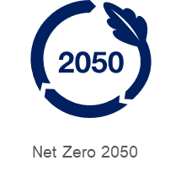
Introduction
Annual Consents Exercise (ACE)
Compliance/ Expertise
An efficient framework to ensure the requisite consents are in place
Ensure alignment with DESNZ Environmental Impact Assessment (EIA) Regulations (2020)
Support delivering the OGA Strategy:
Energy security, emissions reduction and accelerating the transition
Annual Consents Exercise Guidance and Information
Notes:
What is ACE?
All production, flaring and venting, whether onshore, from facilities or from the UKCS requires consent from the NSTA, this extends to around 500 consents on an ongoing basis.
Typically, the ACE program processes around 300 applications each year.
The Annual Consents Exercise (“ACE”) provides an efficient framework:
to ensure that fields and facilities have the requisite consents in place by the end of the year; and
running the exercise in the last half of the year means Operators should have accurate final figures for the current year, and these should provide a good basis to estimate proposed figures for the following year.
Support Delivery of the OGA Strategy:
Applications are subject to review to ensure they are compliant with, among other things:
The key elements of the Central Obligation of the Strategy – including to maximise economic recovery and reduce as far as reasonably practicable in the circumstances greenhouse gas emissions from sources such as flaring and venting.
Industry commitments under the North Sea Transition Deal (“NSTD”). Industry has committed to eliminate routine flaring and to reduce overall emissions of greenhouse gases by 50% by 2030.
Ensure Alignment with EIA Regulations:
The DESNZ Environmental Impact Assessment (EIA) Regulations (2020), in particular the approval by the Secretary of State (“SoS”) of project activity as defined under the EIA Regulations.

Slide 6
Annual Consents Exercise Project Team
ACE 2026
Consents
Operations
Onshore
OPRED
Onshore
Facilities
Production
EMT
Revisions
ACE
Flare & Vent
consents@nstauthority.co.uk
Notes:
How do we run ACE:
Multi-Discipline – Cross Regulator Team,
Regulation : Consents, Onshore
Technical : Operations
Environmental : OPRED EMT
Use the consents mailbox as the thread
- Determine when you contact us whether or not you’re getting in touch with an ACE application or a revision – the queries will go down two separate paths but there’s potential for knock on impact if you’re updating 2025 figures that are then different to what you’ve submitted in your ACE application

Slide 7
Consents Organogram
Malcolm Cowie
ACE Consents
Interim Consents Team Lead
Revisions
-
Senior Case Manager
Alice Chainey
Andrew Carle
Amy Duncan
Case Manager
Case Manager
Case Manager
June Wallace
Patrycja Kupniewska
Sarah Reynolds
Christabel Osunde
Case Officer
Case Officer
Case Officer
Case Officer
consents@nstauthority.co.uk
Notes:
Just to highlight who is dealing with what throughout the course of ACE from the Consents side – AC and SR will deal with anything and everything ACE related.
Utilising CO and AD will be single point of contact for revisions.

Slide 8
ACE Context
Annual Consents Exercise Guidance and Information

Slide 9
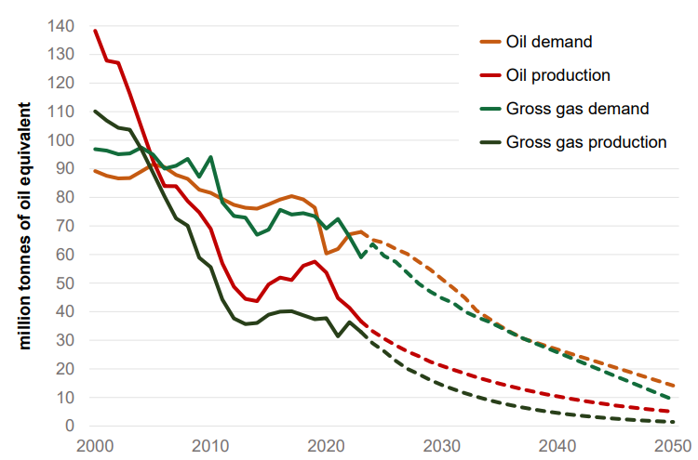
Helping Meet Demand
Oil and Gas currently meet three quarters of UK energy demand and will play an important role in the energy mix for years to come. Though it is declining, domestic production reduced our reliance on imports.
Domestic gas production equated to around half of UK demand in 2024
UK to be a net importer of oil and gas out to 2050
OGA Plan - Emissions Reduction

Slide 10
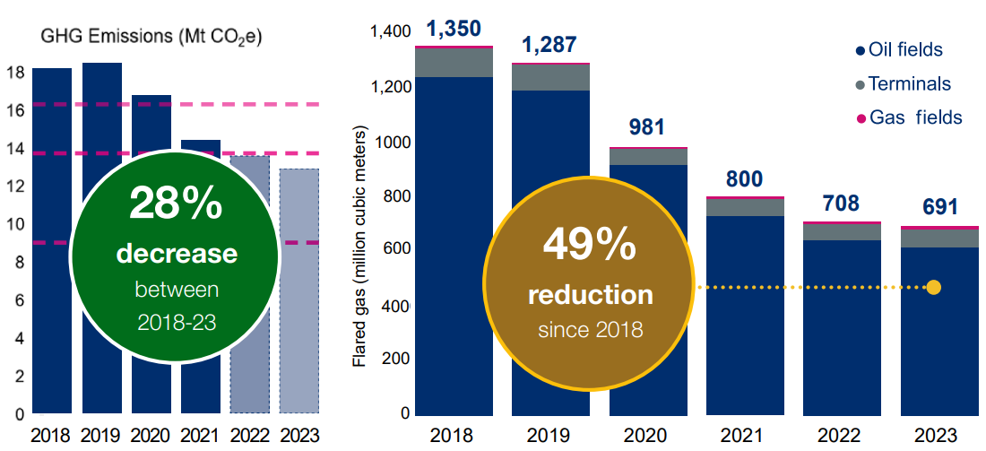
UK Upstream oil and gas GHG emissions
North Sea industry has pledged to reduce its emissions 90% by 2040, on the way to net zero by 2050.
While progress has been made, oil and gas production operations still make up 3% of UK emissions.
GHG emissions reduction
Declining gas flaring
OGA Plan - Emissions Reduction
Notes:
Relevant persons shall, as from 1 June 2024, provide a documented method of the split of projected flaring and venting figures into categories (A, B, and C) with their flare and vent consent applications, to support delivery of zero routine flaring and venting from 2030.
Relevant persons shall within their ERAPs, as from 1 June 2025 at the latest have plans, with associated budgets, to deliver continuous improvements in flaring and venting leading to GHG emissions reductions at the UKCS-level.
All assets consented to on a zero routine flare and vent basis must operate as such.
All new developments, including tiebacks to existing hosts, should be planned, designed and developed on the basis of zero routine flaring and venting.
Zero routine flaring and venting for all by 2030, for the latter with a particular focus on methane.
Relevant persons shall deliver continuous reductions of fugitive emissions.
These requirements build on and are consistent with the NSTA’s existing flaring and venting guidance.

Slide 11
Annual Consents Exercise 2026
Annual Consents Exercise Guidance and Information

Slide 12
ACE 2025 Overview
85% Received On Time
73% Received On Time
Failure to submit compliant applications by deadlines may be regarded as a failure against the Petroleum-Related Requirement to act in accordance with the Strategy
Notes:
Approximately 550 field consents are required to operate assets in the UK, of these 306 are handled via the ACE process. The remainder of these consents are short-term consents for Commissioning / Stewardship, but the majority are Production which sit out with Annual Consents Exercise because these are Long-term.
73% Production Applications received on time, decrease of 24% compared to ACE 2024. Given the new FCS launched and the time it took for things to become familiar this is what we are attributing the decrease to so hopefully things pick up again this year and we’re looking for this to be much higher.
Flare and vent submission rate was steady and slightly better but still down 6% with ACE 2024.
On the other side just a breakdown from last year again of the volume of consents and how they were then distributed around the relevant teams within NSTA
Final point – in regards to the deadlines – failure to meet the deadline may be regarded as a failure against the Petroleum Related Requirements to act in accordance with the Strategy

Slide 13
Dates & Deadlines
ACE 2026
Production Consents
Operator submissions
30 Jun – 15 Aug
ACE 2026
Flare & Vent Consents
Operator submissions
18 Aug– 12 Sept
All Consents Issued
12 December
Own the process of securing your consents, they are prerequisites to ‘getting’ petroleum
Notes:
It should be noted that the Production, flare and vent deadlines have been moved 2 weeks earlier this year than last year.
1. Own the process of securing your consents
– they are prerequisites to ‘getting’ petroleum
2. Reflect plans to reduce flare and vent emissions in your applications
– emissions reduction is not optional
3. Monitor performance and delivery against consent
– compliance remains a key focus for NSTA

Slide 14
Production
Production Consents and Field Development Plans Guidance

Slide 15
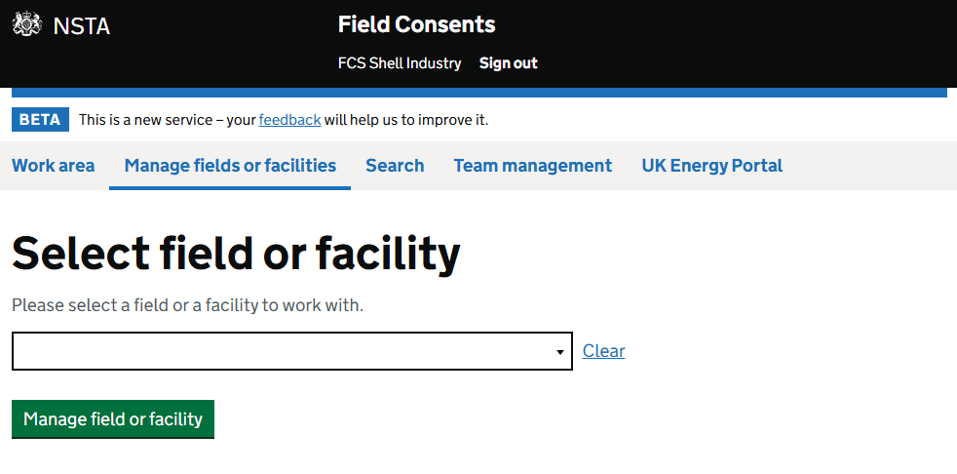
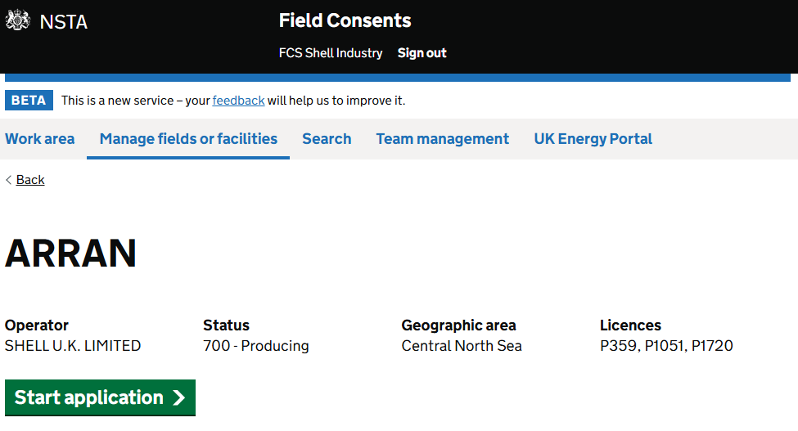
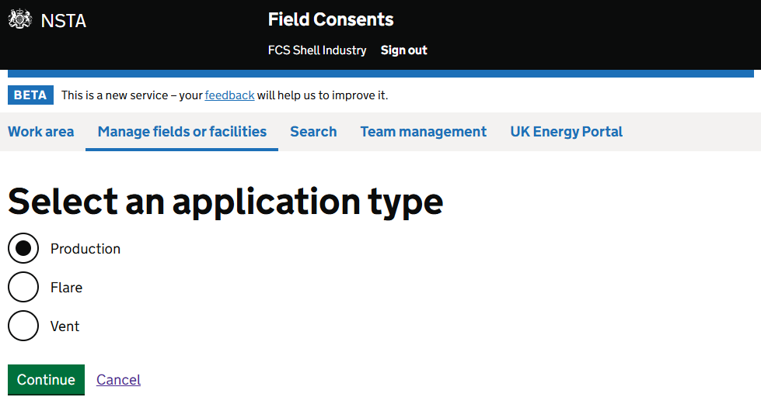
ACE 2026: Production Consents
Applicants Must Select: New Production Consent commencing in 2026.
Production Consent Submission period: 30 June - 15 Aug Production Consents and Field Development Plans Guidance

Slide 16
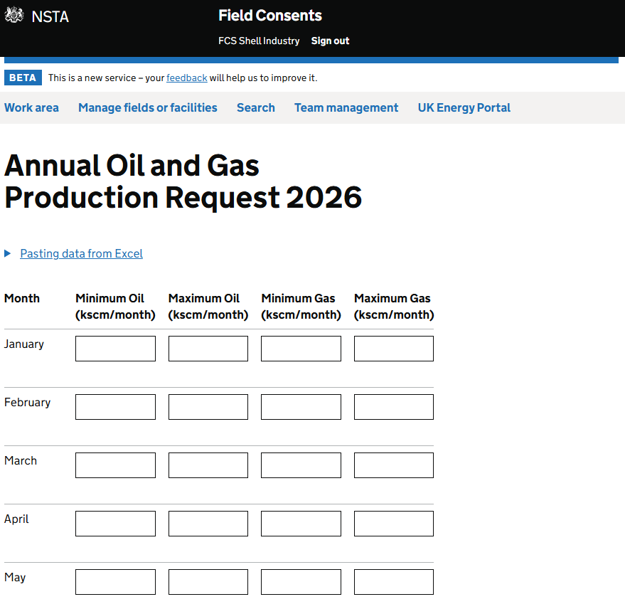
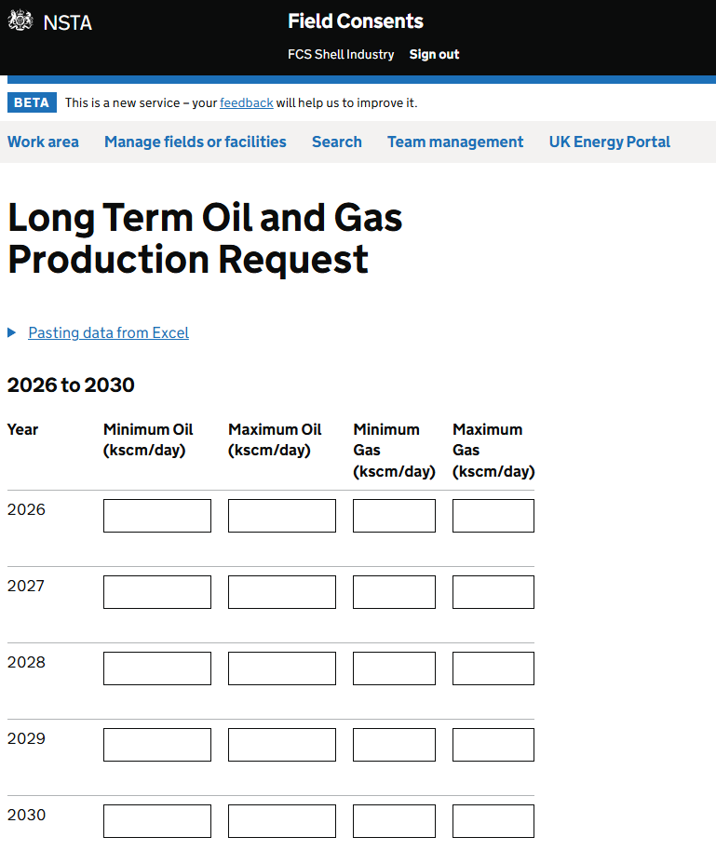
ACE 2026: Production Consents Applications
Volumes will be converted to kscm/day
on the Issued Consent Document
Make full use of the ‘Supporting Information’ boxes to provide supporting detail/rationale for forward profiles, particularly if there is an increase resulting from a project.
Notes:
Input minimum and maximum figures for the consent. Minimum figures are to be greater than 0 (unless it has been agreed with the NSTA).
Make full use of the ‘Supporting Information Notes’ box to provide supporting detail/rationale for forward profiles, particularly if there is an increase resulting from a project.
Long Term Production
Input maximum and minimum figures for each year of the consent. This is to be in thousand standard cubic metres/day (kscm/day) for both oil and gas (as required).
Annual & Short-Term Production
Figures should be in thousand standard cubic metres/month for oil and gas, and this will convert to thousand standard cubic metres/day once totals have been calculated in the application summary screen prior to submission to NSTA.

Slide 17
OPRED
Annual Consents Exercise Guidance and Information

Slide 18
ACE 2026: OPRED – Production & Projects
The NSTA needs confirmation of Secretary of State (“SoS”) agreement prior to issuing field consents which include project activity.
Please engage with OPRED early regarding Project activity and ensure that associated environmental submissions are made in sufficient time.
If you submit an application to the NSTA which is consented, and later considered a Project. As the SoS agreement has not been received for the Project Activity, the NSTA will take action to revoke the consent and you will have to reapply.

Slide 19
Production Consents
Preparation
Screening
Consultation
Authorisation
NSTA Operations Technical Review
Production Consent
NSTA Consents
NSTA Consents
OPRED
“Project”
OPRED
SoS Agreement
(EIA and Habitats Regs)
Habitats or EIA Requirements

Slide 20
ACE 2026: OPRED – What is a Project?
Project defined under the 2020 EIA Regulations: Schedule 1 Extraction of oil and natural gas for commercial purposes where the amount extracted exceeds 500 tonnes per day in the case of oil and 500,000 cubic metres per day in the case of natural gas [compared to consented figures for the current year]. OR Schedule 2 Extraction of oil or natural gas for commercial purposes where the amount extracted is equal to or less than 500 tonnes per day in the case of oil and equal to or less than 500,000 cubic metres per day in the case of natural gas [compared to consented figures for the current year]
AND there is:
the execution of construction works or of other installations or schemes,​
other interventions in the natural surroundings and landscape including those involving the extraction of mineral resources
e.g.
Drilling of a well
Well intervention works
Enhanced oil recovery
Flaring and Venting are not considered ‘projects’ under the 2020 EIA Regulations. Therefore, no assessment is required, and no Secretary of State agreement is required.
Notes:
For Production Consents, there is no requirement for developers to submit an EIA (ES) or Screening Direction unless the proposed changes to the consent can be defined as a project under the 2020 EIA Regulations: Schedule 1 Extraction of oil and natural gas for commercial purposes where the amount extracted exceeds 500 tonnes per day in the case of oil and 500,000 cubic metres per day in the case of natural gas [compared to 2023 figures]. OR Schedule 2 Extraction of oil or natural gas for commercial purposes where the amount extracted is equal to or less than 500 tonnes per day in the case of oil and equal to or less than 500,000 cubic metres per day in the case of natural gas [compared to 2023 figures].

Slide 21
Flare & Vent
Annual Consents Exercise Guidance and Information

Slide 22
Flare & Vent Applications
Screening
Consultation
Authorisation
NSTA Operations Technical Review
Flare Consent
NSTA Consents
NSTA Consents
OPRED
Environmental Review (Habitats Regs)
Screening
Consultation
Authorisation
Vent Consent
NSTA Consents
NSTA Operations Technical Review
NSTA Consents
Flaring and Venting are not considered ‘projects’ under the 2020 EIA Regulations.
Notes:
Flaring and Venting are not considered ‘projects’ under the 2020 EIA Regulations. Therefore, no assessment is required, and no Secretary of State agreement is required.

Slide 23
ACE 2026: Flare & Vent Consents
Applications for ACE Flare/Vent consents and short-terms must be submitted using a new application.
Flare & Vent Consent Submission Period: 18 Aug - 12 Sep Guidance on Applications for Flaring and Venting Consents
Notes:
Applications for both ACE Flare/Vent consents and short-term consents must be submitted using a new application template. (They cannot be processed as revisions to existing consents.)
A revision is only for a change in volumes (no change of dates). Revisions to existing consents should be completed before applying for the new consent which will start on 1st January 2026.
If Operators apply using the wrong application template, they will be requested to withdraw it (i.e revision rather than new), but will be charged, along with the cost for the correct application. If in doubt, please contact the consents@nstauthority.co.uk email box for advice.

Slide 24
ACE 2026: F&V Applications must include:
Explanation for requested Consent
Forecast requirements reflect delivery of all in-year emissions reduction activities
Reported full 12 months Actuals and Requested Consent figures
(in categories)
A: Routine, B: Non routine, C: Safety related
Documentation of how the Categorisation was done
Notes:
Reasonable applications must include:
Explanation of the basis for requested Consent (either in notes or in a supporting document attached to application - which has a file size limit of 50mb)
Forecast requirements reflect delivery of all in-year emissions reduction activities (aligned to your SE-11 ERAP)
Reported Actuals and Requested Consent figures split into Categories as per NSTA Guidance
Prior 12 months data is required: operators to report a full 12 months of actuals* up to the application date. This is for both short term and annual Flare and Vent consents and will be supported by monthly comments.
Explanation of how the Categorisation has been done: Level of rigour should be proportionate to emissions levels, clear on how areas of uncertainty are handled.
* Clarification: ACE flare and vent applications automatically request reporting from Oct 22 - Sept 23. In this section only include months that have completed data. Use the functionality to delete any months that do not have completed data at the time of submission.
As part of the journey towards Zero Routine Flaring, there will be an increasing focus on categorisation of emissions.
NSTA recognises that this will be a journey of continuous improvement towards the 2030 target, and that there is currently no consistent methodology.
Cold flaring (e.g., before a flare is lit or when it goes out) must be classed as Venting (not flaring).

Slide 25
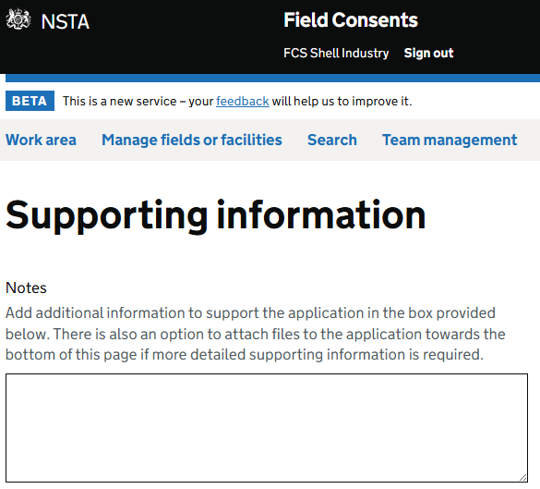
Why F&V applications are returned:
Lack of comments
No attachments/ explanation
Significant variation in month-by-month categories
Significant difference in consent request vs report actuals
Notes:
Immediate areas of concern, likely to result in application being returned:
No monthly comments included in the Flare/Vent report
No monthly comments included in the Flare/Vent consent request
No comments included in Additional Info >> Notes section
No attachments and/or no explanation on the basis for the requested figures
Significant variation in month-by-month categories with no explanation
Significant difference in Flare/Vent consent request vs. Flare/Vent report actuals

Slide 26
Onshore
Annual Consents Exercise Guidance and Information

Slide 27
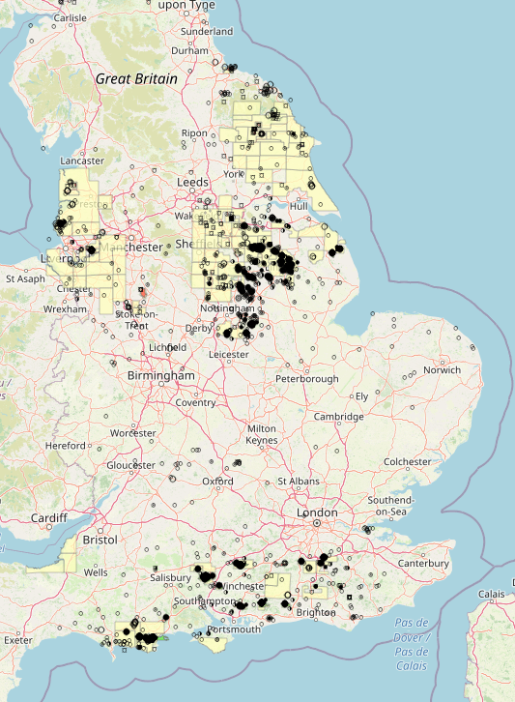
ACE 2026: Onshore
At least 53 Onshore applications requiring consent for 2026
Will follow the same schedule as Offshore consents
Following government commitment to Net Zero and reducing waste of hydrocarbons, we are only accepting annual F&V consents on the new system going forward
We require FDPA if requesting further Production consent
Well stewardship continuing with focus on wells within fields that are not being actively used

Slide 28
Facilities (Terminals)
Annual Consents Exercise Guidance and Information

Slide 29
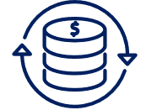
ACE 2026: Consents for Facilities – Key Messages
Queries will be raised, and consents for 2026 issued through the
Field Consents system
Application requirements outlined on slide for Flaring and Venting apply to Facilities
Payment required at the time of application submission
Notes:
Consents Will Be Issued Via Portal
Change from the previous system using email & Consents mailbox
Queries will be raised, and consents issued through the Energy Portal

Slide 30
Disputes & Sanctions
Annual Consents Exercise Guidance and Information

Slide 31
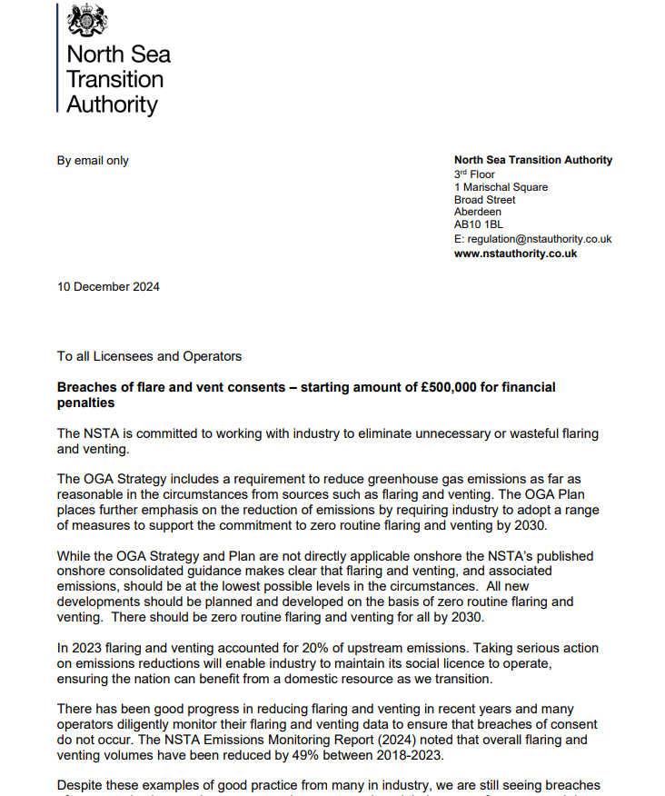
Disputes & Sanctions.
Demonstrate proactivity in your consent management
Should you be referred to D&S you will be expected to demonstrate effective monitoring and tracking
In the event of an unplanned event or where a breach is anticipated - engage early with the NSTA
The majority of breaches are occurring in Q3/Q4 and are often reported months after or are identified by the NSTA Consents Team and not the Responsible Operator
A reminder that when considering the level of fine imposed for a breach of a flaring or venting consent that occurs after 1 January 2025, the starting figure will be £500,000​
The NSTA Financial Penalty Guidance available on our website - Financial Penalty Guidance
Notes:
- Breaches are still occurring where operators are not monitoring their performance and data effectively. Regular monitoring of your actual flare and vent volumes vs. consent volume is crucial to effective consent management. ​
1. -
2. -
3. Be prepared to explain why you didn’t if you choose not to. ​
4. You are expected to anticipate reasonably foreseeable events such as equipment maintenance and adverse weather - your consents ought to be aligned to allow for this.
5. This was confirmed in an open letter from the NSTA to all Licensees and Operators on 10 December 2024​

Slide 32
Key Messages
Annual Consents Exercise Guidance and Information

Slide 33
Key Messages - Dates & Deadlines
ACE 2026
Production Consents
Operator submissions
30 Jun – 15 Aug
ACE 2026
Flare & Vent Consents
Operator submissions
18 Aug– 12 Sept
All Consents Issued
12 December
Own the process of securing your consents, they are prerequisites to ‘getting’ petroleum
Notes:
1. Own the process of securing your consents
– they are prerequisites to ‘getting’ petroleum
2. Reflect plans to reduce flare and vent emissions in your applications
– emissions reduction is not optional
3. Monitor performance and delivery against consent
– Regulatory compliance remains a key focus for NSTA

Slide 34
Key Messages – Process and Information
Process
Information
Revisions to current consents are to be submitted before applications for the new consent.
Charge remains for withdrawing wrong application & for submitting the new correct application.
Promptly respond to NSTA requests and comments
Minimum of two working contacts in each role in the new Field Consents system.
Engage early with OPRED EMT
Unable to meet deadlines?
Email consents@nstauthority.co.uk with background info
Pay up front for application by credit/debit card
ACE FAQ Document
Notes:
‘Non or late responders’ will be noted by the NSTA, but we will no longer be issuing reminders 5 days prior to or after the deadlines for submissions. In terms of ‘non or late responders’ this may put at risk the timely approval of the consent or may mean you do not get the consent requested; and may be regarded as a failure against the Petroleum-Related Requirement to act in accordance with the Strategy.

Slide 35
Q&A

Slide 36
Thank You

