Slide 1
Annual Consents Exercise (ACE) 2027
Presentation to Industry
NSTA Consents & Authorisations, Operations and Onshore
OPRED EMT
25 June 2026

Slide 2
Annual Consents Exercise (ACE) 2027
What we will cover
Presenter (slides)
ACE 2027
  Intro & Housekeeping Marc 2-3
  What is ACE Patrycja 4-8
  ACE Overview Patrycja 9-10
  Production Applications Andrew S & Patrycja 11-15
  OPRED Environmental Requirements Sarah (OPRED) 16-23
  Flare and Venting Applications Robert 24-28
  Onshore Lisa 29-30
  Consents for Facilities Andrew 31-32
  Investigations and Enforcement David 33-34
  Key Messages Patrycja 35-47
  Q&A All

Slide 3
Etiquette Expectations
Turn your camera
off
Mute your Mic
Use the chat to park questions
This meeting is being recorded and will be uploaded to our website

Slide 4
What is ACE?
Annual Consents Exercise Guidance and Information

Slide 5
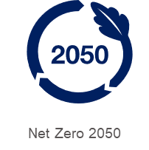

Annual Consents Exercise
Compliance/ Expertise
An efficient framework to ensure the requisite consents are in place
Ensure alignment with relevant environmental assessments:
Environmental Impact Assessment (EIA) Regulations & Habitats Regulations
Delivering our strategy:
Energy security, emissions reduction and accelerating the transition

Slide 6
Annual Consents Exercise Project Team
ACE 2027
NSTA Consents
NSTA Operations
NSTA Onshore
OPRED
Production
Production
EMT
Revisions
ACE
Flare & Vent
Facilities
Flare & Vent
consents@nstauthority.co.uk

Slide 7
Consents Organogram
Jenni Whitfield
Consents Team Lead
Malcolm Cowie
Principal Case Manager
Patrycja Kupniewska
Case Manager
June Wallace
Case Officer
Andrew Carle
Senior Case Manager
Terri Kelbie
Case Manager
Alice Chainey
Case Manager
Christabel Osunde
Case Officer
ACE Consents
Revisions
consents@nstauthority.co.uk

Slide 8
ACE 2026 Overview
96% Flare & Vent
Received On Time
88% Production
Received On Time
consents@nstauthority.co.uk

Slide 9
Annual Consents Exercise 2027
Annual Consents Exercise Guidance and Information

Slide 10
Dates & Deadlines
ACE 2027
Production Consents
Operator submissions
29 Jun – 14 Aug
ACE 2027
Flare & Vent Consents
Operator submissions
17 Aug– 11 Sept
All Consents Issued
11 December
Own the process of securing your consents, they are prerequisites to ‘getting’ petroleum

Slide 11
Production
Production Consents and Field Development Plans Guidance

Slide 12
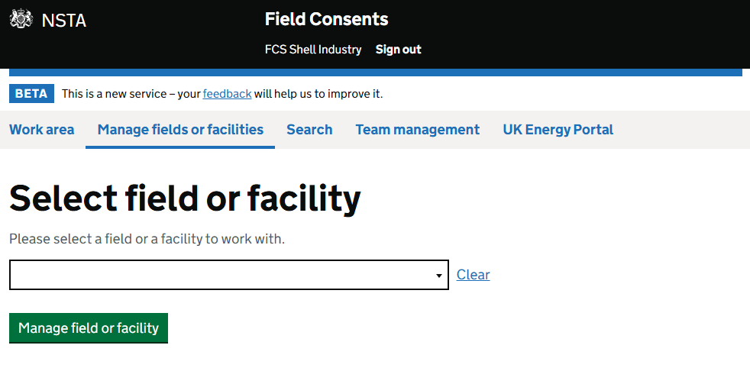
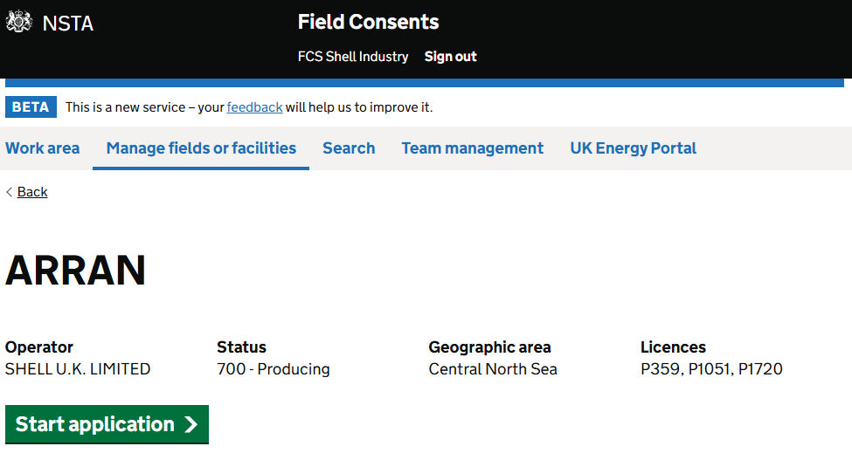
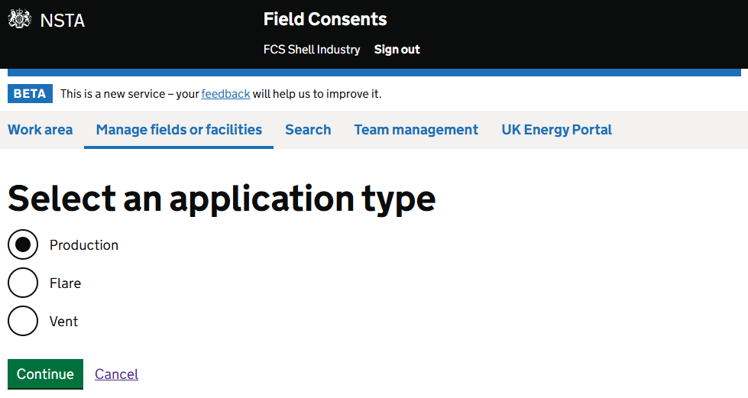
ACE 2027 Production Consents
  Applicants Must Select: New Production Consent commencing in 2027.
Production Consent Submission period: 29 June - 14 Aug Production Consents and Field Development Plans Guidance

Slide 13
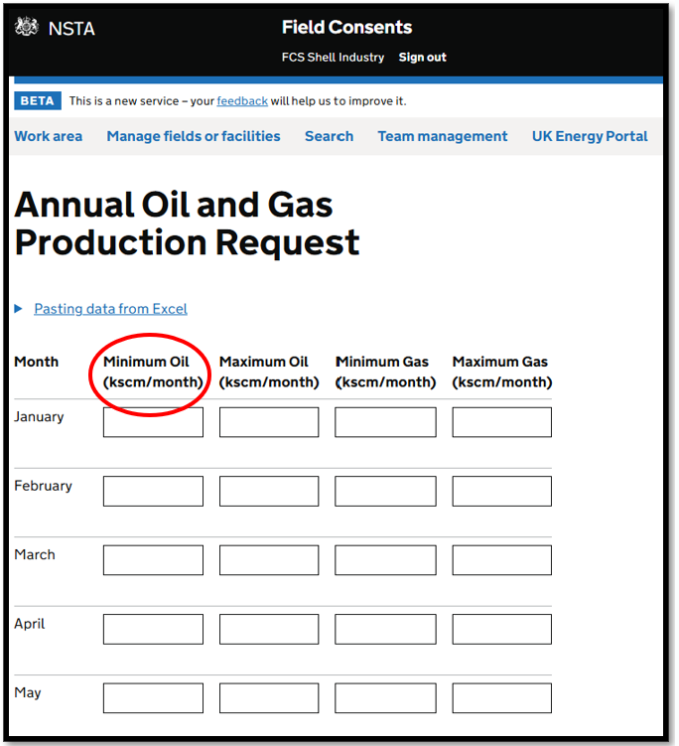
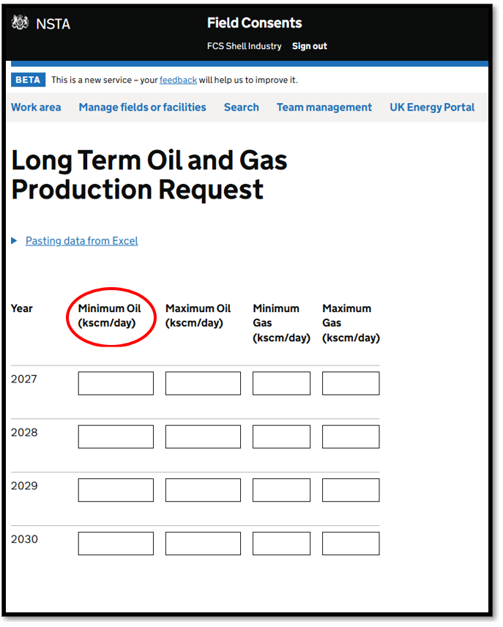
ACE 2027 Production Consents
2027 to 2030
Volumes will be converted to kscm/day
on the Issued Consent Document
Make full use of the ‘Supporting Information’ boxes to provide supporting detail/rationale for forward profiles, particularly if there is an increase resulting from a project.

Slide 14
Application rationale - definitions
Increase
Compared to the previous year “increase” should be selected where:
there is an increase in the average oil or;
there is an increase in the average gas profile or;
any of the years show an increase over the current year's consented volumes or;
there is no previous consent as the application is related to an FDP
Decrease
Compared to the previous year “decrease” should be selected where:
there is a decrease in the average oil or;
there is a decrease in the average gas profile or;
any of the years show a decrease over the current year's consented volumes
Extension
Should only be selected with prior agreement of the NSTA and will typically relate to unique circumstances around end of field life.
Other
Should be selected when this application does not result in an increase, decrease, or extension in production, for example when there is a change of operator.
Definitions are written in priority order, starting with “increase”.
If the case meets any of the bullet points under increase, please select that option.
If none of these criteria are met, move on to decrease.
Similarly, if the criteria for increase are not met but any of the decrease criteria apply, the selected option should be decrease.
Annual Consents Exercise 2027

Slide 15
Production rationale – flow chart
Start
compare to the latest consent
Does it meet any “increase” criteria?
Yes
Select increase
No
Does it meet any “decrease” criteria?
Yes
Select decrease
No
Has it been agreed prior with NSTA for extension?
(exceptional circumstances)
Yes
Select extension
No
None of the above apply
Select other
Annual Consents Exercise 2027

Slide 16
OPRED
Annual Consents Exercise Guidance and Information

Slide 17

ACE 2027: OPRED – Production & Projects
The NSTA needs confirmation of Secretary of State (“SoS”) decision on whether to agree to the grant of consent agreement prior to issuing field consents which include project activity.
This is only required where an application for consent meets a definition of a project under Regulation 3 of the EIA Regulations.
Please engage with OPRED early regarding Project activity and ensure that associated environmental submissions are made in sufficient time.
If you submit an application to the NSTA which is then consented and later considered a project and the SoS agreement has not been received, the NSTA will take action to revoke the consent and you will have to reapply.

Slide 18
Production Consents
Preparation
Screening
Consultation
Authorisation
NSTA Operations Technical Review
Production Consent
NSTA Consents
NSTA Consents
OPRED
“Project”
OPRED
SoS Agreement
(EIA and Habitats Regs)
Habitats or EIA Requirements

Slide 19
ACE 2027: OPRED – What is a Project?
Schedule 1
Extraction of oil and natural gas for commercial purposes where the amount extracted exceeds 500 tonnes per day in the case of oil and 500,000 cubic metres per day in the case of natural gas [compared to consented figures for the current year].
OR
Schedule 2
Extraction of oil or natural gas for commercial purposes where the amount extracted is equal to or less than 500 tonnes per day in the case of oil and equal to or less than 500,000 cubic metres per day in the case of natural gas [compared to consented figures for the current year].
Regulation 3 of the Offshore EIA Regulations defines a “project” as “the execution of construction works or other installations or schemes and other interventions in the natural surroundings and landscape, where those activities fall under, or relate to the implementation of, a matter set out in Schedules 1, 2 or 3.”
For context, most Schedule 1 and 2 activities clearly meet the definition of a project under Regulation 3 e.g. the drilling of a well is a Schedule 2 activity and satisfies the remaining Regulation 3 definition.
For Schedule 1 and 2 activities which relate to production it is less obvious what may constitute “the execution of construction works or other installations or schemes and other interventions in the natural surroundings and landscape”

Slide 20
Activities which may result in a change to production or an extension of the development and production consent within a regulation 3 ‘project’
Activities which may result in a change to production or an extension of the development and production consent within a regulation 3 ‘project’
Drilling and completing a new production well
Drilling a sidetrack from an existing wellbore to a new target
Re-completions that are deemed heavy well interventions not considered to be maintenance should be considered as “the execution of construction works or other installations or schemes and other interventions in the natural surroundings and landscape” which comprise of:
Re-completion activities undertaken at reservoir depth to draw hydrocarbons from the reservoir e.g. perforation, hydraulic fracturing of a previously shut in reservoir or at a new zone.

Slide 21
In relation to production this would mean that:
In relation to production this would mean that:
A revised or new production consent where daily production has increased and/or the consented period of the production consent is due to end and is a consequence of the activities described will constitute a project under regulation 3 and require an EIA or screening direction.
Flaring and Venting are not defined as projects under the 2020 EIA Regulations, therefore there is no EIA requirements and no requirement for the SoS to agree or refuse to agree to the grant of consent.

Slide 22
Key Takeaways
There is a core relationship between development and production consents (ACE) and the Offshore EIA Regulations
The environmental assessment pathways inform whether the production consent can be granted
2 Part Test – (1) is there a daily production increase and/or new consent required (2) are you doing something to make this happen which fits the definition of a project
Plan, seek advice and submit applications at the earliest opportunity

Slide 23
Questions?

Slide 24
Flare & Vent
Annual Consents Exercise Guidance and Information

Slide 25
Flare & Vent Applications
Screening
Consultation
Authorisation
NSTA
Technical Review
Operations, Onshore & Facilities
Flare Consent
NSTA Consents
NSTA Consents
OPRED
Environmental Review (Habitats Regs)
Screening
Consultation
Authorisation
Vent Consent
NSTA
Technical Review
Operations, Onshore & Facilities
NSTA Consents
NSTA Consents
Flaring and Venting are not considered ‘projects’ under the 2020 EIA Regulations.

Slide 26
ACE 2027 Flare & Vent Consents
  Applications for ACE Flare/Vent consents and short-terms must be submitted using a new application.
Flare & Vent Consent Submission Period: 17 Aug - 11 Sep Guidance on Applications for Flaring and Venting Consents

Slide 27
ACE 2027: F&V Applications must include:
Any flare and vent applications are submitted via
Field Consents System on the Energy Portal (inc. facilities)
Explanation for requested Consent
Forecast requirements reflect delivery of all in-year emissions reduction activities
Reported full 12 months Actuals and Requested Consent figures
(in categories)
A: Routine, B: Non routine, C: Safety related
Documentation of how the Categorisation was done

Slide 28
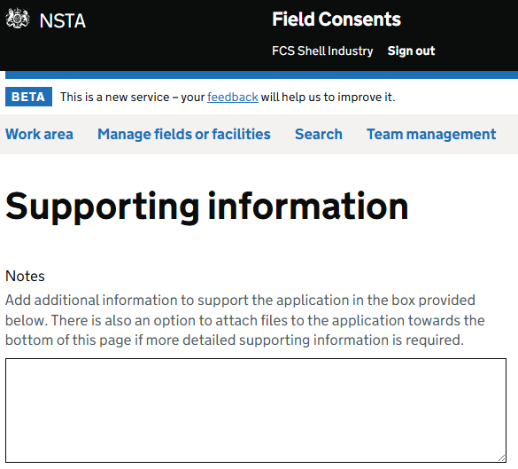
Why F&V applications are returned:
Lack of comments
No attachments/ explanation
Significant variation in month-by-month categories
Significant difference in consent request vs report actuals

Slide 29
Onshore
Annual Consents Exercise Guidance and Information

Slide 30
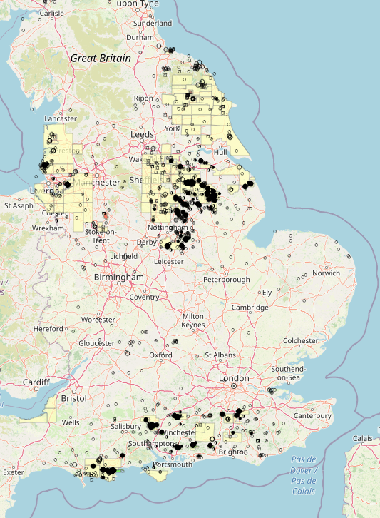
ACE 2027 Onshore
At least 55 Onshore applications requiring consent for 2027
Will follow the same schedule as Offshore consents
Following government commitment to Net Zero and reducing waste of hydrocarbons, we are only accepting annual F&V consents on the new system going forward
We require FDPA if requesting further Production consent
Well stewardship continuing with focus on wells within fields that are not being actively used

Slide 31
Facilities
(Terminals)
Annual Consents Exercise Guidance and Information

Slide 32
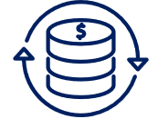
ACE 2027: Consents for Facilities – Key Messages
Applications will be raised and 2027 consents issued through the
Field Consents system on the Energy Portal
Application requirements outlined on slide for Flaring and Venting apply to Facilities
Payment required at the time of application submission
Revision fees introduced in April 2026

Slide 33
Investigations & Enforcement
Annual Consents Exercise Guidance and Information

Slide 34
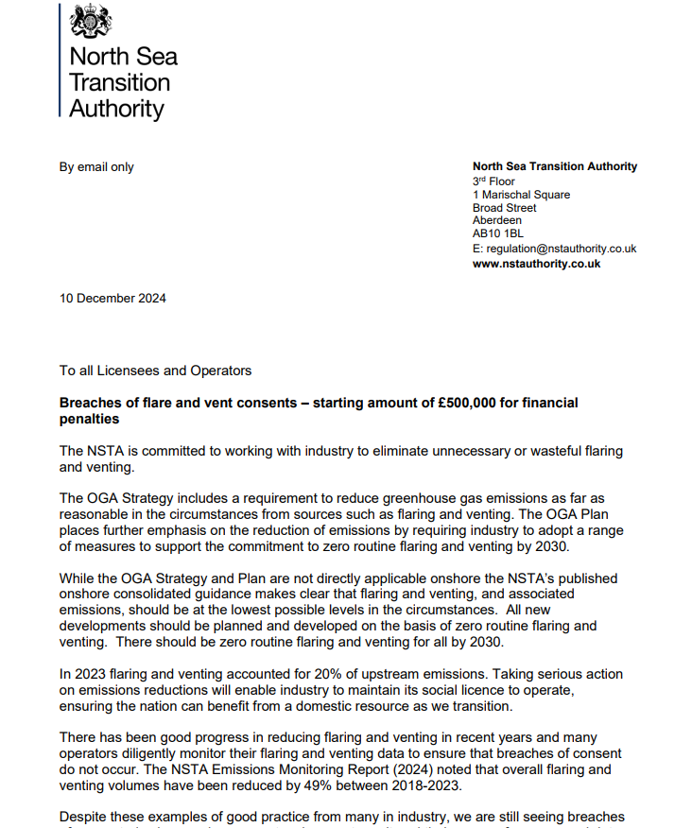
Investigations & Enforcement
Demonstrate proactivity in your consent management
Should you be referred to I&E you will be expected to demonstrate effective monitoring and tracking
In the event of an unplanned event or where a breach is anticipated - engage early with the NSTA
The majority of breaches are occurring in Q3/Q4 and are often reported months after or are identified by the NSTA Consents Team and not the Responsible Operator
A reminder that when considering the level of fine imposed for a breach of a flaring or venting consent that occurs after 1 January 2025, the starting figure will be £500,000​
The NSTA Sanction Procedure is available on our website - Sanction Procedure

Slide 35
Key Messages
Annual Consents Exercise Guidance and Information

Slide 36
Key Messages - Dates & Deadlines
ACE 2027
Production Consents
Operator
submissions deadline
COB 14 Aug 2026
ACE 2027
Flare & Vent Consents
Operator submissions deadline
COB on 11 Sept 2026
All Consents Issued
11 December
Own the process of securing your consents, they are prerequisites to ‘getting’ petroleum

Slide 37
Key Messages – Process and Information
Process
Information
Revisions to current consents are to be submitted before applications for the new consent
Charge remains for withdrawing wrong application & for submitting the new correct application
Promptly respond to NSTA requests and comments
Minimum of two working contacts in each role in the Field Consents system
Engage early with OPRED EMT
Unable to meet deadlines?
Email consents@nstauthority.co.uk with background info
Pay up front for application by credit/debit card

Slide 38
Q&A

Slide 39
Thank You

