Slide 1
Industry compliance with regulatory obligations:
The OGA’s first thematic review
Tom Wheeler – Director of Regulation, Oil and Gas Authority
Ross Dornan – Market Intelligence Manager, OGUK
Brian Malone – Principal Case Officer, Oil and Gas Authority
9 October 2019
OGA/OGUK Breakfast Briefing
© OGA 2019
This presentation is for illustrative purposes only. The OGA makes no representations or warranties, express or implied, regarding the quality, completeness or accuracy of the information contained herein. All and any such responsibility and liability is expressly disclaimed. The OGA does not provide endorsements or investment recommendations. Oil and Gas Authority is a limited company registered in England and Wales with registered number 09666504 and VAT registered number 249433979. Our registered office is at 21 Bloomsbury Street, London, United Kingdom, WC1B 3HF

Slide 2
Agenda for Breakfast Briefing
Tom Wheeler
Ross Dornan
Brian Malone
Introduction: the why and what of this Thematic Review
The Industry Grassroots Awareness Survey
The Survey in practice
Indicative timeline and other Thematic Review activities
Survey outputs and Thematic Review outcomes
Close and Survey reminder
Q and A

Slide 3
What is a Thematic Review and what has the OGA selected for its first?
Thematic reviews are used to assess a current or emerging risk across the UKCS, rather than a specific issue in a particular field or area.
Industry compliance with regulatory obligations selected for the OGA’s first review. We will focus on finding out what is causing issues with compliance and suggest ways of mitigating the problem.
This will enable us to identify the specific key risks to fulfilling regulatory obligations. Armed with this knowledge, we will be able to focus on these specific risks with detailed follow-up educational work in those particular areas.

Slide 4
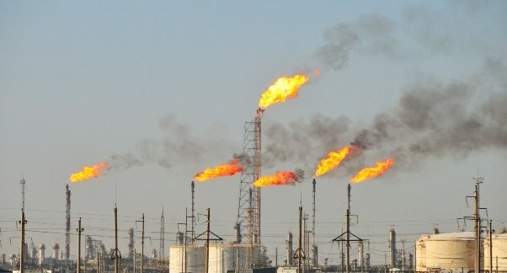
Why focus on industry compliance with regulatory obligations?
Where licensees pay insufficient attention to their regulatory obligations, it has the potential to affect their social licence to operate
Licences and associated consents are the Operator’s most valuable asset
FOR EXAMPLE…
Exceeding venting and flaring consents demonstrates lack of control and has environmental implications
Neglecting statutory notification of meetings risks making investment decisions that are not MER compliant
Missing regulatory deadlines creates additional work for everyone, diverting resources from more productive work

Slide 5
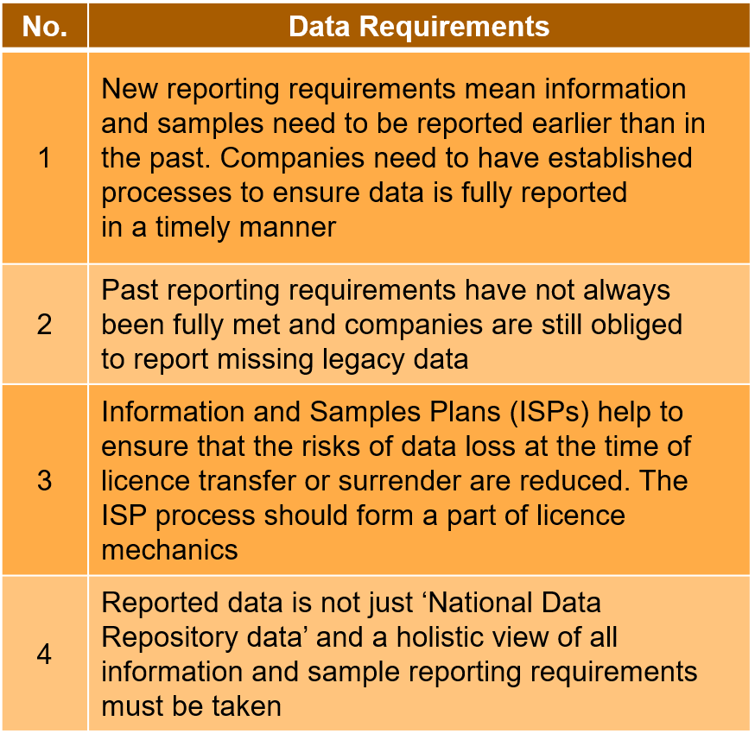
What specifics will this Thematic Review cover?
No. | Data Requirements
1 | New reporting requirements mean information and samples need to be reported earlier than in the past. Companies need to have established processes to ensure data is fully reported in a timely manner
2 | Past reporting requirements have not always been fully met and companies are still obliged to report missing legacy data
3 | Information and Samples Plans (ISPs) help to ensure that the risks of data loss at the time of licence transfer or surrender are reduced. The ISP process should form a part of licence mechanics
4 | Reported data is not just ‘National Data Repository data’ and a holistic view of all information and sample reporting requirements must be taken
No. | Production/Flare/Vent Consents
1 | Give companies set consents on how much they can flare, vent and produce
2 | Environmental impacts, important for the OGA to have an awareness on how much is being produced in the UKCS
3 | Number of issues increased by 50% from 2016 to 2018
4 | The OGA welcomes industry’s thoughts in response to survey as to how to bridge that gap
No. | Meetings Statutory notifications
1 | EA2016 sets obligations on industry to inform the OGA of relevant meetings
2 | Ensures the OGA can attend those meetings that may be strategically important – given the OGA’s “helicopter view”
3 | Currently no mechanism for checking easily that we are notified of all relevant meetings
4 | We welcome industry’s thoughts as to how to bridge that gap
5 | OGA has had to remind at least one operator of its obligation to notify us of relevant meetings
No. | Licence Mechanics Issues
1 | Poor quality of licence extension requests
2 | Licences extended, often several times, when work delayed or modified
3 | Interim licence milestones missed; firm well commitments not met
4 | 30% of licence extension requests received late
5 | Insufficient notice given of licence relinquishments (licence determinations and surrenders of acreage)
6 | Wells left suspended rather than plugged and abandoned prior to determination or surrender of relevant acreage
No. | PWA Issues
1 | Legal consent permitting construction, modification or removal of a pipeline
2 | Breaches provided for by Petroleum Act 1998 and are pursued through the courts
3 | Several potential breaches recorded per annum since 2016
4 | Most instances of potential breaches due to companies not taking time to ask OGA for advice first
No. | WONs Consents
1 | Licensees must apply for consent to drill and conduct other activities on a well and notify the OGA of these through WONS
2 | It is important for the OGA to have awareness of drilling and associated activities in order to effectively support the principal objective of MER UK
3 | More instances of non-compliance with WONS consents, with 5 of potential non-compliance instances being identified this year
4 | Reasons for breaching have been down to a lack of knowledge/education on how and when to submit the relevant consents
Licence Mechanics
WONs consents
Pipeline works authorisations
What’s in Scope?
Meetings: Statutory Notifications
Data Requirements
Production, flaring and venting consents

Slide 6
How will the OGA run this thematic review?
Open, transparent process to review extent of industry awareness of regulatory obligations
Consultative approach – including grassroots awareness survey; engagement with industry compliance teams; discussion with other jurisdictions
Set new standards of compliance across the UKCS – proper maintenance of a Licence is key to business profitability, investor confidence, and relationship with licensing authority – all key elements for delivering the MER UK strategy
Final report with evidence based recommendations having consulted industry first
Provides a solid basis for OGA and industry to work on increased education in the most needy and appropriate areas to minimise need for enforcement action
(Re)focus on regulatory obligations and explain why they are important

Slide 7
Thematic Reviews – OGUK View & Role
Process
Output
Constructive process
Chance to shape regulatory processes
Participation encouraged!
Survey development with OGA
Anonymous & aggregated data and feedback to OGA
CA in place to ensure anonymity
Develop recommendations & report
OGUK to run survey with industry
Improved regulatory processes

Slide 8
Thematic Reviews – How will the survey work in practice?
Survey Scope
Licence Mechanics
Statutory notifications of meetings
Well operations and notifications system (WONS)
Flaring, venting and production consents
Data reporting requirements
Pipeline works authorisations and associated consents
General matters relating to licences and consents
Designed to be simple to complete – scale of 1-5 where possible
Comments boxes to add any detail
Excel based due to number of assumed internal stakeholders

Slide 9
Indicative Timeline
September 2019
November 2019
December 2019
October 2019
January 2020
February 2020
March 2020
April 2020
Planning
External Launch
Initial Analysis
Solution Planning
Draft Final Report
Follow up work
Awareness Survey
Discussion of Options
Issue Final Report

Slide 10
Survey outputs and other thematic review activities
Survey outputs
Other external work
Dovetail with internal OGA project
OGA/OGUK analysis and discussion of outcomes and potential solutions
Final OGA report with statistical/graphical analysis and recommendations for driving improvement including action plan, timetable and responsibilities
Follow up work with industry e.g. educational package and/or awareness raising
Parallel discussions with other regulators on best practice to feed into OGA report
Opportunity for 1:1 OGA meetings with industry
Involvement of and views from BEIS and OPRED
Examining and refreshing existing guidance on licence and consents
Issue of Regulatory Obligations summary document
Learning from Thematic Review

Slide 11
Thematic Review outcomes
Industry will have a better understanding of its regulatory obligations
Report published as hardcopy
Increase in compliance with regulatory obligations across industry as a whole
Improved communication between OGA and industry regarding issues with compliance
Report published on www.ogauthority.co.uk

Slide 12
Questions?
Survey reminder
Will be sent out tomorrow (10 October)
Deadline for responses Thursday 7 November
Don’t leave it till the last minute!
Assistance available from: Ross Dornan
rdornan@oilandgasuk.co.uk
01224 577276
OGUK Market Intelligence Manager
Survey needs to be completed by those who do the work!

