Slide 1
UK National Data Repository
User Group Meeting No. 10
12 September 2023

Slide 2
Meeting etiquette & structure
Please turn your cameras off and remain muted.
Please use the meeting chat to post your questions throughout the meeting.
Questions raised in the meeting chat will be addressed at the end of each section of today’s presentation, time permitting.
Please feel free to ask questions at the end of each section of today’s meeting.
Should there be time remaining after all planned sections, we can use that for general discussion.
The meeting will not be recorded - slides to be shared on the NDR User Group web page
https://www.nstauthority.co.uk/data-centre/national-data-repository-ndr/ndr-user-group-and-updates/

Slide 3
Agenda
Introduction and general topics (11:00)
Last meeting – Recap and Activity
Data Reporting and Disclosure Insights
General updates: Version releases, Updates to documentation
Task Finish Groups & Projects (11:15)
Programmatic (API) access to wellbore data
TFG007 – Legacy Seismic Data Reporting
Project - BGS Collaboration - NHDA collection to the NDR
Planned Updates and Developments (11:45)
Co-ordinate Reference Systems for Surveys
Licensee specific NDR User Group events
Resolving issues with NDR metadata – File Format labelling
Next steps – 3-month outlook (12:20)
Development plan summary
Dates for your diary and Contact information

Slide 4
June meeting – Recap and Activity
Development plan – continuous improvement
Programmatic access (API) to data wellbore – operational
Legacy SEG-D reporting solution and procedure
Edit Data Request UI for DMs – track status of submitted edit requests
NSTA strategic projects
Upload NHDA holdings versus NDR
Review and plan to migrate remaining offline data collection
Review and plan to migrate ‘other’ sources of licence information
Review and plan to correct NDR “File Format” labelling

Slide 5
Well data – Reporting and Disclosure
2006 - values omitted – 1,254 GB and 273K files migrated to CDA’s service with SLB
2019 – Probably due to NSTA loading of JDWL etc. sourced to support licensing rounds
2023 – YTD file count is equivalent to all of 2022 – size is far greater. All licensee led self-service reporting

Slide 6
Seismic data – Reporting and Disclosure
2009 – 20,000 files loaded – primarily seismic navigation, so relatively low volume
2021/22 – significant increase: Upload of NSTA’s data (Osokey) and 3D field data from archive (Moveout)
2023 – Largely licensee driven data reporting. Approximately 135 TB loaded self-service by end July

Slide 7
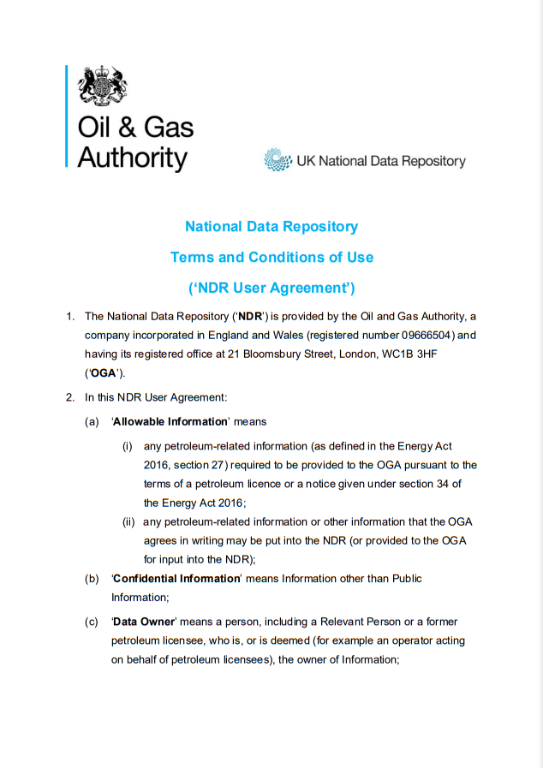
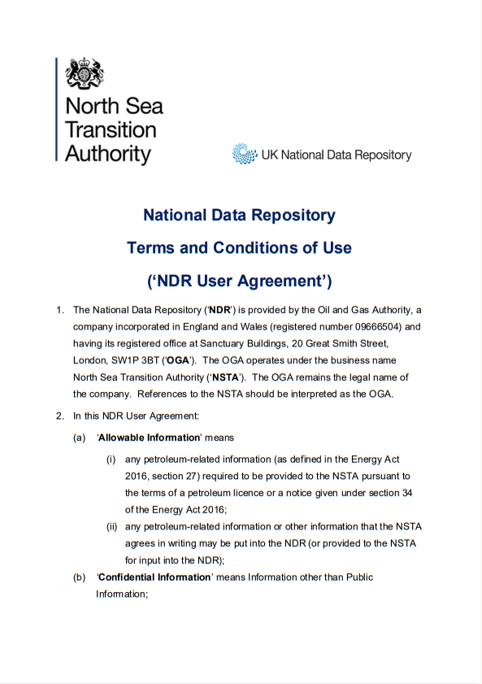
Version, documentation and other updates
Most recent major version was released before the June 2023 meeting, with accompanying update to the “Form and Manner” document.
A revised NDR User Agreement
Revised UA will in included in the next deployment
All users will be required to accept before proceeding
Paragraph | Amendment
Throughout | Text colour palette updated to reflect NSTA branding.
Throughout | ‘OGA’/‘Oil and Gas Authority’ changed to ‘NSTA’ / ‘North Sea Transition Authority’
1 | OGA registered address and business name updated.
10 | Password expiry changed from 90 to 180 days.
36, 37 & 38 | Links updated. (Privacy Statement, Cookie Policy and Website Ts&Cs)

Slide 8
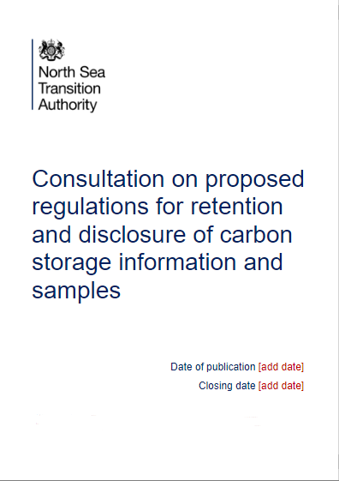
Version, documentation and other updates 2
Carbon Storage Licences – Reporting and Disclosure of Information and Samples
Subject to DESNZ procedure and approval:
NSTA intends to launch a public consultation in Q4 2023
Seeking opinions on NSTA proposals for reporting/disclosure, modelled on Petroleum licences (Energy Act 2016)
Made into legislation no sooner than mid 2024
Look out for publication and please give your feedback

Slide 9
Q&A
General topics

Slide 10
Task Finish Groups and Projects

Slide 11
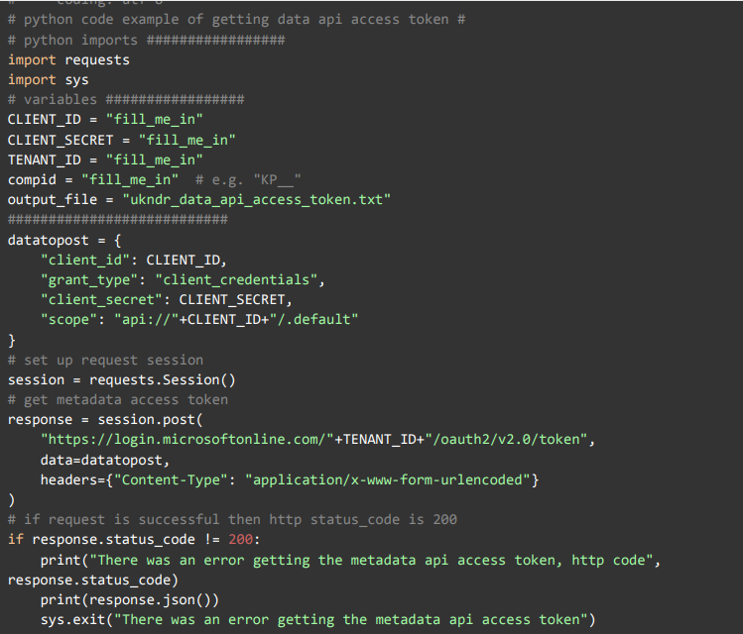
Programmatic access to wellbore data
API service enabling download of wellbore data launched in May 2023
NDR Metadata API launched August 2022
Company Administrator can request to subscribe (24 using)
Covers metadata for all NDR content
Wellbore data API launched May 2023
Enables programmatic download of released wellbore data
~98% of NDR well data (720K + files or 5.7 TB)
Download up to 1 TB of released well data
Companies can top up their allowance for a fee via Osokey
Cost recovery for greater use is necessary due to costs of cloud egress (“User Pays principle”)
Metadata API access is required to enable wellbore data API access
NDR Support Centre for advice or email ndr@nstauthority.co.uk

Slide 12
Q&A
Programmatic access to wellbore data

Slide 13
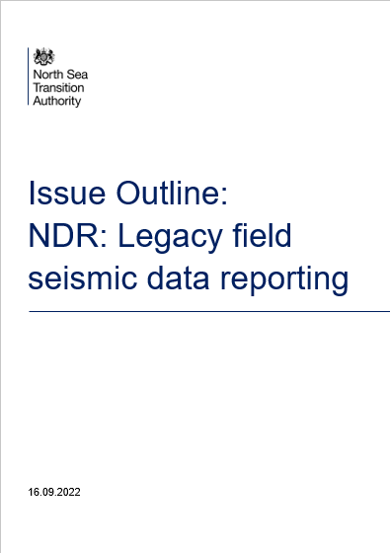
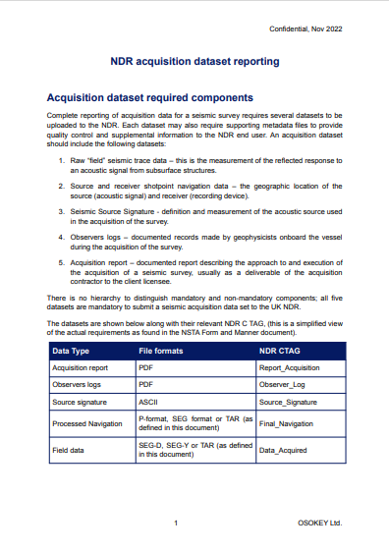
TFG007 - Legacy Seismic Reporting…
Recap: What does this relate to, and why?
Earlier revisions of SEG-D formats were designed to be written to tape
Licensees can report SEG-D rev2.1 and above directly to the NDR
Data held in SEG-D rev0 and rev1 does not lend itself to being stored on disk
SEG-D rev2.1 was published in 2006
Field data for all surveys acquired before 2006 (and some after…) will be stored in an early revision of SEG-D (Or SEG-A, B or C)
Reporting legacy SEG-D to the NDR requires:
Navigation seismic merge to SEG-Y, then upload to the NDR
OR
Convert to SEG-D rev3.1 then can upload to NDR
Such interventions will involve costs and are prohibitive to the process of data reporting and disclosure

Slide 14
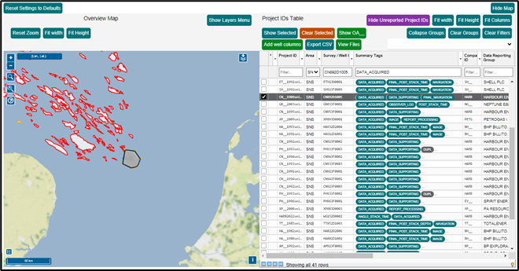
TFG007 - Legacy Seismic Reporting 2…
Task Finish Group initiated late in 2022…
Since then:
Archival methodology devised
Review archive identified candidate test data sets
Development of archival code and procedure
Rigorous testing and iterative development
Workflow is ready to deploy to the NDR
NSTA is re-engaging with TFG participants and other licensees who may find they will benefit directly from this development

Slide 15
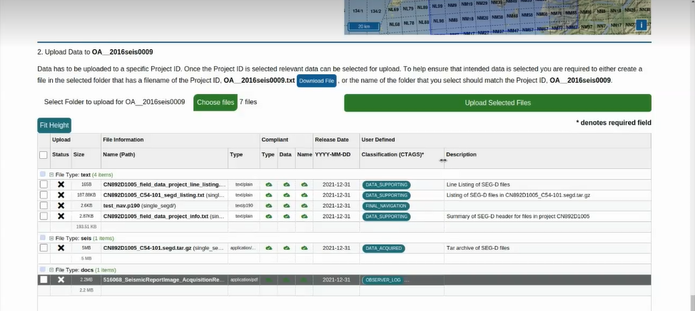
TFG007 - Legacy Seismic Reporting 3…
What does the solution do, and how does it work?
Enables the reporting of Surveys – not just SEG-D data
An ‘acquisition data set’ consisting of five elements:
Acquisition report; Observers Logs;
Source signature; Final Navigation data;
Field data
Concatenate individual files on a spatial basis (e.g., sail-line)
Using TAR utility – widely and freely available - vendor neutral – persistent
TAR file components are created from the command line – documented workflow and examples
Requires supporting files (SEG-D file list (per file); Survey line list; NDR Project info (both 1 per Project)
Files are loaded using the familiar NDR data submission UI – some CTAGs automatically assigned

Slide 16
Q&A 2
TFG007 - Legacy Seismic Reporting

Slide 17
National Hydrocarbons Data Archive
What is the NHDA?
NDR precursor managed by the BGS on behalf of the DTI (originally), then DECC
Enabling:
Data reporting of licence data in accordance with PON9
Relief of licensee obligation to retain data ‘in perpetuity’
Access to petroleum licence information
Submissions suspended in 2016 when ‘OGA’ announced plans to implement an NDR.
Archived data remains held by the BGS
Some will have been reported via CDA’s UKOilandGasData service
Some will have been reported directly to the NHDA
BGS and NSTA currently collaborating to ensure that ALL reported offshore petroleum licence data is under one roof
https://www.bgs.ac.uk/geological-data/national-geoscience-data-centre/national-hydrocarbons-data-archive/

Slide 18
National Hydrocarbons Data Archive 2
NHDA Well Data – pdf and tif files
Received data from BGS 7,419 files
Performed SHA 512 matches to identify files already loaded to the NDR
5,584 files (c75%) already loaded to NDR
Remaining 1,835 files opened, contents reviewed and descriptions created
Further duplicate files removed (duplicates within BGS, file name matches, contained within existing NDR zip files...)
1,309 files to be loaded:
793 loaded directly to NDR
488 files converted to searchable PDF
312 loaded at higher resolution
176 loaded at lower resolution due to file size limits
c20 files can’t be loaded – issues with PDF conversion, reports in tiff format can’t assign CTAGs…
NHDA Well Log Data – lis, dlis, las, pds, asc…
Received data from BGS 786 files
Performed SHA 512 matches to identify files already loaded to the NDR
708 files (c90%) already loaded to NDR
35 files in non-compliant (.lis) format
41 files (.las) loaded to NDR

Slide 19
National Hydrocarbons Data Archive 3
NHDA Data Loading - Issues
Well name issues BGS v NDR (e.g. 211/28-H11 / 211/28a-H11)
Well not in NDR: 211/18-13
Well name issue in .las files – load routine flagged up error
File name in NDR 211/28a-H35 v File Name in .las 211/28-H35/25
New versions of .las files created with correct NDR well name
NHDA Data Loading - Remaining
Clean-up remaining files with issues (file size issues, corruption)
Site Surveys – some files loaded to wells but other site surveys don’t have a parent well – decide what to do with these
Review VSP (SEG-Y) files
Unlikely that these will load due to lack of co-ordinate reference in headers
Review loading processes and suggest improvements

Slide 20
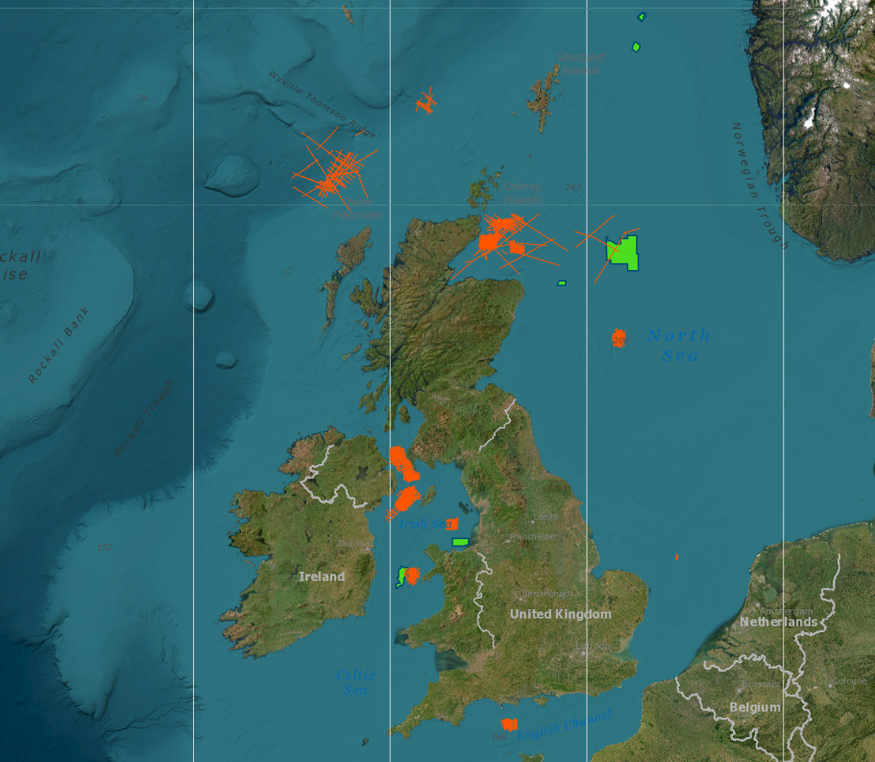
National Hydrocarbons Data Archive 4
NHDA Seismic Data
3D surveys: Of the 7 surveys in NHDA, 2 x data sets were already fully present in the NDR.
All remaining available field data nav-merged and loaded (3 surveys)
SEG-Y QC’d, conditioned and uploaded (4 surveys)
Ancillary docs (acquisition reports, observers logs, processing reports)
All 3D survey data that was archived to NHDA is now available in the NDR
2D surveys: Of 33 surveys listed, 18 x SEG-Y conditioned and loaded
Includes 1 survey that is not in NSTA “systems or record”
Supporting documentation uploaded if not already present
Field data for 20 surveys has not been included in this project
NSTA intends to upload SEG-D for 2D surveys using the new archival procedure.
BGS holdings also include Site Survey data, information pertaining to licences, fields and information that may not be ‘reportable’. Review & planning continues.

Slide 21
Surveys Included in NHDA Listing
# | 2D Survey ID | # | 2D Survey ID | # | 2D Survey ID
1 | BG942D0002 | 12 | BG962D0001 | 23 | AM812D1004
2 | BG962D0001 | 13 | AM782D1002 | 24 | AM822D1003
3 | BP902D2001 | 14 | AM792D0001 | 25 | AM882D0008
4 | BP872D2014 | 15 | BO802D2005 | 26 | AT812D1001
5 | BP852D1007 | 16 | BO862D1008 | 27 | AT812D1009
6 | BP852D1008 | 17 | BP812D0004 | 28 | AT852D1002
7 | BP892D1006 | 18 | BP862D1004 | 29 | AT822D1013
8 | EC932D0001 | 19 | BO862D1008 | 30 | HA932D2001
9 | EC942D0001 | 20 | AM722DGP01 | 31 | HA912D1002
10 | EC952D0001 | 21 | BO852D1002 | 32 | HA932D2002
11 | BH972D2001 | 22 | AT782D1003 | 33 | CV922D0002
# | 3D Survey ID
1 | VT023D2001
2 | CN903F0001
3 | EL963F0001
4 | BO823F0001
5 | BP933F0005
6 | CV933F0001
7 | BG043DFLNT

Slide 22
Wells Included in NHDA Listing
# | Well ID | # | Well ID | # | Well ID | # | Well ID | # | Well ID
1 | 12/25- 2 | 12 | 49/09B- 6Z | 23 | 164/25- 2 | 34 | 211/18-N2 | 45 | 211/28a-H43Z
2 | 12/25- 3 | 13 | 110/04- 1 | 24 | 204/21- 1 | 35 | 211/18-N3 | 46 | 211/28a-H44
3 | 12/25- 4 | 14 | 110/18- 1 | 25 | 204/22- 1 | 36 | 211/18-N4 | 47 | 211/28a-H45
4 | 12/25- 4Y | 15 | 110/18- 2 | 26 | 204/22- 2 | 37 | 211/27- 1 | 48 | 211/28-H1
5 | 12/25- 4Z | 16 | 110/18- 2Z | 27 | 204/22- 2Z | 38 | 211/27- 1A | 49 | 211/28-H10
6 | 13/21b- 7 | 17 | 111/15- 1 | 28 | 204/23- 1 | 39 | 211/27- 2 | 50 | 211/28a-H11
7 | 28/10- 1 | 18 | 111/25- 1 | 29 | 211/08b- 3 | 40 | 211/28- 1A | 51 | 211/28a-H12
8 | 28/10a- 2 | 19 | 111/25- 1A | 30 | 211/18- 13A | 41 | 211/28- 2 | 52 | 211/28a-H13
9 | 29/01c- 9 | 20 | 111/29- 1 | 31 | 211/18a- 23 | 42 | 211/28- 3 | 53 | 211/28a-H14
10 | 21/01c- 9Z | 21 | 164/25- 1 | 32 | 211/18a- 24 | 43 | 211/28- 4 | 54 | 211/28a-H15
11 | 49/09B- 6 | 22 | 164/25- 1Z | 33 | 211/18-N1 | 44 | 211/28a-H43 | 55 | 211/28a-H16

Slide 23
Wells Included in NHDA Listing (2)
# | Well ID | # | Well ID | # | Well ID | # | Well ID | # | Well ID
56 | 211/28a-H17 | 67 | 211/28-H24 | 78 | 211/28a-H32 | 89 | 211/28-H4 | 100 | 211/28-H9
57 | 211/28a-H18 | 68 | 211/28-H25 | 79 | 211/28a-H32Y | 90 | 211/28a-H40 | 101 | 26/04- 1
58 | 211/28a-H18Y | 69 | 211/28-H26 | 80 | 211/28a-H32Z | 91 | 211/28-H41 | 102 | 42/27a- 3
59 | 211/28a-H18Z | 70 | 211/28-H26Z | 81 | 211/28a-H33 | 92 | 211/28-H41Z | 103 | 48/23b- 6
60 | 211/28a-H19 | 71 | 211/28-H27 | 82 | 211/28a-H33Z | 93 | 211/28a-H42 | 104 | 49/07a- 1
61 | 211/28-H2 | 72 | 211/28a-H28 | 83 | 211/28a-H34 | 94 | 211/28-H5 | 105 | 49/07a- 3
62 | 211/28a-H20 | 73 | 211/28a-H29 | 84 | 211/28a-H35 | 95 | 211/28-H6 | 106 | 97/19- 1
63 | 211/28a-H20Z | 74 | 211/28-H3 | 85 | 211/28-H36 | 96 | 211/28-H6Z | 107 | 97/24- 1
64 | 211/28a-H21 | 75 | 211/28a-H30 | 86 | 211/28-H37 | 97 | 211/28-H7 | 108 | 97/24- 1A
65 | 211/28a-H22 | 76 | 211/28a-H31 | 87 | 211/28-H38 | 98 | 211/28-H7Z
66 | 211/28a-H23 | 77 | 211/28a-H31Z | 88 | 211/28a-H39 | 99 | 211/28-H8

Slide 24
Q&A 3
National Hydrocarbons Data Archive

Slide 25
Forthcoming updates and developments

Slide 26
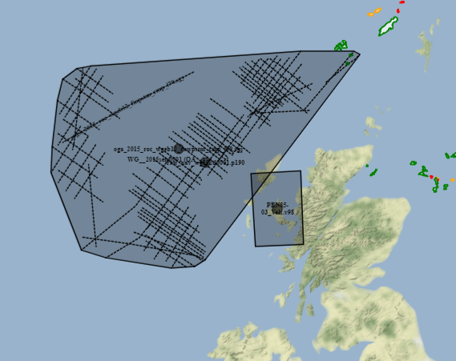
Co-ordinate Reference Systems: Surveys
Almost all NDR surveys (Seismic, Site etc.) do not have a defined CRS
Why do we need to define a CRS for NDR surveys?
Data reporting integrity checks include spatial controls
So, the CRS of the data and the survey need to be aligned
Enabling integrity checked data reporting and quality assurance in data obtained from the NDR
Spatially referenced data can be displayed on a map
Enables NDR integration with the NSTA’s future SoR for seismic surveys and related services
Projects created since July 2021 have CRS defined as a mandatory attribute (Remember TM0?)

Slide 27
Q&A
Co-ordinate Reference Systems: Surveys

Slide 28
Licensee specific NDR User Group events
The NDR is used by a diverse userbase, including:
Company types | Reporting data to the NSTA | Downloading and using NDR data
Petroleum licensees
Public and Governmental bodies
Academia
Consultancies & Service Companies
General public, trade associations etc.
We try to keep the topics and detail of User Group meetings at a level that is relevance to everyone
Meaning we avoid in-depth coverage some important, licensee specific aspects of our developments
We think we could be engaging licensee users differently – particularly those using the NDR to report data

Slide 29
MS Forms survey – Licensee specific NDR events

Slide 30
Resolving metadata issues: Format Labelling
Incorrect File Format label: Over 84,000 files have an incorrect ‘File Format’ label
Legacy issue across multiple data types – roughly 10% of files
e.g. >600 files labelled as LAS have a suffix other than .las
Errors in metadata have a range of consequences for users including:
Files labelled as non-compliant formats cannot be edited (even if they are actually in a compliant format…)
Search/filtering using the File Format label gives partial results: You get some things you don’t want but you miss other things that you do want.
Initial research in early summer was presented last time – we’re planning our project approach with a view to starting to fix incorrect metadata, to improve data quality, accessibility and provide a true reflection of reporting.

Slide 31
Q&A 4
Developments

Slide 32
Next steps

Slide 33
Next steps – 3-month outlook
Active Projects
NHDA archive to NDR - seismic and well information
Edit Data Request UI for DMs – track status of your Project/File Edit requests
CRS assignment workflow for surveys
Under consideration/planning
Licensee specific NDR User Group events
NDR Project ‘active dates’ correction workflow (for NSTA users)
File Format label corrections
Offline archive and ‘other’ licence data sources to NDR (continued)
Seismic survey metadata to NSTA Open Data
Seismic navigation data review

Slide 34
Dates For Your Diary
Month | Date | Event | Participants
November | Tue 14* | NDR User Group Meeting 11 (hybrid) | All NDR Users
March | Tue 12* | NDR User Group Meeting 12 (online) | All NDR Users
 | ??? | Licensee NDR UG event | Licensee ISC & DM Users
 | TBC | TFG007 – Review: Legacy Seismic Reporting | Licensee ISC & DM Users
*Provisional date

Slide 35
Contact Information
NSTA NDR Team
NDR Team - email our mailbox ndr@nstauthority.co.uk
General enquires in relation to the National Data Repository
Referrals to NSTA colleagues or Support Centre, where appropriate
Register for the NDR User Group mailing list – updates and User Group invitations
NDR Support Centre
Technical support for matters in relation to using the National Data Repository
Advice on how to use the UI, uploading data, downloads, ordering on media, metadata services
Osokey and Moveout technical expertise
support@uk-ndr.co.uk
https://support.uk-ndr.co.uk/
in app Support Centre launch – raise tickets, support articles and video explainers
Support Centre chat option

Slide 36
Thank You

