Slide 1
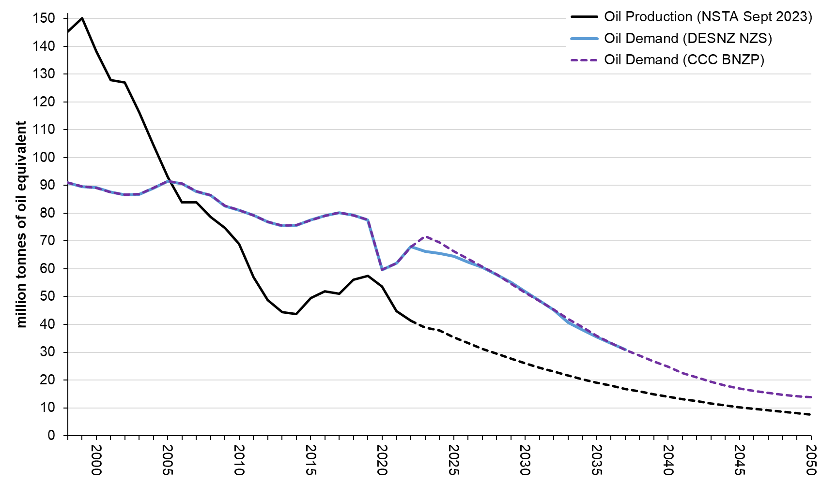
UK Oil: DESNZ NZS and CCC BNZP Demand and NSTA Production Projections

Slide 2
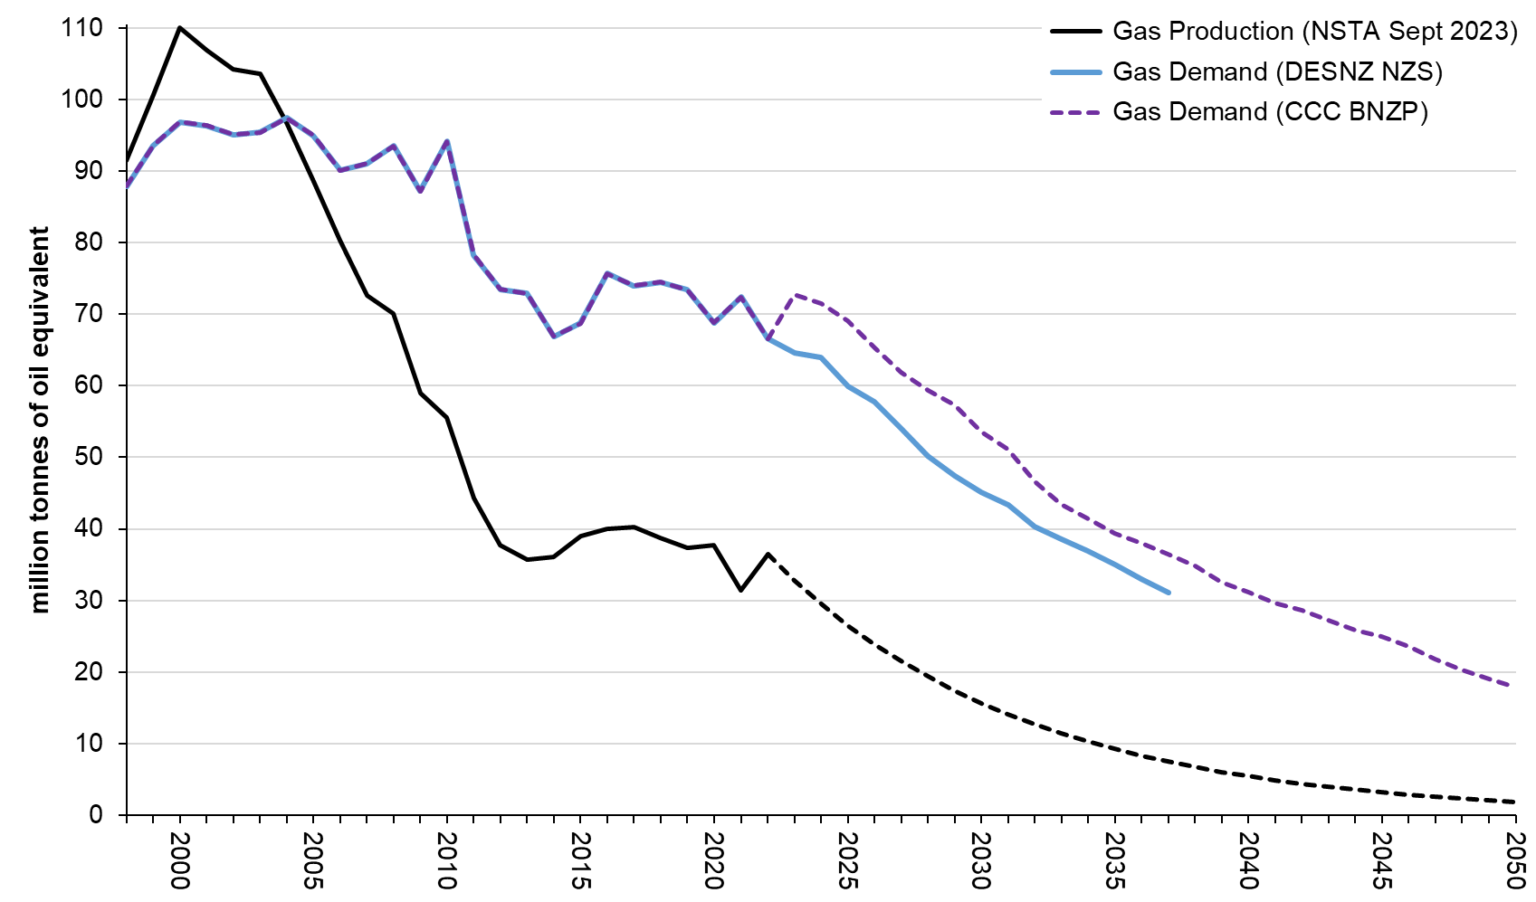
UK Gross Gas: DESNZ NZS and CCC BNZP Demand and NSTA Production Projections

Slide 3
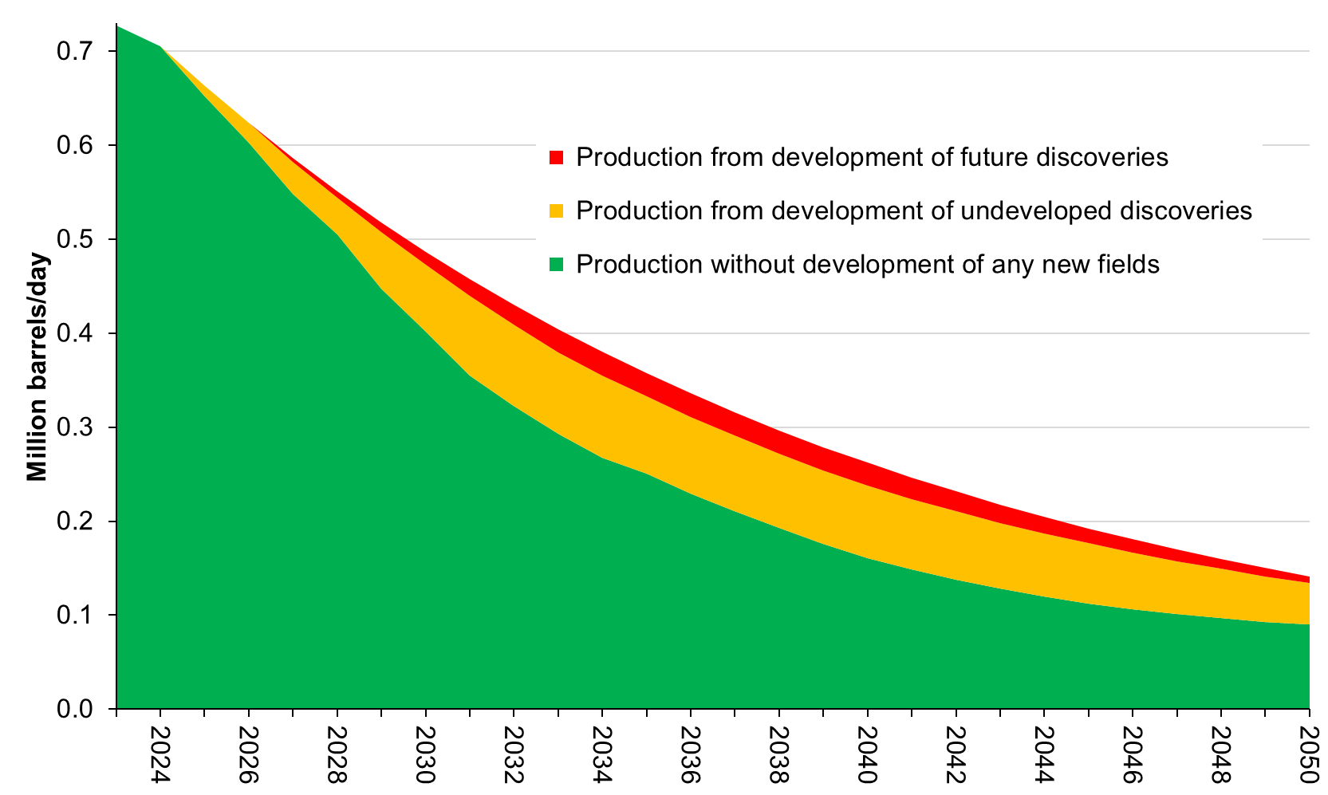
UK Oil: Illustrative splits of NSTA September 2023 Production Projections

Slide 4
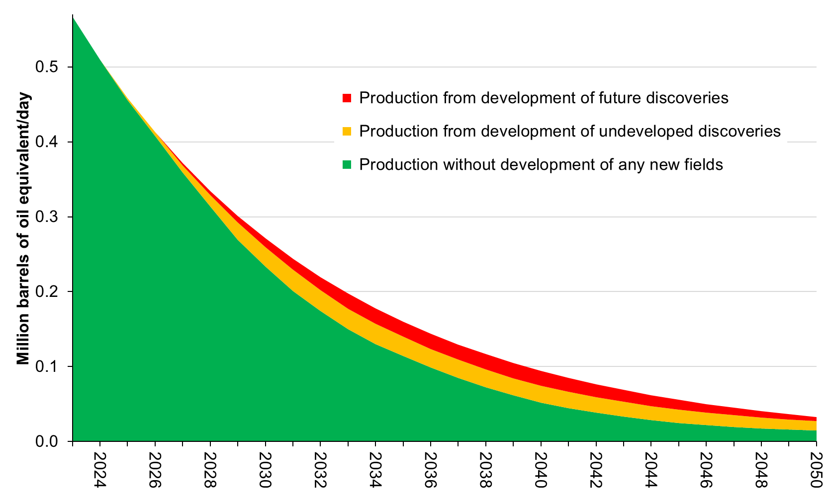
UK Gross Gas: Illustrative splits of NSTA September 2023 Production Projections

