Slide 1
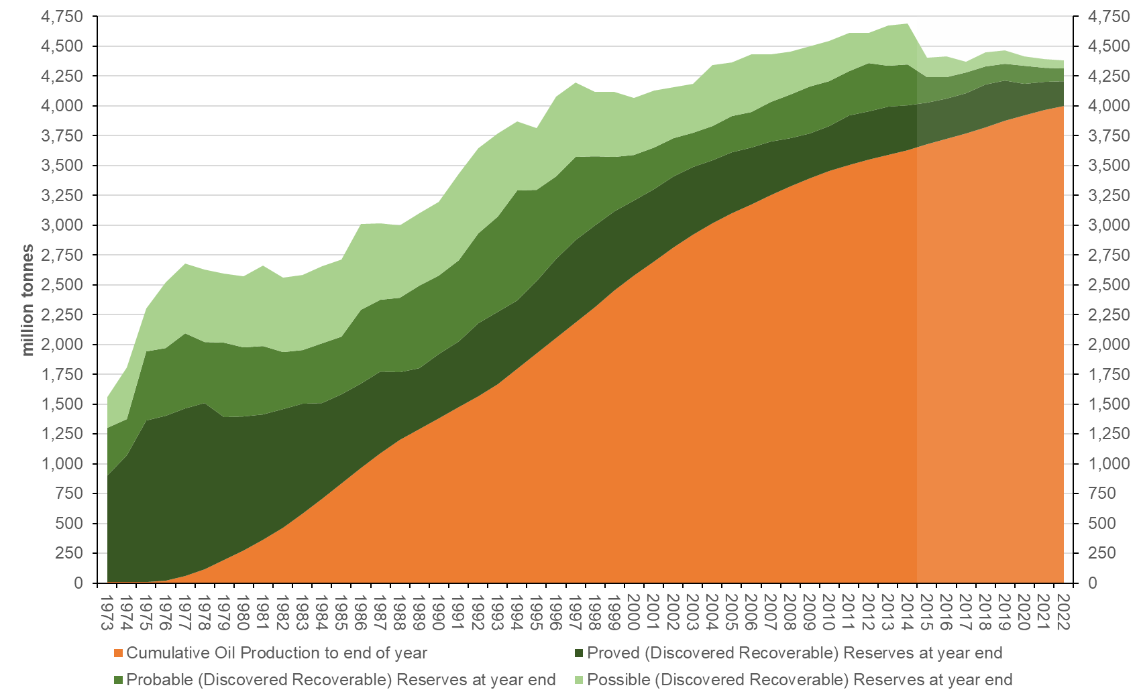
UK Oil Production and Reserves

Slide 2
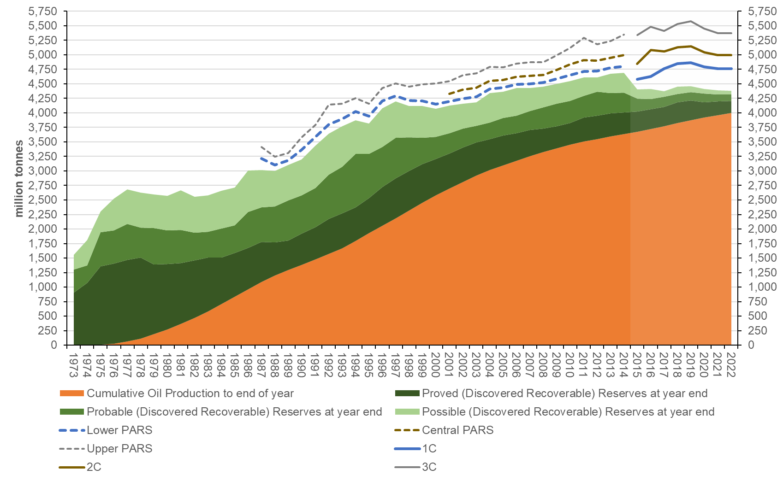
UK Oil Production, Reserves and Contingent Resources

Slide 3
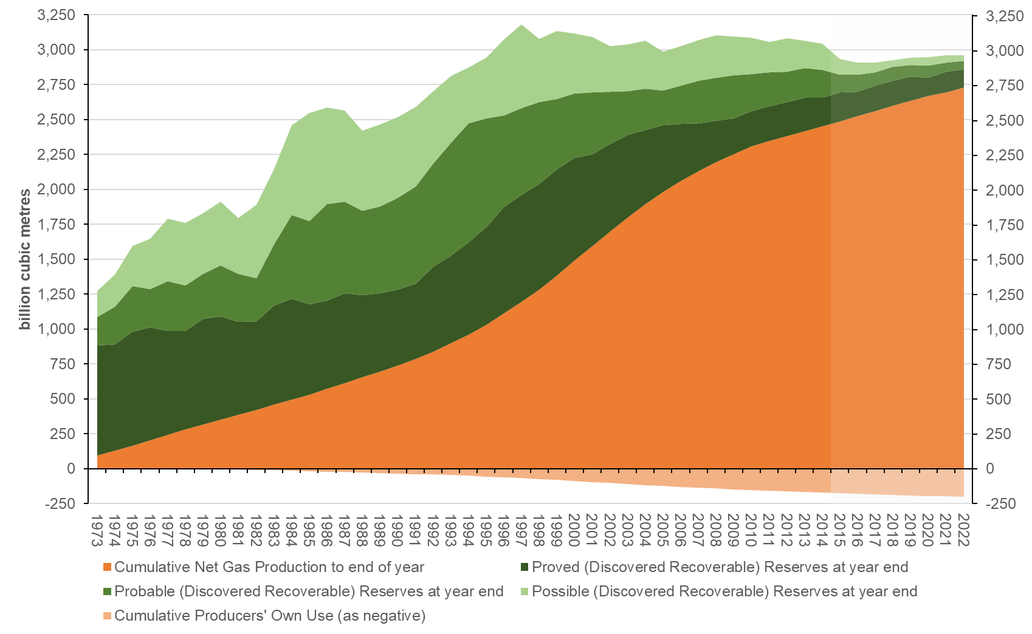
UK Gas Production and Reserves

Slide 4
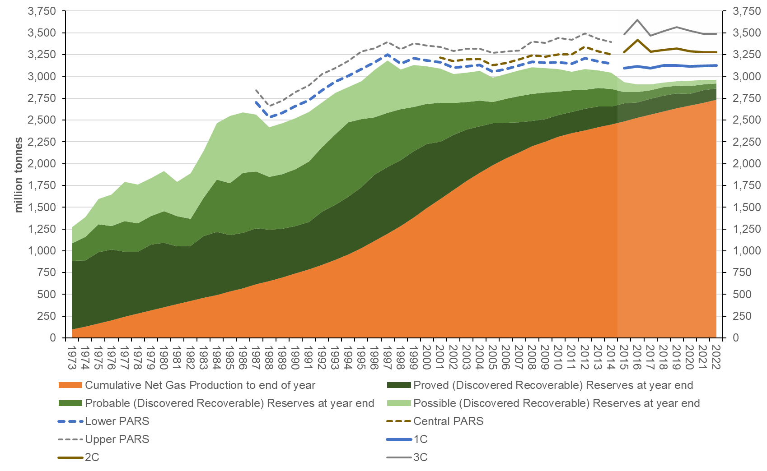
UK Gas Production, Reserves and Contingent Resources

