Slide 1
Seismic Imaging within the UKCS Energy Transition Environment
Part A (Subsurface Foundations)
TECHNICAL REPORT
Seismic Measurement Monitoring and Verification (MMV) with particular emphasis
on Southern North Sea Carbon Stores and understanding of co-location issues
10 October 2023

Slide 2
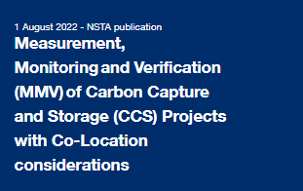

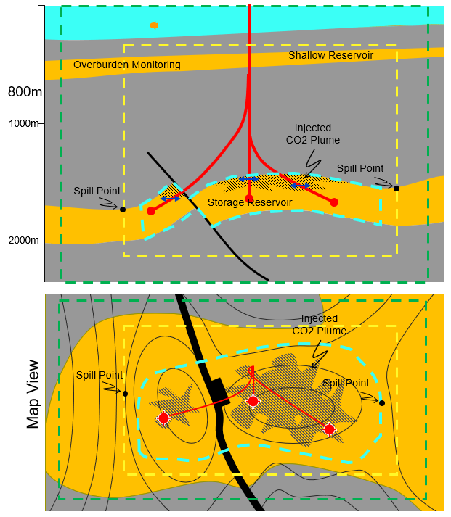

Part A Subsurface Foundations: Preview
This summary (Part A) gives an abridged form of the main report (Part B) using a few selected sections to help provide background to this research.
Section 2 builds upon the previous NSTA report (“MMV Phase 1” report) to show the storage constraints and volumes of CS targets: the depth range for CO₂ storage, the size and extent of some of the SNS subsurface reservoirs. It highlights those areas around the UKCS where co-location between CCS, Windfarm and O&G activity is currently an issue.
Section 3 offers the foundations for seismic imaging.
Commercial O&G geophysics has been very successfully focussed on enhancing the signal of (P-wave) seismic reflection embedded with a sequential workflow – collect seismic, (re)process & interpret seismic, then build & integrate into geological model, develop subsurface rocks (drill wells – produce or inject fluids) and then repeat.
Introduced are the concepts of vertical scales of O&G or CS subsurface reservoirs vs surface wind turbines, highlighting the different types of seismic resolution available with depth. A brief history of the development and range of seismic options focusses on comparing the very different scales of surface streamer towed for “deep” reservoir vs “shallow” site survey and seabed (aka “Ocean bottom”) seismic and where they could be applied. This section 3 concludes with links to other useful UK databases.
Section 4 summarises the acquisition coverage and history specifically for the SNS, where there is the highest density of CS licences.
Section 12 summaries the areas where 4D (time lapse) 3D seismic is most likely to be applicable.
(Ref. 1a)
“MMV Phase1” Report
0m
CS site, complex and monitoring area
0→200m
Cross section
view
Subsurface and seismic foundations

Slide 3
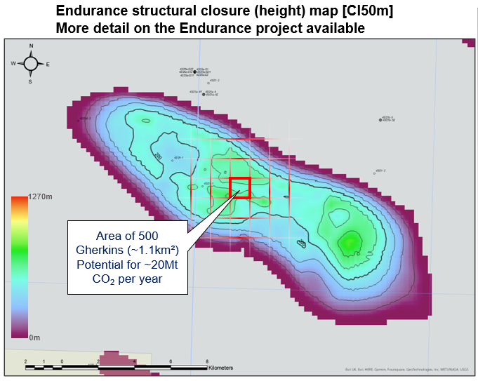
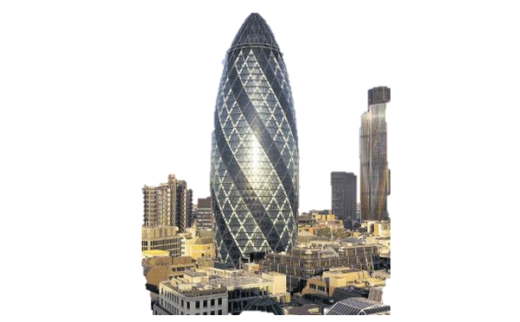
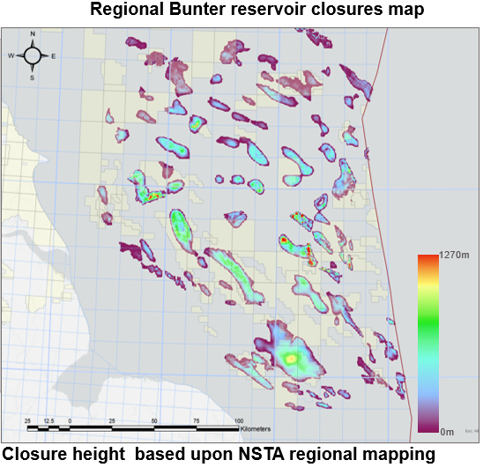
2.4 CO₂ Storage dimensions analogue
To provide a comparative analogy, the capacity contained within the shape of an “open plan” Gherkin (without any walls & floors!) is calculated to be 510 tons CO₂.
CO₂ Density kg/m3
At surface conditions an “open plan” Gherkin has volume to contain
~510 tons CO2.
0
200
400
600
800
0
Low density Gas
High density liquid
800m
1000
Supercritical Fluid
2000
At 2500m depth
An “open plan” Gherkin could contain 370 times more CO₂, but the available pore space in the rock to store fluid reduces this to ~40,000 tons
Can inject dense phase
CO₂ into this
depth range
Depth m
3000
To meet UK 2030 annual CCS target of 20Mt of CO₂ storage, we need to store the equivalent (rock storage capacity) of 500 Gherkins worth of CO₂ each year.
Storing CO₂ at depth enables much larger volumes to be stored: the UK has very many storage areas which could be used

Slide 4
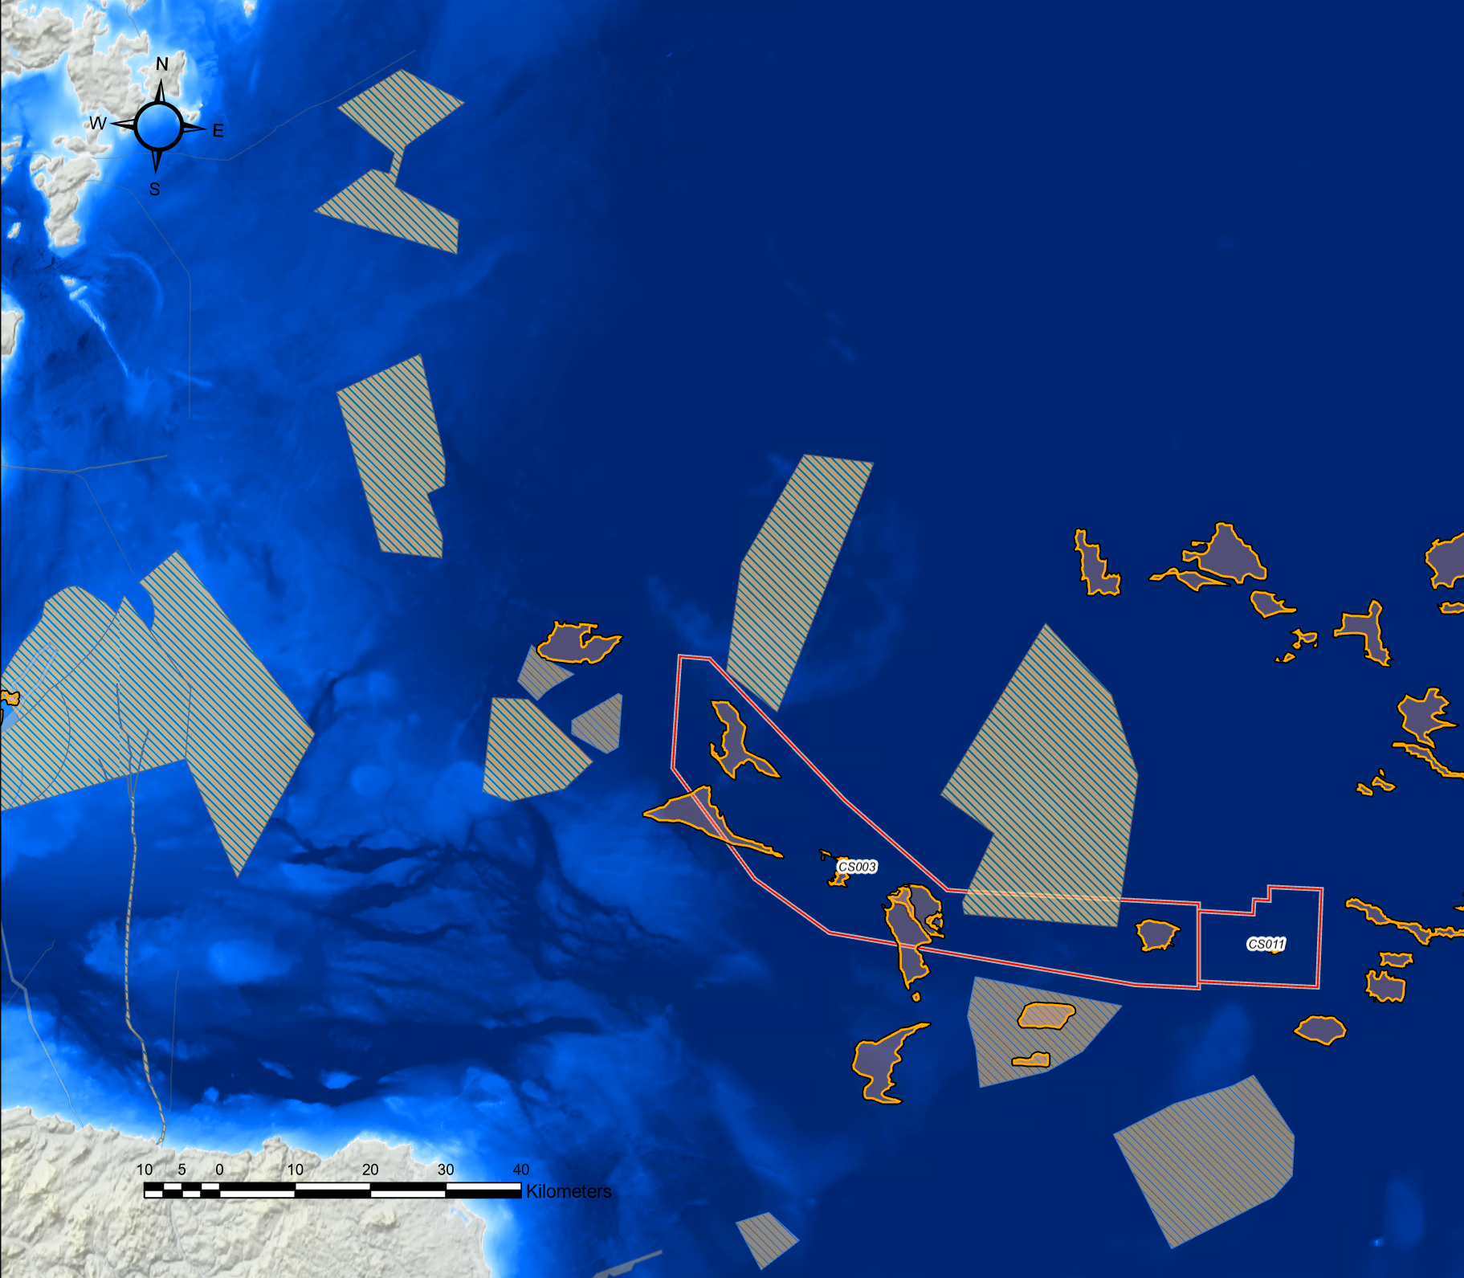
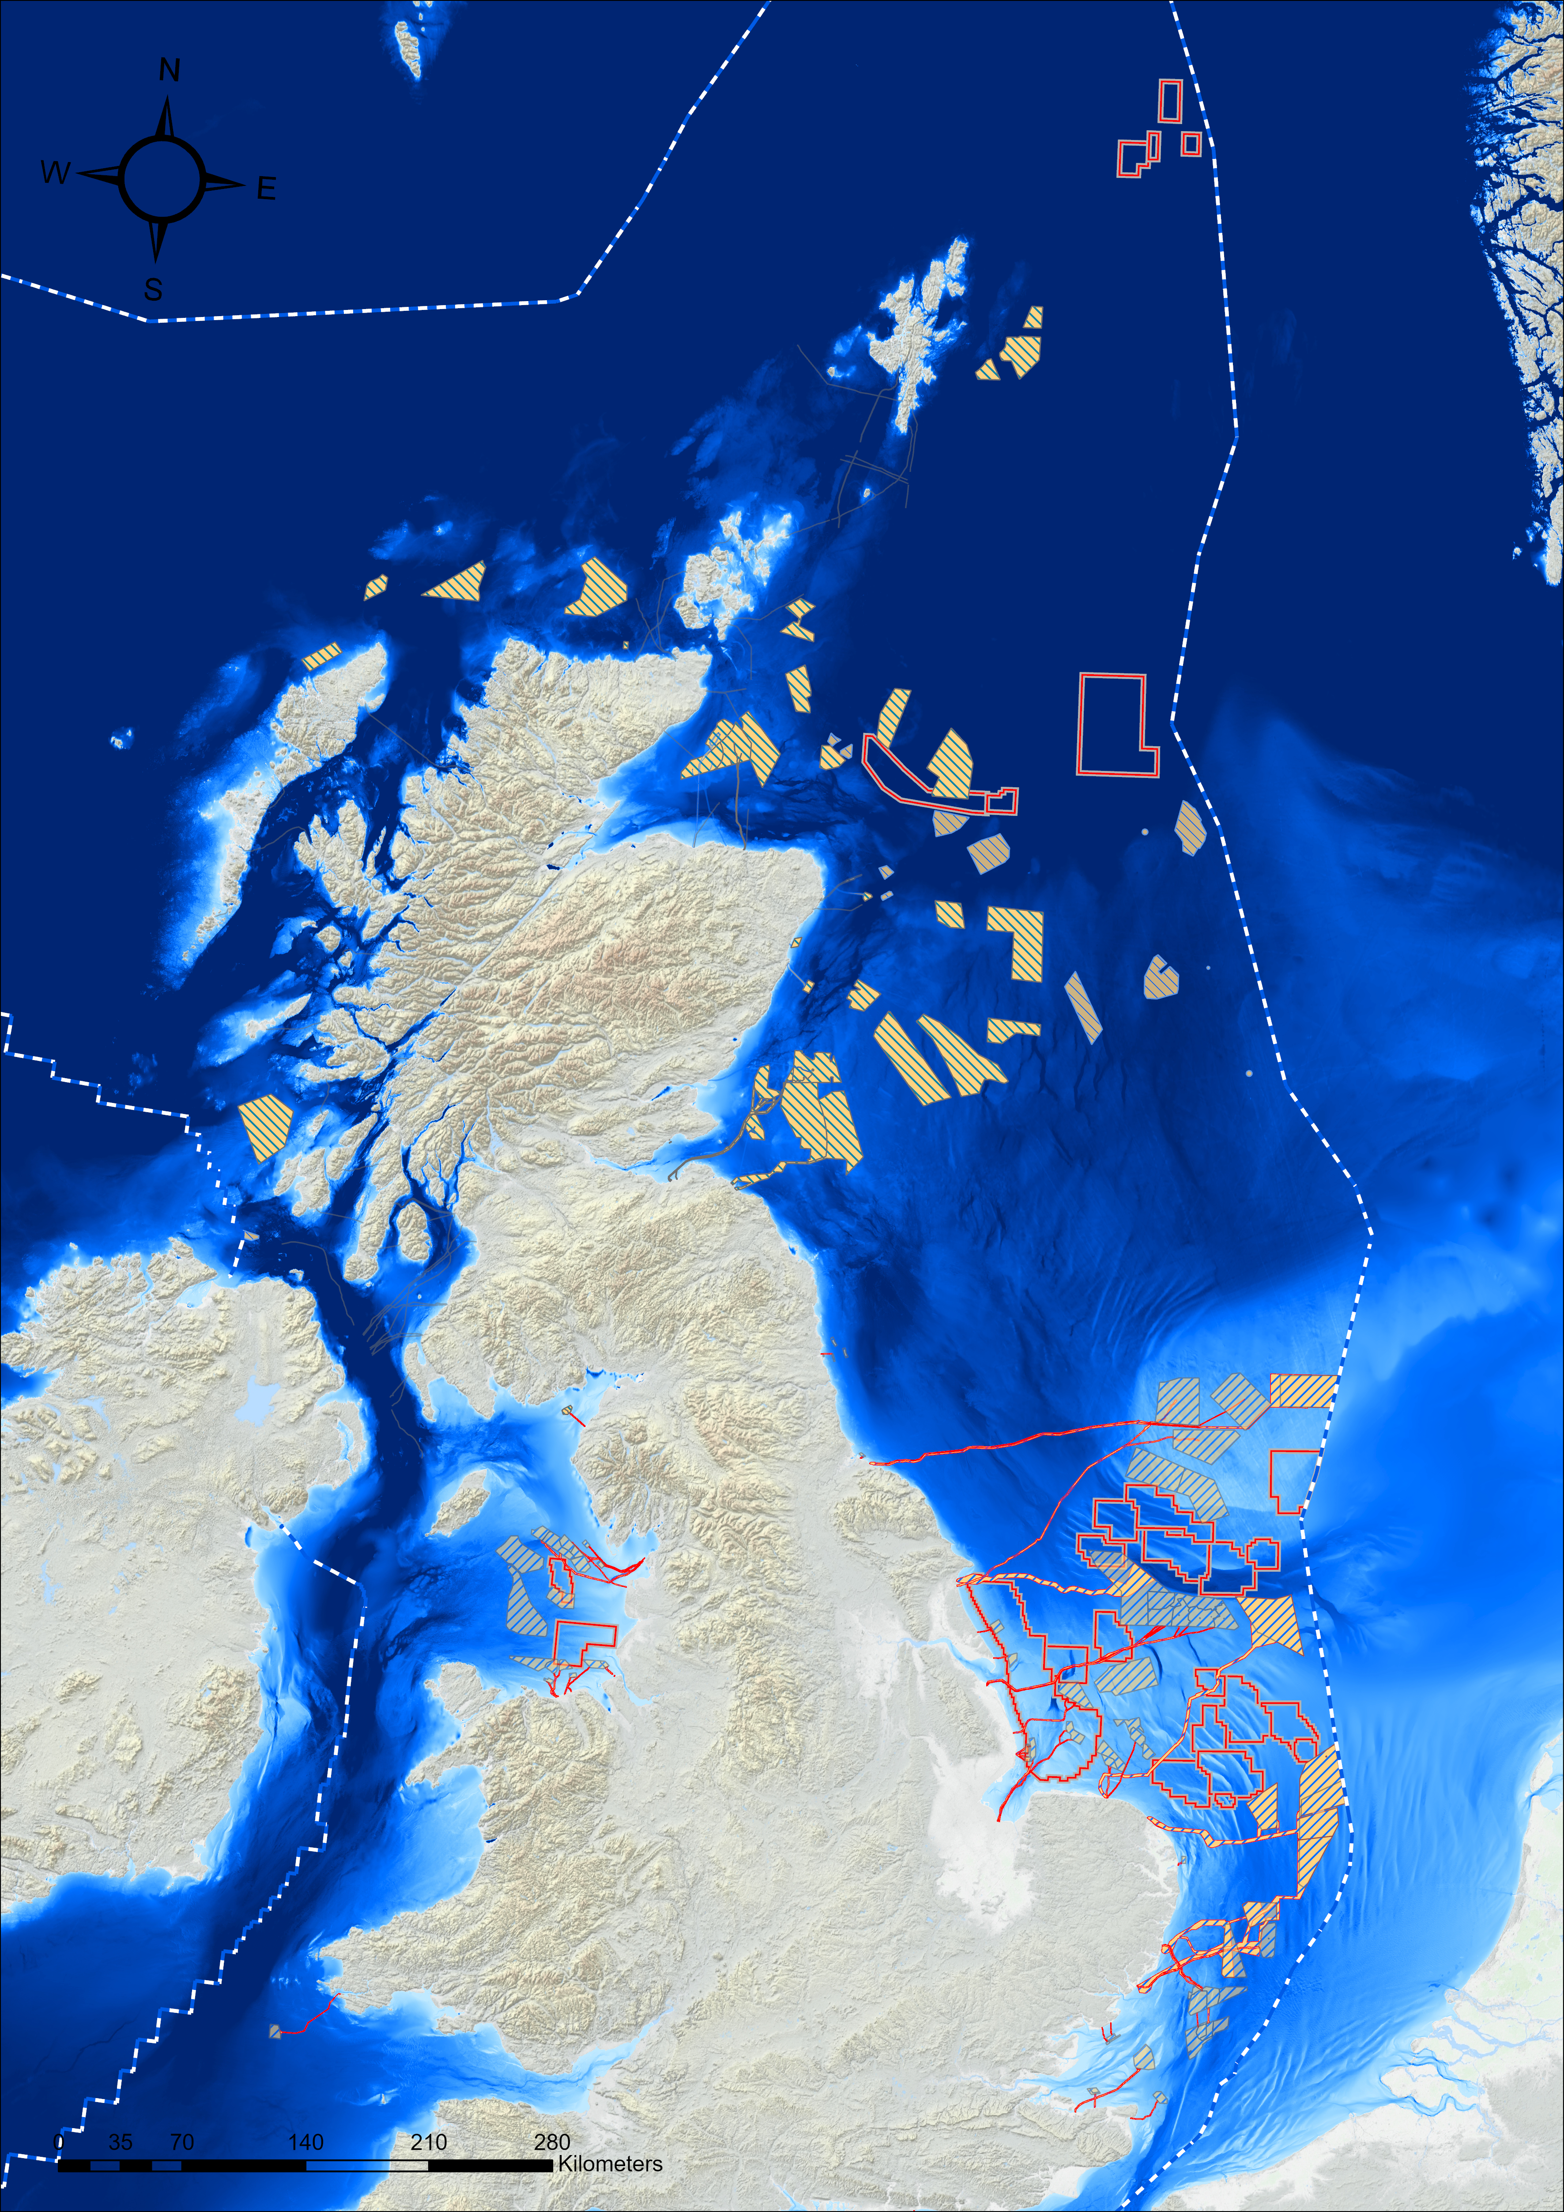
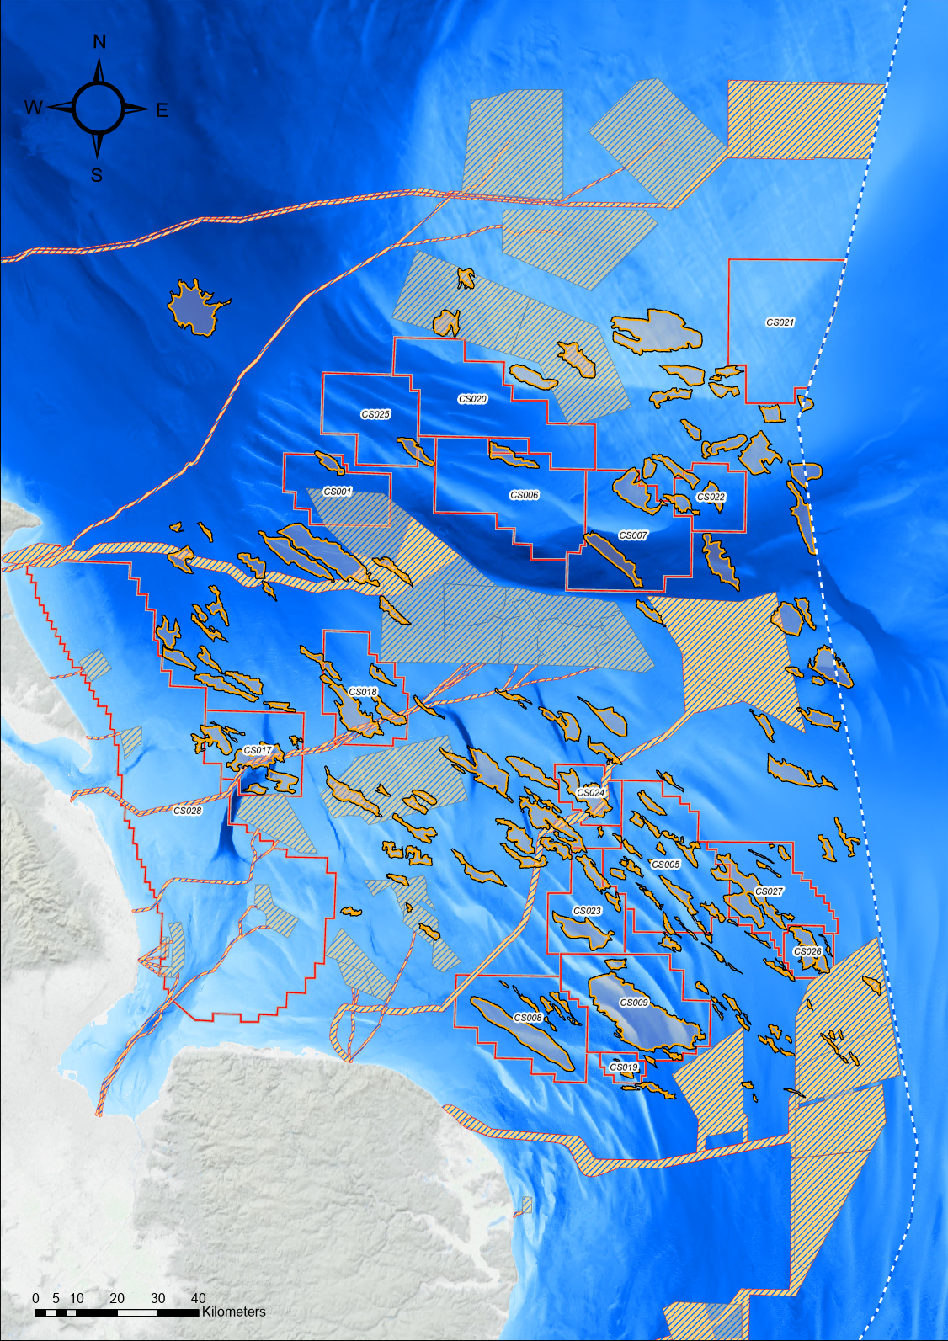
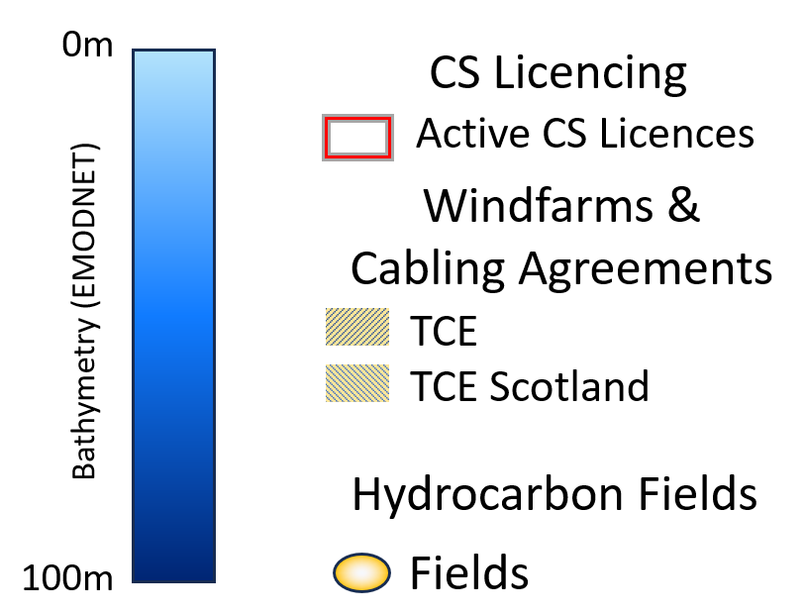
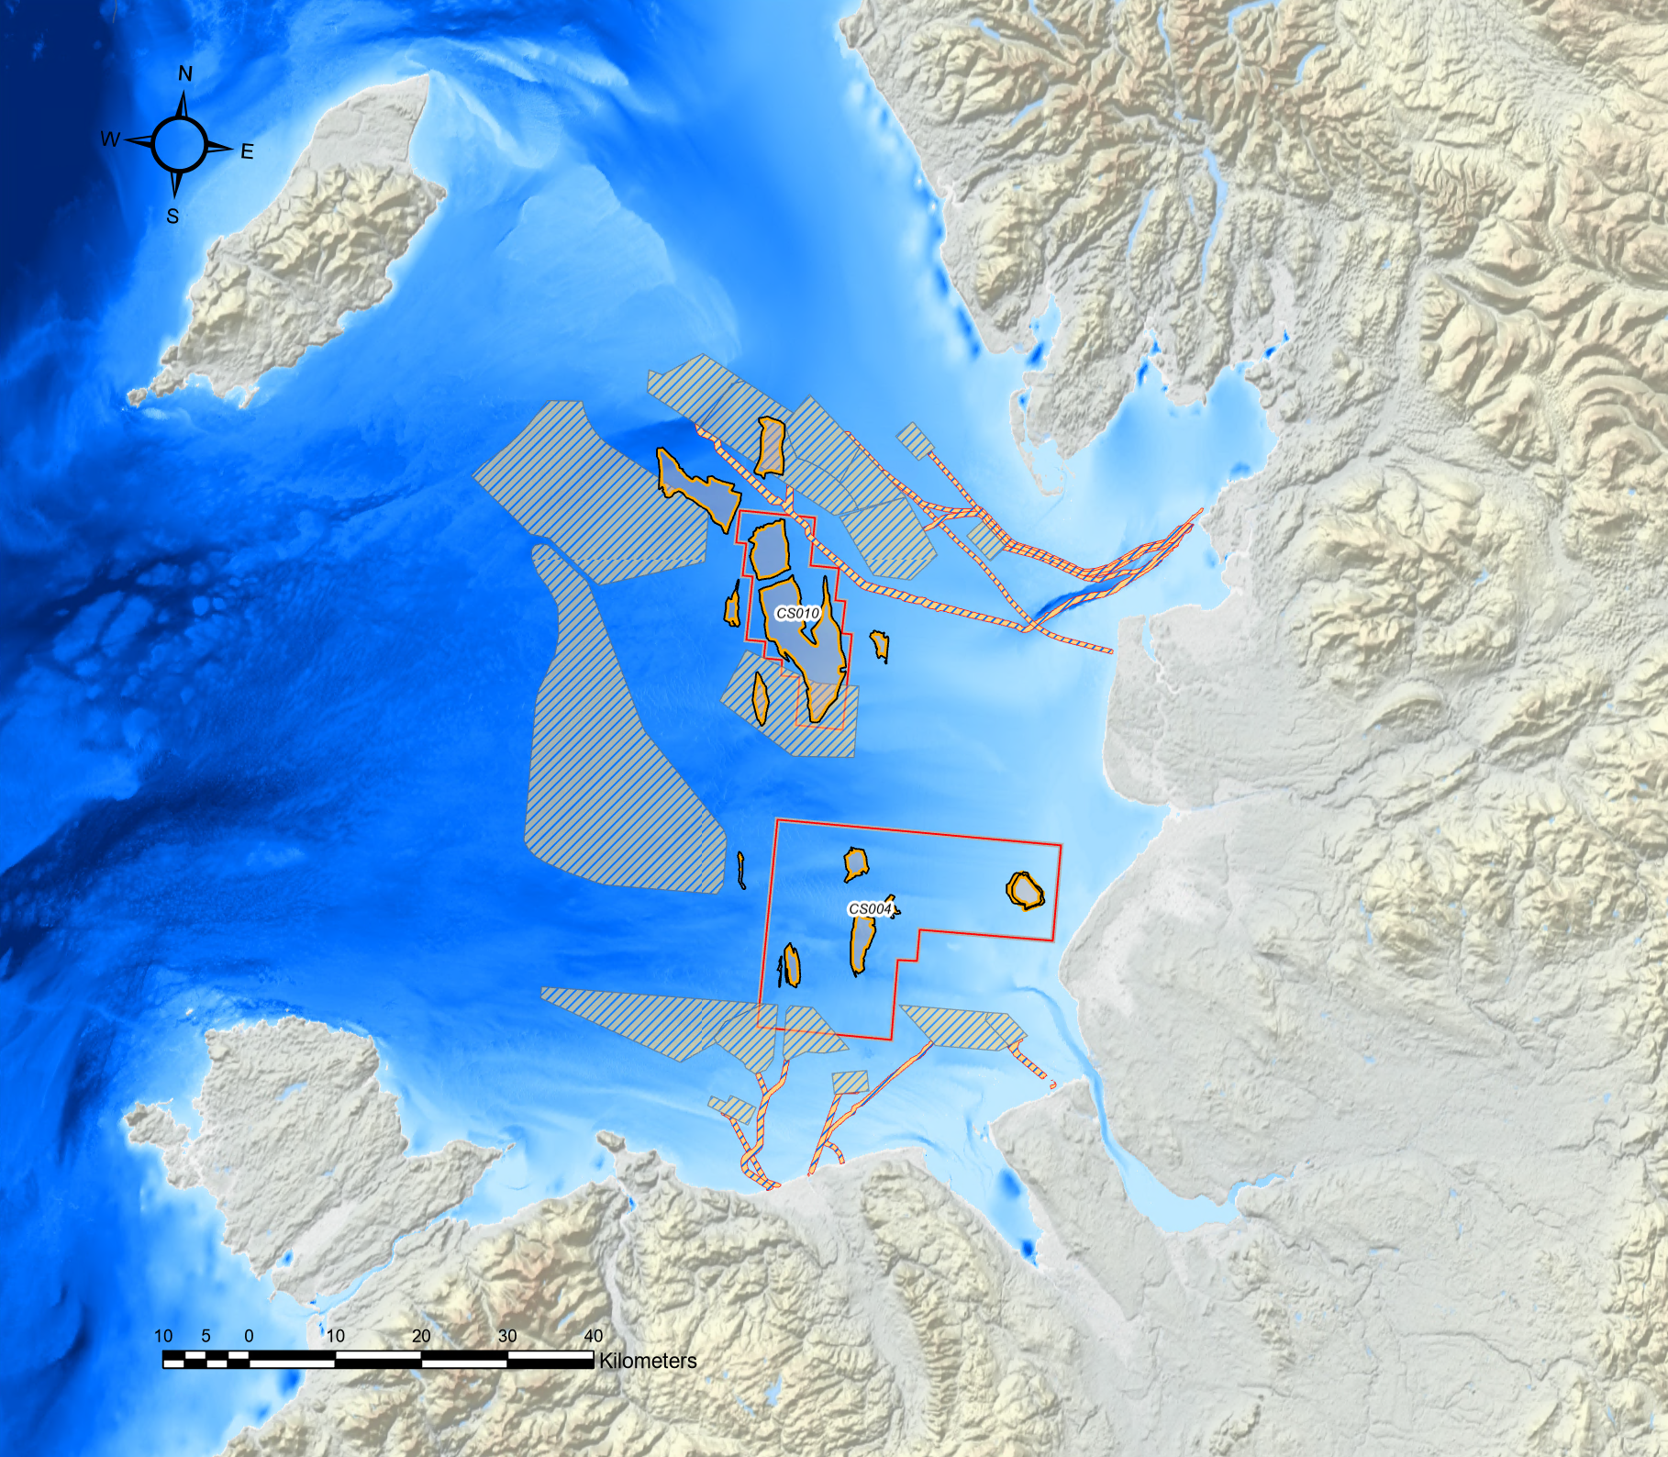
2.5 UK Offshore Current Co-location areas
Central North Sea
Southern North Sea
CS006 & CS007
Triassic Aquifer
Acorn CCS
Depleted Fields & Aquifer Store
Endurance
Triassic Aquifer
East Irish Sea
“V” Fields
Depleted Permian
Gas Fields
Hynet CCS
Depleted Triassic Fields
(Ref. 2d)
UK marine environment is increasingly being used for a range of energy transition activities; Co-location is an increasing concern especially in SNS

Slide 5
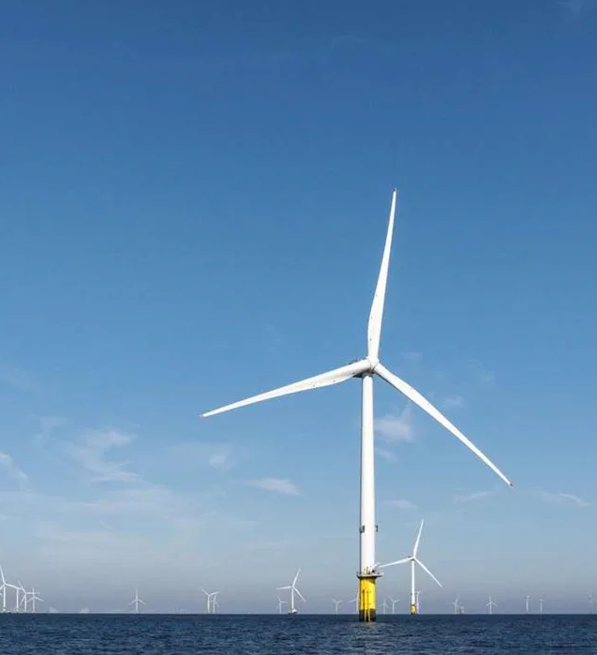
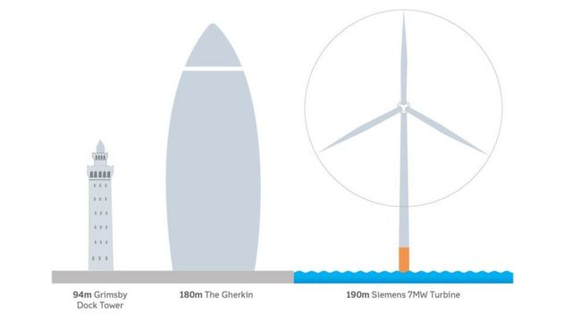
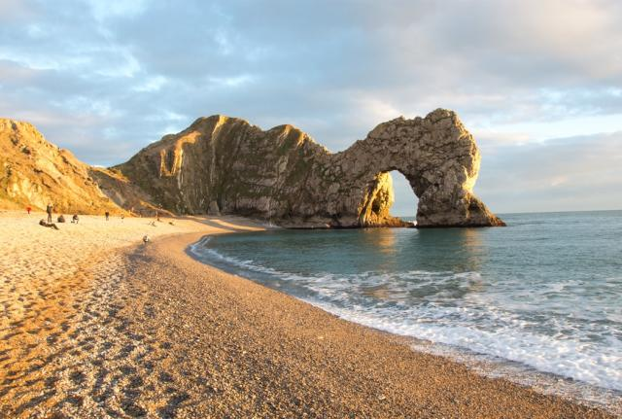
3.1a Introduction: Vertical scale
Simplistic reservoir
to scale
The Gherkin
Height: 180m
London
7MW Turbine
Height: 190m
Hornsea-2
30m
100m
Seismic resolution
1000m
60m
Overburden
Diameter 167m
60m wide
Bunter
Reservoir
260m
Durdle Door
Underburden
  Offshore windfarm turbines are increasingly giant structures with future 13-15MW turbines likely to be 300m tall (roughly height of the Eiffel Tower). A key risk to their installation are boulders on the seabed and the nature of the post-glacial sediment impacting stability of foundations and the setting of supporting piles 60m (turbine) to 100m (substation) below seabed that requires a jack-up rig for operations. This is a very shallow target by conventional Oil and Gas (O&G)/Carbon storage (CS) perspective. Whilst O&G/CS are also interested in jack-up rig stability more effort is looking at:
    The overburden for shallow, naturally occurring (biogenic) gas or indication of carbon leaking from the underlying store.
    Trying to image the storage reservoir from 800m down to >4000m (for most typical O&G or CS) using seismic data.
  It should be noted that the ability of seismic data to resolve fine scale geological details (seismic resolution) decreases with depth beneath surface.
Comparative vertical scale of SNS turbines, Endurance reservoir and seismic resolution

Slide 6
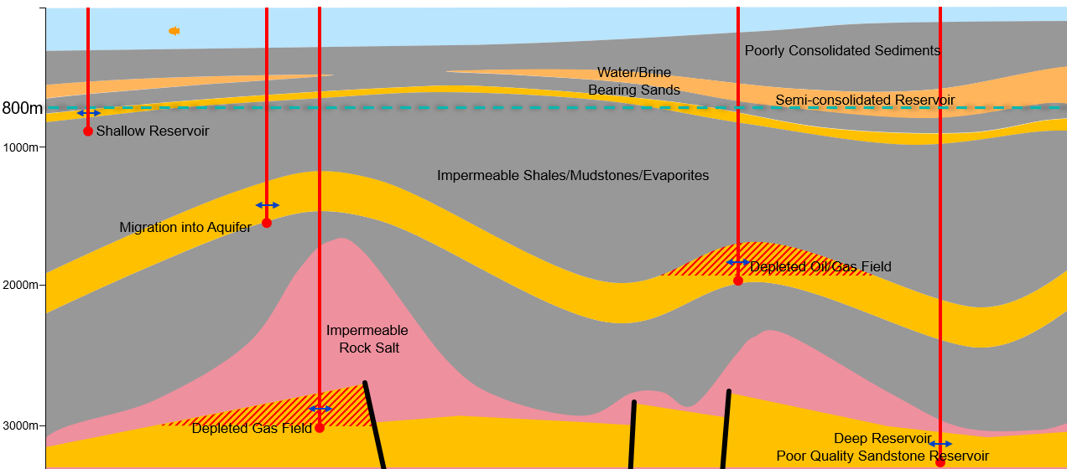
3.1b Range of UKCS Carbon Storage sites
0-150m
(Ref. 1a)
Typical range of different aquifer and depleted oil/gas carbon stores in the UKCS

Slide 7
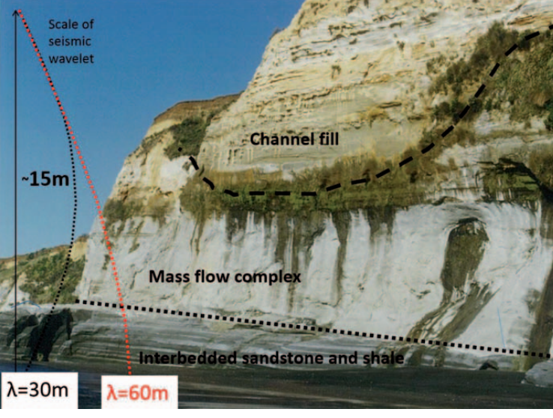
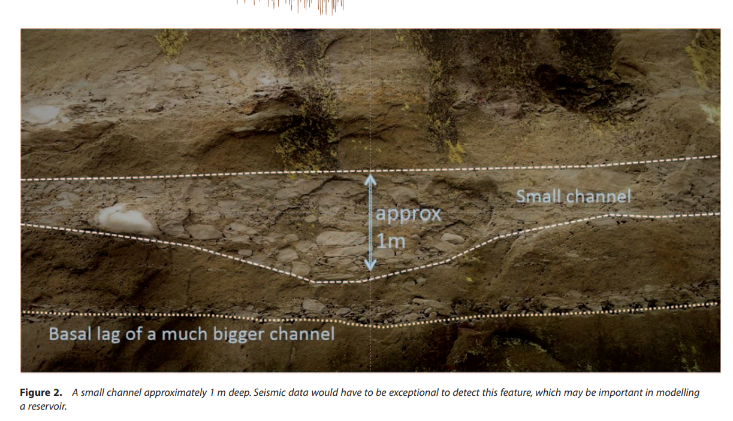
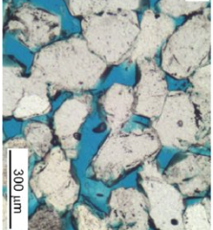
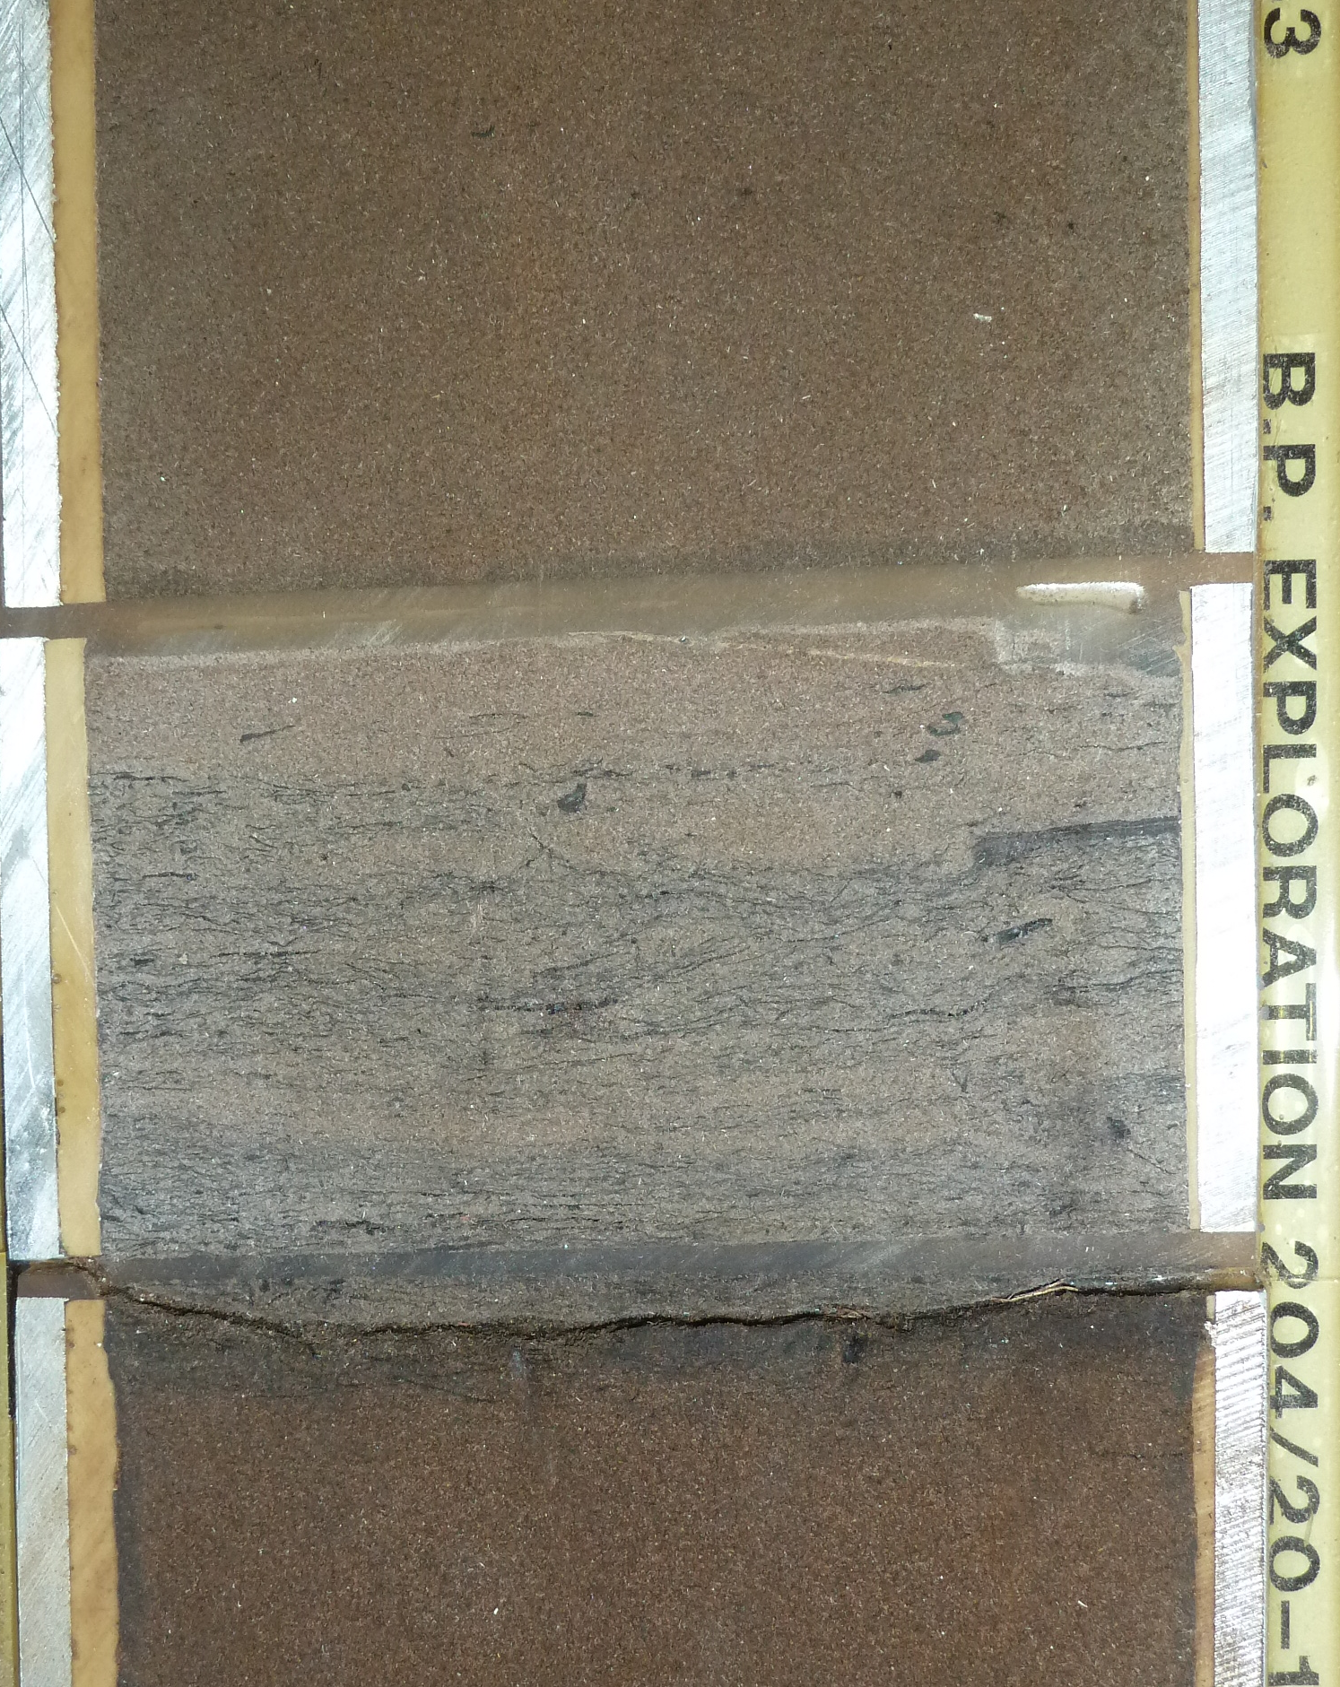
3.1c Seismic resolution and detection
A seismic source emits a controlled pulse of sound into the subsurface. This expanding wavefront interacts and reflects back from rock layers. The different rock layers have differing acoustic properties (based on the rock density and speed-of-sound velocity parameters).
Seismically Detectable
Seismically Not Detectable
Core Scale
Pore Scale
(Ref. 3b)
(Ref. 3a)
Oil-stained net sand
Quartz is white
Pore space is blue.
10cm
15m
1m
Shale: No net reservoir
Seismic may detect,
but not resolve the base channel
Seismic resolution relies on the frequency of the input impulse frequency at the target. Generally, at typical CS reservoir depths the wavelength is 60m. Seismic resolution is defined as ¼ wavelength, in this case ~15m. This implies that the base channel fill cannot be seismically resolved.
However, seismic attributes can detect changes down to 1/30 wavelength.
~0.03cm
This is a small channel; the dimensions are typical in Quaternary drainage systems in the SNS. This channel may be detected with UHR/UUHR shallow geotechnical surveys, but at CS reservoir depths this channel is far below seismic detection limits. Channels similar to this could negatively, or positively affect CS injectivity.
Oil-stained net sand
Good quality sandstone - Reservoir
Core recovered from wells allows an understanding of cm scale variations in geology. These variations may directly affect the volumetrics and injectivity associated with a CS.
Thin-section analysis shows the mineralogy of the rock (recovered from core-plugs, SWCs or cuttings). This allows an understanding of the porosity, permeability and chemical reactivity of the rock.
Most geological details in reservoirs are much smaller than seismic imaging can capture

Slide 8
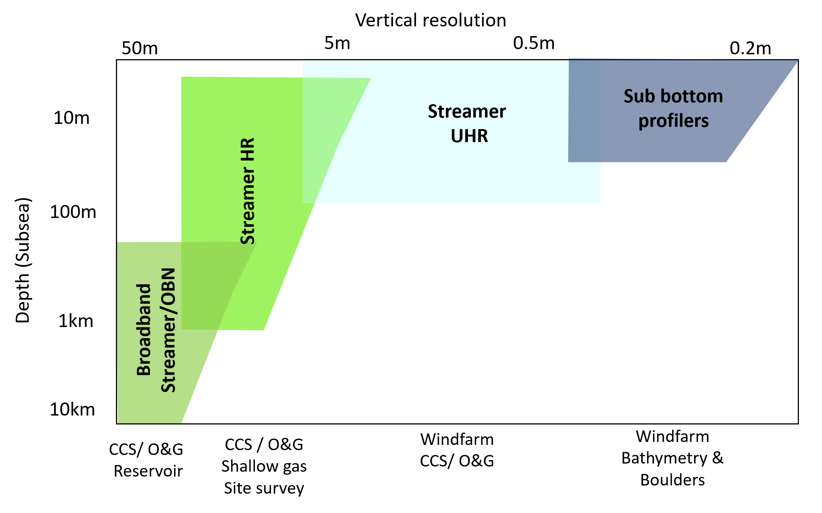

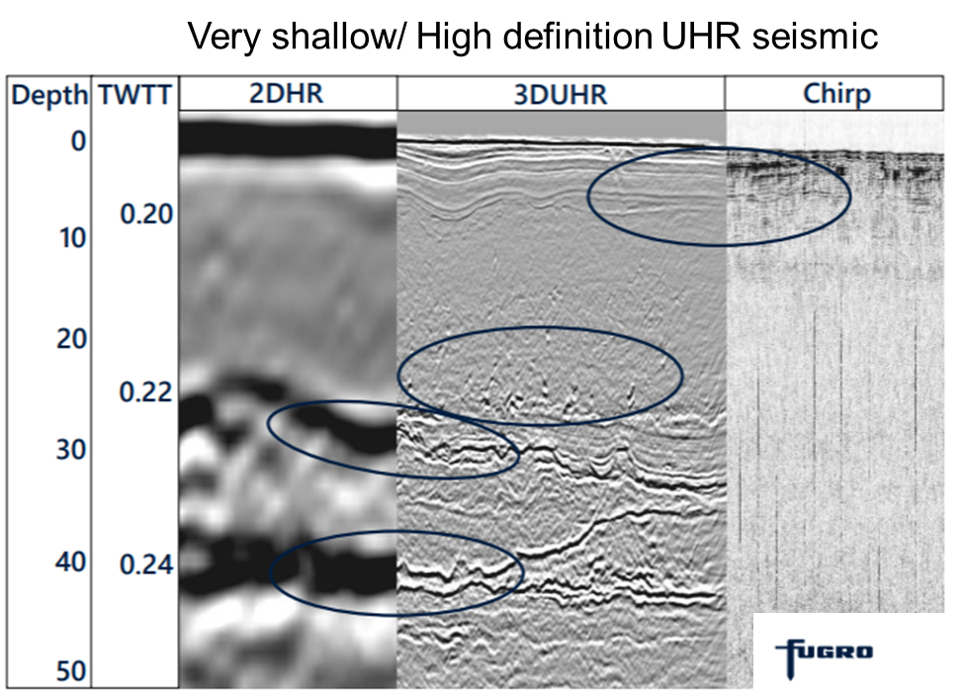
3.2 Depth of Investigation & Seismic Resolution
A seismic source emits a controlled pulse of sound into the subsurface. This expanding wavefront interacts with the rock layers. The different rock layers have differing acoustic properties (based on density and velocity parameters).
Seismic survey design is optimised against survey objectives:
  Depth of objective
  Required resolution
  Area of investigation
Increasing individual components generally leads to increasing cost associated with planning, acquisition and processing times.
Adapted from:
(Ref. 3c)
Comparing HR, UHR and UUHR seismic
2ms
20Hz
Increasing Sampling rates & frequencies
.
0.25ms
10khz
.
12.5m
.
0.06m
‘00’s-
000’s
km²
Seismic Spatial sampling (aka ‘bin’ sizes) Decreasing
‘00’s km² /
00’s LKm 2D
Overall Survey Dimensions Decreasing
2
Years
Weeks→
Months
Planning, Acquisition, & Processing time Decreasing
Comparative seismic techniques: resolution and depth of penetration

Slide 9

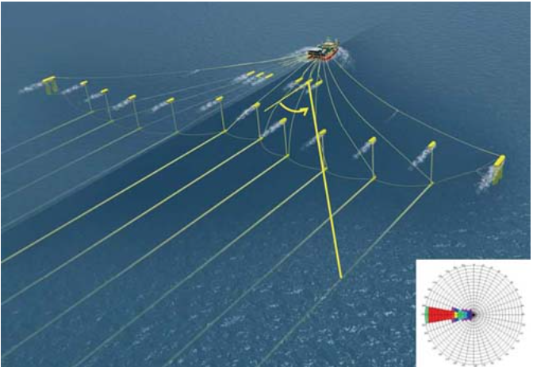
3.3a Seismic: A history
Modern seismic acquisition, processing and imaging is scarcely recognisable from its origins, although the fundamentals of 1) acquisition involving towing seismic source(s) and receiver cable(s)/streamer(s) at <5 knots from the aft of a diesel-powered vessel on a designated track, and 2) processing the raw data to maximise accuracy & fidelity of the final interpreter's image. The technology has grown significantly in density, detail and accuracy.
Acquisition
2D data – 1970/1980s; single recording streamer.
3D data – 1980’s to Present; Large multiple (~16) streamers and optimise depth in water for signal and noise. Navigation improves with GPS data advancements. Multi–azimuth, Wide Azimuth & multiple smaller seismic sources.
4C data – 2000’s to Present; includes Shear Component acquisition through geophones coupled to seabed. (OBC, OBN) or via multi-component streamers.
4D data – 3D+Time; Repeatability to image changes in subsurface. Usually, streamer but can also be seabed seismic at extra cost & complexity
Modern HR/ UHR 2D or 3D seismic using increasingly dense spatial and temporal sampling, usually with smaller sources and shorter cables for O&G High Resolution Site Surveys / Shallow Gas Hazard surveys.
3D seismic vessel equipment schematic
Front of streamers
Towed ~10m below
sea surface
Sources of sound
Towed ~6m below
sea surface
Processing:
Semi-Manual unmigrated Processing (1970s).
Post-stack (1980s) or Pre-stack time (late 1990s) on pcs.
  Fluid and lithology prediction/ AVO analysis.
Increasingly highly complex, computer intensive (1990s+) on clusters
  Pre-stack depth migration and inversion.
  Pre stack 4D survey matching.
Future Direction: Autonomous vessels or nodes acquisition with increasingly shared space and noise budgets. Processing/Imaging geared towards generating comprehensive synthetic models of rock layers accurately matched to the observed full seismic wavefield (rather than just reflections), and more targeted, lower effort geophysical monitoring of carbon stores.
Wide and long towed array of in-water equipment
Overview of seismic acquisition and processing development

Slide 10
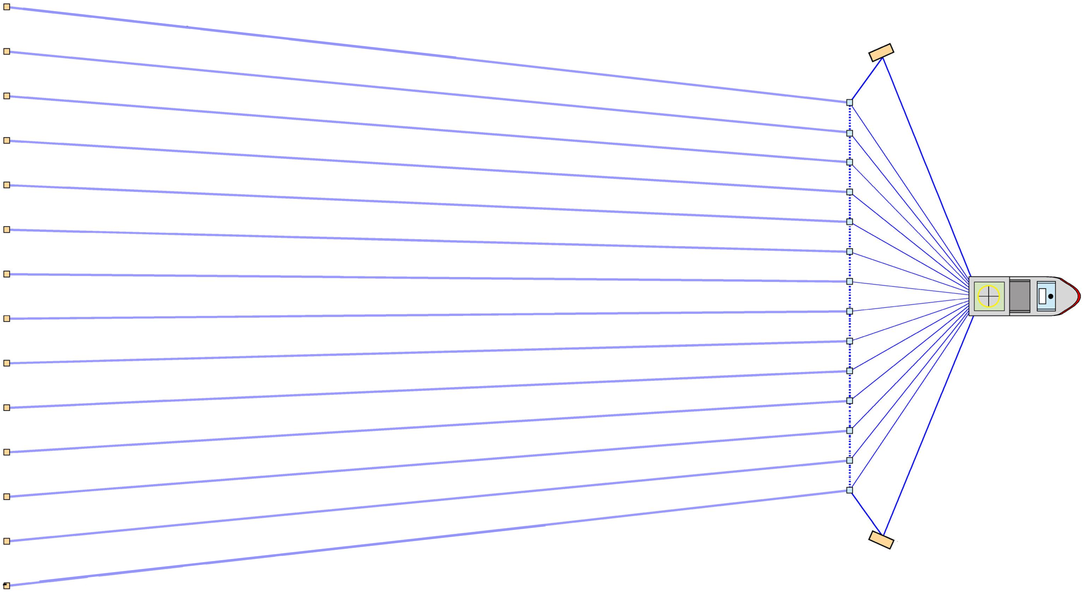
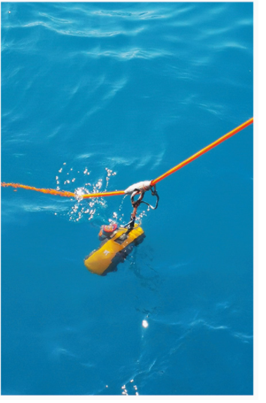
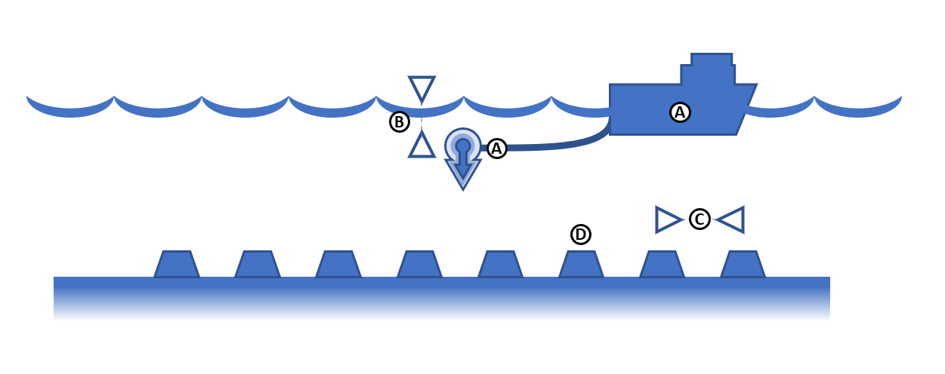
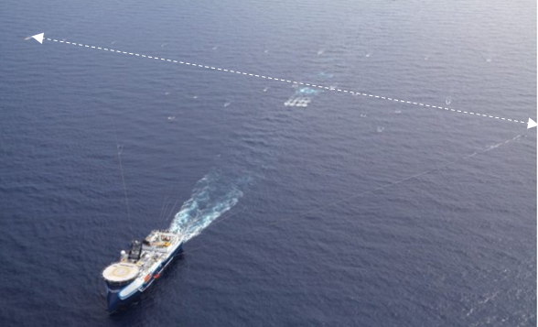

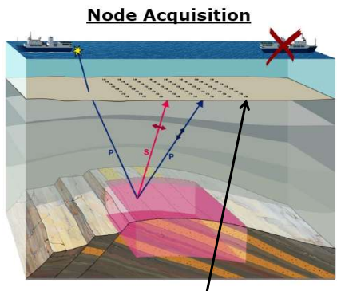
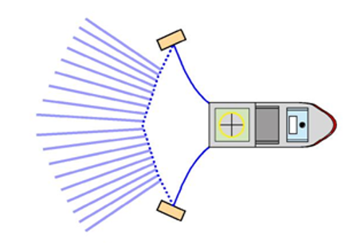

3.3b Comparison of surface and OBN seismic
Deep 3D Streamer seismic configuration
Deep 3D OBN (ocean bottom nodes) seismic
3-6km
Seismic source vessel & nodes placed on seabed
Not to scale
<1km
Source vessel
Towing streamers (receivers)
Source vessel
100m
<1km
Source vessel
Receivers along length of streamers: hydrophone (measure pressure) and now usually also geophones to measure movement
seabed
UHR (shallow) 3D Streamer seismic
Reflections from
Rock layers
Smaller Source vessel
Towing very short
streamers
4 Component Pressure (hydrophone) and movement (x,y,z geophone) sensors
Often 2nd vessel needed for node deployment and retrieval
100m
Range of acquisition styles: Deep seismic involves wide & long streamers, HR much more compact. Nodes deployed independently on seabed

Slide 11
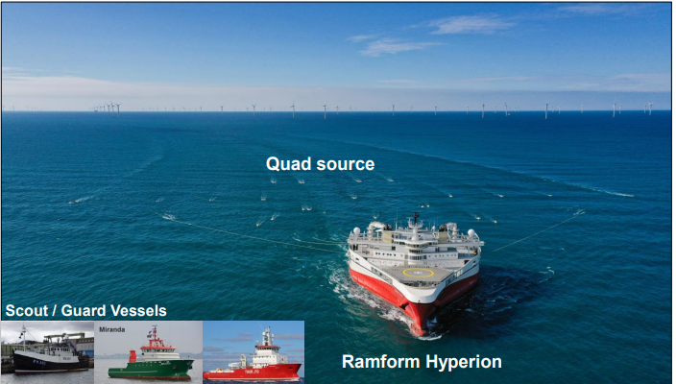
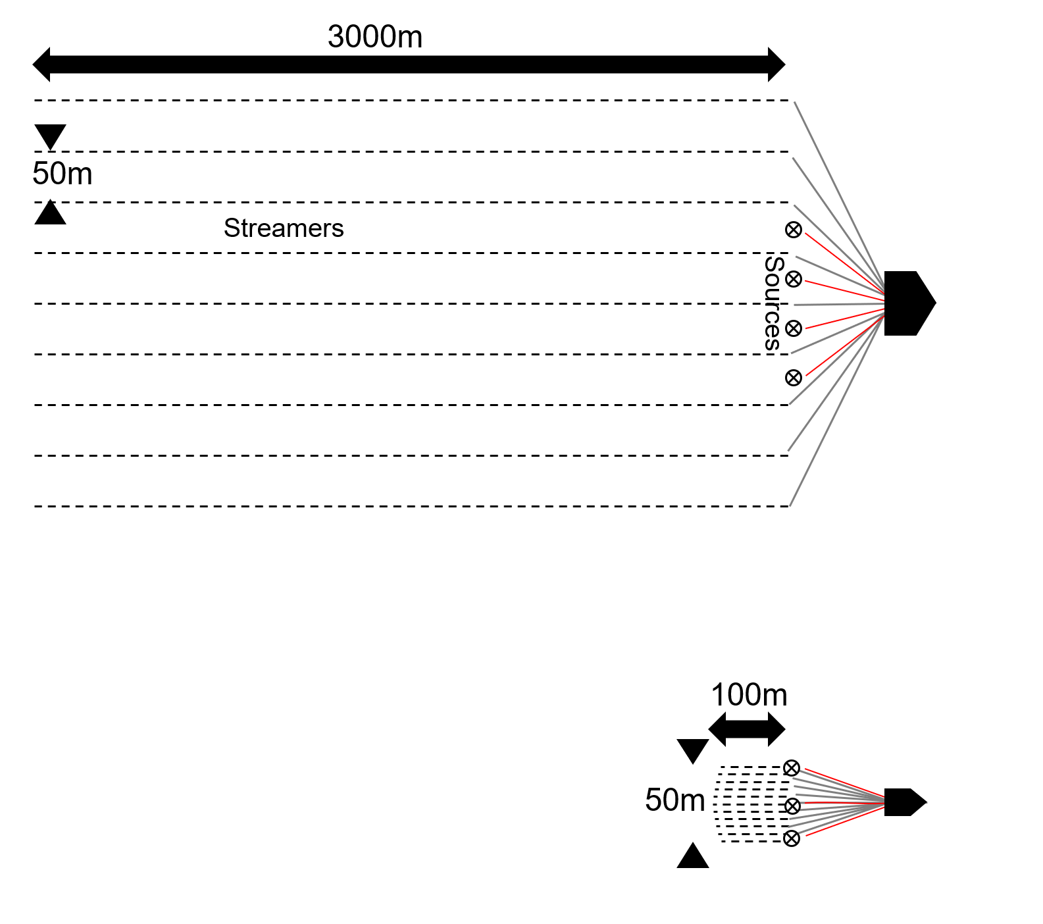
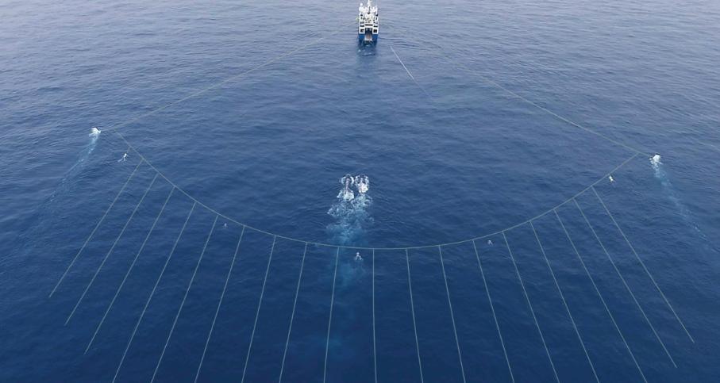
3.5a Reservoir vs Site Survey Scales
Endurance Reservoir 3D passing windfarm
Possibly Hornsea 2
Turbines ~200m tall
“Deep” seismic for CS & O&G reservoir
Streamers
Turning after
Passing windfarm
“Close approach”
to turbines?
Large vessel
Endurance HR 3D
A typical streamer exclusion zone is 2000m
104m length
70m beam
NEP CCS 3DHR
4 Sources
9 Streamers
Sampling 2ms,
towed 10-20m, bin 6.25m
Sophisticated 3D
Site Survey
Small vessel
UHR P-Cable 3D
(section 5.12)
3DUHR 3 Sources < 11 Streamers
More typically windfarm UHR 4-7 streamers
Streamers
Sampling 0.125-0.25ms,
towed 2-4m, bin <1-6m
(Refs 3k, 3l & 3m)
Vessel scale, parameters & footprint between reservoir “deep” & site survey seismic. Close approach/exclusion zones apply.

Slide 12
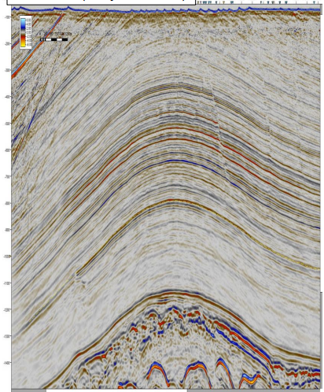
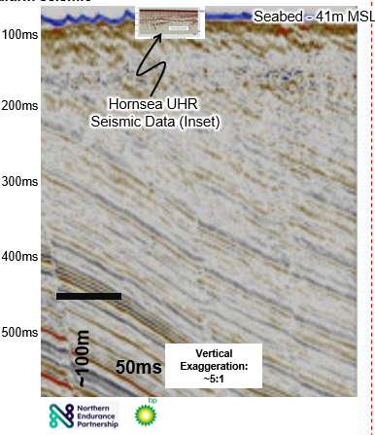
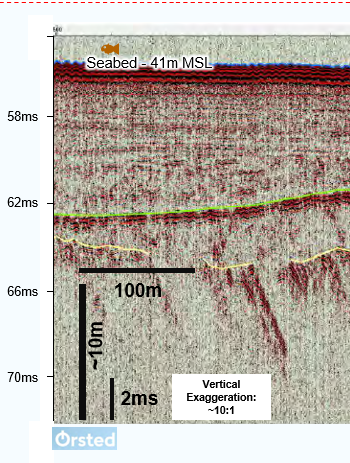

3.5b Comparative seismic scales
“Deep” seismic for CS reservoir
“Shallow” seismic for windfarm
0ms
Seabed &
Sandwaves
Overburden
Two Way Time (msec)
1000ms
(Ref 3n)
Storage
Underburden
2000ms
(modified from Ref 3m)
SNS storage complex elements and a comparison of imaging resolution between reservoir HR and windfarm seismic

Slide 13
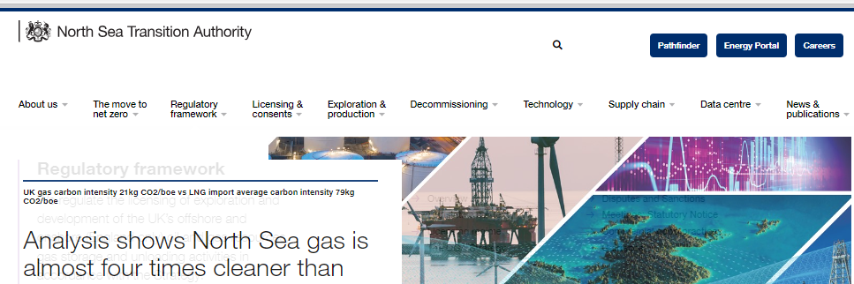
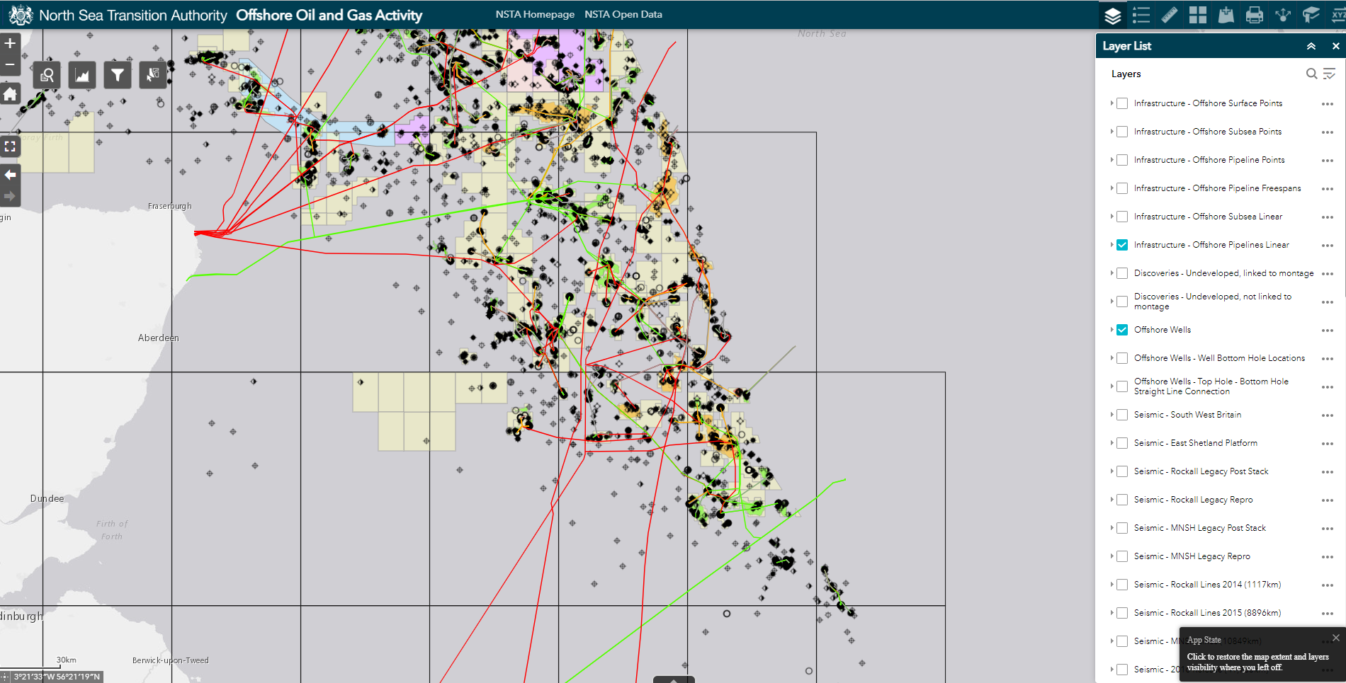
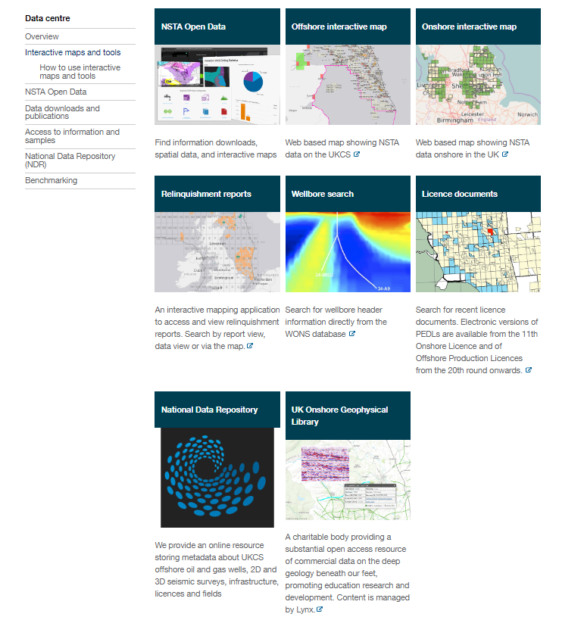
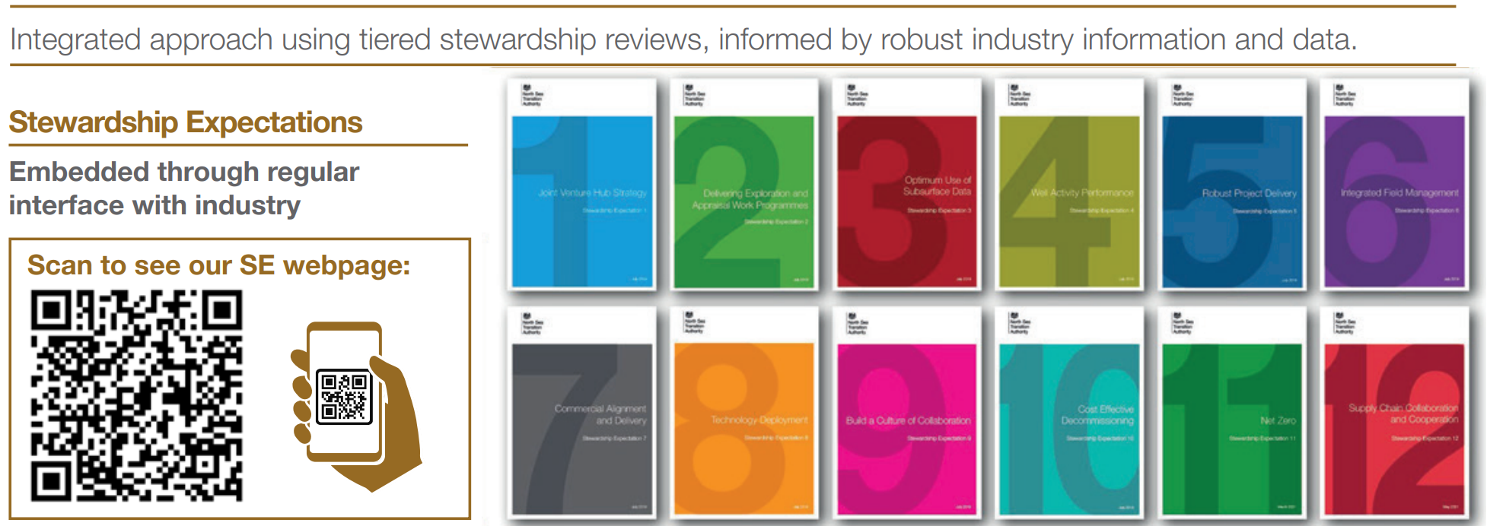

3.6a Useful NSTA Links
The NSTA website & interactive data centre provides a valuable link into the range of NSTA data download options:
NSTA website
NSTA Offshore interactive map
NSTA Interactive data centre
https://www.nstauthority.co.uk/
Offshore Oil and Gas Activity (arcgis.com)
NSTA Stewardship Expectations
NDR
(3.8b)
UKOGL
(3.8c)
SE3 Expectation (Optimum Use of Subsurface Data)
https://www.nstauthority.co.uk/exploration-production/asset-stewardship/expectations/
North Sea Transition Authority (NSTA): Interactive maps and tools - Data centre (nstauthority.co.uk)
Note: there is an ongoing consultation on future date retention, reporting and disclosure requirements for CS licences.
(Refs. 3o, 3p, 3q &3r)
NSTA useful links

Slide 14
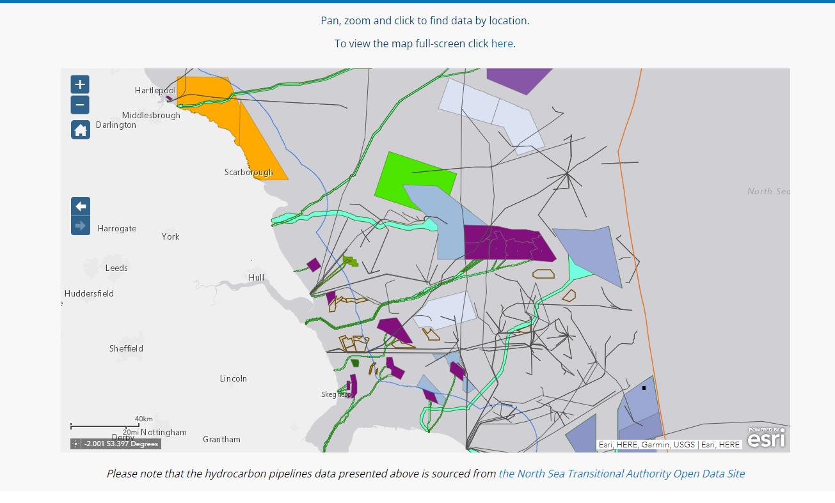
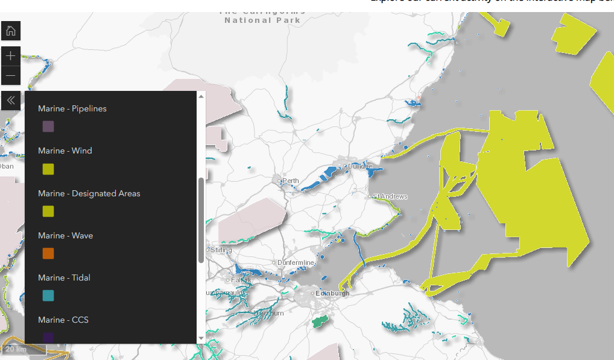
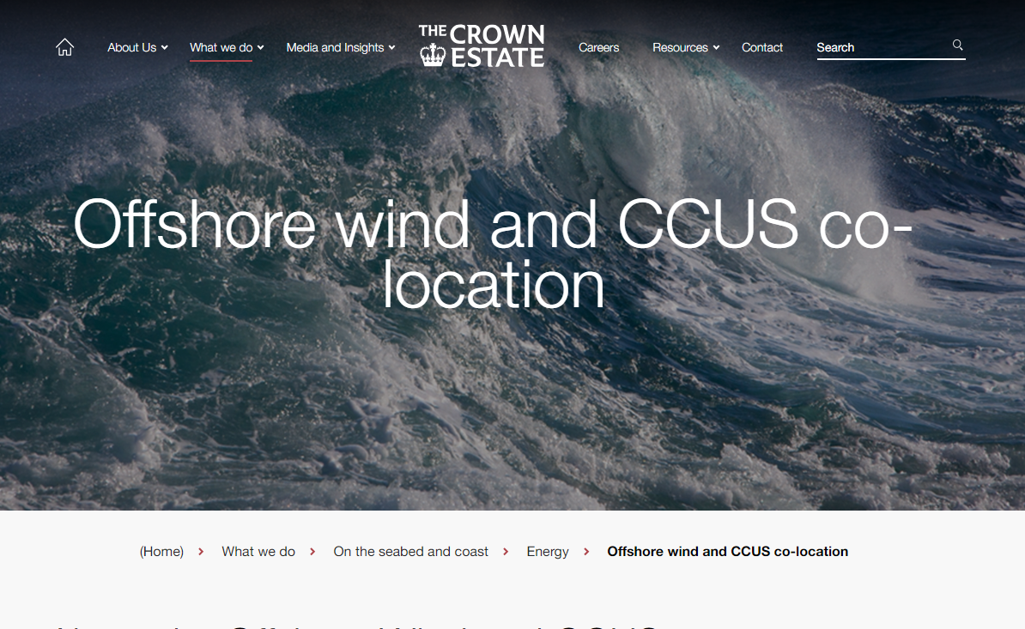



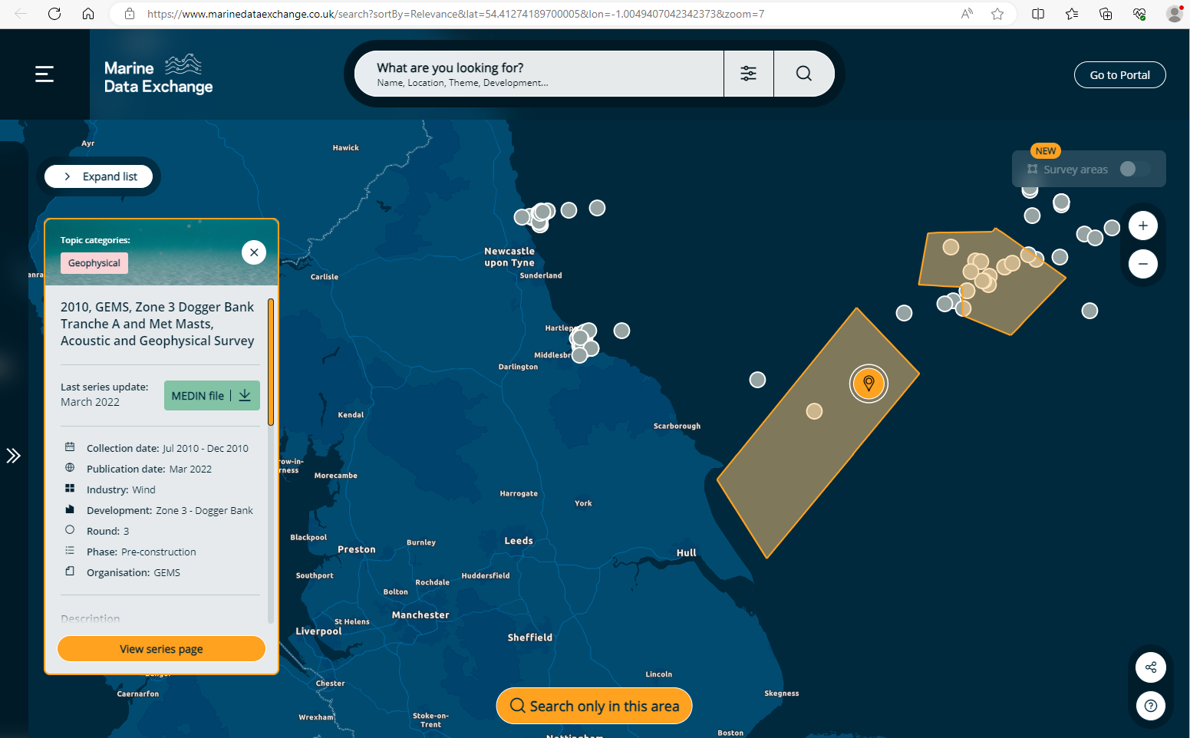
3.6d Useful links Crown Estates
https://opendata-thecrownestate.opendata.arcgis.com/
Offshore wind, carbon store lease agreements (England, Wales & Northern Ireland)
https://crown-estate-scotland-spatial-hub-coregis.hub.arcgis.com/
Offshore wind, INTOG, & carbon store lease agreements (Scotland)
https://www.thecrownestate.co.uk/en-gb/what-we-do/on-the-seabed/energy/offshore-wind-and-ccus-co-location/
Co-Location Forum: challenges & opportunities associated with the efficient use of the seabed
https://www.marinedataexchange.co.uk/
Collection of offshore marine industry data, including site survey information.
Operated by Crown Estates
(Refs 3y , 3z, 3aa &3ab)
Additional marine planning and survey data available to download

Slide 15
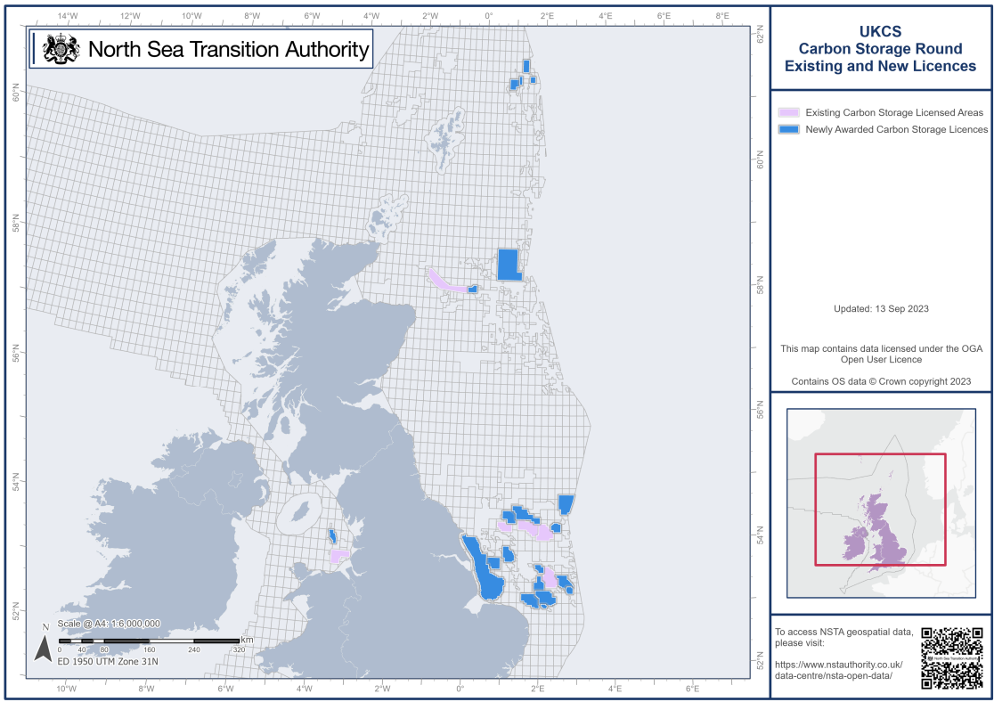

3.6e 1st Carbon storage licence round awards
15th September 2023 the NSTA announced the award of 21 CS licences in the UKCS.
These licences span c.12,000km² and are predominantly within the SNS where competition with planned and active windfarm sites is increasing.
Recent CS licence round awards

Slide 16
4.1a SNS Geology and Seismic Overview
Whilst modern reprocessing of legacy seismic helps support CS store site characterisation, the NSTA expects that modern high resolution or broadband acquisition will deliver significant improvement for CS development phase.
SNS comprises 4 broad reservoirs of which 2 have high potential to be developed for CS:
  Bunter (Triassic) - predominantly aquifer closures → Estimated 10GT CO₂ capacity
  Zechstein dolomites – petroleum play being appraised → Assumed unsuitable for CO₂
  Leman (Permian) - currently producing and depleted natural gas fields → Est 3GT CO₂ capacity
  Carboniferous - currently producing and depleted natural gas fields → Assumed reservoir typically poor quality for CO₂
Legacy/Vintage 3D seismic – Predominantly 1990s acquisition
    Large number/patchwork of surveys
    Each 3D surveys has slightly different acquisition parameters
    Most 3D surveys do not meet modern specifications, especially in main CS part of basin
    Some 3D coverage gaps especially nearshore
    Modern reprocessing always improves the seismic image
Future seismic acquisition will be increasingly challenging
  Shallow water sandbanks & wrecks restrict vessel draft & deep tow streamer
  Strong tides create significant streamer feather or noise on ocean bottom cables/nodes
    Multiple marine users (Fishing/ lobster pots, shipping, leisure)
  Increasing development of windfarms: Preventing all streamer seismic & severely restricting OBN access
  Enhanced HSE (risk to deep tow cables) & environmental (noise budgets, cetaceans, marine areas)
Majority of SNS legacy seismic inadequate for CCS development but new acquisition will be increasingly difficult

Slide 17
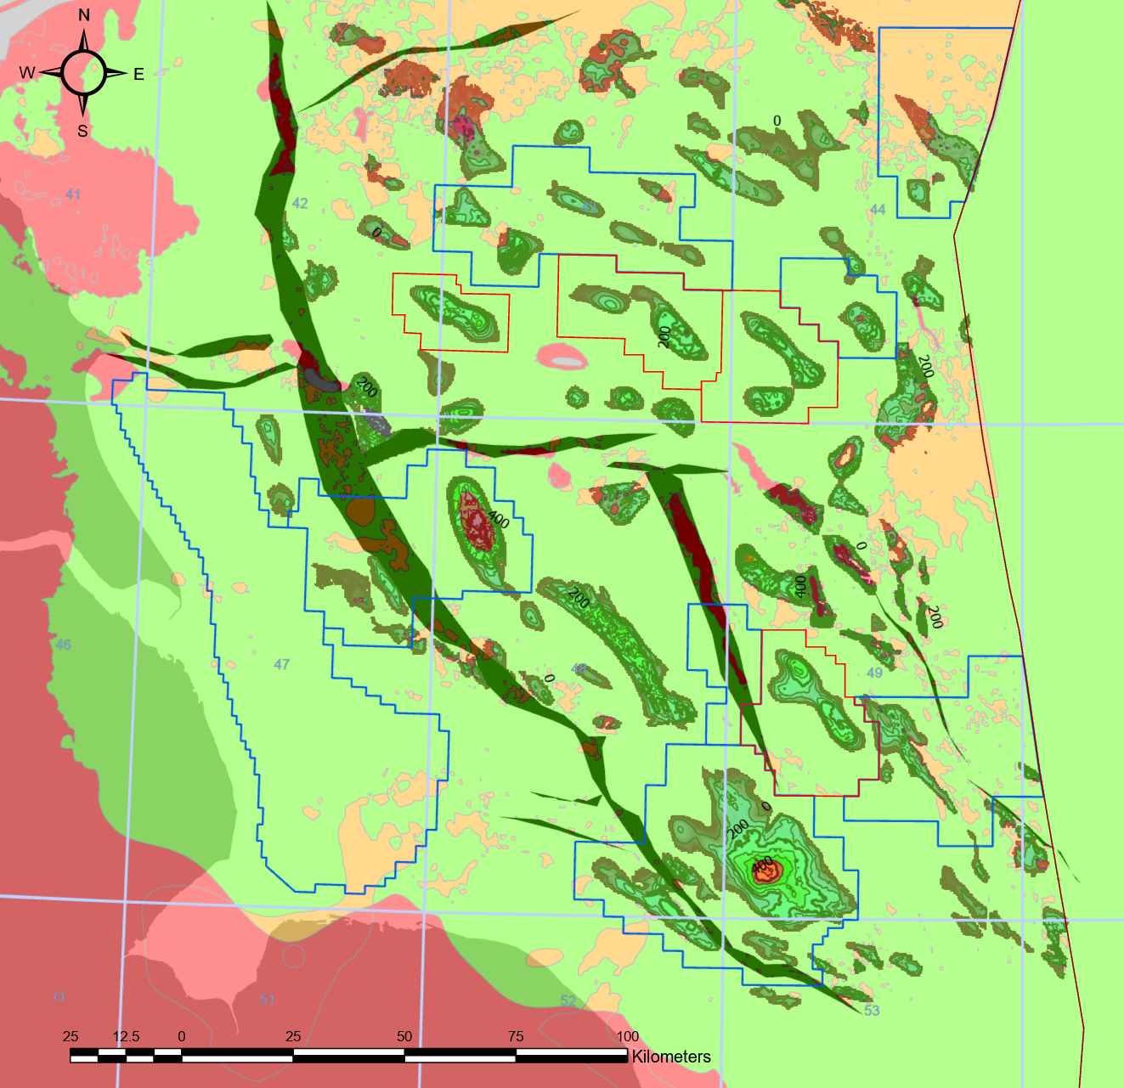
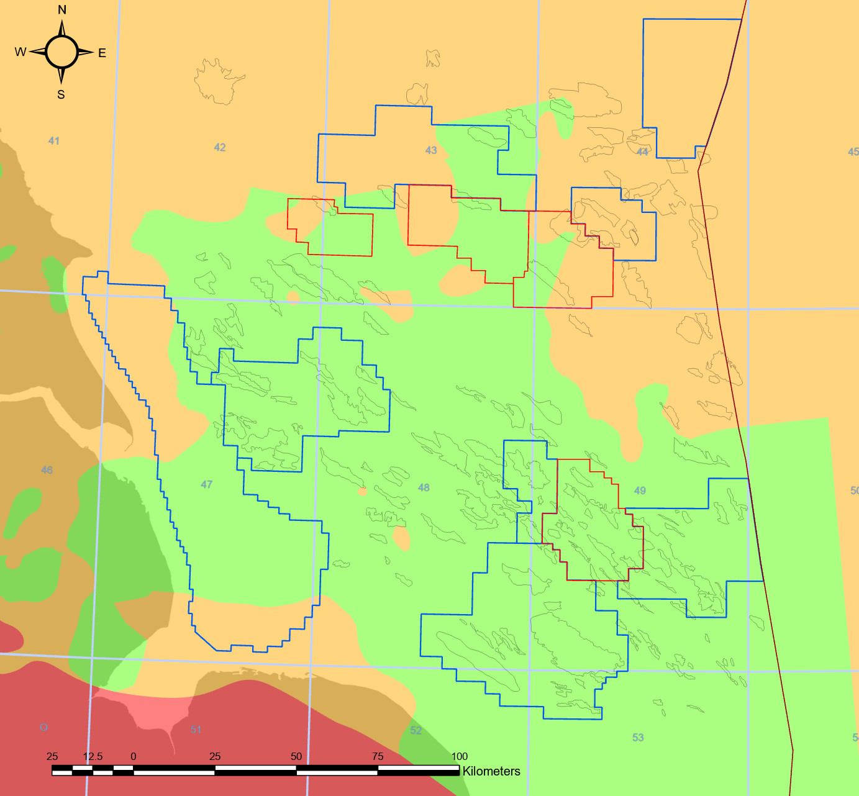
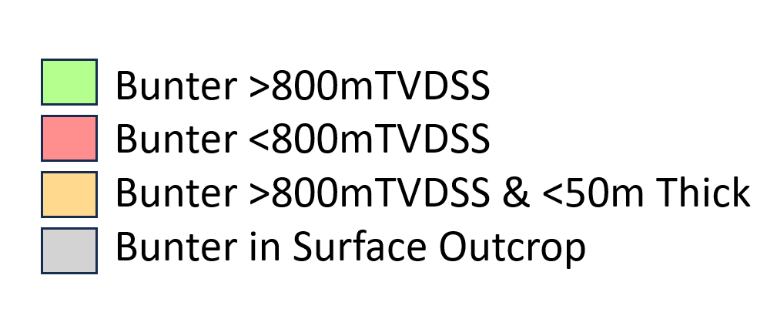
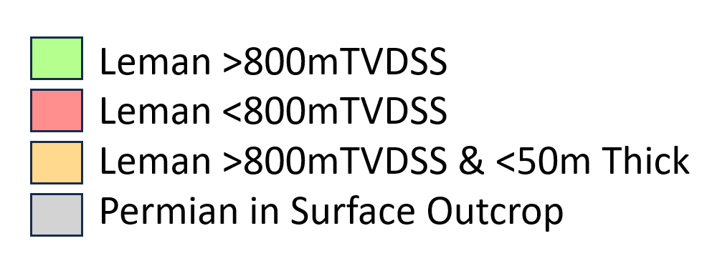
4.2 Potential CCS Bunter & Leman reservoirs
(Ref 4b)
Carboniferous Play to North – not assumed CCS compatible at this time
Endurance
Endurance
Complex
Leman Gas Field Outlines
Complex
West Sole
Complex
West Sole
Bunter closures
depth considered suitable for HR 3D seismic reservoir imaging (c.f. Endurance acquisition)
Leman fairway Suited to deep (broadband) seismic imaging.
The contoured areas within the green polygon are the spatial extents of Bunter closures.
Bunter covers an area of ~ 30,000km² and the Leman mostly underlies the southern 2/3rds of the Bunter fairway (19,000km²).
Both the Bunter and Leman outcrop onshore to the west.
Reservoirs at >800mTVDSS depth (section 2.3) allow CO₂ injection as a super-critical dense fluid. Red fill areas show where reservoir is too shallow (<800m).
Salt ridges and faulted are areas of particularly complex imaging and require more sophisticated seismic acquisition (see section 4.3).
Maps show the extent of the geological extent CCS fairway in the Bunter and Leman reservoirs

Slide 18
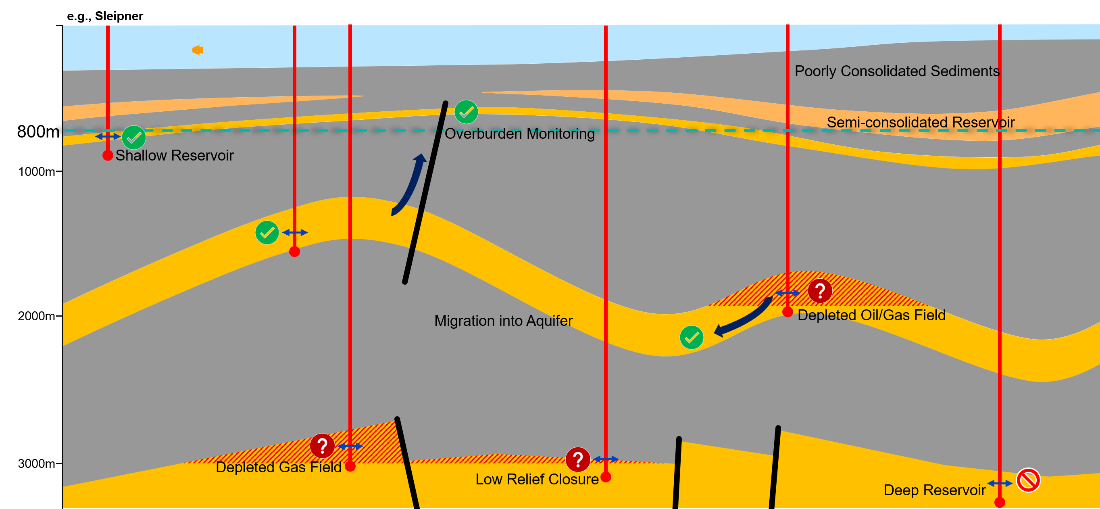
12.1 4D seismic monitoring summary
Seismic detectability study (section 11 & 12) indicates that a significant 4D seismic signal should be anticipated in most situations where the CO₂ is:
Injected or migrates into an aquifer.
Leaks/breaches into a shallower overburden aquifer.
The 4D seismic detection threshold is linked to the sand thickness, porosity, reservoir stiffness and level of CO₂ saturation at the time of surveying.
In deeply buried/consolidated reservoirs, a large change in pressure does not produce an appreciable 4D response.
HR short streamer or wellbore seismic
Long/Wide towed streamer or OBN reservoir seismic
Detection of an amplitude change where CO₂ is injected into a pre-existing depleted natural gas field appears difficult and may require either:
Acquisition of higher specification seismic / improved repeatability to reduce the noise floor (e.g. OBN)
  Albeit the higher cost would be difficult to justify for a smaller signal? OR
Await higher CO₂ concentrations / greater separation between surveys
  Too late to influence further development? OR
Assume reservoir seismic monitoring is not part of the complex MMV strategy
  HR seismic will still be needed for monitoring the overburden.
Multi-fluid phase systems (e.g. brine, natural gas, condensate, oil and CO₂) are likely to provide ambiguous interpretations.
Each CCS site is unique, but Seismic monitoring is likely to be a key tool in most situations

Slide 19
Part A Review
Seismic imaging of the subsurface geology and structures has been advanced significantly in the last few decades with the advent of increased computing power and new approaches to signal processing.
Modern 3D seismic acquisition programmes can be tailored to suit specific objectives, such as shallow high-resolution for geotechnical and leak-monitoring requirements, to deeper imaging of subsurface structures. Although not directly imaged within seismic data, the development of rock physics equations allows the geoscientist to visualise changes in fluid fill at the pore-scale, and changes over time with the processing of 4D time lapsed data.
The marine environment is seeing increased competition for space, particularly in the shallow waters of the Southern North Sea. In this area, with the decline of natural gas, there is the emergence of a new industry which seeks to re-use the depleted gas reservoirs of the Permian Rotliegendes and simple structural traps of the Triassic Bunter reservoirs for the permanent storage of CO₂. However, for security of the sequestered CO₂, the carbon store sites must be monitored for injection and long term containment, which will rely on good quality seismic data.
The subsurface description of carbon stores will remain to be heavily influenced by the quality of the initial pre-development seismic image. With increasing utilisation of the marine environment for Windfarms and subsea cabling, securing a modern data acquisition to benefit carbon stores as a baseline from which to compare deviations from expected injection results remains a top priority. Marine access to Windfarm areas is expected to be prohibited for a substantial period of time (30 to 50 years+) and will ultimately exclude the acquisition of modern high-quality seismic data from which to monitor the carbon stores.
Carbon store site characterisation can be achieved with seismic reprocessing to modern standards, and could be considered suitable for pre-development site characterisation during NSTA licence project “appraise” and “assess” phases. However, if not recently acquired, the NSTA expects a pre-injection baseline survey will be acquired involving modern long offset (3-6km), broadband acquisition during the pre-development phase. OB seismic may also be acquired in areas of complex geology or shallow bathymetry, but it is recognised that this particular technology has a high financial cost. The strong recommendation is for modern seismic operations to be conducted before windfarm development is undertaken.
During the active injection phase, 4D (time lapse) seismic is expected across certain types of carbon store complexes, particularly where it is believed CO₂ is injected directly into or has displaced the in-situ brine filled reservoir. It is expected that occasional seismic acquisition will be required throughout the life and abandonment/post-closure phase of carbon store projects, particularly for critical risk areas such as around current and legacy wells and geological faults to seabed.
Acquisition does have an environmental impact, and there is a current technology trend toward lower environmental impact & lower cost, highly targeted monitoring, built upon very accurate model predictions and comprehensive baseline surveys.
Part A Review

Slide 20
15. References
Part A Only

Slide 21
References: Part A Only
1a) Measurement, Monitoring and Verification (MMV) of Carbon Capture Storage (CCS) Projects with Co-Location considerations​ NSTA Jul 2022 North Sea Transition Authority (NSTA): Measurement, Monitoring and Verification (MMV) of Carbon Capture and Storage (CCS) Projects with Co-Location considerations - 2022 - Publications - News & <br/>publications (nstauthority.co.uk)
2d) UK offshore oil and gas activity map portal: https://www.arcgis.com/apps/webappviewer/index.html?id=f4b1ea5802944a55aa4a9df0184205a5
3a)Seismic Window, Micenko 2017, Michael Micenko (Associate Editor for Petroleum) (2017) Seismic Window, Preview, 2017:187, 39-40, DOI: 10.1071/PVv2017n187p39, https://www.tandfonline.com/doi/abs/10.1071/PVv2017n187
3b) Petroleum reservoir quality prediction: Overview and contrasting approaches from sandstone and carbonate communities, Horden et al 2018 https://www.researchgate.net/publication/324876102_Petroleum_reservoir_quality_prediction_Overview_and_contrasting_approaches_from_sandstone_and_carbonate_communities/figures?lo=1
3c) Sub-seabed boulder detection using 3DUHR seismic data Simon Oakley Fugro, Seismic 2021, SPE https://www.spe-aberdeen.org/wp-content/uploads/2021/06/Day-4_Seismic-2021-Sub-seabed-boulder-detection-using-3DUHR-seismic-data.pdf
3k) P-Cable: UHR 3D Seismic Technology for Energy Transition, PGS website https://www.pgs.com/company/resources/feature-stories/ultra-high-resolution-3d-seismic-for-energy-transition-challenges/
3l) Toward one-meter resolution in 3D seismic | The Leading Edge (seg.org), Nina Lebedeva-Ivanova et al 201 8https://library.seg.org/doi/10.1190/tle37110818.1
3m) 3DHR Seismic Acquisition for CCS and considerations for Windfarm UHR, Cooper Seismic-2023 conference, SPE https://www.spe-aberdeen.org/events/seismic-2023
3n) Hornsea Project Four, Volume A5, Annex 2.1 report Aug 2022, https://infrastructure.planninginspectorate.gov.uk/wp-content/ipc/uploads/projects/EN010098/EN010098-002023-Hornsea%20Project%20Four%20-%20Other-%20A5.2.1%20Benthic%20and%20Intertidal%20Ecology%20Technical%20Report.pdf
3o) NSTA website https://www.nstauthority.co.uk/
3p) NSTA stewardship expectations, NSTA website link https://www.nstauthority.co.uk/exploration-production/asset-stewardship/expectations/
3q) NSTA interactive data portal https://www.nstauthority.co.uk/data-centre/interactive-maps-and-tools/
3r) Offshore oil and gas activity map, NSTA website Offshore Oil and Gas Activity (arcgis.com)
3y) The Crown estates (TCE) open data https://opendata-thecrownestate.opendata.arcgis.com/
3z) Crown estates Scotland (CES) open data https://crown-estate-scotland-spatial-hub-coregis.hub.arcgis.com/
3aa) Marine data exchange: windfarm related database: https://www.marinedataexchange.co.uk
3ab) Crown Estates Co-location forum: https://www.thecrownestate.co.uk/en-gb/what-we-do/on-the-seabed/energy/offshore-wind-and-ccus-co-location/
References Sections 1, 2 and start 3

